Slide 1
SOFTWARE DESIGN AND ARCHITECTURE
LECTURE 12

Slide 2
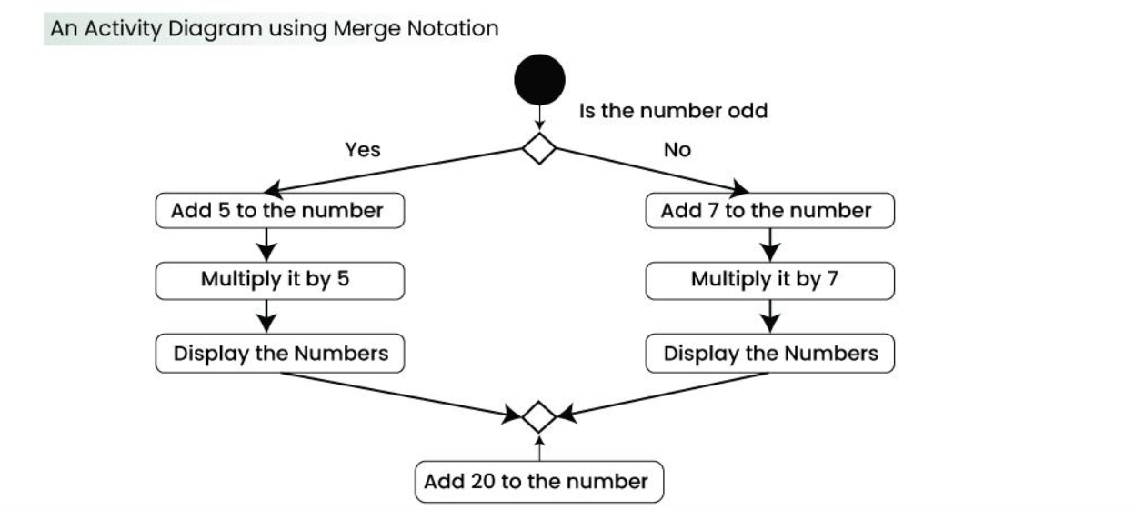
Review
Activity Diagram (Explain)

Slide 3
Outline
Class Responsibility Collaboration Cards
CRC Models
Creating CRC Models

Slide 4
CRC Cards
Class Responsibility Collaboration Cards

Slide 5
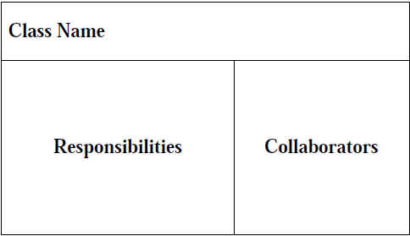
CRC Cards
A CRC card is divided into three sections (Beck & Cunningham, 1989; Ambler, 1995)

Slide 6
Responsibilities and Collaborations
A responsibility is anything that a class knows or does.
Sometimes a class will have a responsibility to fulfill, but will not have enough information to do it. When this happens it has to collaborate with other classes to get the job done.

Slide 7
CRC Model
A CRC model is a collection of CRC cards that represent whole or part of an application or problem domain.
The most common use for CRC models is to gather and define the user requirements for an object-oriented application.
Collaborating cards are placed close to each other

Slide 8
Perform The Iterative Steps of CRC Modeling
Find classes
  Look for anything that interacts with the system, or is part of the system
  Ask yourself “Is there a customer?”
  Follow the money
  Look for reports generated by the system
  Look for any screens used in the system
  Immediately prototype interface and report classes
  Look for the three to five main classes right away
  Create a new card for a class immediately
  Use one or two words to describe the class
  Class names are singular

Slide 9
Perform The Iterative Steps of CRC Modeling
Find responsibilities
  Ask yourself what the class knows
  Ask yourself what the class does
  If you’ve identified a responsibility, ask yourself what class it "belongs" to
  Sometimes get responsibilities that we won’t implement, and that’s OK
  Classes will collaborate to fulfill many of their responsibilities

Slide 10
Perform The Iterative Steps of CRC Modeling
Define collaborators
  Collaboration occurs when a class needs information that it doesn’t have
  Collaboration occurs when a class needs to modify information that it doesn’t have
  There will always be at least one initiator of any given collaboration
  Sometimes the collaborator does the bulk of the work
  Don’t pass the buck
  New responsibilities may be created to fulfill the collaboration

Slide 11
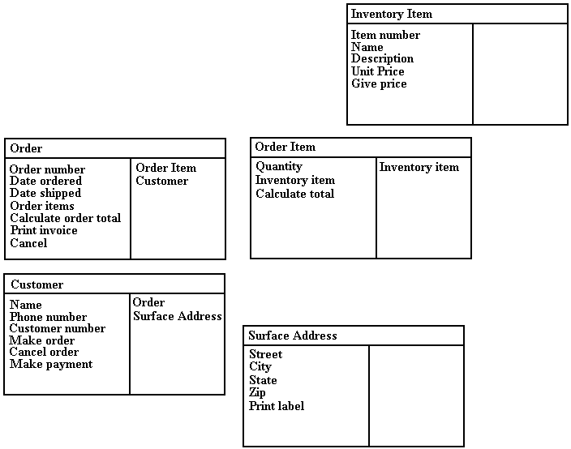


Slide 12
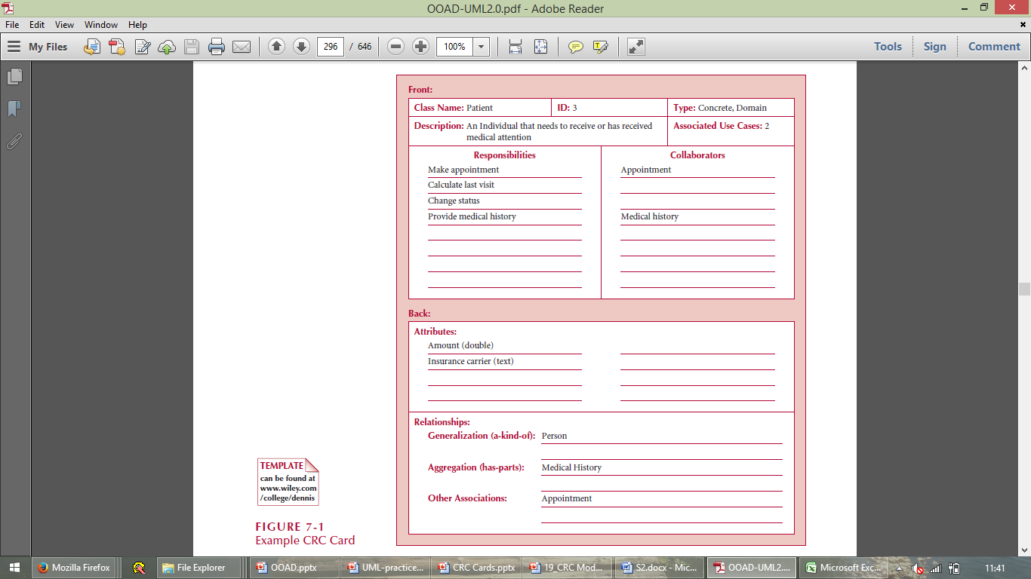

Slide 13
Your title here
Presentations are communication tools that can be used as demonstrations.
Your title here
Presentations are communication tools that can be used as demonstrations.
Your title here
Presentations are communication tools that can be used as demonstrations.

Slide 14
Creating CRC Model
Put together the CRC modeling team.
Organize the modeling room.
Do some brainstorming.
Explain the CRC modeling technique.
Iteratively perform the steps of CRC modeling.
Perform use-case scenario testing.

Slide 15
CRC Team
Business Domain Experts (BDEs).
Facilitator.
Scribe(s).
Observers.

Slide 16
Room preparation
Reserve a meeting room that has something write on.
Bring CRC modeling supplies.
Have a modeling table
Have chairs and desks for the scribe(s).
Have chairs for the BDEs.
Have chairs for the observers

Slide 17
Brainstorming
Set of questions:
Who is this system for?
What will they do with the system?
Why do we do this?
Why do we do this the way that we do?
What business needs does this system support?
What do/will our customers want/demand from us?
How is the business changing?
What is our competition doing? Why? How can we do it better?
Do we even need to do this?
If we were starting from scratch, how would we do this?
Just because we were successful in the past doing this, will we be successful in the future?

Slide 18
Brainstorming (cont…)
Can we combine several jobs into one? Do we want to?
How will people’s jobs be affected? Are we empowering or disempowering them?
What information will people need to do their jobs?
Is work being performed where it makes the most sense?
Are there any trivial tasks that we can automate?
Are people performing only the complex tasks that the system can’t handle?
Will the system pay for itself?
Does the system support teamwork, or does it hinder it?
Do our users have the skills/education necessary to use this system? What training will they need?
What are our organization’s strategic goals and objectives? Does this system support them?
How can we do this faster?
How can we do this cheaper?
How can we do this better?

Slide 19
Explain the CRC Modeling Technique
Facilitator should describe the CRC modeling process. This usually takes between ten and fifteen minutes and will often include the creation of several example CRC cards.
Lead BDEs through creation of example CRC cards

Slide 20
Define use-cases
  The BDEs will identify them as responsibilities of actor classes
  Do some brainstorming
  Transcribe the scenarios onto cards
Arrange the cards on the table
  Cards that collaborate with each other should be close to one another on the desk
  The more that two cards collaborate, the closer that they should be on the desk
  Expect to be moving the cards around a lot at the beginning
  Put "busy" cards towards the center of the table
  Actually move them around
  People will identify relationships/associations between classes as they move them around

Slide 21
Perform Use-Case Scenario Testing
Call out a new scenario
Determine which card should handle the responsibility
Update the cards whenever necessary
Describe the processing logic
Collaborate if necessary

Slide 22
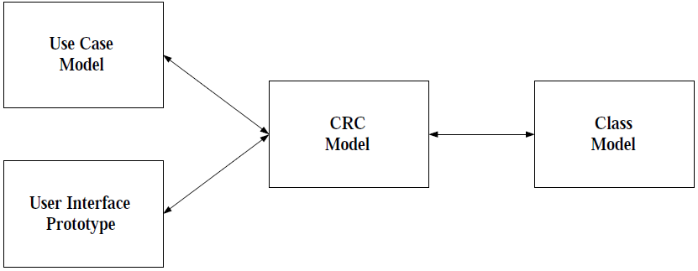
How CRC Modeling Fits in?

Slide 23
CRC Modeling Tips and Techniques
Send ahead an agenda a few days before the modeling session
Prominently display the CRC definitions
Use their terminology
Keep it low tech
Expect to prototype
Expect to take a few days
Get management support
Include CRC modeling in your system development life cycle
Do CRC modeling with front-line staff only

Slide 24
Advantages of CRC Modeling
The experts do the analysis
User participation increased
Breaks down communication barriers
It’s simple and straightforward
It’s non-threatening to users
It’s inexpensive and portable
It goes hand-in-hand with prototyping
It leads directly into class diagramming

Slide 25
Disadvantages of CRC Modeling
It’s threatening to some developers
It’s hard to get users together
CRC cards are limited

Slide 26
Home-work (3 Solid Marks)
Objective
This homework aims to help students understand and apply the CRC (Class-Responsibility-Collaboration) technique for object-oriented system design. By completing this task, students will gain insights into identifying system components, their responsibilities, and their collaborations with other components.

Slide 27
Instructions
Choose one of the following systems to design CRC cards for:
An online bookstore
A smart home system
A library management system
[Optional: Students can propose their system, subject to my approval]

Slide 28
Analysis and Design
Identify at least five classes that the chosen system requires.
For each class, define:
Class Name: Clearly state the name of the class.
Responsibilities: List the main functions, duties, or behaviors the class will perform.
Collaborators: Identify other classes that the class will interact with to fulfill its responsibilities.

Slide 29
Create CRC Cards:
Use the following template to create CRC cards for each identified class:

Slide 30
Submission Requirements:
A document (or PDF) containing:
A brief explanation (1-2 paragraphs) of the chosen system and why you selected the identified classes.
CRC cards for all identified classes.

Slide 31
Evaluation Criteria:
Completeness: All required components of CRC cards are present.
Clarity: Responsibilities and collaborations are well-defined and logically structured.
Creativity: Original and thoughtful consideration of system design.
Presentation: Neatness and organization of submitted work.

Slide 32
Reference
Ambler, S.W., (1998) CRC Modelling: Bridging the Communication Gap Between Developers and Users, An AmbySoft Inc. White Paper

Slide 33
Summary
Class Responsibility Collaboration Cards
CRC Models
Creating CRC Models

