Slide 1
Assignment 11

Slide 2
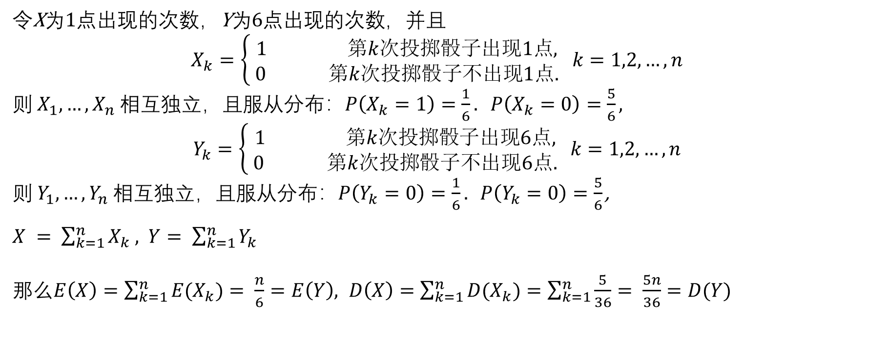
令X为1点出现的次数，Y为6点出现的次数，并且
$$X_{k}=\left\{\begin{aligned} 1 第k次投掷骰子出现1点, \\ 0 第k次投掷骰子不出现1点.\end{aligned} k=1,2,…,n\right.$$
则 $X_{1},…,X_{n}$ 相互独立，且服从分布：$P\left(X_{k}=1\right)=\frac{1}{6}. P\left(X_{k}=0\right)=\frac{5}{6}$ ,
$$Y_{k}=\left\{\begin{aligned} 1 第k次投掷骰子出现6点, \\ 0 第k次投掷骰子不出现6点.\end{aligned} k=1,2,…,n\right.$$
则 $Y_{1},…,Y_{n}$ 相互独立，且服从分布：$P\left(Y_{k}=0\right)=\frac{1}{6}. P\left(Y_{k}=0\right)=\frac{5}{6}$ ,
$X = \sum_{k=1}^{n}{X_{k}}$ , $Y= \sum_{k=1}^{n}{Y_{k}}$
那么$E\left(X\right)=\sum_{k=1}^{n}{{E(X}_{k})}= \frac{n}{6}=E\left(Y\right), D\left(X\right)=$ $\sum_{k=1}^{n}{{D(X}_{k})=\sum_{k=1}^{n}{\frac{5}{36}= \frac{5n}{36}=D(Y)}}$

Slide 3
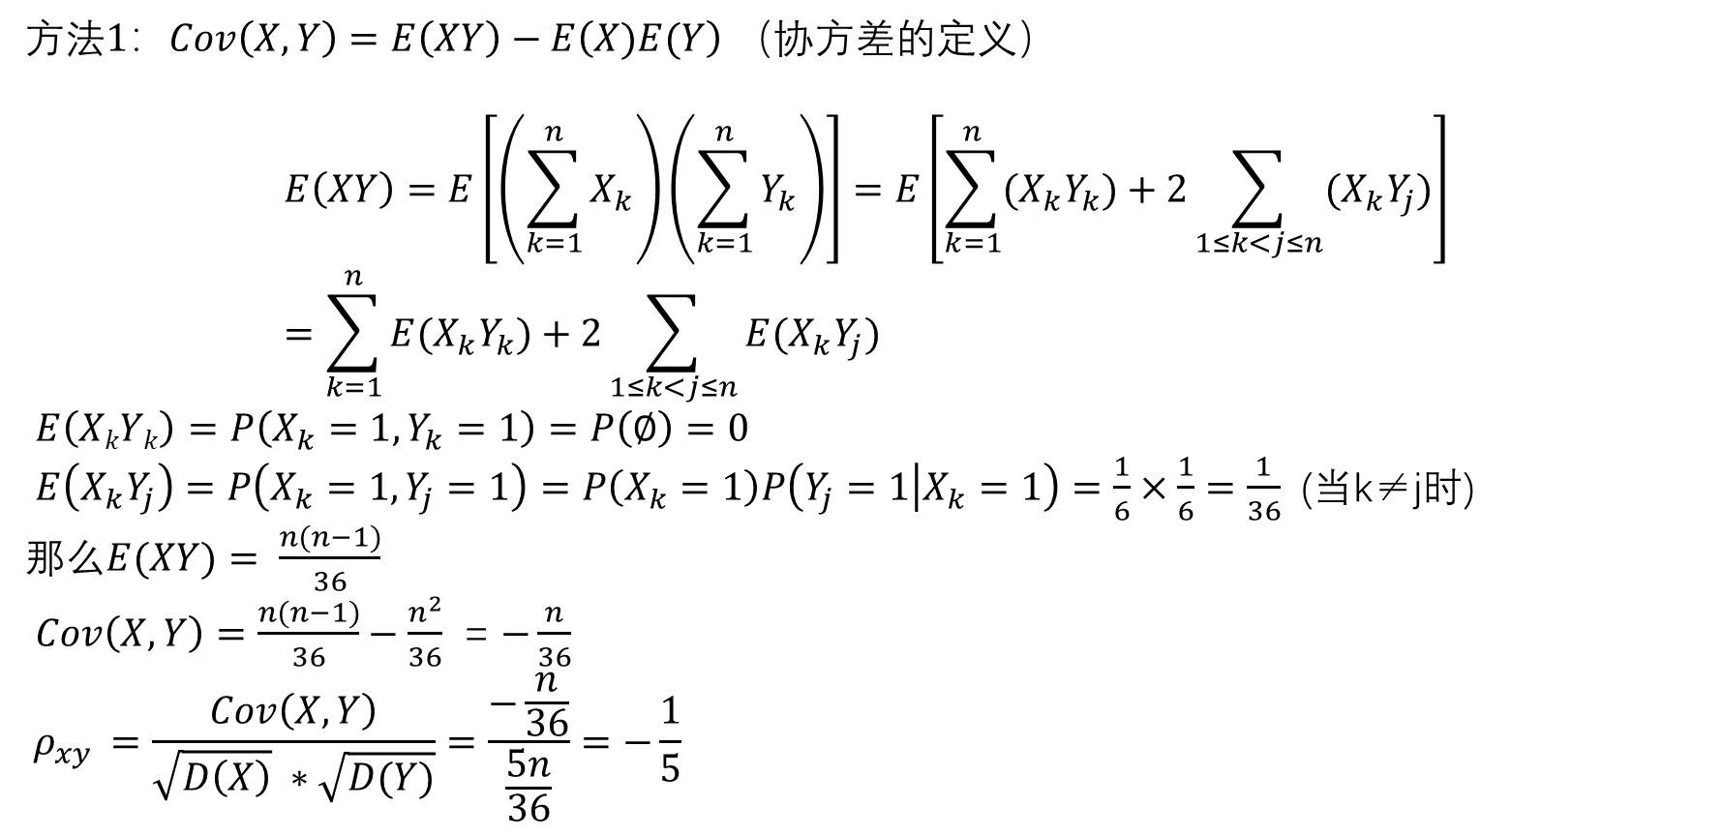
方法$1：Cov\left(X,Y\right)=E\left(XY\right)−E\left(X)E(Y\right)$ （协方差的定义）
$$E\left(XY\right)=E\left[\left(\sum_{k=1}^{n}{X_{k}}\right)\left(\sum_{k=1}^{n}{Y_{k}}\right)\right]=E\left[\sum_{k=1}^{n}{{(X}_{k}Y_{k})+2\sum_{1≤k<j≤n}{{(X}_{k}Y_{j})}}\right]=\sum_{k=1}^{n}{{E(X}_{k}Y_{k})+2\sum_{1≤k<j≤n}{E{(X}_{k}Y_{j})}}$$
$E\left(XkYk\right)=P\left(X_{k}=1,Y_{k}=1\right)=P\left(∅\right)=0$
$E\left(X_{k}Y_{j}\right)=P\left(X_{k}=1,Y_{j}=1\right)=P\left(X_{k}=1\right)P\left(Y_{j}=1 | X_{k}=1\right)=\frac{1}{6}×\frac{1}{6}=\frac{1}{36}$ (当k≠j时)
那么$E(XY)= \frac{n(n−1)}{36}$
$Cov\left(X,Y\right)=\frac{n(n−1)}{36}−\frac{n^{2}}{36}$ = $−\frac{n}{36}$
$$ρ_{xy }=\frac{Cov\left(X,Y\right)}{\sqrt{D\left(X\right)} ∗\sqrt{D(Y)}}=\frac{−\frac{n}{36}}{\frac{5n}{36}}=−\frac{1}{5}$$

Slide 4
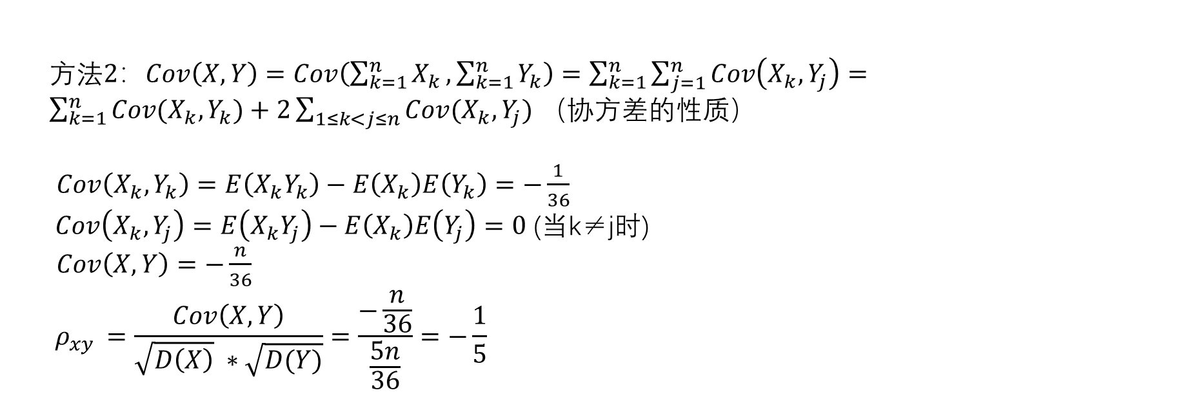
方法$2：Cov\left(X,Y\right)=Cov\left(\sum_{k=1}^{n}{X_{k}},\sum_{k=1}^{n}{Y_{k}}\right)=\sum_{k=1}^{n}{\sum_{j=1}^{n}{Cov\left(X_{k},Y_{j}\right)}=}$ $\sum_{k=1}^{n}{{Cov(X}_{k}, Y_{k})+2\sum_{1≤k<j≤n}{Cov{(X}_{k}, Y_{j})}}$ （协方差的性质）
$Cov\left(X_{k},Y_{k}\right)=E\left(X_{k}Y_{k}\right)−E\left(X_{k}\right)E\left(Y_{k}\right)=−\frac{1}{36}$
$Cov\left(X_{k},Y_{j}\right)=E\left(X_{k}Y_{j}\right)−E\left(X_{k}\right)E\left(Y_{j}\right)=0$ (当k≠j时)
$Cov\left(X,Y\right)=−\frac{n}{36}$
$$ρ_{xy }=\frac{Cov\left(X,Y\right)}{\sqrt{D\left(X\right)} ∗\sqrt{D(Y)}}=\frac{−\frac{n}{36}}{\frac{5n}{36}}=−\frac{1}{5}$$

Slide 5
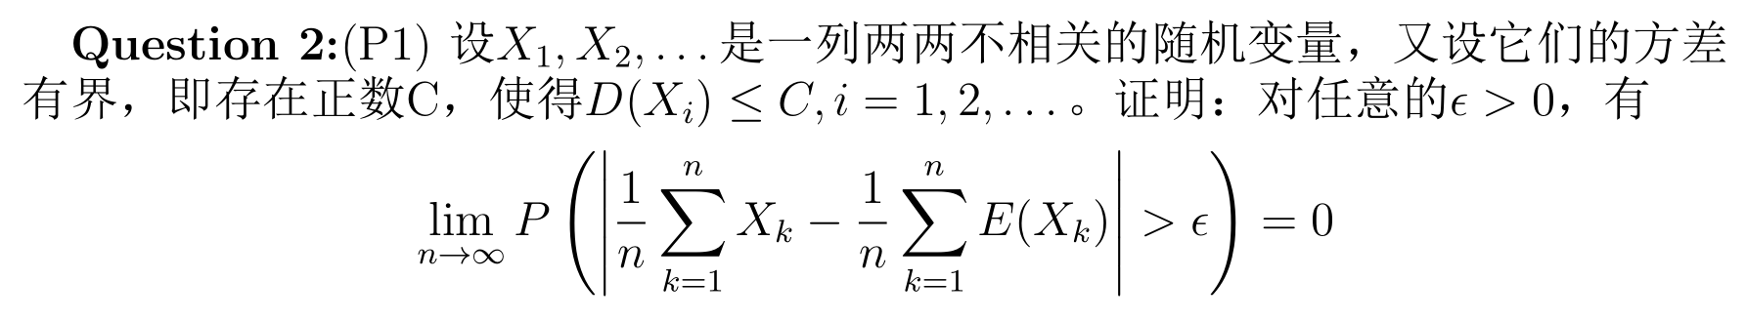
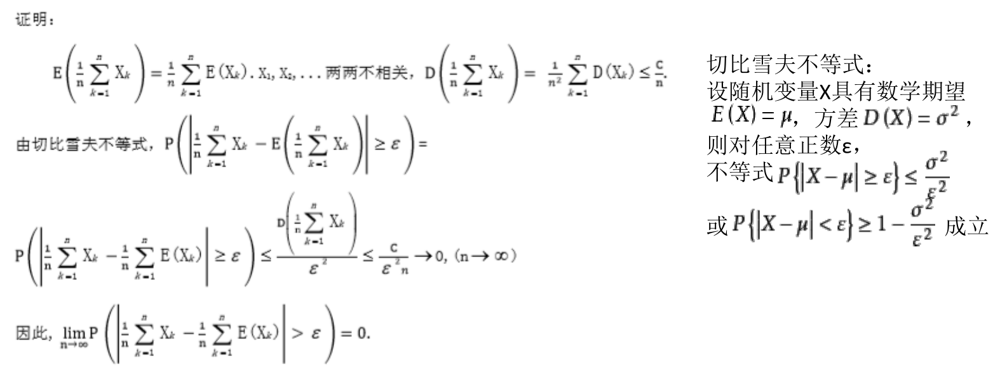

Slide 6
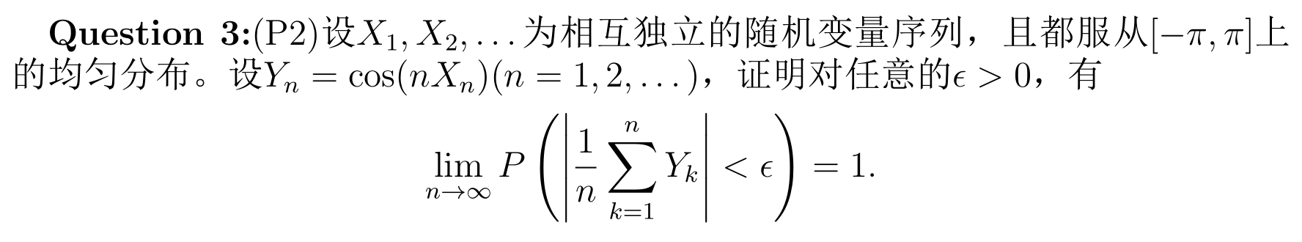
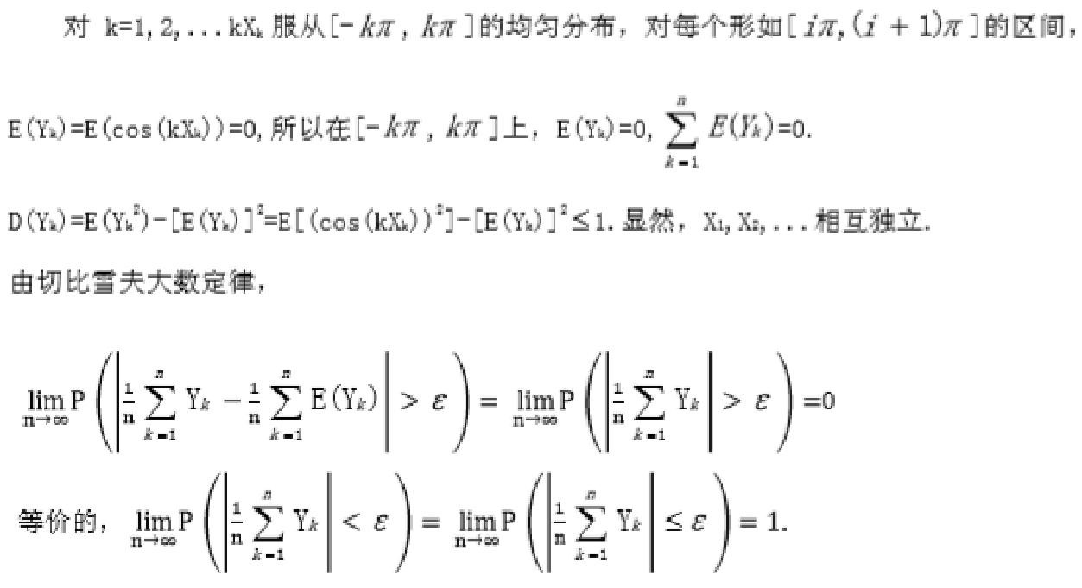

证明：

Slide 7
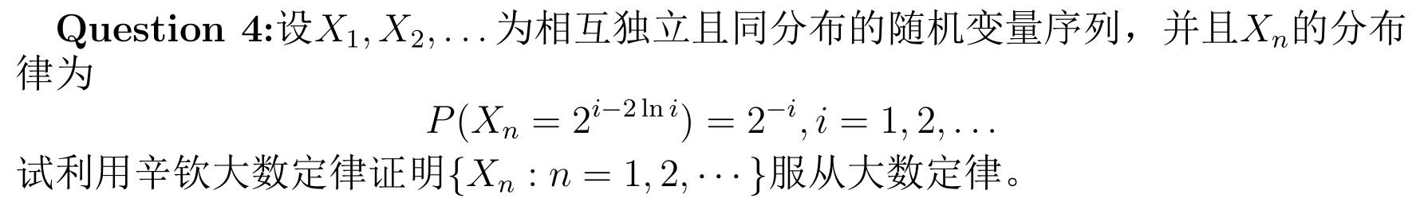
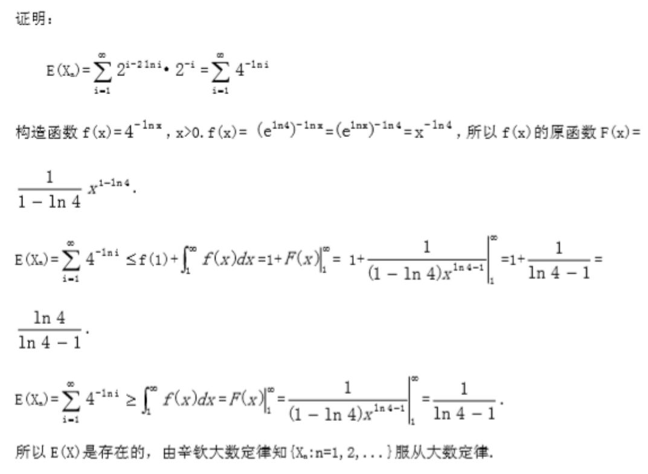
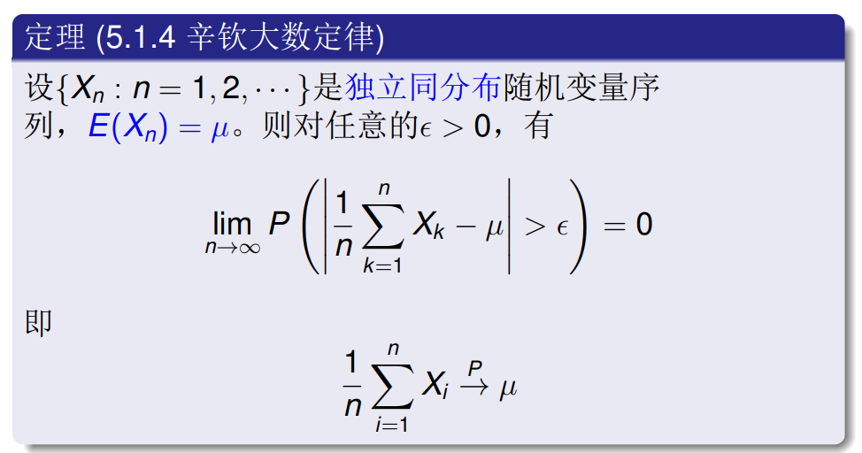
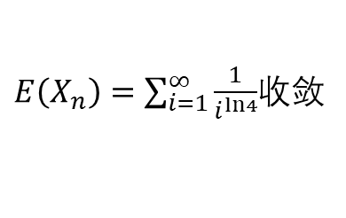
$E\left(X_{n}\right)=\sum_{i=1}^{∞}{\frac{1}{i^{ln4}}}$收敛

Slide 8
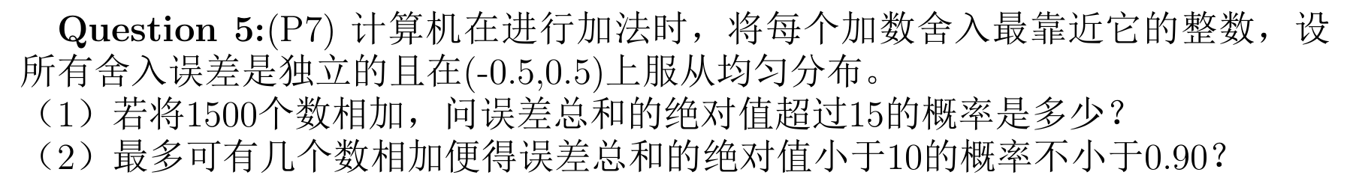
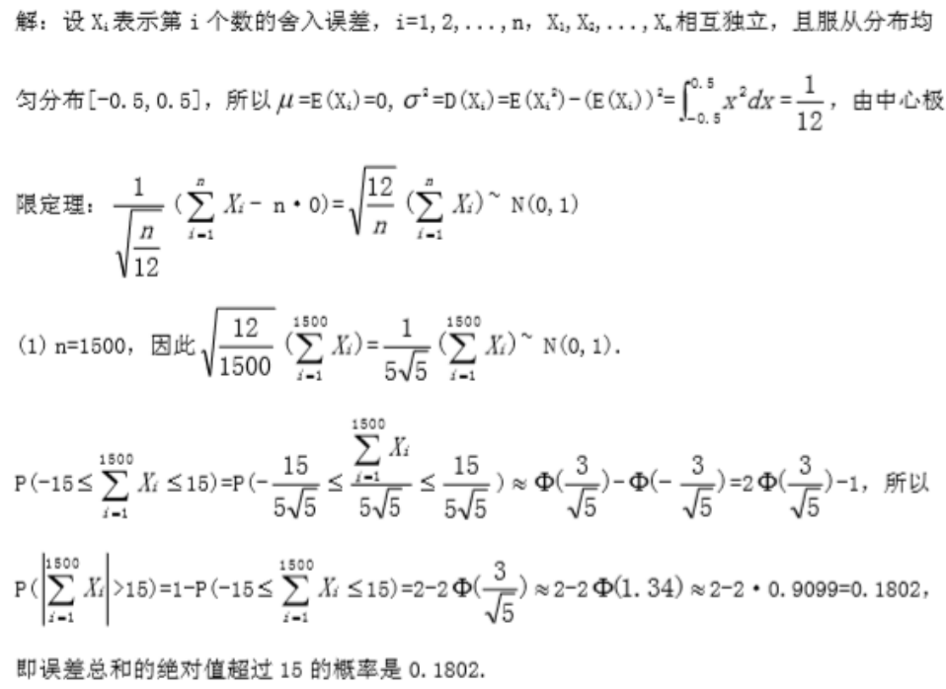

Slide 9
