Slide 1
概率论与数理统计 Assignment 6

Slide 2
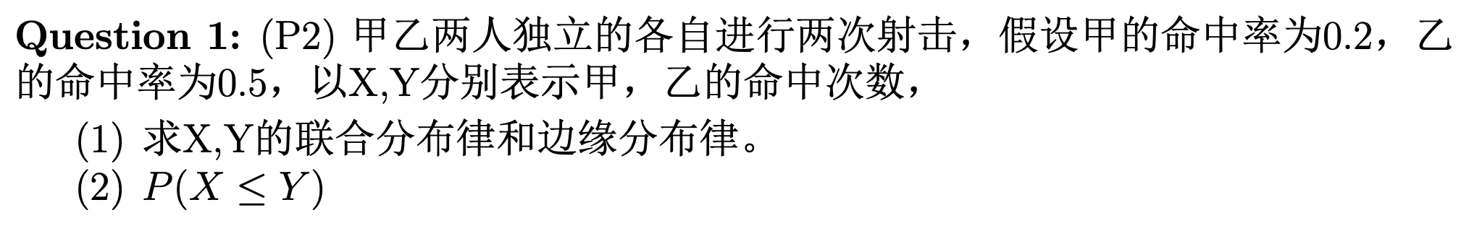
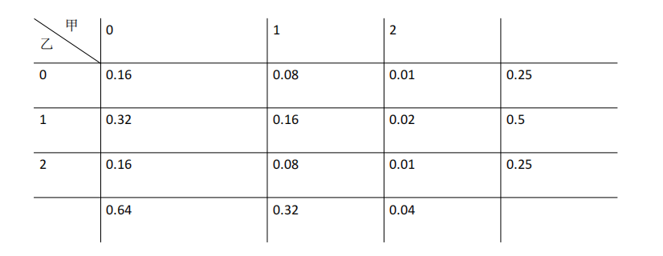


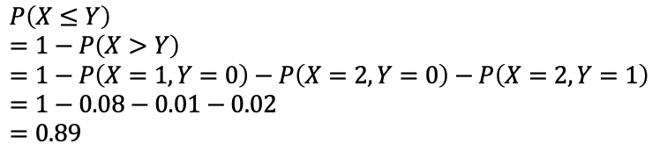
$$X$$
$$Y$$
$$P\left(X≤Y\right)$$
$$=1−P\left(X>Y\right)$$
$$=1−P\left(X=1,Y=0\right)−P\left(X=2,Y=0\right)−P\left(X=2,Y=1\right)$$
$$=1−0.08−0.01−0.02$$
$$=0.89$$

Slide 3
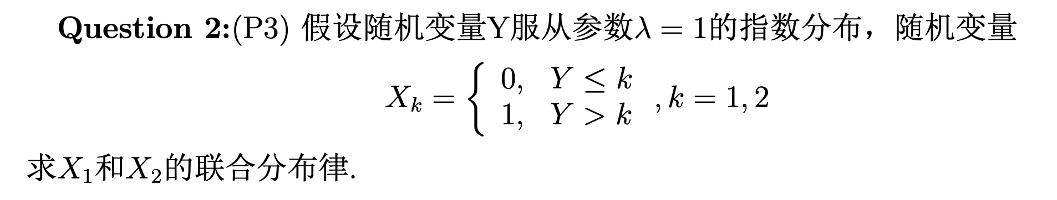
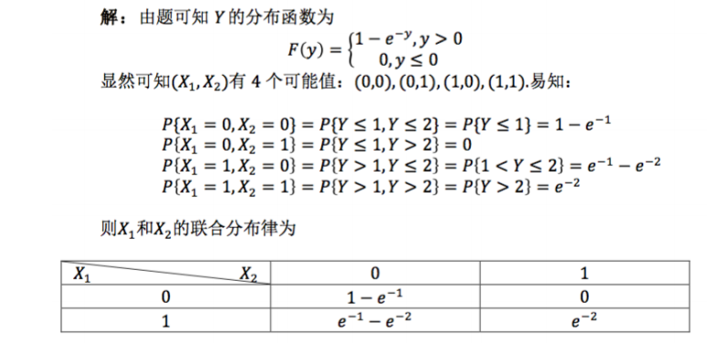

Slide 4
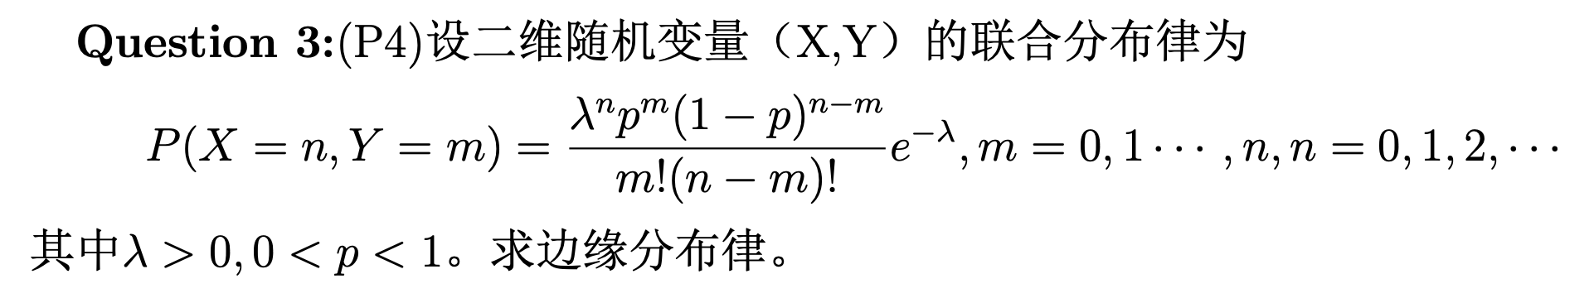
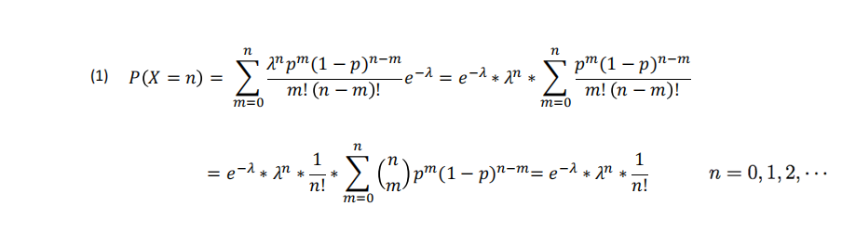
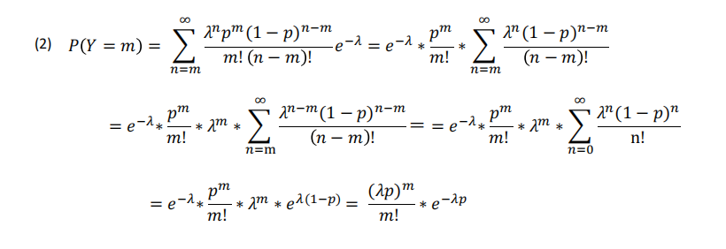

Slide 5
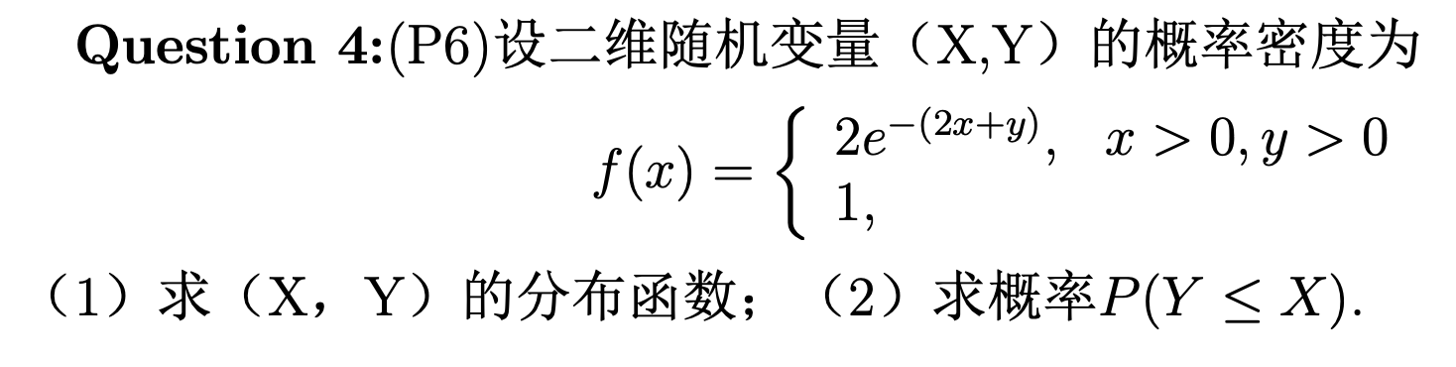
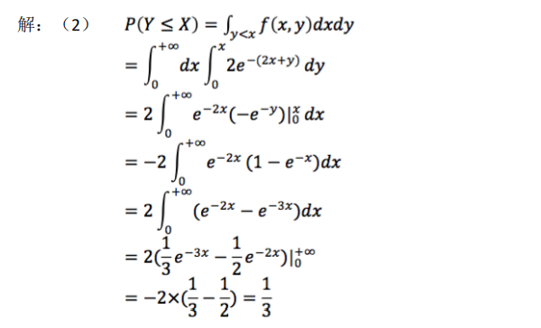
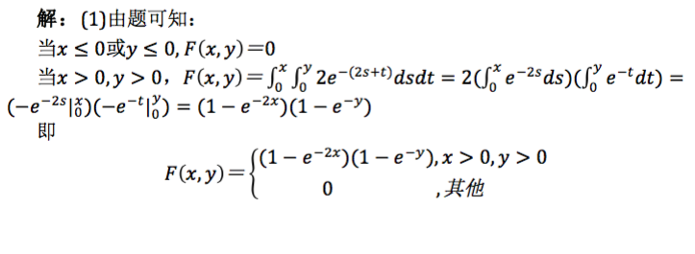
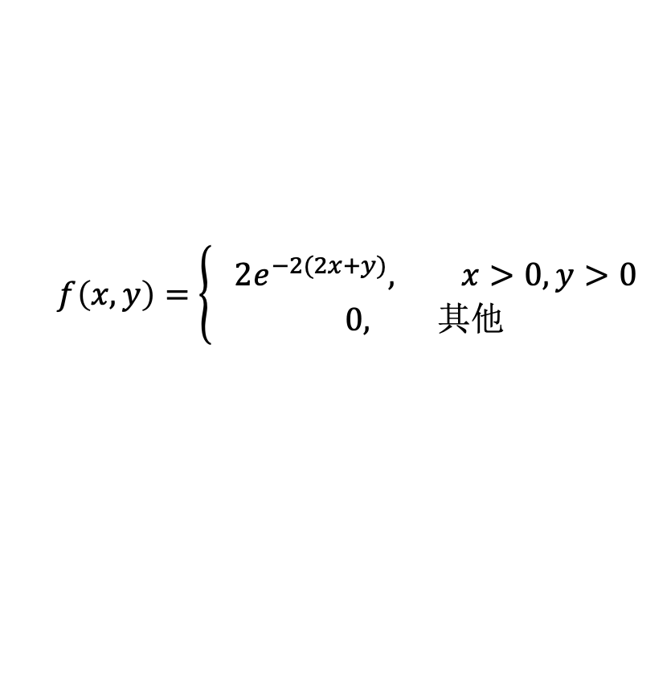
$$f\left(x,y\right)=\left\{\begin{aligned} 2e^{−2(2x+y)}, x>0,y>0 \\ &0, 其他\end{aligned}\right.$$

Slide 6
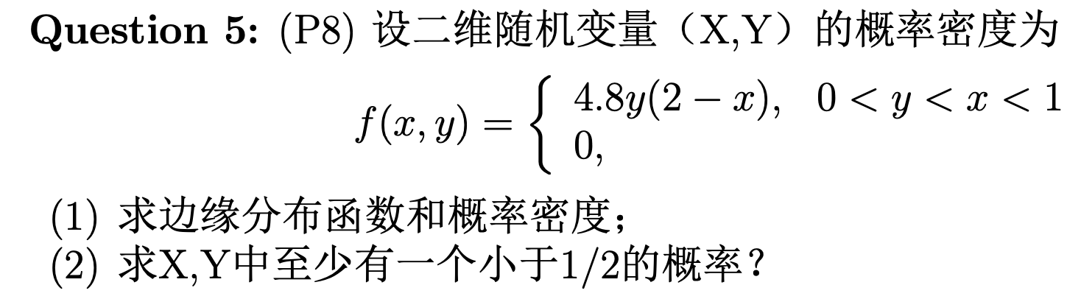
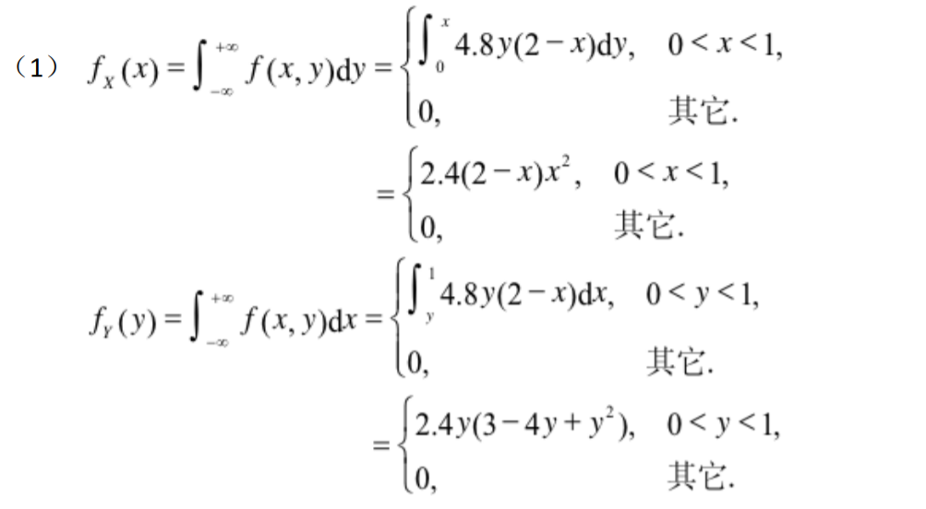
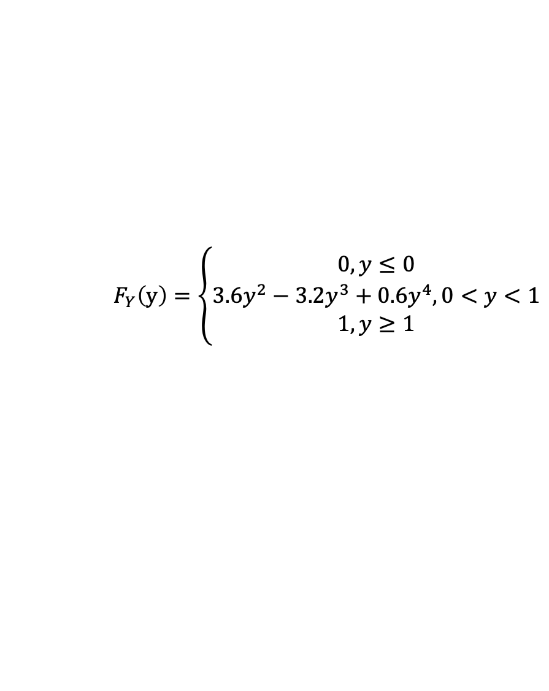
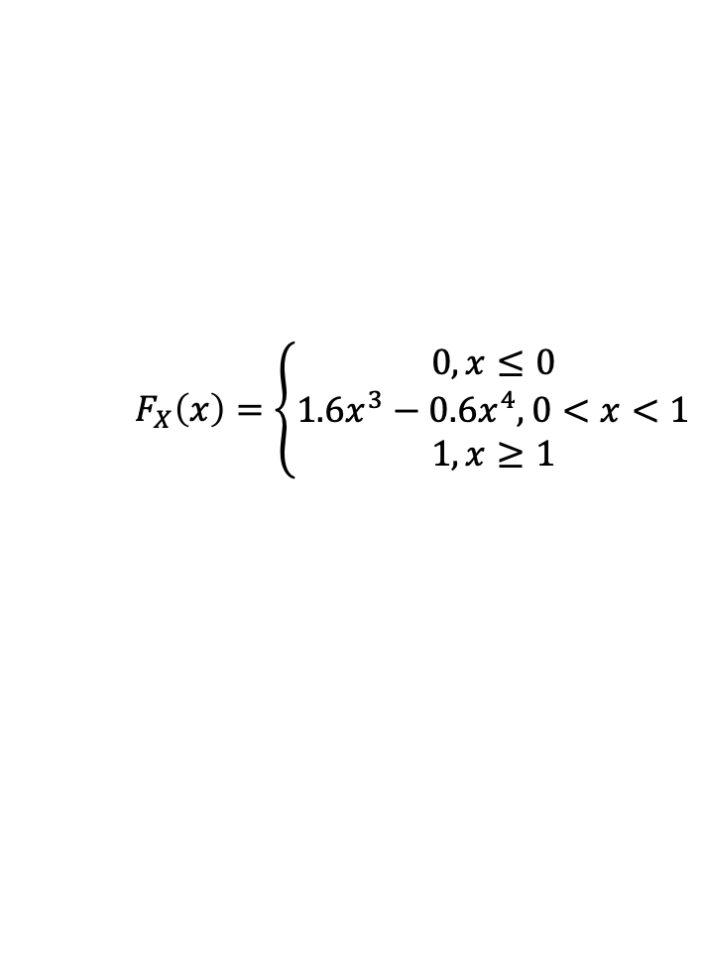
$$F_{X}\left(x\right)=\left\{\begin{aligned}0, x≤0 \\ 1.6x^{3}−0.6x^{4}, 0<x<1 \\ 1,x≥1\end{aligned}\right.$$
$$F_{Y}\left(y\right)=\left\{\begin{aligned}0, y≤0 \\ 3.6y^{2}−3.2y^{3}+0.6y^{4}, 0<y<1 \\ 1,y≥1\end{aligned}\right.$$

Slide 7
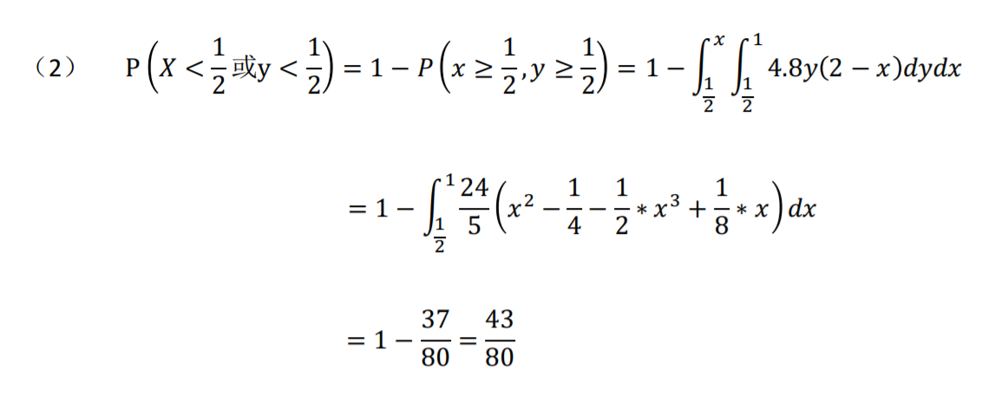

Slide 8
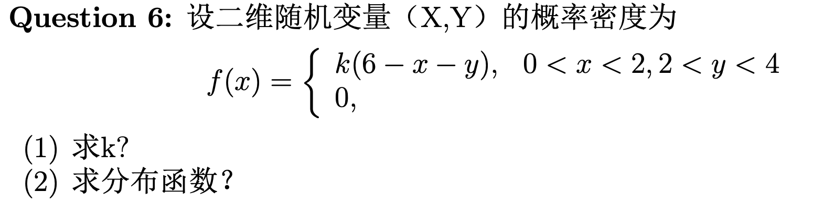
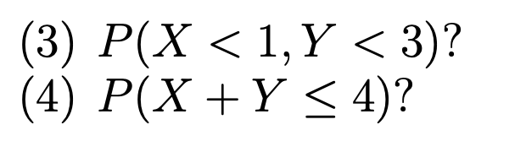
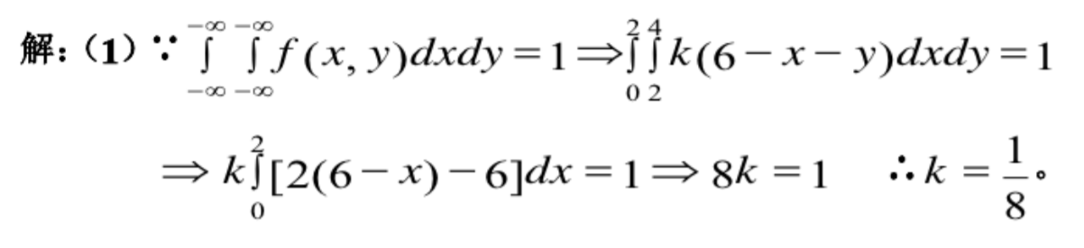

Slide 9
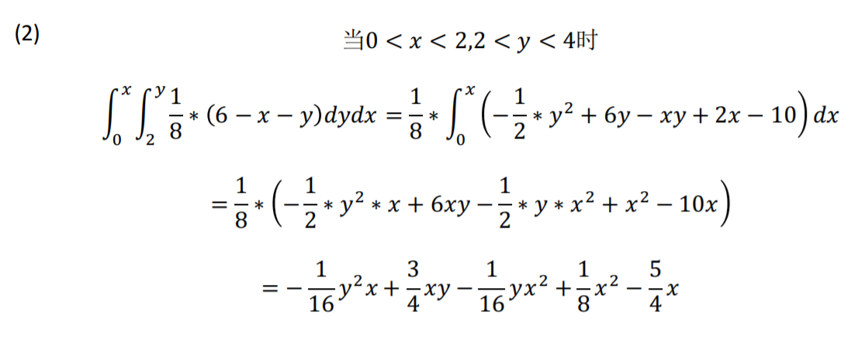

Slide 10
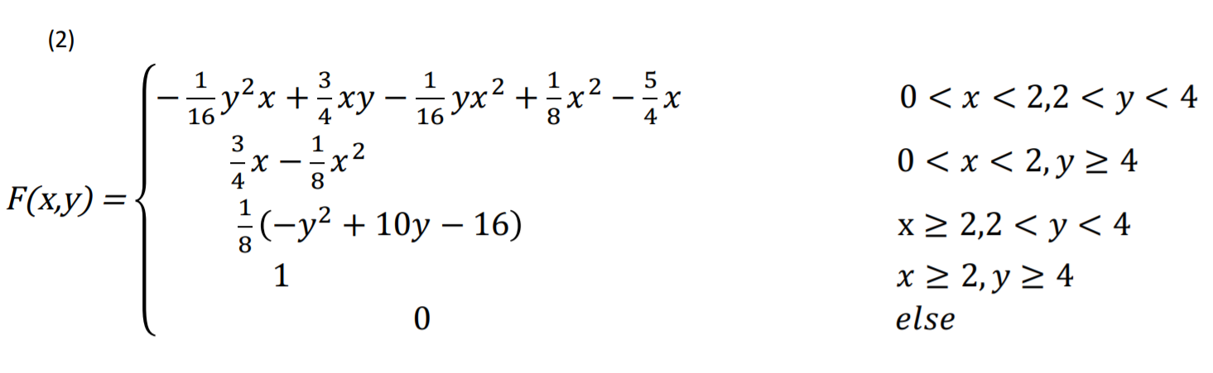

Slide 11
