Slide 1
Assignment9

Slide 2



但由于
因此X的数学期望不存在

Slide 3

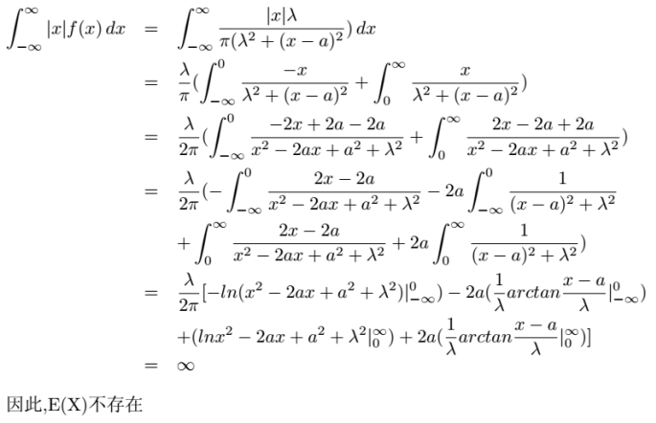

Slide 4

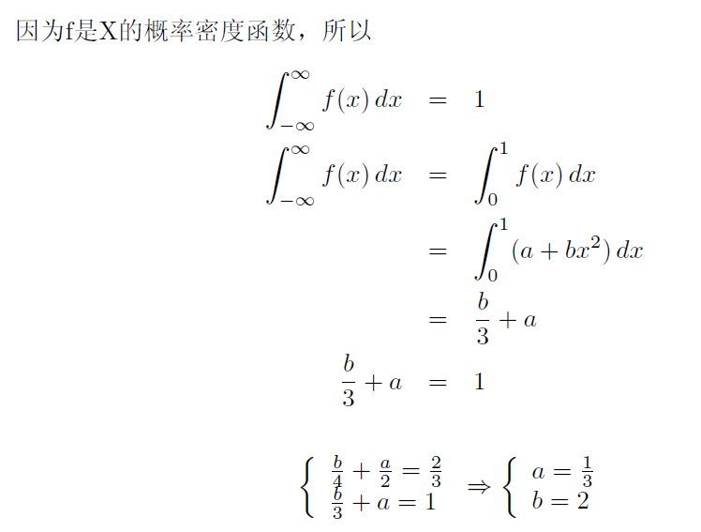
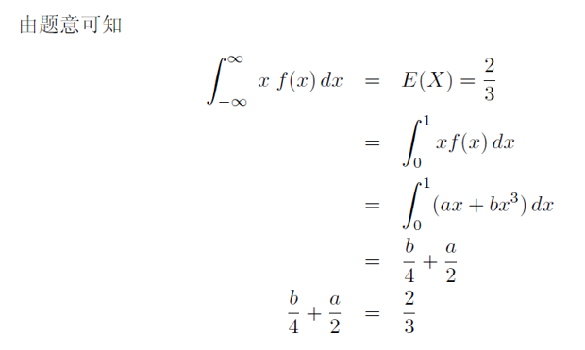

Slide 5

$E$ = $P\left(X=0\right)∗10+P\left(X=1\right)∗5−P\left(X≥3\right)∗2$
= ${0.8}^{5}∗10+5∗0.2∗{0.8}^{4}∗5$ + ($1−{0.8}^{5}−5∗0.2∗{0.8}^{4}−\left({5 \atop 2}\right)∗{0.2}^{2}∗{0.8}^{3})∗2$
$$=0.520896$$
5.20896

Slide 6

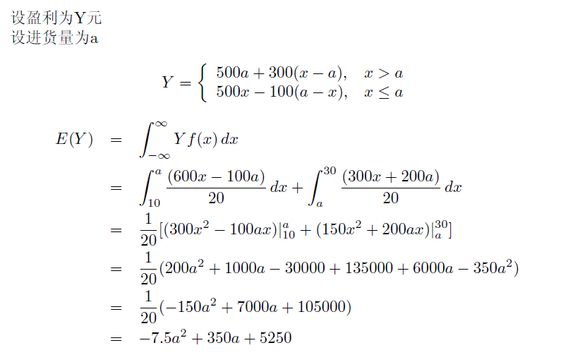
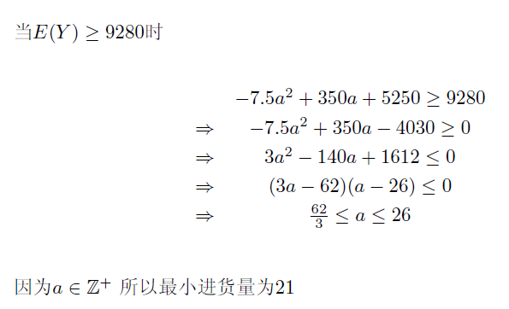

Slide 7





Slide 8

