Slide 1
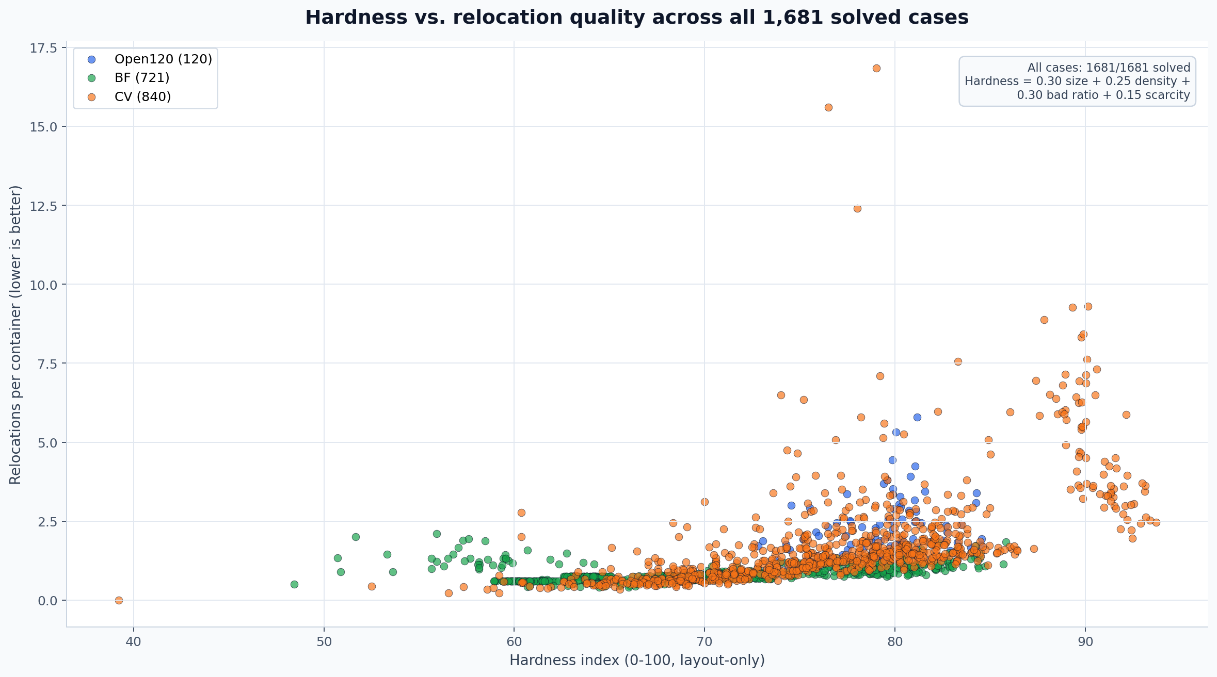
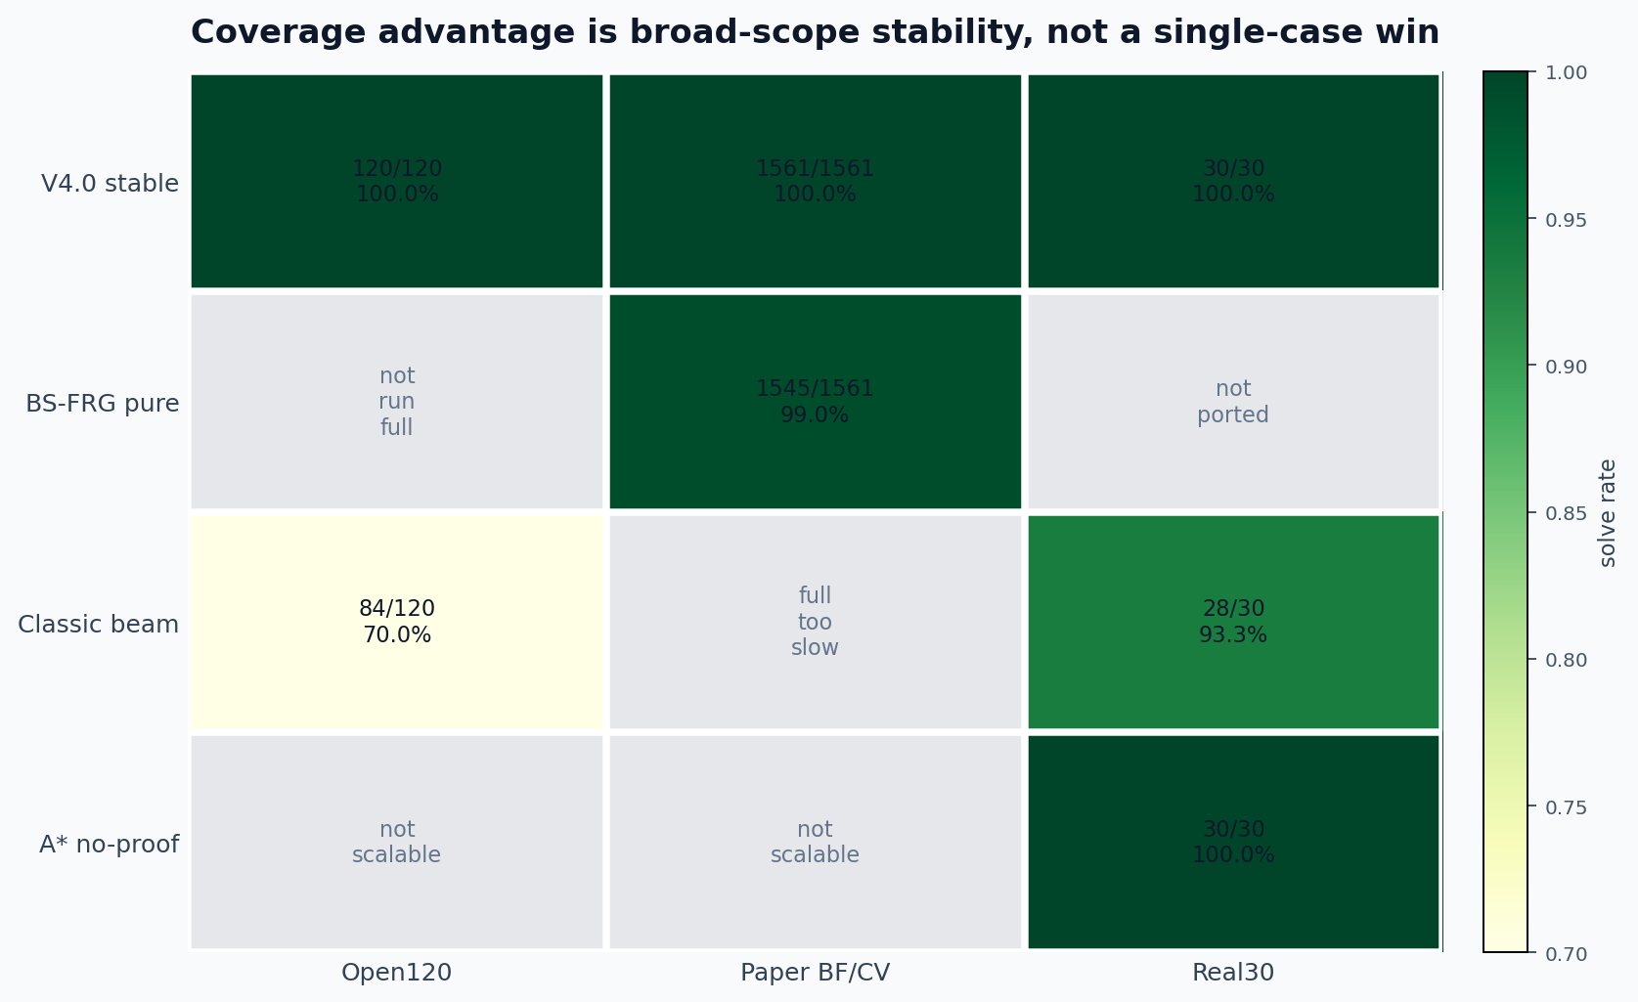
CPMP V4.0 FULL SNAPSHOT · OPEN120 + BF + CV
Hardness shows quality pressure after full coverage
V4.0 stable solves all 1,681 benchmark cases; the hard CV tail now appears as path-quality pressure rather than feasibility failure.
Coverage against classic references
1681/1681 solved
solved under the stable all-solved reporting standard
BS-FRG pure: 1545/1561
same paper BF/CV scope, no QUBO mainline
Classic beam: 84/120 open · full too slow paper
Open120 120/120 · BF 721/721 · CV 840/840
A*: 30/30 Real30 only
Hardness = 0.30 size + 0.25 density + 0.30 initial bad ratio + 0.15 scarcity. Solution quality = relocations per container for the scatter; raw moves remain the same-case quality metric. Coverage is reported separately.

