Slide 1
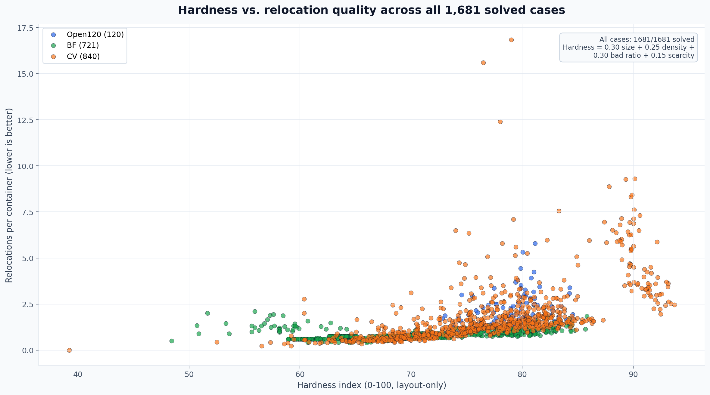
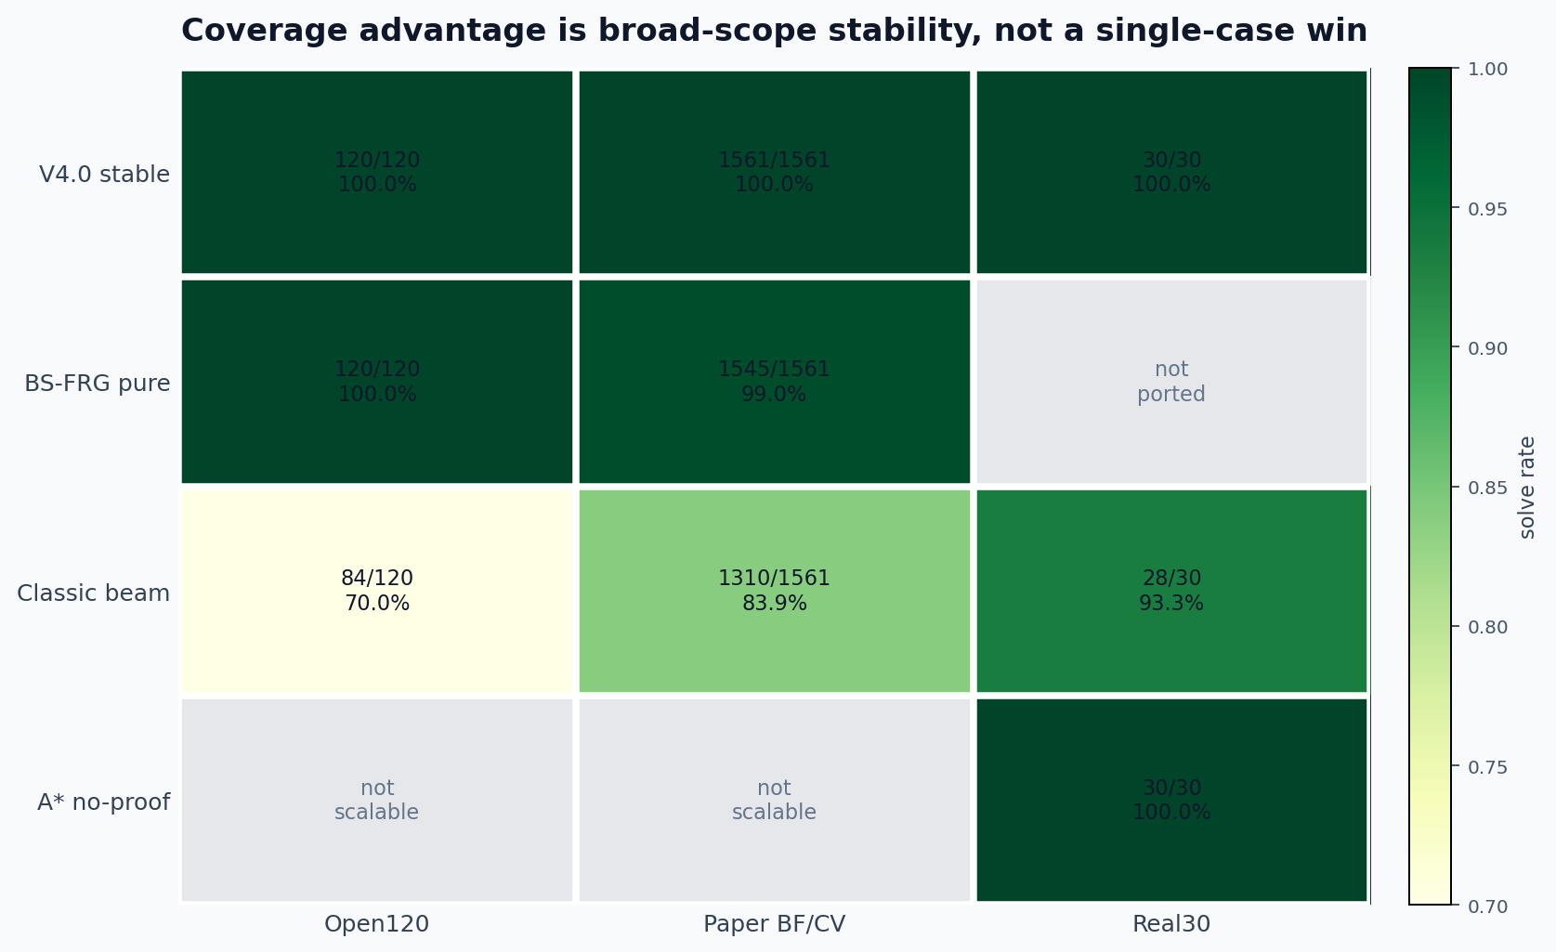
CPMP V4.0 FULL SNAPSHOT | OPEN120 + BF + CV
Hardness shows quality pressure after full coverage
V4.0 stable solves all 1,681 benchmark cases; the hard CV tail now appears as path-quality pressure rather than feasibility failure.
Coverage against classic references
1681/1681 solved
solved under the stable all-solved reporting standard
BS-FRG pure: 1545/1561
paper-style reference, Open/Paper t20, no QUBO mainline
Classic beam: 84/120 open / 1310/1561 paper
Open120 120/120 / BF 721/721 / CV 840/840
classic t120; A*: 30/30 Real30 only
Hardness = 0.30 size + 0.25 density + 0.30 initial bad ratio + 0.15 scarcity. Solution quality = relocations per container for the scatter; raw moves remain the same-case quality metric. Coverage is reported separately.

