Slide 1
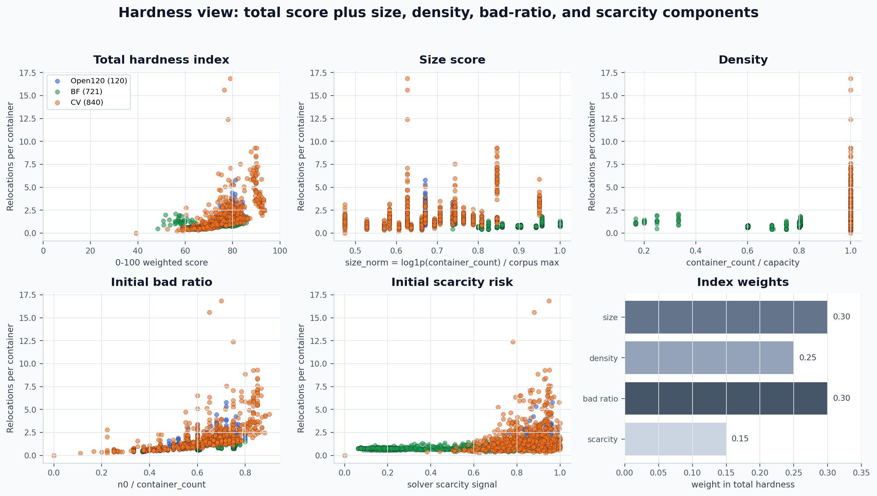
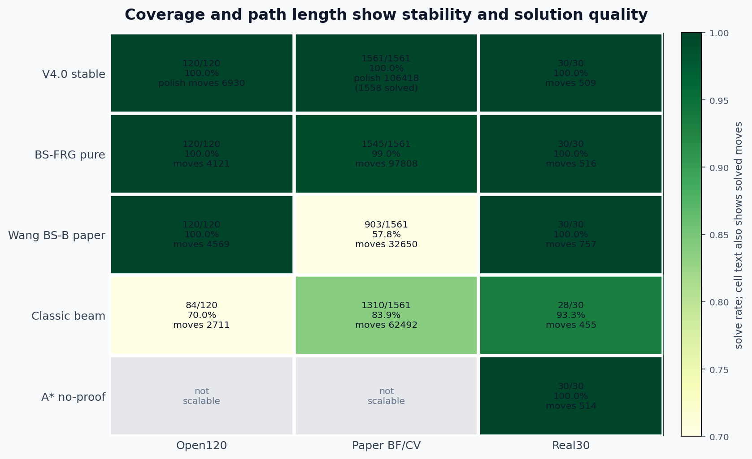
CPMP V4.0 FULL SNAPSHOT | OPEN120 + BF + CV
Hardness components expose remaining quality pressure
V4.0 stable solves all 1,681 benchmark cases; total hardness and its components separate layout difficulty from path-length quality.
Coverage and path length
1681/1681 solved
113,348 polish moves before stable guard patches (1678/1681 solved)
BS-FRG: 1545/1561, moves 97808
Real30 30/30, moves 516; t20 reference
Wang BS-B: 903/1561, moves 32650
Open120 120/120 / BF 721/721 / CV 840/840
Classic 1310/1561; A* Real30 30/30, moves 514
Hardness = 0.30 size + 0.25 density + 0.30 initial bad ratio + 0.15 scarcity. V4.0 coverage uses stable all-solved rows; V4.0 path length reports polish/repaired mainline moves before guard patches.

