Slide 1
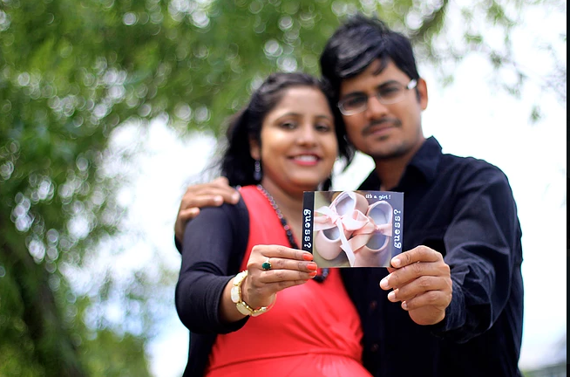
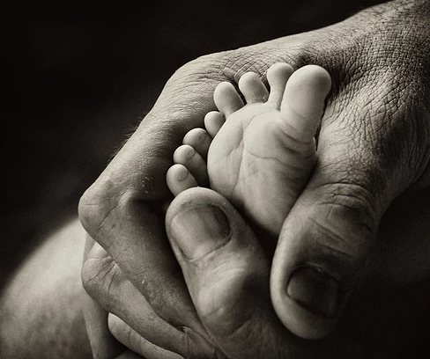


Memoirs Photography Services – Maternity Photo Shoot
PACKAGES | SILVER | GOLD | DIAMOND
PRICING | 5000/- | 8000/- | 11999/-
EDITED PICTURES | Best of 15 | Best of 30 | Complete Set
DURATION | 1.5 -2 hours | 2 – 3 hours | 4- 5 hours
LOCATION | 1 Location | 1 Location | 2 Locations Max
UNEDITED PICS | YES | YES | YES
PROPS | YES | YES | YES
A Joyful Journey….A Blissful Feeling
Shoot Locations Options
1)Society Park/ Your residence
2) Savitri Phule Park Garden (Wakad)-(Rs 250 admission charges included in our package)
3) You can book any special resort/park based on your preference. 3) Any specific nature friendly location based on your preference.
4)Outside Pune charges will change accordingly
7077245388
anshumanmah@gmail.com
For Further Details Contact us:-

