Slide 1

Statistical NLP

Slide 2
Agenda
Text Analytics Frameworks
Stemming
Lemmatization
Named Entity Resolution
Case studies
Documents Similarity
Documents Clustering
Yelp Review Sentiment Analysis
News Headlines Analysis
POS Tagging
TF-IDF
Language Detection
References
Possible Capstone Projects

Slide 3
Text Analytics Frameworks
NLTK: The Natural Language Toolkit is a complete platform that contains more than 50 corpora and lexical resources. It also provides the necessary tools, interfaces, and methods to process and analyse text data
Pattern: pattern provides tools and interfaces for web mining, information retrieval, NLP, machine learning and network analysis. The pattern.en module contains most of the utilities for text analytics
Gensim: The genism library has a rich set of capabilities for semantic analysis, including topic modelling and similarity analysis. But the best part is that it contains a Python port of Google’s popular word2vec model, a neural network model implemented to learn distributed representations of words where similar words(semantic) occur close to each other
Textblob: Provides several capabilities including text processing, phrase extraction, classification, POS tagging, text translation and sentiment analysis
Spacy: Claims to provide industrial-strength NLP capabilities by providing the best implementation of each technique and algorithm, making NLP tasks efficient in terms of performance and implementation
Sklearn

Slide 4
Text preprocessing and wrangling
Objective
Transform unstructured or semi-structured noisy text data into clean text data after removing unnecessary elements
Techniques:
Remove HTML and markup tags
Handling accented characters
Expanding contractions
Removing special characters & symbols
Stemming
Lemmatization
Removing Stopwords

Slide 5
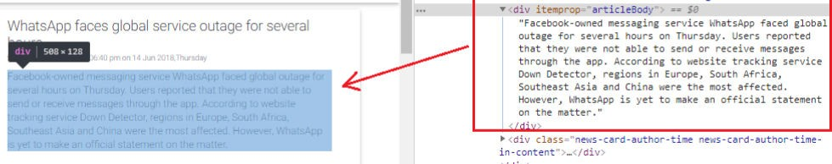
Text preprocessing – removing html tags
Often, unstructured text contains a lot of noise, especially if you use techniques like web or screen scraping. HTML tags are typically one of these components which don’t add much value towards understanding and analyzing text.
strip_html_tags('<html><h2>Some important
text</h2></html>')
'Some important text'

Slide 6
Text preprocessing – handling accented
characters
Usually in any text corpus, you might be dealing with accented characters/letters,
especially if you only want to analyze the English language.
Hence, we need to make sure that these characters are converted and standardized into ASCII characters.
A simple example — converting é to e.
remove_accented_chars('Sómě Áccěntěd těxt')
'Some Accented text'

Slide 7
Text preprocessing – Expanding Contractions
Contractions are shortened version of words or syllables. They often exist in either written or spoken forms in the English language. These shortened versions or contractions of words are created by removing specific letters and sounds.
In case of English contractions, they are often created by removing one of the vowels from the word. Examples would be, do not to don’t and I would to I’d.
expand_contractions("Y'all can't expand contractions I'd
think")
'You all cannot expand contractions I would think'

Slide 8
Text preprocessing – Removing special
characters
Special characters and symbols are usually non-alphanumeric characters or even occasionally numeric characters (depending on the problem), which add to the extra noise in unstructured text.
Usually, simple regular expressions (regexes) can be used to remove them.
remove_special_characters("Well this was fun! What do you
think? 123#@!",
remove_digits=True)
'Well this was fun What do you think '

Slide 9
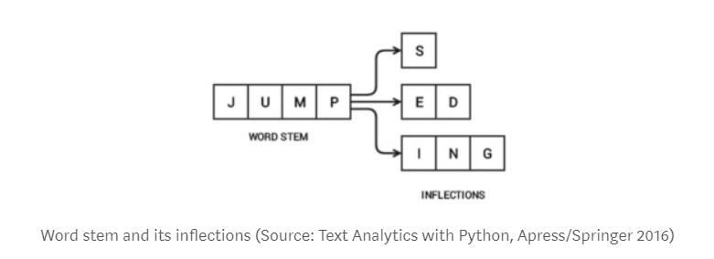
Text preprocessing – stemming
To understand stemming, you need to gain some perspective on what word stems represent. Word stems are also known as the base form of a word, and we can create new words by attaching affixes to them in a process known as inflection.
Consider the word JUMP. You can add affixes to it and form new words
like JUMPS, JUMPED, and JUMPING. In this case, the base word JUMP is the word stem.

Slide 10
Text preprocessing – stemming
The reverse process of obtaining the base form of a word from its inflected form is
known as stemming. (May not be a dictionary\lexicographically correct word)
The Porter stemmer is based on the algorithm developed by its inventor, Dr. Martin Porter. It is said to have had a total of five different phases for reduction of inflections to their stems, where each phase has its own set of rules.
simple_stemmer("My system keeps crashing his
crashed yesterday, ours crashes daily")
'My system keep crash hi crash yesterday, our crash daili'

Slide 11
Text preprocessing – lemmatization
Lemmatization is very similar to stemming, where we remove word affixes to get to the base form of a word. However, the base form in this case is known as the root word, but not the root stem.
The difference being that the root word is always a lexicographically correct word (present in the dictionary), but the root stem may not be so. Thus, root word, also known as the lemma, will always be present in the dictionary.
lemmatize_text("My system keeps crashing his
crashed yesterday, ours crashes daily")
'My system keep crash ! his crash yesterday , ours crash daily'

Slide 12
Text preprocessing – removing stopwords
Words which have little or no significance, especially when constructing meaningful
features from text, are known as stopwords or stop words.
These are usually words that end up having the maximum frequency if you do a simple term or word frequency in a corpus.
Typically, these can be articles, conjunctions, prepositions and so on. Some
examples of stopwords are a, an, the, and the like.
remove_stopwords("The, and, if are stopwords, computer is
not")
', , stopwords , computer'

Slide 13
Beatiful Soup
Library for pulling data out of HTML and XML Files
Beautiful Soup is a Python library designed for quick turnaround projects like screen-scraping. Three features make it powerful:
Beautiful Soup provides a few simple methods and Pythonic idioms for navigating, searching, and modifying a parse tree: a toolkit for dissecting a document and extracting what you need. It doesn't take much code to write an application
Beautiful Soup sits on top
of popular you to try out
Python different
parsers parsing
like lxml and html5lib, allowing
strategies or trade speed for flexibility.

Slide 14
Text Preprocessing HandsOn
Hands-on: nlpEDA_v1.ipynb

Slide 15
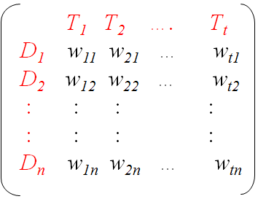
Text representation model
Machine Learning models at heart are mathematical functions and cannot understand unstructured text
Hence we need to convert text into some numeric representations which can be understood by
machines
In information retrieval and text mining, text data of different formats can be represented in a
common representation model, popularly known as Vector Space Model
Unstructured text data is converted to the model representation giving structured data representations using feature engineering models (e.g. Bag of Words)
Representational Model
Text
Documents
Conversion

Slide 16
Bag of words
This is perhaps the most simple vector space representational
model for unstructured text.
A vector space model is simply a mathematical model to represent unstructured text (or any other data) as numeric vectors, such that each dimension of the vector is a specific feature\attribute.
The bag of words model represents each text document as a numeric vector where each dimension is a specific word from the corpus and the value could be its frequency in the document, occurrence (denoted by 1 or 0) or even weighted values.
The model’s name is such because each document is represented literally as a ‘bag’ of its own words, disregarding word orders, sequences and grammar.

Slide 17
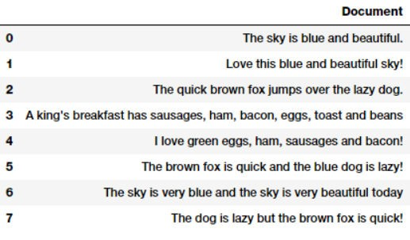
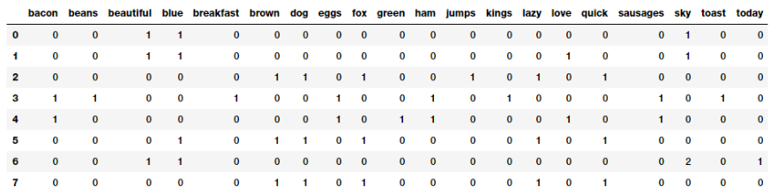
Bag of words

Slide 18
Bag of N-grams
A word is just a single token, often known as a unigram or 1-gram.
And the Bag of Words model doesn’t consider order of words.
What if we also wanted to take into account phrases or collection of
words which occur in a sequence? N-grams help us achieve that.
An N-gram is basically a collection of word tokens from a text document such that these tokens are contiguous and occur in a sequence. Bi-grams indicate n-grams of order 2 (two words), Tri- grams indicate n-grams of order 3 (three words), and so on.
The Bag of N-Grams model is hence just an extension of the Bag of
Words model so we can also leverage N-gram based features.

Slide 19
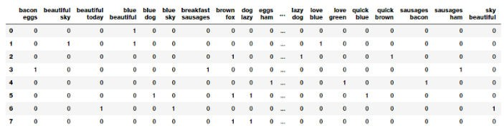
Bag of N-grams

Slide 20
Tf-idf model
There are some potential problems which might arise with the Bag of Words model when it is used on large corpora.
Since the feature vectors are based on absolute term frequencies, there might be some terms which occur frequently across all documents and these may tend to overshadow other terms in the feature set.
The TF-IDF model tries to combat this issue by using a scaling or normalizing factor in its computation.
TF-IDF stands for Term Frequency-Inverse Document Frequency, which uses a combination of two metrics in its computation, namely: term frequency (tf) and inverse document frequency (idf).
This technique was developed for ranking results for queries in search engines and now it is an indispensable model in the world of information retrieval and NLP.

Slide 21
Word Frequencies with TFIDFVectorizer
Term Frequency: This summarizes how often a given word appears within a document.
Inverse Document Frequency: This downscales words that appear a lot across documents.
Without going into the math, TF-IDF scores are word frequency scores that try to highlight words that are more interesting, e.g. frequent in a document but not across documents.

Slide 22
BAG Of Words / Vector Space model
TF: Term Frequency, which measures how frequently a term occurs in a document.
Since every document is different in length, it is possible that a term would appear much more times in long documents than shorter ones.
Thus, the term frequency is often divided by the document length (aka. the total number of terms in the document) as a way of normalization:
TF(t) = (Number of times term t appears in a document) / (Total number of terms
in the document)
IDF: Inverse Document Frequency measures how important a term is.
Certain terms, may appear a lot of times across documents but have little importance.
Weigh down the frequent terms while scale up the rare ones, by computing the following:
IDF(t) = log_e(Total number of documents / Number of documents with term t in it).
Source: http://www.tfidf.com/

Slide 23
BAG Of Words / Vector Space model
w = tf ⋅ log ^{N}
i, j i, j
n
i
^{w}i, j
^{tf}i, j
N
n_{i}
weight assigned to term i in document j
number of occurrence of term i in document j
number of documents in entire collection
number of documents with term i
Consider a document containing 1000 words wherein the word ML appears 30 times. The term frequency (i.e., tf) for ML is then (30 / 1000) = 0.03. Now, assume we have 10 million documents and the word ML appears in one thousand of these. Then, the inverse document frequency (i.e., idf) is calculated as log(10,000,000 / 1,000) = 4. Thus, the Tf-idf weight is the product of these quantities: 0.03 * 4 = 0.12.
This is the coefficient of the given document

Slide 24
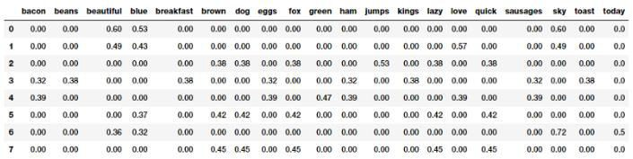
Tf-idf model

Slide 25
Word Frequencies with TFIDFVectorizer
Hands-on: tfIdf_Example_v1.ipynb

Slide 26
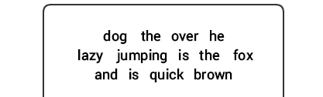
Understanding Language Syntax and Structure
For any language, syntax and structure usually go hand in hand, where a set of specific rules, conventions, and principles govern the way words are combined into phrases; phrases get combines into clauses; and clauses get combined into sentences.
We will be talking specifically about the English language syntax and structure in this section. In English, words usually combine together to form other constituent units. These constituents include words, phrases, clauses, and sentences.
Considering a sentence, “The brown fox is quick and he is jumping over the lazy dog”, it is made of a bunch of words and just looking at the words by themselves don’t tell us much.

Slide 27
Understanding Language Syntax and Structure
Knowledge about the structure and syntax of language is helpful in many areas like text processing, annotation, and parsing for further operations such as text classification or summarization.
Typical parsing techniques for understanding text syntax are mentioned below.
Parts of Speech (POS) Tagging
Shallow Parsing or Chunking

Slide 28
Parts of Speech Tagging
Parts of Speech(POS) are specific lexical categories to which words are assigned, based on their syntactic context and role. Usually, words can fall into one of the following major categories:
Noun
Verb
Adjective
Adverb

Slide 29
Shallow Parsing or Chuncking
Shallow parsing, also known as light parsing or chunking , is a popular natural language processing technique of analyzing the structure of a sentence to break it down into its smallest constituents (which are tokens such as words) and group them together into higher-level phrases. This includes POS tags as well as phrases from a sentence.

Slide 30
Named Entity Recognition
In any text document, there are particular terms that represent specific entities that are more informative and have a unique context.
These entities are known as named entities , which more specifically refer to terms that represent real-world objects like people, places, organizations, and so on, which are often denoted by proper names.
A naive approach could be to find these by looking at the noun phrases in
text documents.
Named entity recognition (NER) , also known as entity chunking/ extraction , is a popular technique used in information extraction to identify and segment the named entities and classify or categorize them under various predefined classes.

Slide 31
Named Entity Recognition
NER
Classifies a text into predefined categories or real world object entities
Takes a string of text(sentence or paragraph) as input and identifies relevant nouns(people, places, and organizations) that are mentioned in that string
Uses
Classify or categorize contents by getting the relevant tags
Improve search algorithms
For content recommendations
For info extraction
Ref:
https://spacy.io/api/annotation#named-entities

Slide 32
NER HandsOn
Hands-on: nlpEDA_v1.ipynb

Slide 33
Case Studies

Slide 34
Document Similarity
Document similarity is the process of using a distance or similarity based metric that can be used to identify how similar a text document is with any other document(s) based on features extracted from the documents like bag of words or tf-idf.
Pairwise document similarity in a corpus involves computing document similarity for each pair of documents in a corpus.
Thus if you have C documents in a corpus, you would end up with a C x C matrix such that each row and column represents the similarity score for a pair of documents, which represent the indices at the row and column, respectively.
There are several similarity and distance metrics that are used to compute document similarity. These include cosine distance/similarity, euclidean distance, manhattan distance, BM25

Slide 35
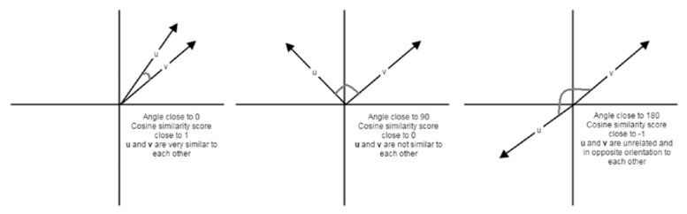
Document Similarity
Cosine similarity basically gives us a metric representing the cosine of the angle between the feature vector representations of two text documents. Lower the angle between the documents, the closer and more similar they are as depicted in the following figure.

Slide 36
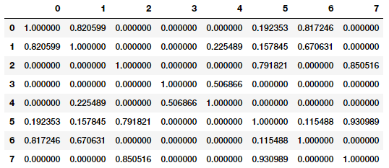
Similarity features

Slide 37
Document Similarity
DocumentSimilarityClustering_v1.ipynb

Slide 38
Document Clustering
DocumentSimilarityClustering_v1.ipynb

Slide 39
Yelp Reviews Sentiment Analysis and
Classification: Hands-On
textClassficationWithAdvancedML.ipynb

Slide 40
News HeadLines Analysis: Hands-On
newsHeadlinesAnalysis.ipynb

Slide 41
References
Text Analytics with Python by Dipanjan Sarkar
Natural Language Processing by Steven Bird, Ewan Klein and Edward Loper
Practical Machine Learning with Python by Dipanjan Sarkar

Slide 42
Possible Capstone Projects
Information retrieval: Find relevant results and similar results
Information extraction: Structured information from unstructured documents
Machine translation: One language to another
Text simplification: Preserve the meaning of text, but simplify the grammar and vocabulary
Predictive text input: Faster or easier typing
Sentiment analysis: Attitude of speaker
Automatic summarization: Extractive or abstractive summarization
Natural Language Generation: Generate text from data
Speech recognition and generation: Speech-to-text, text-to-speech
Question answering: Determine the intent of the question, match query
with knowledge base, evaluate hypotheses

Slide 43
Possible Capstone Projects: Specific
Consumer complaints data analysis and case outcome prediction
Collect case status data from district, state and NCDRC
Extract important basic info about each case ( using NLP
techniques) and add to the features
Build predictive models for the outcome of the complaints
Consumer complaints judgments summarization
Real estate
Healthcare
Similar consumer complaints judgements identification
NLP based features engineering for consumer complaints judgements(may need to use sequential models also)

Slide 44
Summary
Text Analytics Frameworks
Stemming
Lemmatization
Named Entity Resolution
Case studies
Documents Similarity
Documents Clustering
Yelp Reviews Sentiment Analysis
and Classification
News Headlines Analysis
POS Tagging
TF-IDF
Language Detection
References
Possible Capstone Projects

Slide 45
Questions?

