Slide 1

Summarising the butterfly commuity of dry meadows
Species richness, Shannon’s diversity and Pielou’s evenness

Slide 2
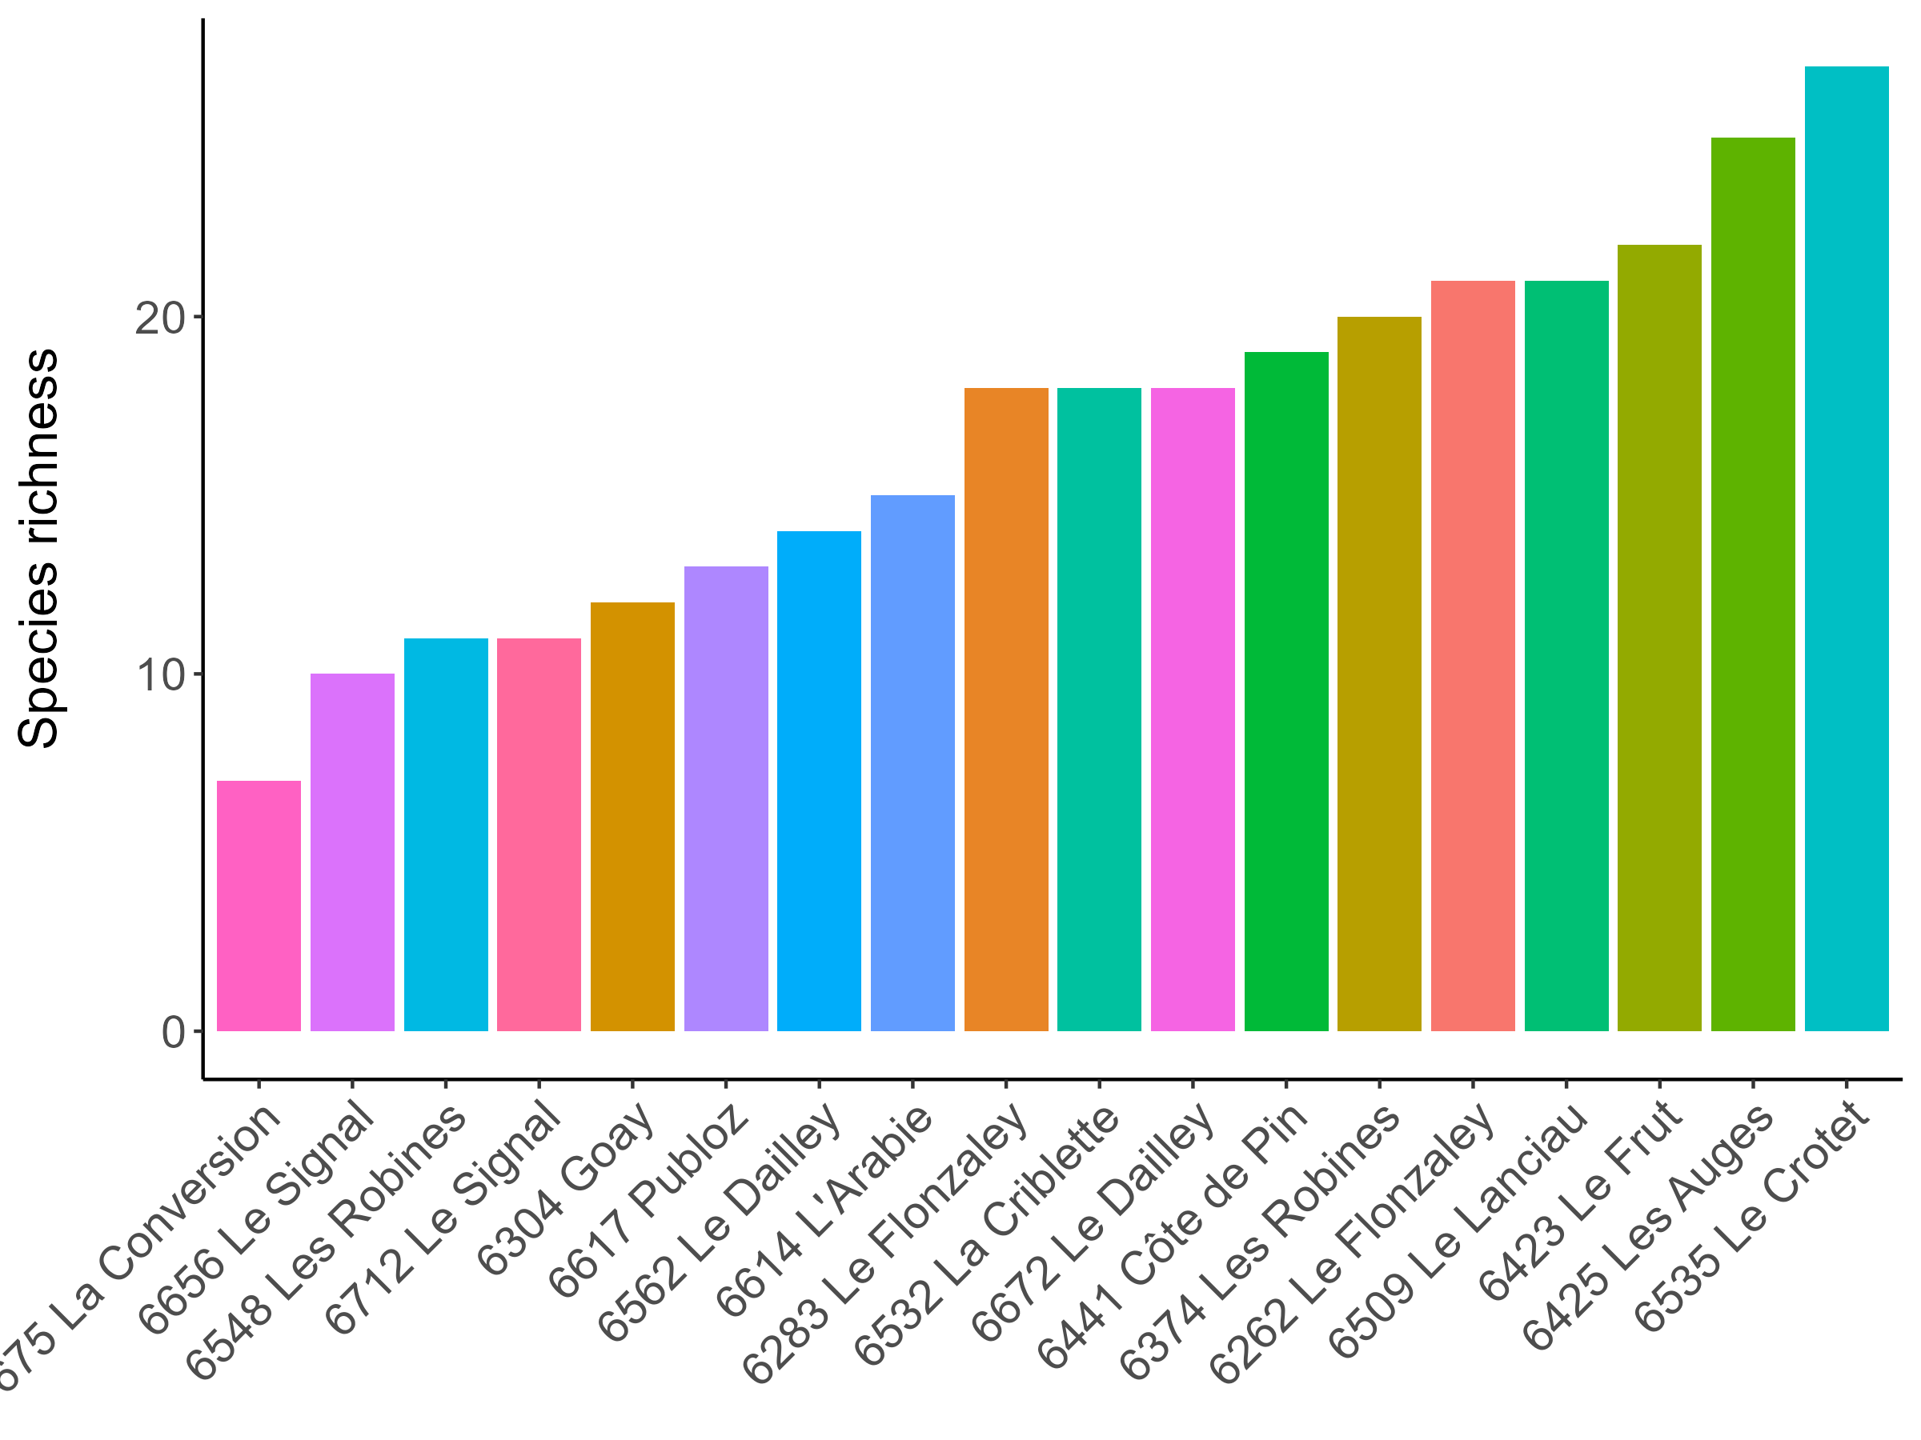
Species richness
Number of species present at a site
Range: 7 (La Conversion)
27 (Le Crotet)
Advantages:
Intuitive, easy to interpret
Only need P/A data
Disadvantages:
Ignores abundance, dominance and rarity
Doesn’t describe community assembly
Sensitive to sampling effort and area
Notes:
do some sites hold more species than others?
18 sites

Slide 3
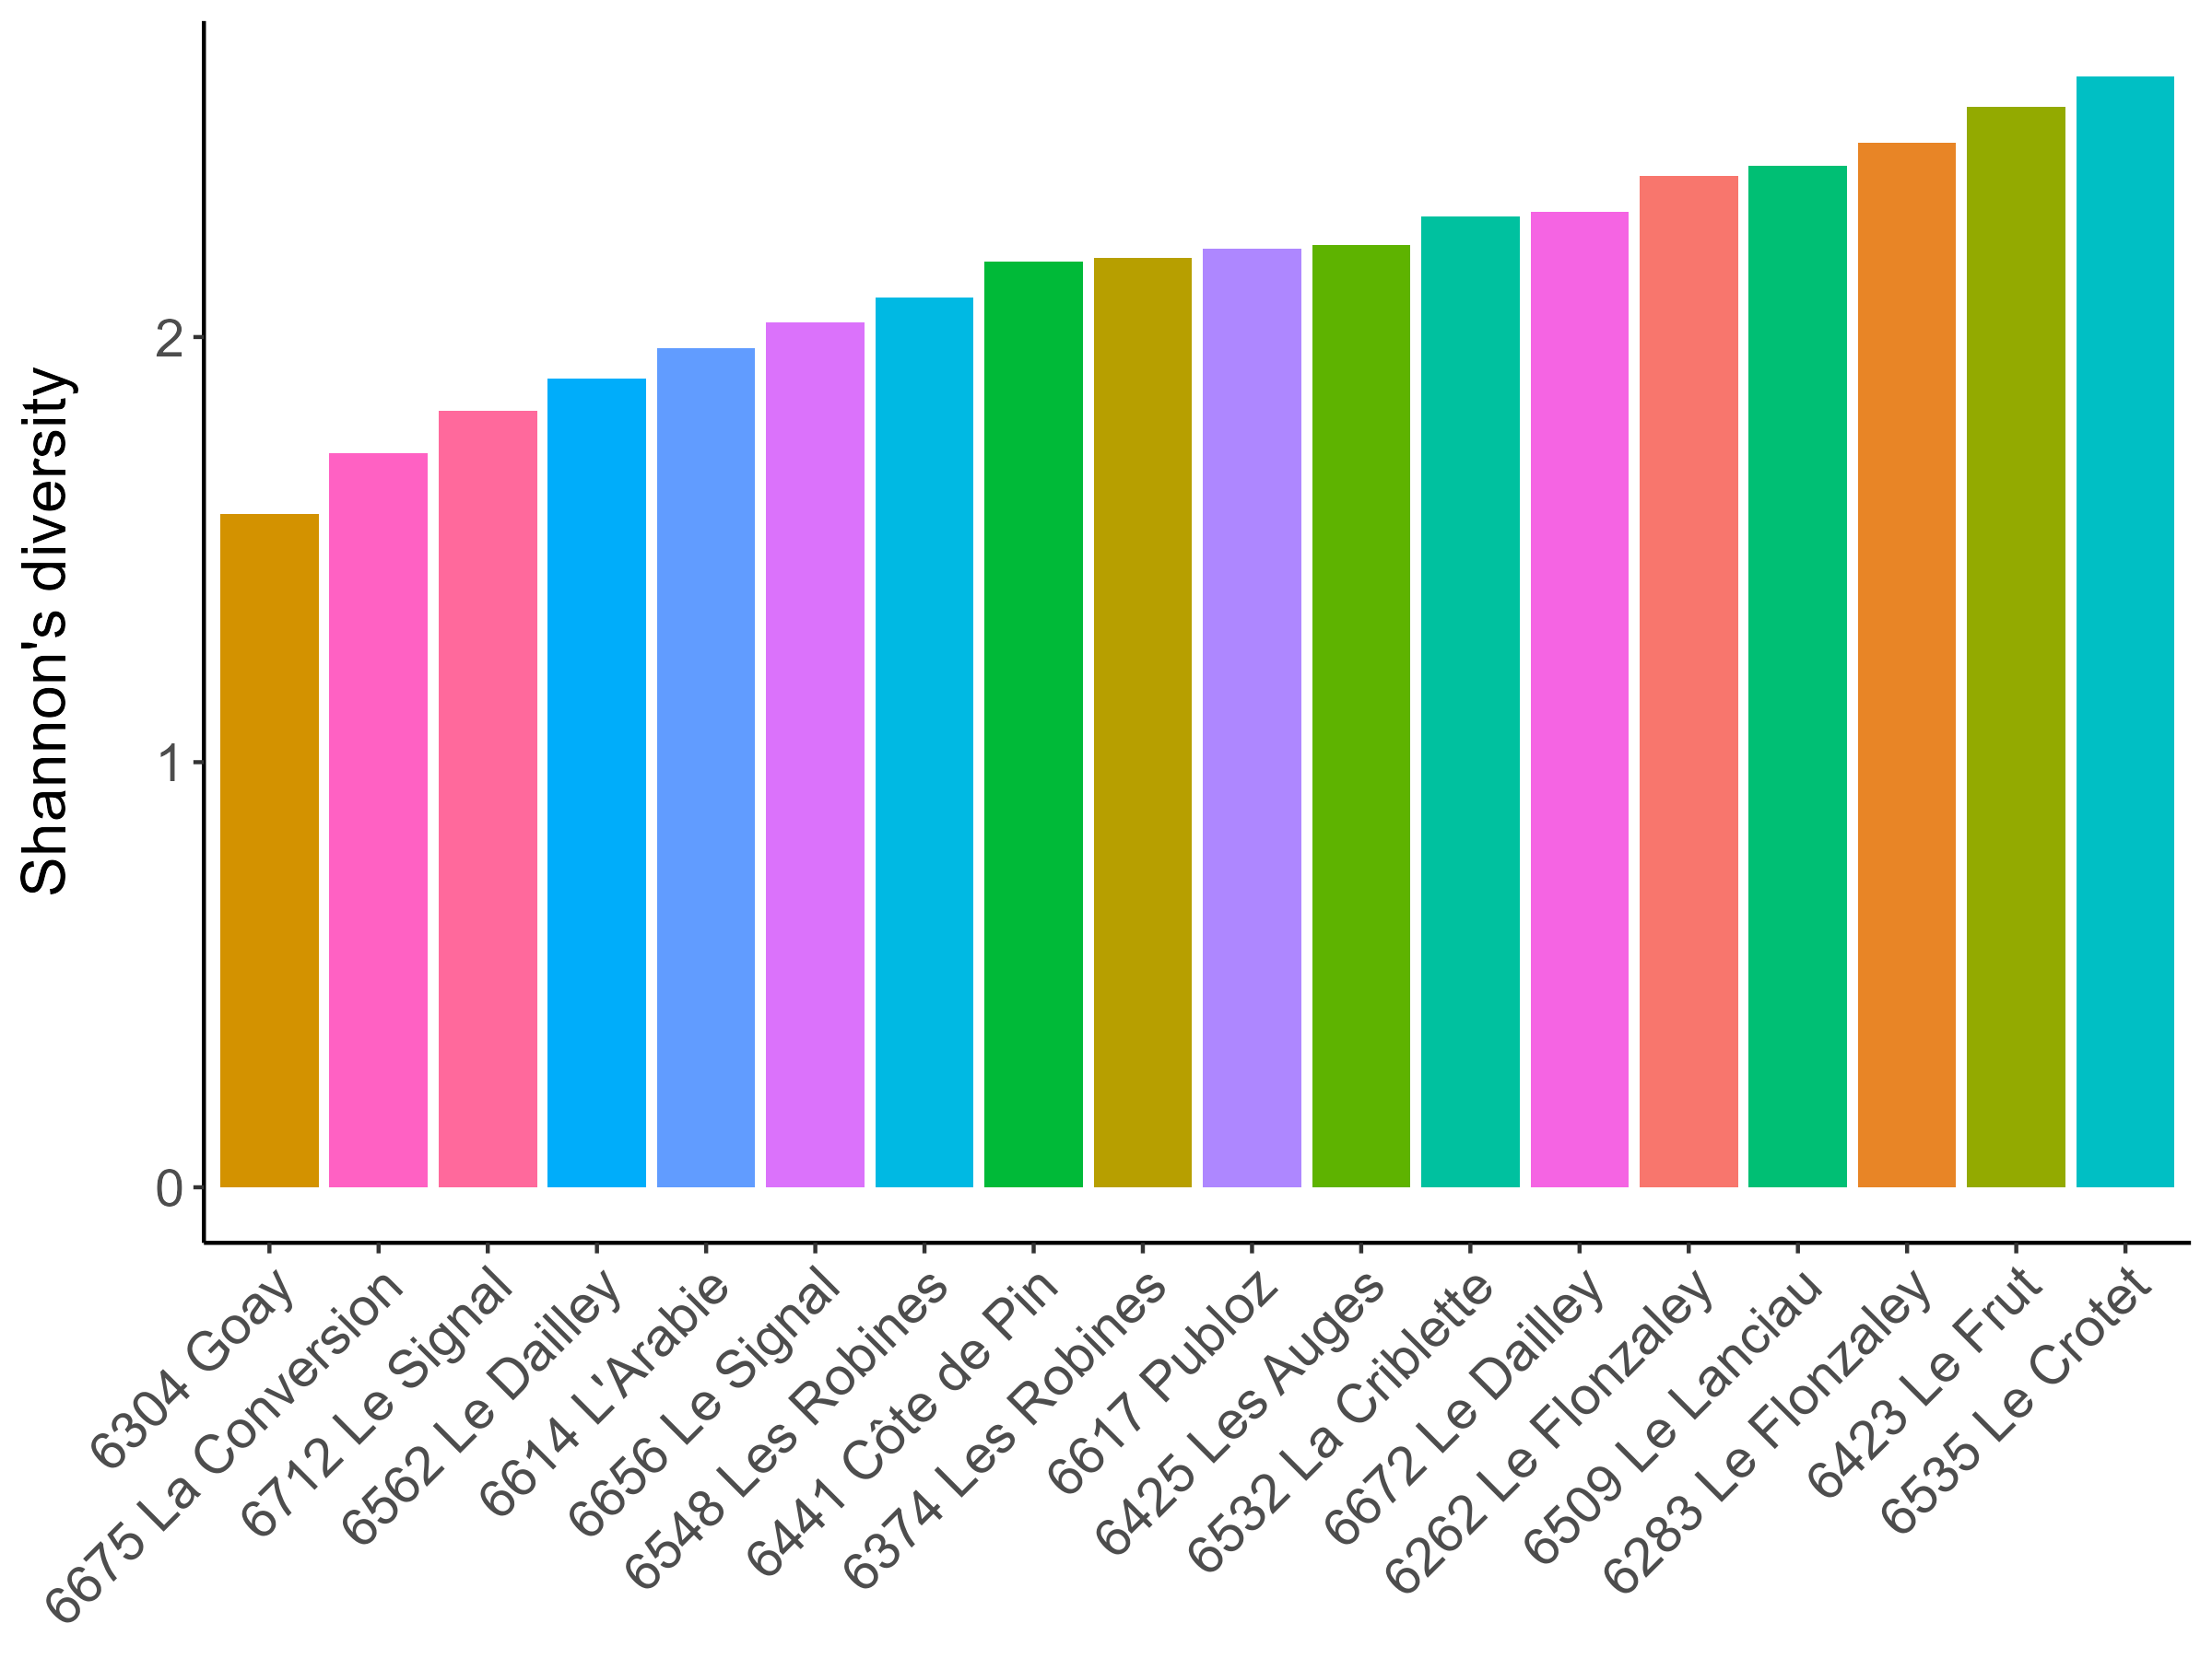
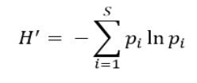
Shannon’s diversity (H')
Based on species richness & species evenness (relative abundances).
Higher when there are more species and when species are more evenly distributed
Advantages:
Incorporates richness, evenness, dominance
Less sensitive to sampling effort than richness
More ecologically meaningful
Disadvantages:
More difficult to interpret
Still ignores species identity
No universal threshold -> hard to compare, max value depends on richness at site
Notes:
accounts for both species richness (the number of species) and species evenness (the relative abundance of each species).
Higher when there are more species and when species are more evenly distributed
Mention les auges, le flonzaley, goay
elative abundance. This value is specific to each species, and indicates how common or rare a given species is relative to others. It is calculated as the number of individuals belonging to a given species divided by the number of all individuals present in the area.
Range: 0 to ln(S)
How individuals are distributed among species, how many individuals in a given species
calculated as the number of individuals belonging to a given species divided by the number of all individuals present in the area
: how common or rare a given species is relative to others
High H’ often indicates a balanced healthy ecosystem
Difs in ranking must be due to evenness
Top the same but mention: Les Auges, Le Flonzaley

Slide 4
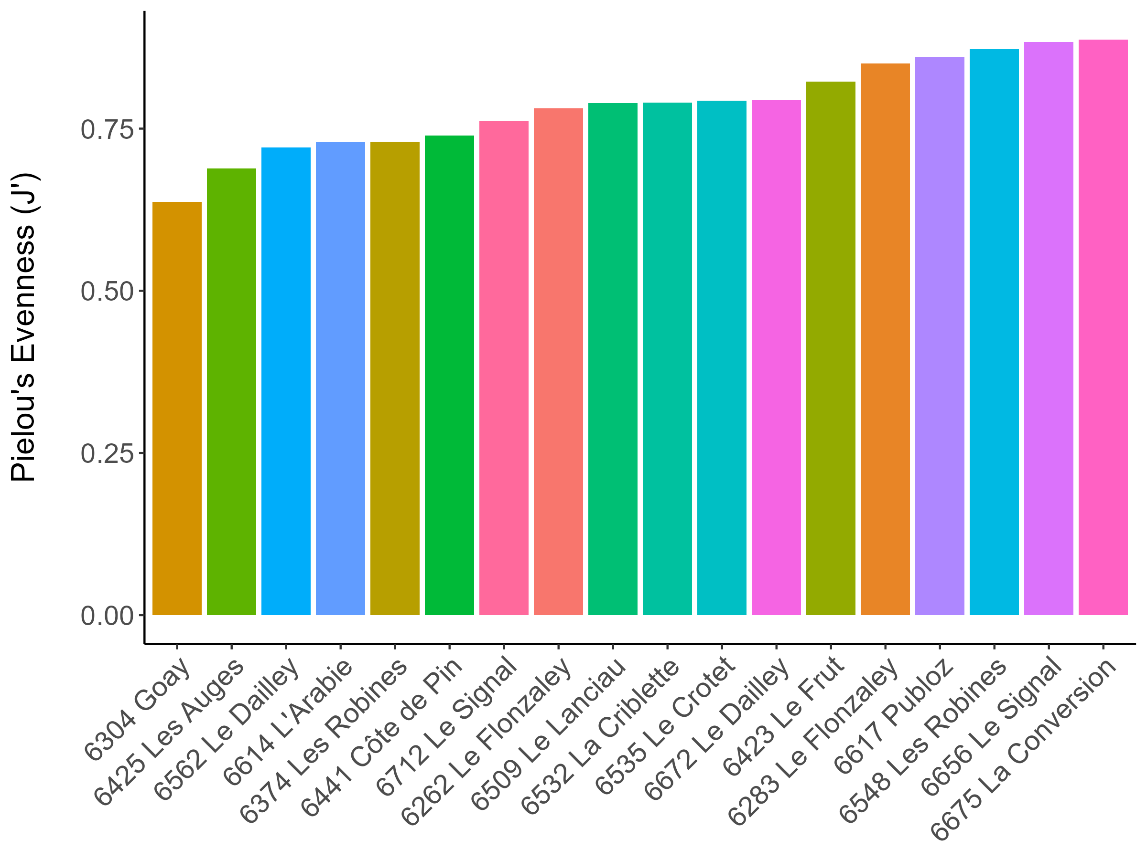
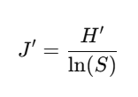
Pielou's evenness (J')
Measures how evenly individuals are distributed across species
Advantages:
Universal range: 0-1
Easy comparison
A clear indicator of one metric
Disadvantages
Ignores species identity
Sensitive to rare species
Notes:
Closer to 1 when species are equally abundant
However, H′′ does not distinguish whether a high value comes from many species or a very even distribution of few species.
Pielou’s Evenness (J′) isolates evenness from richness
It removes the effect of species richness by dividing by ln⁡(S)\ln(S)ln(S), so it purely reflects how equal species abundances are
Standardized measure bc of universal range
Do a few species dominate the community?
Communities with many rare species may appear more even than they actually are because rare species contribute to SSS without significantly affecting Shannon’s index.
hannon’s Diversity tells you about overall diversity, while Pielou’s Evenness tells you whether that diversity is balanced!

Slide 5
Notes:
Sites w few species have high evenness – but maybe bc of low possible diversity, low possible dominance

Slide 6
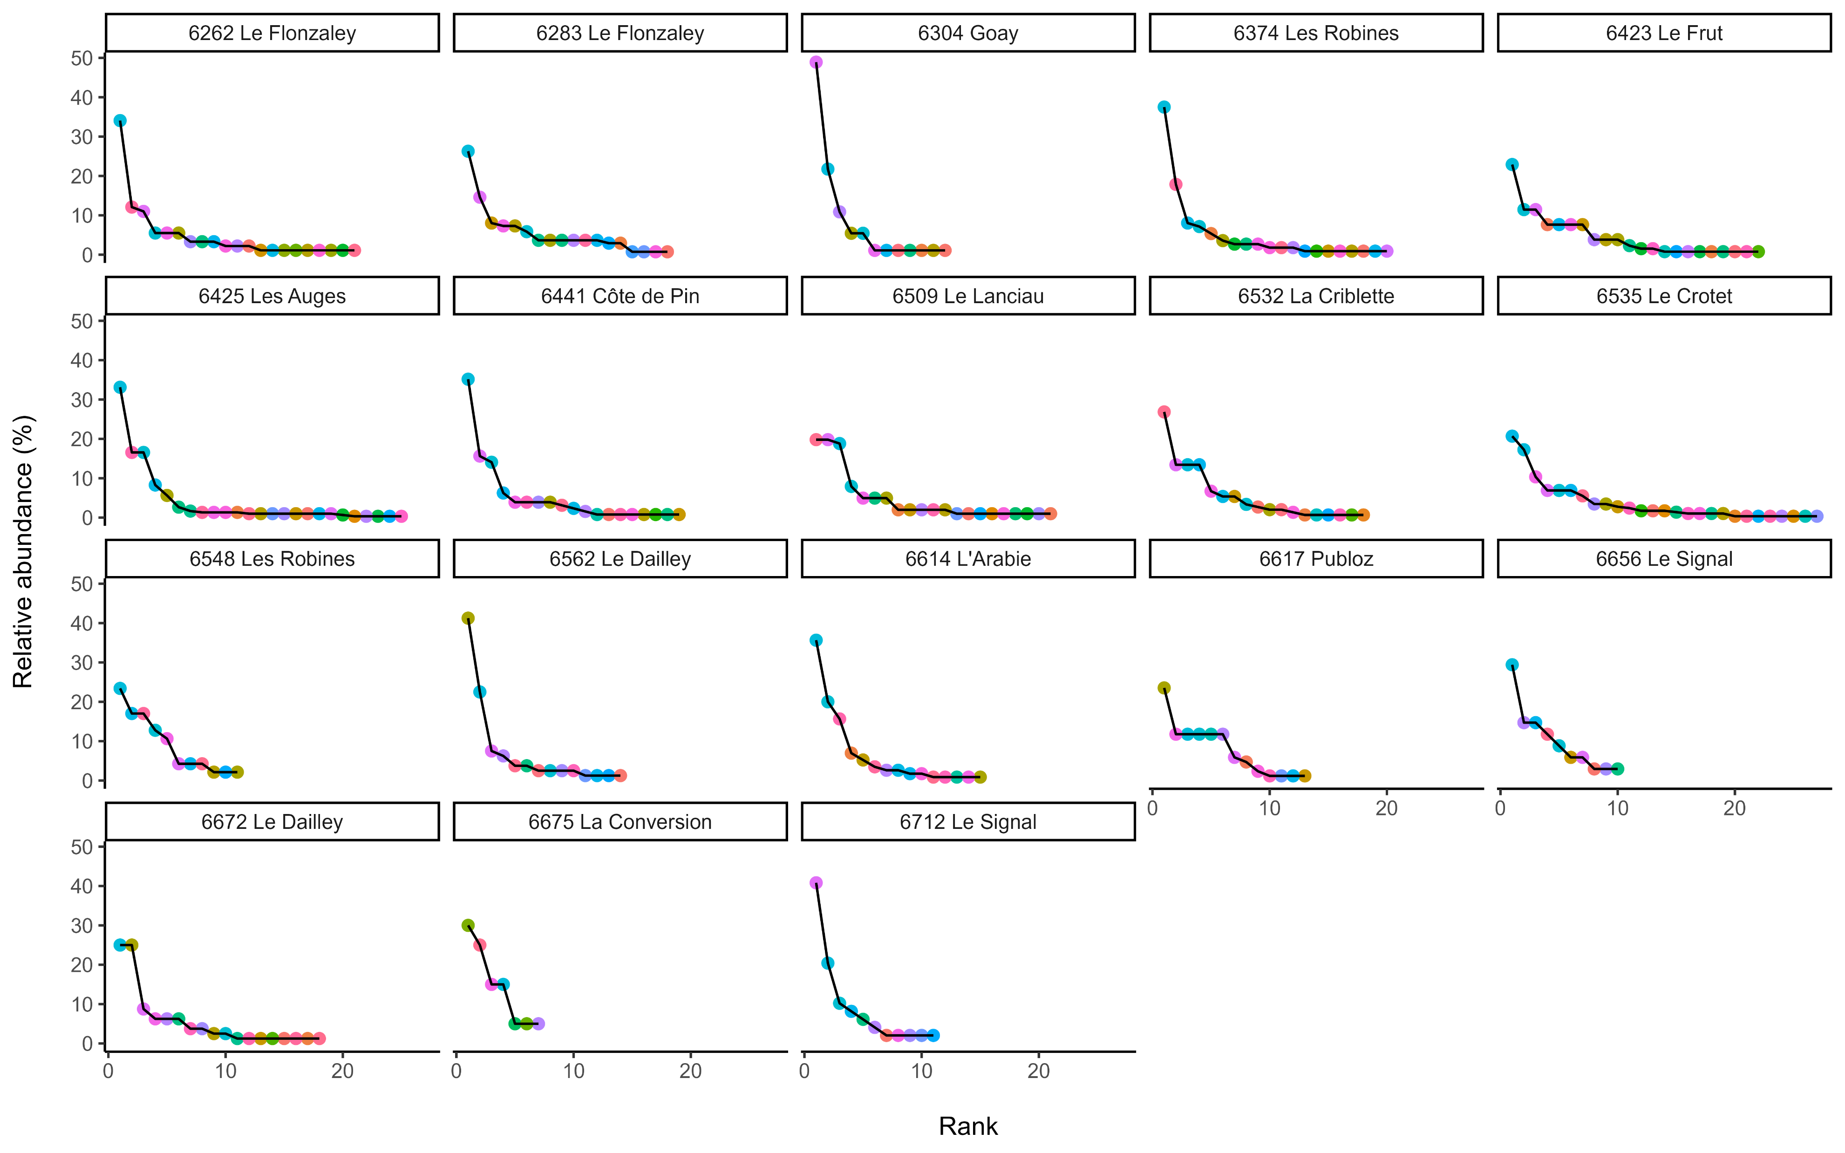
Notes:
species ranked from most to least abundant within each site. Basically, this is almost like having “Species” on the x axis, only they are already ranked by the values they take on the y axis
we have relative abundance, again, within sites - so the position of, say, the first “dot” tells us the relative abundance of the most abundant species (assigned rank 1), the second about the relative abundance of the second most abundant species, and so on. In other words, it tells us how dominant the most abundant species is in the environment.
ntuitively tell about evenness (Probably more intuitively than from the SAD graphs). It is not hard to tell that since the line connecting the dots is nearly straight in the case of Blackford and Figgate, individuals are evenly distributed among species in these parks. However, the large drop between the first and the second dot in the graphs for Craigmillar and the Meadows show that these communities are uneven, and have one highly dominant species
hey visualise evenness and commonness/rarity. Species are assigned a rank based on abundance, with most abundant ranked 1 and least abundant S (where S is the number of species in the community). Like our diversity indices, rank-abundance requires a knowledge of the relative abundance of each species. We then plot relative abundance against rank to visualise the community.
Sites with fewer species often have artificially high J′J'J′ scores, even if the dominance structure is similar to richer sites.

Slide 7
