Slide 1



A PROJECT REPORT
ON
Covid-19 Data Analysis using Machine Learning
Presented By:
ANUPAM DUTTA
BIROTTAM BISWAS
RITESH SAHA
SHUBHRANIL MAZUMDER

Slide 2

Introduction to Covid-19
On 31st December 2019, in the city of Wuhan (CHINA), a cluster of cases of pneumonia of unknown cause was reported to World Health organization. In January 2020, a previously unknown new virus was identified, subsequently named 2019 novel corona virus. WHO has declared the COVID-19 as a pandemic. A pandemic is defined as disease spread over a wide range of geographical area and that has affected high proportion of the population.

Slide 3
Problem Statement
The pandemic has already taken grip over peoples’ life. Since the start of the pandemic, some countries are facing problem of ever-increasing cases. Through the data analysis of cases one can Analyse how countries all over the world are doing in terms of controlling the pandemic. Analyzing data leads to adapt the prevention model of the countries that are doing great in terms of lowering the graph. Predictions are made with the dataset available to the individual/country/organization's, thus helping them to decide how far they are able to control the pandemic or up to how much extent they should guide preventive measures.
Through this project, a step towards helping people to understand the spread and predict the cases in their country is done. This project also gives an insight of how a country is doing in terms of limiting the spread.

Slide 4
Technology and Concept
Machine Learning
Machine learning is a field of study or process of teaching a computer to learn the fed data without being explicitly programmed. It makes computer make decisions similar to humans.
Now a days, it is actively being used in various field. E.g. Medical, Industries, Astronomy etc. The major types of Machine learning are Supervised Learning, Unsupervised Learning and Reinforcement Learning.

Slide 5
Supervised Learning
The machine learning task of learning a function that can map an input data to output data and performs analysis based on that input-output pair.
Unsupervised Learning
A type of machine learning that draw an inference from dataset consisting of input data without labelled responses. One of the common unsupervised learning methods called cluster analysis, is used find the hidden pattern or grouping of data.
Reinforcement Learning
A type of machine learning that is bound to learn from experiences. There is no training dataset provided *(such methods work in the absence of datasets). An agent in Reinforcement learning that rewards or penalize for actions done by the algorithm. The task is to find the best possible path to reach the goal.

Slide 6
Some important terms
Data frame
Pandas Data frame is 2D, mutable and heterogeneous tabular data structure with labelled axes. Data frame can be made of more than one series (series can only contain single list with index).
Hypothesis
In Machine learning, Hypothesis is a model that is used to approximate the target function and performs mapping of input with output.
Regression
Regression in Machine Learning is about predicting the continuous value-based learning gained by dataset. The correctness of the output can depend on the size of dataset, features, hypothesis used etc.
Classification
The problem of identifying that in which sub-population a new example/observation belongs to, on the basis of learning obtained through training set containing observations along with the category they belong to.

Slide 7
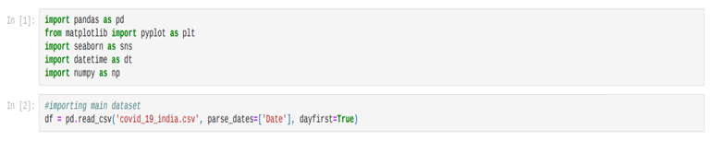
Dataset Pre-processing

Slide 8
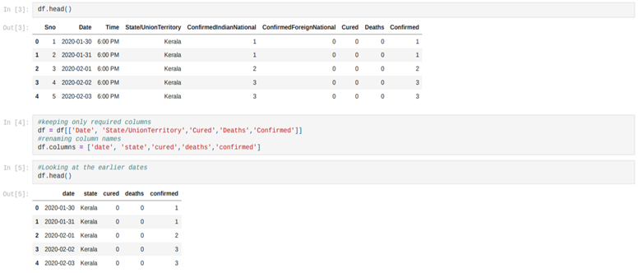
Prediction and Forecasting for India
Confirmed Cases (INDIA)

Slide 9
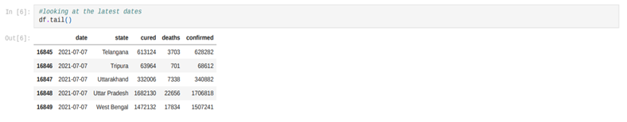

Slide 10
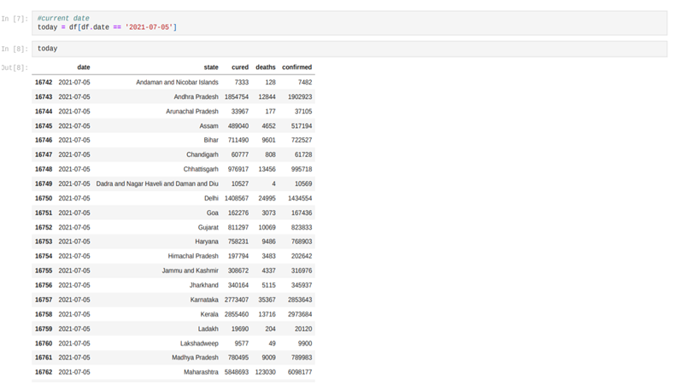

Slide 11
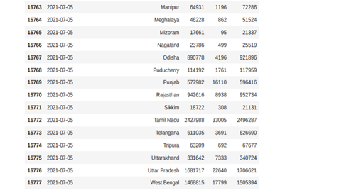

Slide 12
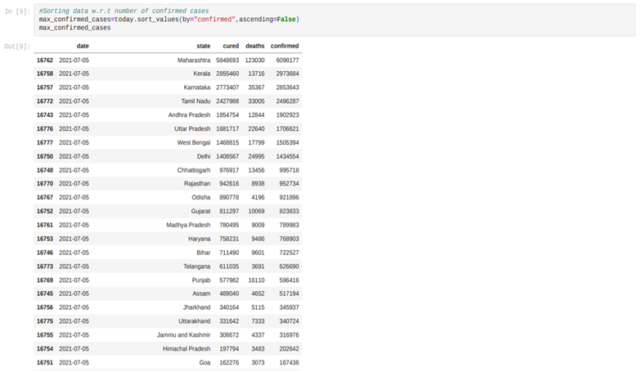

Slide 13
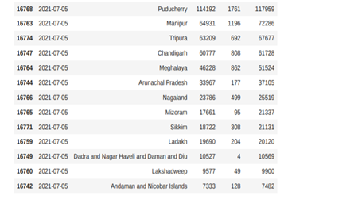

Slide 14
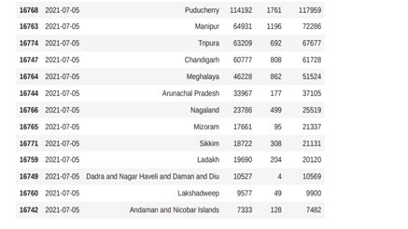

Slide 15
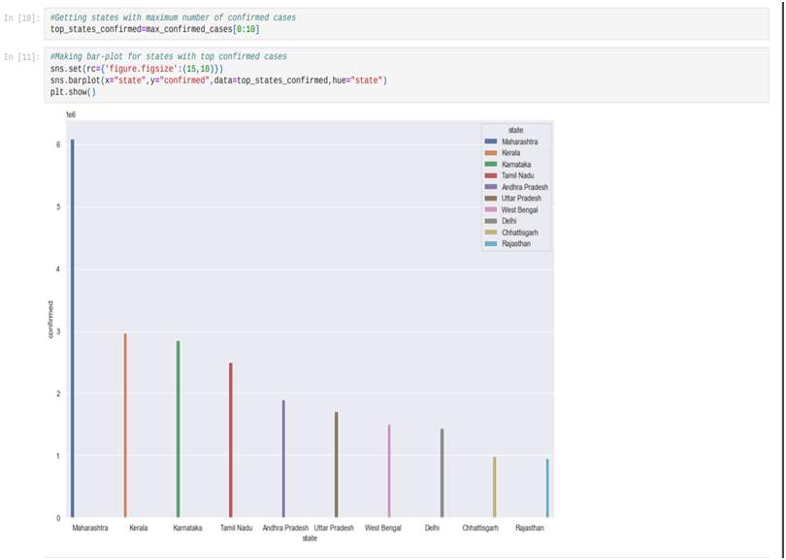

Slide 16
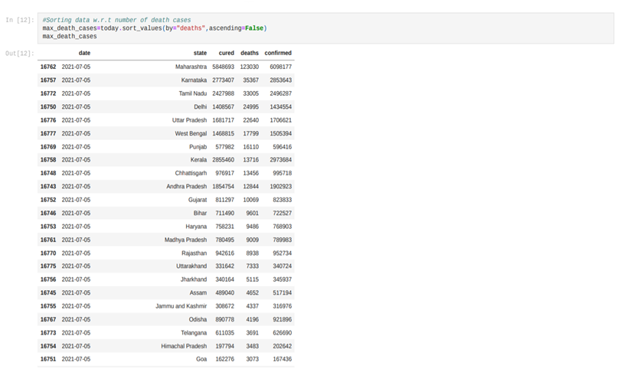
Death Cases (INDIA)

Slide 17


Slide 18
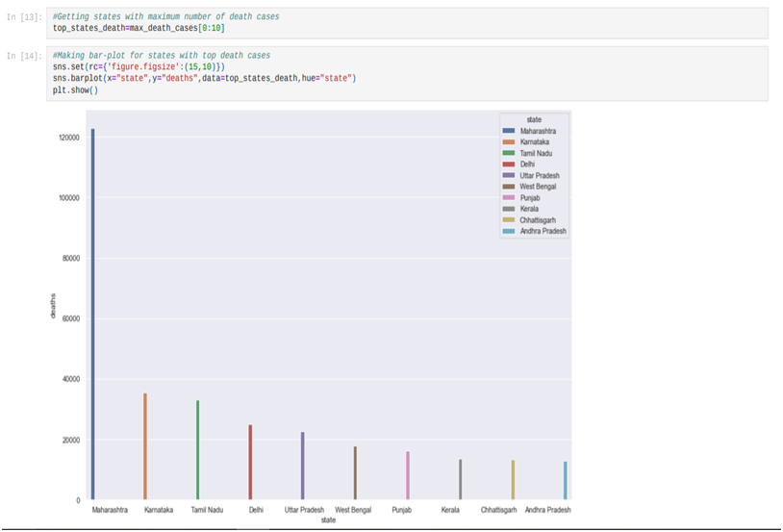

Slide 19
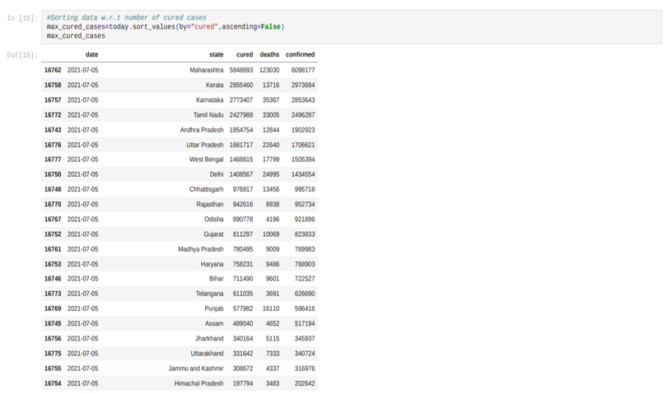
Recovered Cases (INDIA)

Slide 20
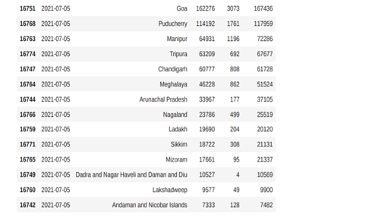

Slide 21
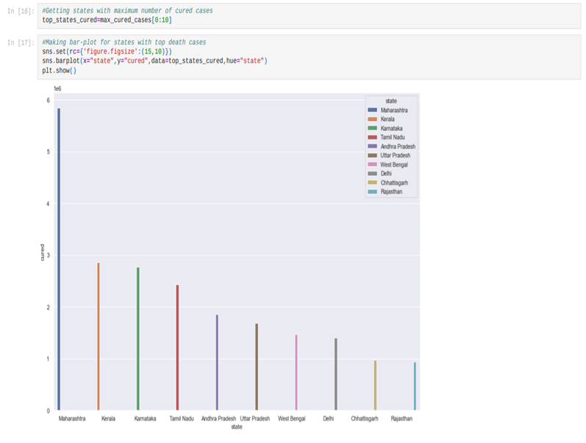

Slide 22
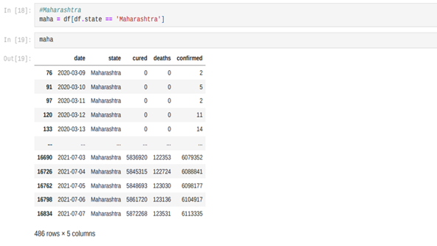

Slide 23
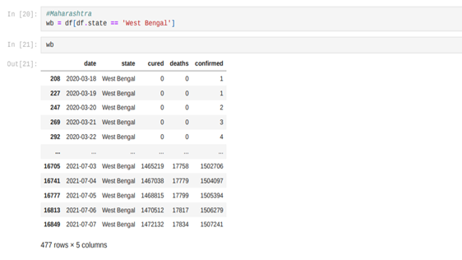

Slide 24
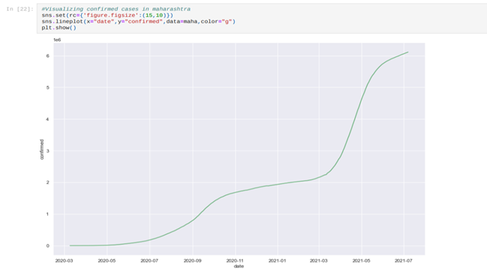

Slide 25
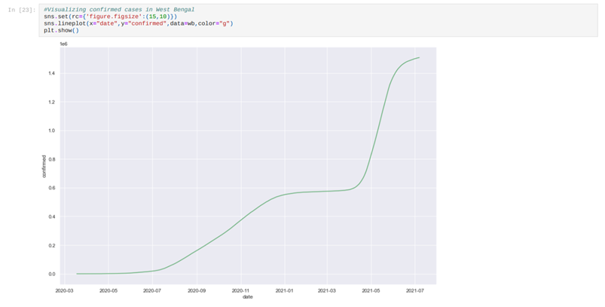

Slide 26
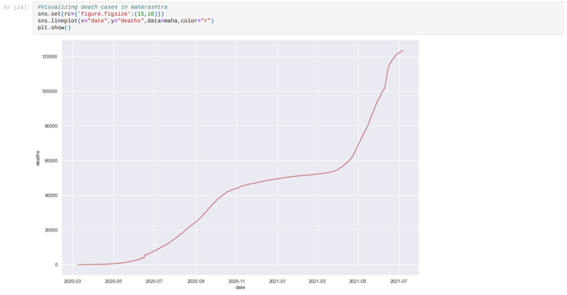

Slide 27
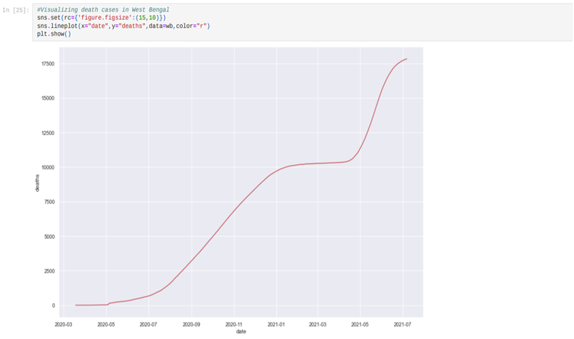

Slide 28
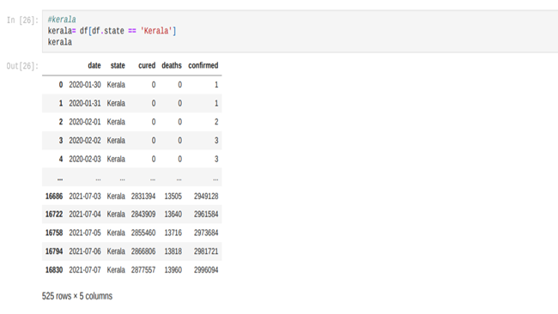

Slide 29
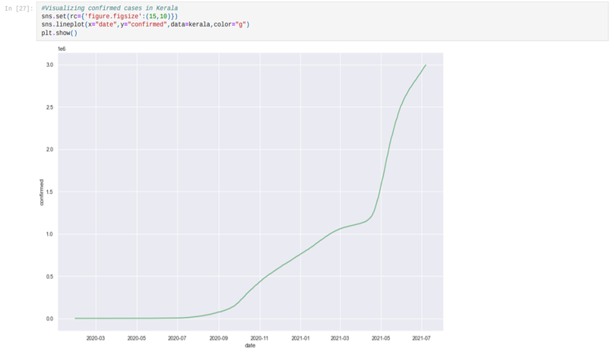

Slide 30
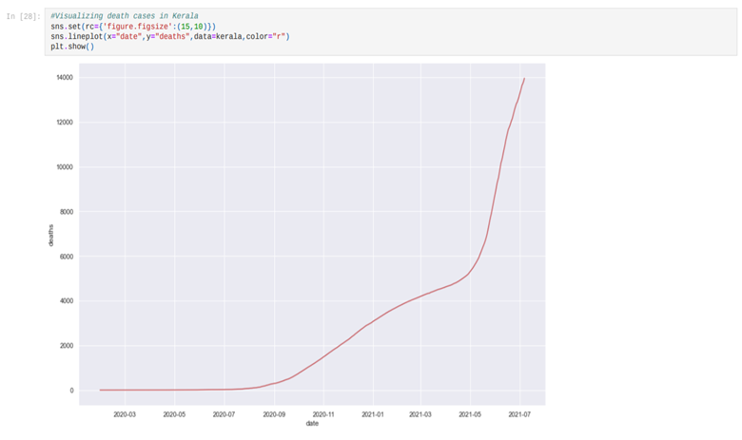

Slide 31
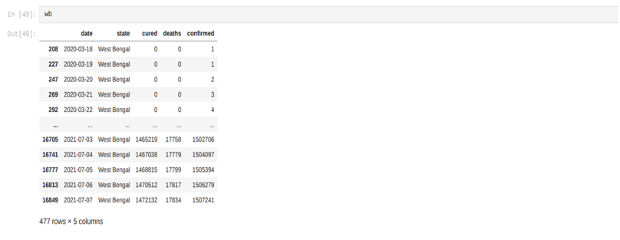
ALL Cases (West Bengal)

Slide 32
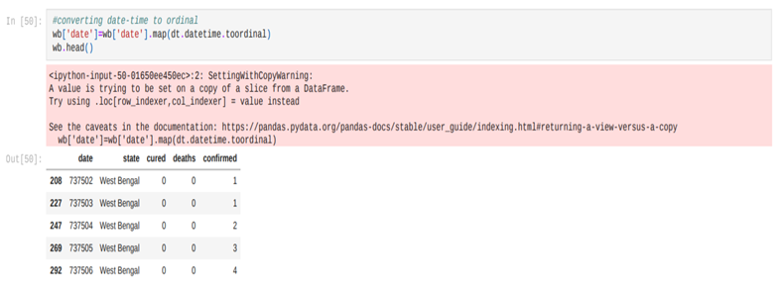

Slide 33
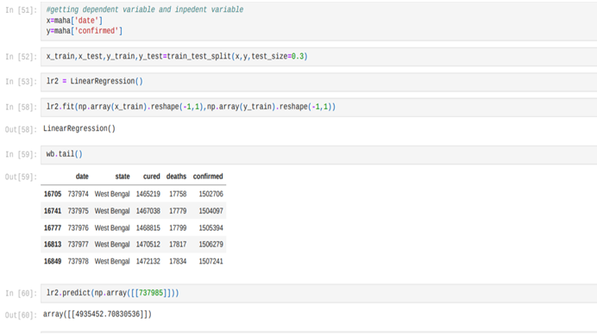

Slide 34
Accuracy Check
R2 Score: R-squared values range from 0 to 1 and are commonly stated as percentages from 0% to 100%. An R-squared of 100% means that all movements of a security (or another dependent variable) are completely explained by movements in the index (or the independent variable(s) you are interested in).
Mean Square Error: In statistics, the mean squared error or mean squared deviation of an estimator measures the average of the squares of the errors—that is, the average squared difference between the estimated values and the actual value. MSE is a risk function, corresponding to the expected value of the squared error loss
Mean Absolute Error: In statistics, mean absolute error is a measure of errors between paired observations expressing the same phenomenon. Examples of Y versus X include comparisons of predicted versus observed, subsequent time versus initial time, and one technique of measurement versus an alternative technique of measurement.

Slide 35
On prediction of cases around world
 | R2 score | Mean square | Mean absolute
Confirmed | 0.9999772750477183 | 43988753.26062069 | 4776.939775171555
Active | 0.999955817645072 | 32950433.474696837 | 4229.980832226832
Recovered | 0.9997722347863156 | 43611232.23497777 | 603.0377561268665
Deaths | 0.999925570048949 | 724820.3995915962 | 3814.2269851803526

Slide 36
On prediction of cases in INDIA
 | R2 score | Mean square | Mean absolute
Confirmed | 0.993311900403622 | 2704197.579317428 | 861.7053695219906
Active | 0.9960804198909399 | 695454.5901662812 | 442.7155239532528
Recovered | 0.9826537818355147 | 673471.1660193523 | 425.5148015583853
Deaths | 0.994769823876583 | 2291.2709680931116 | 26.071559835315867

Slide 37
THANK YOU

