Slide 1
Oracle Parse
Just ask the Oracle!
Priests Of The Oracle: Brandon King & Omar Rehmane
The problem
Web scraping is hard. Pulling data off the web in a meaningful fashion is difficult to do, especially in a world with extremely ill-formatted/outright broken HTML.
Though HTML is technically an AST, the data within is not, which is what makes the problem so hard.

Slide 2
Domain Analysis
We propose to write a smart web scraper, one that can deal with the pitfalls on the Net today, and doesn’t require any onerous hacking and special-casing for each target page.
State of the art is a Python library called Scrapy, which has some cool features, but requires a good deal of code to get running. It also doesn’t support scraping by example, which is one feature we feel is both doable and needed.

Slide 3
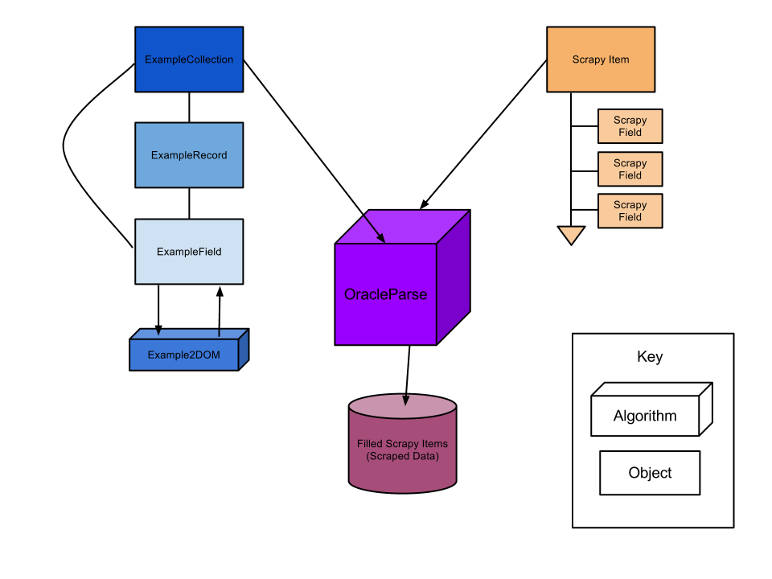
Language Constructs
Our library, Oracle Parse, is made up of Examples and Oracle objects. Examples comprise examples of each category of data on the page, and the Oracle does the parsing and the finding.
Scraping the iTunes Top 100
from oracleparse import example
from oracleparse import oracle
record = example.ExampleRecord()
record.add_field('song-title', 'Call Me Maybe')
record.add_field('artist', 'Gotye')
sybil = oracle.Oracle(record, 'http://www.apple.com/itunes/charts/songs/')
print sybil.parse()

Slide 4
record = example.ExampleRecord([])
record.add_field('City', 'Seattle Al-Anon')
record.add_field('Day', 'Sun')
record.add_field('Time', '8:30 AM')
record.add_field('Location', """4101 15th Ave NE
UW School of Social Work
Entrance corner of 41st and 15th - take elevator to 3rd
Room 305 second on left.""")
record.add_field('Meeting Name', 'Sunday AM Fresh Start AFG (Open)')
record.add_field('District', '20')
sybil = oracle.Oracle(record, 'http://www.wa-al-anon.org/Meeting-Seattle-All.html')
data = sybil.parse()
pp = pprint.PrettyPrinter(indent=4)
pp.pprint(data)

Slide 5
Implementation
The Oracle object downloads the HTML of target URL and turns it into a DOM (using LXML and Beautiful Soup, two Python libraries).
Using the provided examples, it determines a generic XPath for each field. It also disambiguates XPaths if they collide, and maintains the proper level of generalness for each one.
OP then populates a list of dictionaries with field names as keys, and scraped data as values.

Slide 6
What you are proud of
The user is capable of scraping an entire site’s worth of data from providing just a few examples!
Mistakes
As it stands right now, we need to clean up the distinctions between each type of Example object – it’s not really clear what each does and why it’s needed. (Brandon claims it’s for future logical inferences, but I didn’t know what that meant either)
What we would do differently
Spend more time on it! If we could do this again, we’d love to devote two weeks (or a summer) to Oracle Parse and nothing else.

Slide 7
You have only 6 slides.
No font smaller than 28 points, please.
No crz acrnyms n odr trix

