Slide 1
https://www.youtube.com/watch?v=jR35JKq5rmc&list=WL&index=2

Slide 2
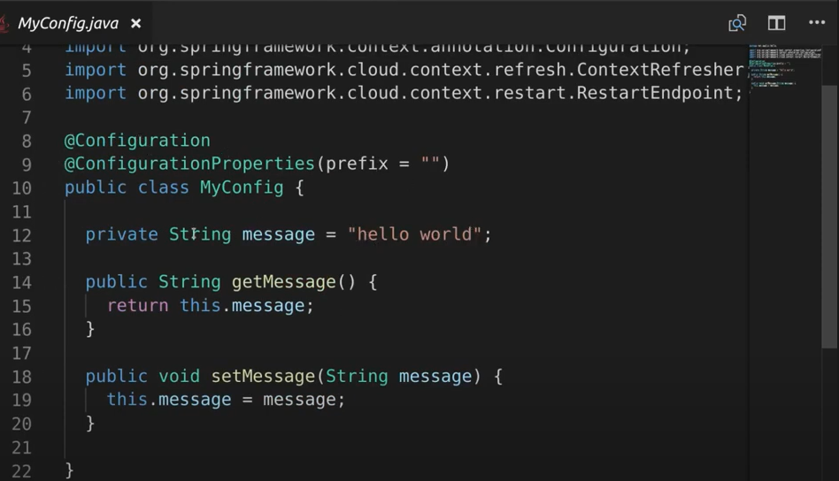
預設 message. 注意這個 class 有 Cinfiguratoin 的 annotation.

Slide 3
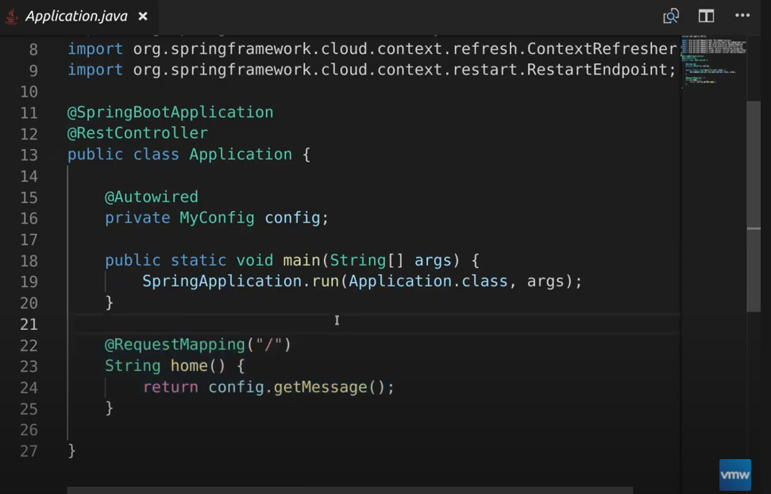
主程式

Slide 4
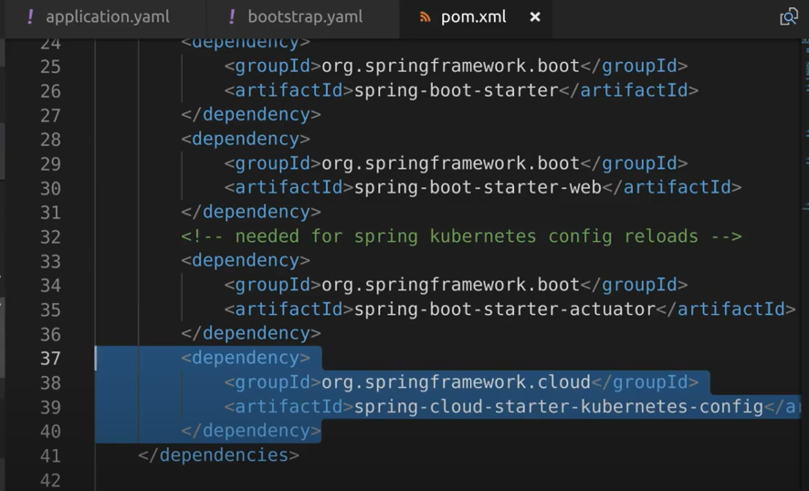
安裝必要套件

Slide 5
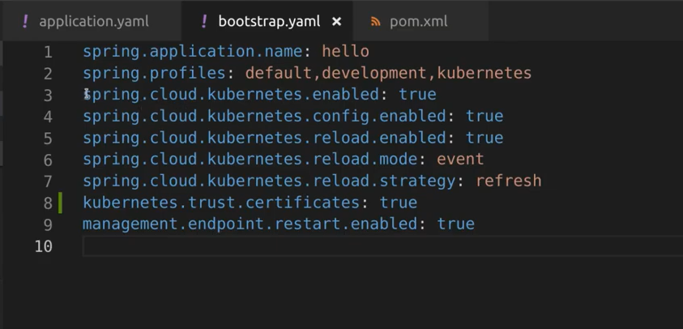
Bootstrap 設定 configMap 重載的策略 refresh ..

Slide 6
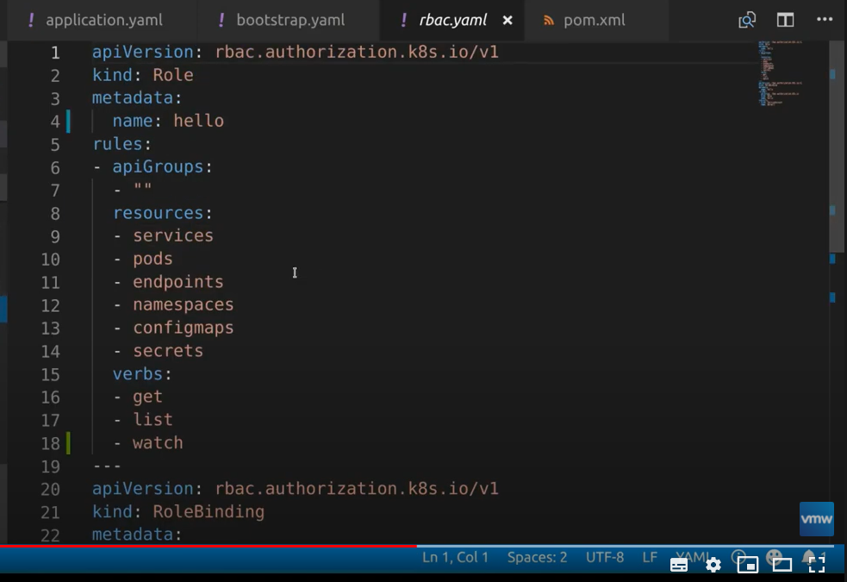
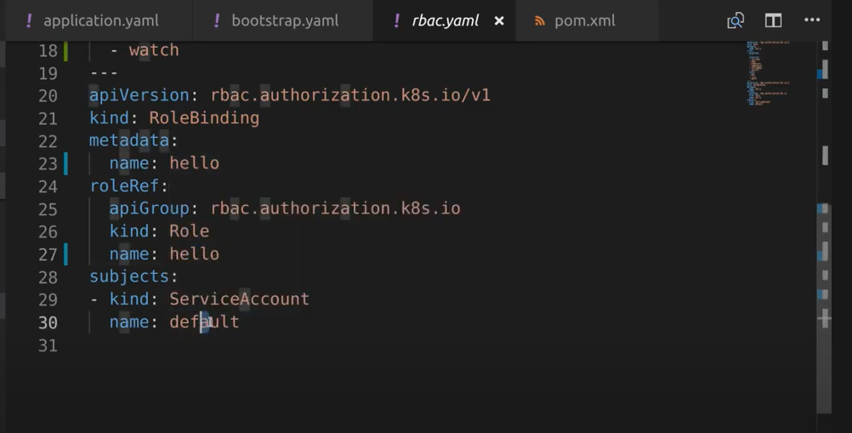
運行的必要資源

Slide 7
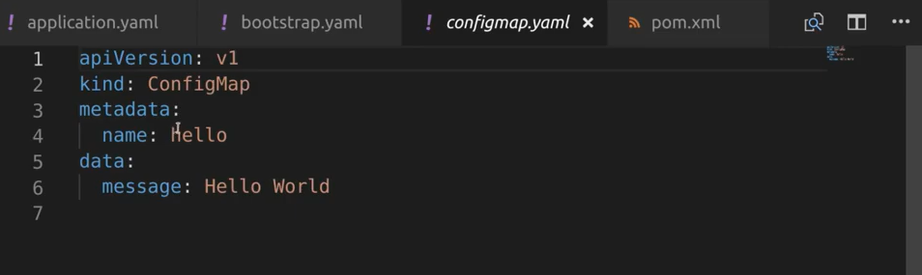
設定 ConfigMap yaml
Key / value
message / Hello World

Slide 8
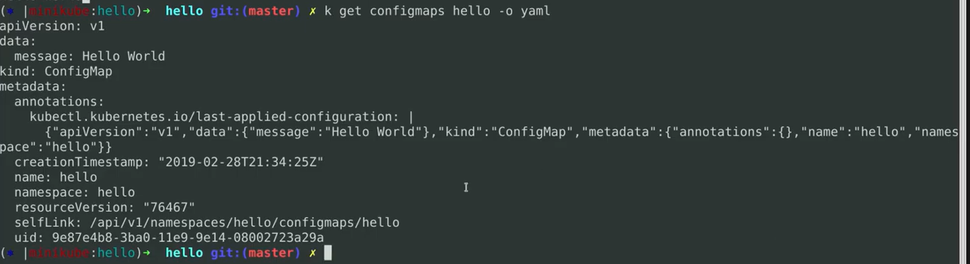
服務重啟 ，因為開啟動了 configmap 的設定，會用 ConfigMap 的值
取得 configMap 的設定
$ get configmaps hello -o yaml

Slide 9
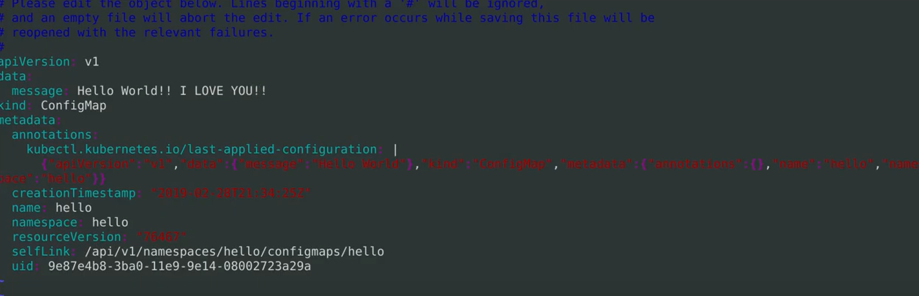
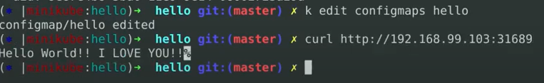
Online 修改 configmaps
儲存後馬上就會反應

Slide 10
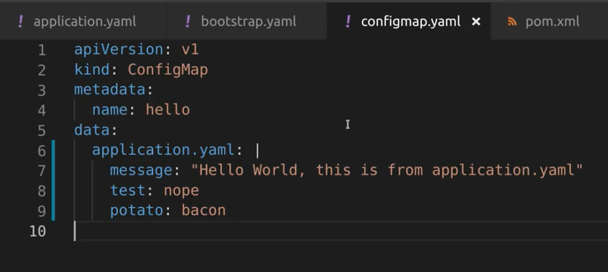
configMap 可以不僅指定 key/value
重新編輯 ConfigMap.yaml
重新載入

Slide 11
App 會 output 以下: 把它視為 yaml file 非單純的 key value

Slide 12
# 取得目前 configmaps
jerry@ubuntu:~$ kubectl get configmaps
NAME DATA AGE
game-config 2 3s
# 建立 configMap
$kubectl create configmap <map-name> <data-source>
$kubectl create configmap game-config --from-file=configure-pod-container/configmap/
$ kubectl create configmap hello --from-literal=message="HELLO KUBERNETES"

Slide 13
jerry@ubuntu:~/configServer$ kubectl describe configMap hello
Name: hello
Namespace: default
Labels: <none>
Annotations: <none>
Data
====
message:
----
HELLO KUBERNETES
Events: <none>

Slide 14
jerry@ubuntu:~/configServer$ kubectl get configmaps hello -o yaml
apiVersion: v1
data:
message: HELLO KUBERNETES
kind: ConfigMap
metadata:
creationTimestamp: "2021-02-27T08:20:13Z"
managedFields:
- apiVersion: v1
fieldsType: FieldsV1
fieldsV1:
f:data:
.: {}
f:message: {}
manager: kubectl
operation: Update
time: "2021-02-27T08:20:13Z"
name: hello
namespace: default
resourceVersion: "24672370"
selfLink: /api/v1/namespaces/default/configmaps/hello
uid: e3cf65cb-7680-481c-860f-7cfbdd8e5d68

Slide 15

DEMO
運行 service
kubectl apply -f deploymentWithService.yaml
發 api
curl http://localhost:32018
建立 configMap
kubectl create -f configmaps_hello.yaml
kubectl create configmap hello --from-literal=message="HELLO KUBERNETES“
kubectl create configmap game-config --from-file=configure-pod-container/configmap/
顯示 configMap
kubectl get configmaps
kubectl describe configmaps hello
發 api
for i in {1..50} ; do curl http://localhost:32018 ; sleep 2 ; done
刪除 configMap
kubectl delete configmaps hello
編輯 ConfigMap
kubectl edit configmaps hello (online)
Revise configmaps_hello.yaml && $ kubectl replace –f configmaps_hello.yaml
發 api
curl http://localhost:32018
Notes:
refresh (default): only configuration beans annotated with @ConfigurationProperties or @RefreshScope are reloaded. This reload level leverages the refresh feature of Spring Cloud Context.
如果 service 起來沒吃到 configMap 會用程式的預設值，但之後 confiMap 再加程式也不會有反應) 必須要重新啟動 Pod 才行
kubectl delete -f deploymentWithService.yaml && kubectl apply -f deploymentWithService.yaml

Slide 16
sudo docker build -t kingbike/spring-hello .
sudo docker push kingbike/spring-hello:latest

