Slide 1
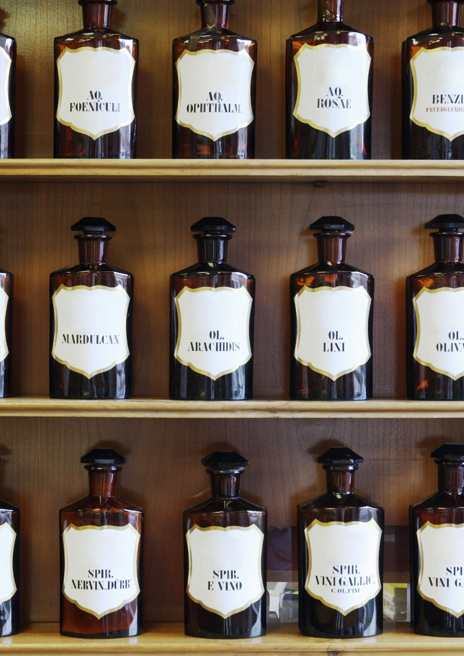
Bacchus Winery Case Study & Database Solutions
Wine About It Group
William Stearns & Colby King
Csd-310 Milestone project
May 2025

Slide 2

Bacchus Wine
Bacchus Wine is a family-run company known for growing premium grapes and crafting four varieties of fine wine. Recently, brothers Stan and Davis Bacchus have taken over operations following their father’s retirement. Eager to honor and expand their father's legacy, they are seeking more advanced technological solutions to modernize their business. Their priorities include improving product and supply inventory management, ensuring reliable delivery from vendors, tracking wine sales by type and distributor, and monitoring employee hours more effectively.

Slide 3
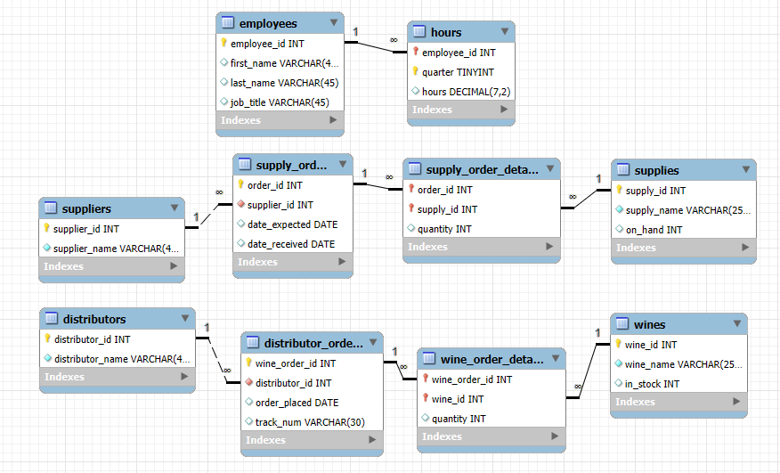

Entity-Relationship Diagram
Notes:
The Entity Relationship Diagram evolved over several iterations throughout the project—even after the initial database structure was implemented. One key improvement involved refining junction tables by removing redundant surrogate primary keys and instead relying on the unique combination of two foreign keys to serve as composite primary keys. This simplified design choice not only adhered to best normalization practices but also helped reduce unnecessary complexity. While the model could certainly be expanded with additional attributes, the focus was on creating a clean, efficient schema that captured all essential business data in a structured, normalized format.

Slide 4
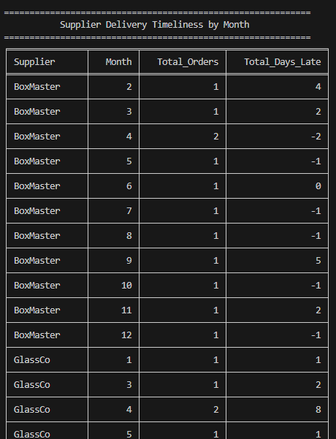
Supplier Delivery Timeliness by Month
This report analyzes the reliability of each supplier by calculating how many days late their deliveries were, aggregated by month. It groups orders by supplier and month, then totals the number of supply orders along with the cumulative number of days they were received after the expected date. This helps Bacchus Winery identify which suppliers are consistently meeting deadlines and which may be causing delays in production.

Slide 5
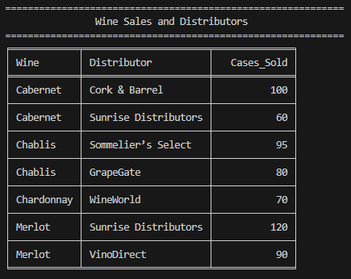
Wine Sales and Distributors
This report summarizes total wine sales by distributor, showing how many cases of each wine were sold through each partner. It allows the company to assess distributor performance and demand trends for specific wines. The data is grouped by wine and distributor and sorted to highlight the top-selling combinations, supporting both sales strategy and inventory planning.

Slide 6
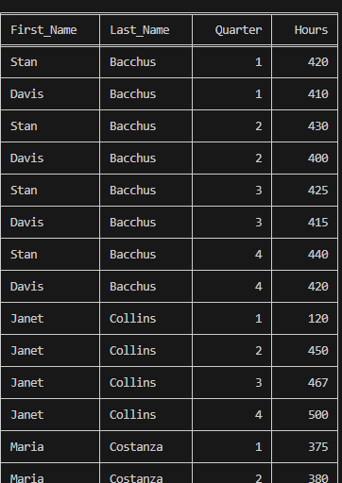
Employee Hours By Quarter
This report tracks the total number of hours worked by each employee, grouped by calendar quarter. It provides insight into workforce activity and productivity over time, helping Bacchus Winery evaluate labor needs, identify seasonal trends, and ensure efficient staffing throughout the year.
Notes:
Though there were additional production employees mentioned in the study, for the sake of time only the named managerial/administrative employees were included.

