Slide 1
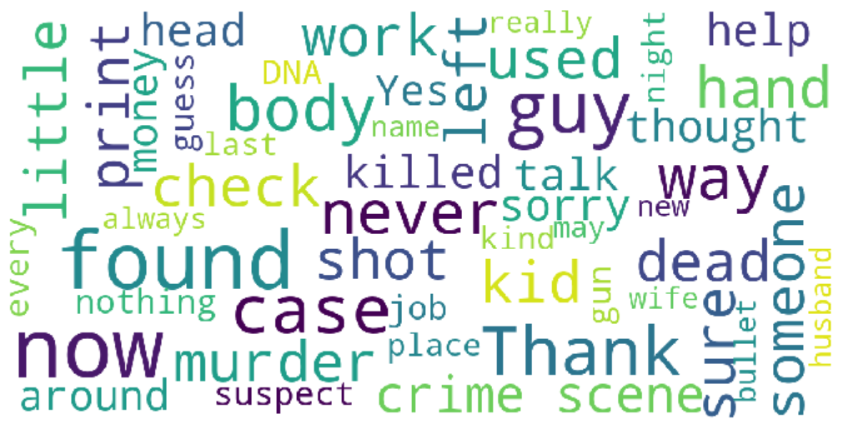
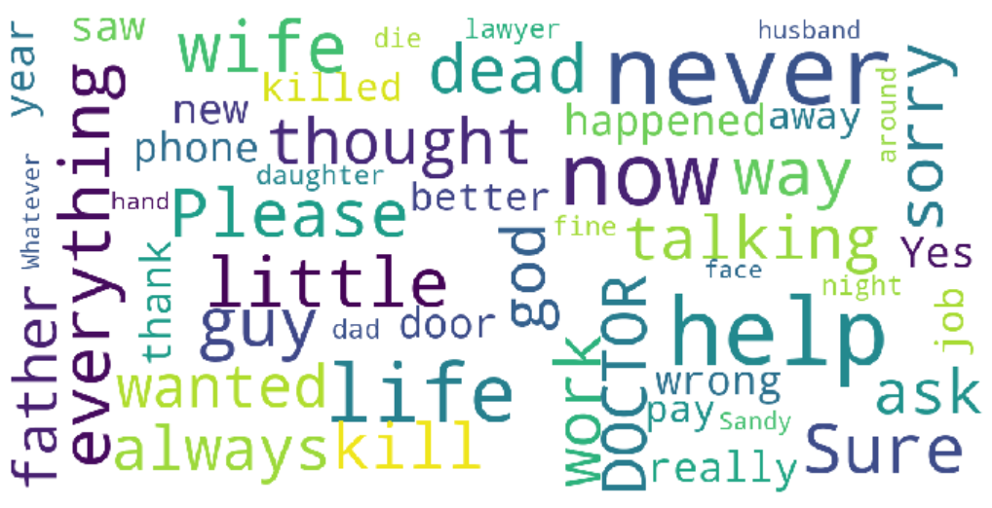
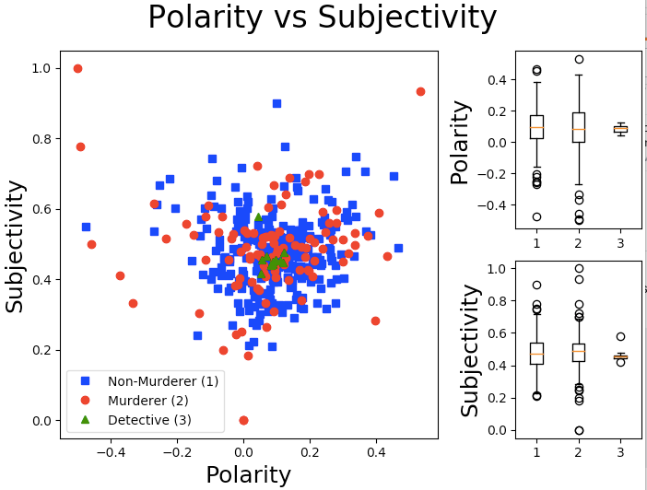
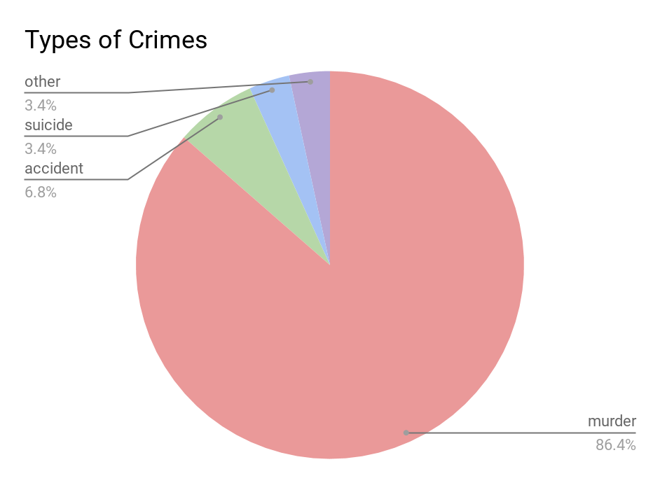
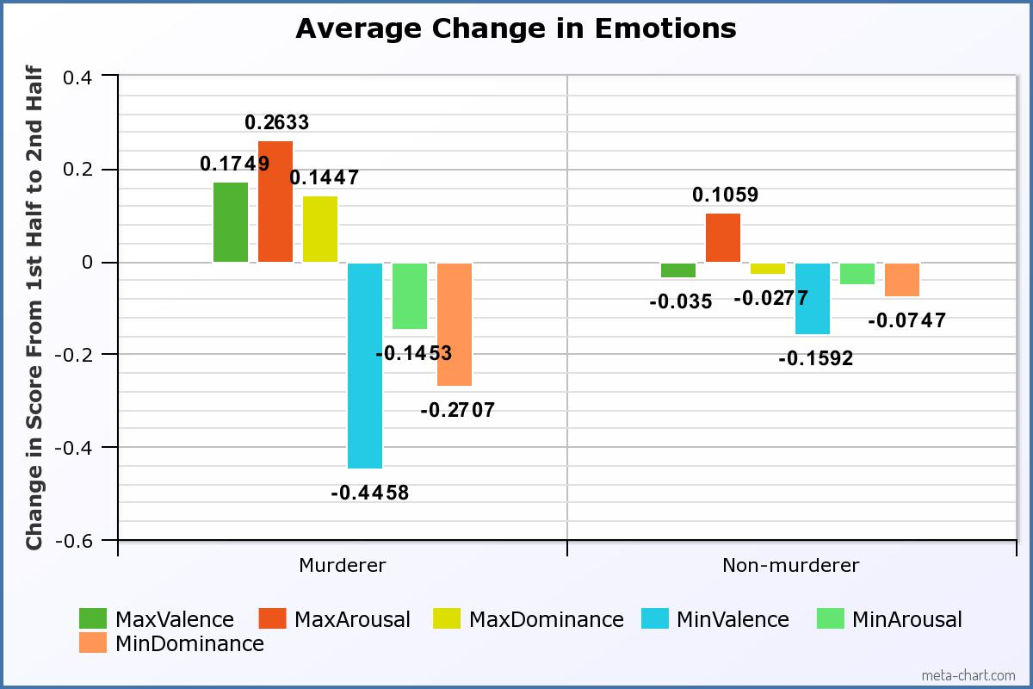
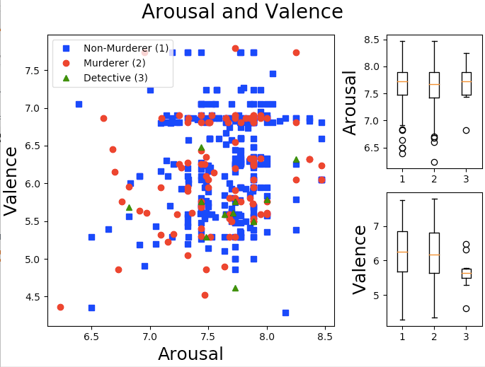
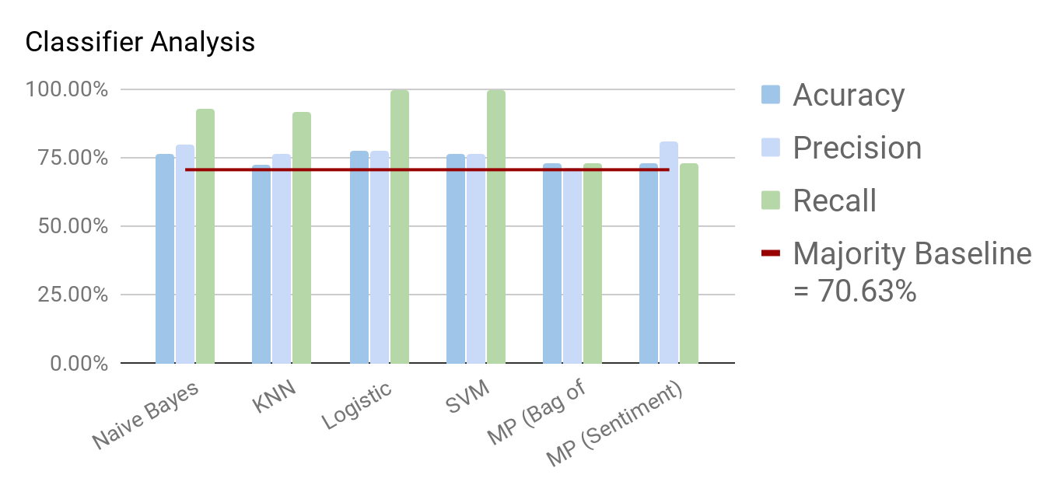
What Makes a Murderer?
Jessica Bolduc, Donghyuk Kim, Ashley Oh, Dipesh Patel
Boston College, CSCI 3349.01 Natural Language Processing, Fall 2019
Introduction
Results
There are a lot of crime podcasts investigating the motivation and psyche of a murderer. But do murderers talk differently than non murderers?
We will Crime Scene Investigation (CSI) scripts as a corpus to create a classifier to identify murderers and non murderers.
We hypothesize that characters will be separable by the language and sentiments used.
Word Cloud: Murderer vs. Non-Murderer
Polarity [-1,1]: Positivity/Negativity of a statement
Subjectivity [0,1]: Personal opinion or factual statement
Valence [1,9]: Positive or negative emotion
Arousal [1,9]: Strong or weak emotion
Dominance[1,9]: Controlling vs Submissive
Sentiment and Affect Analysis
Data
Obtaining the Data
Scrape CSI episode scripts from transcripts.foreverdreaming.com¹ using beautifulsoup and requests resulting in one text file per episode
Clean the scripts using regex to get rid of non-speech lines such as stage directions, descriptions and cues
Extract character’s lines and write to a text file
Sort the character text files using a list of manually tagged murderers
Character files with less than 5 lines were excluded
116 Murderer and 279 Non-Murderer text files
Tagging the Murderers
Characters in Seasons 1-8 were tagged based on summaries on CSI: Wiki
Episodes without summaries were excluded
Fig. 1. A sample of CSI episode crimes. The high rate of murder crimes shows that CSI is an excellent corpus for use.
Top Words (50) by Non- Murderer | Non- Murderer | Murderer
Average by Character | 104.3117 | 19.0
Average by Total Words | 0.1004 | 0.1042
Top Words (50) by Murderer | Non- Murderer | Murderer
Average by Character | 96.8831 | 21.33
Average by Total Words | 0.0932 | 0.1170
 | Non- Murderer | Murderer
Polarity | 0.0994 | 0.0897
Subjectivity | 0.465 | 0.472
Valence | 5.691 | 5.663
Arousal | 4.0633 | 4.088
Dominance | 5.552 | 5.523
Per Case | Average
Sentences | 689
Sentences with Perpetrator | 89
Spoken Utterances | 444
Characters | 20
Fig. 2. Per case analysis show that on average, 89 out of 689 sentences are spoken with the perpetrator. There will be enough perpetrator data to build a dataset.
Model | Accuracy | Recall | Precision
Gaussian NB | 76.6% | 92.8% | 79.6%
K-nearest neighbors | 72.6% | 91.5% | 76.6%
Logistic Regression | 77.6% | 99.3% | 77.4%
SVM | 76.6% | 99.3% | 76.5%
Multilayer Perceptron (Bag of Words) | 73% | 73% | 71%
Multilayer Perceptron (Sentiment) | 73% | 73% | 81%
Methods
Classifier
Feature Extraction:
Bag of Words (Average number of “top words” by Character, Sentences, Words) → Using NLTK methods
Sentiment (Subjectivity, Polarity) → Using Textblob
Affective (Valence, Arousal, Dominance) → Using Warriner, Kuperman, Brysbaert Lexicon
Normalization:
Lowercasing
Tokenization
List of stop-words
Creating Dataset:
Vectorized features we’ve experimented with (did not use all of them to test with model)
Presence of top murderer/non-murderer words in each script: yes(1) or no(0).
(# of “top 50 words” in script)/(total # of words in script).
Sentiment and affective values of each script.
Sentiment and affective only considering last 10 lines of script.
Max and min affective values of each script.
Max/min affective changes from first half to second half of script.
Labeling: Non-murderer: 1, murderer: 0.
Model:
5-fold Cross-Validation
Tested on different classifiers built using Python library sklearn¹⁰.
Gaussian Naive Bayes, K-Nearest Neighbor, Logistic Regression, SVM, Multilayer Perceptron (80% training and 20% testing)
Conclusions
The data available for use was limited
Scripts for season 9 onwards were not annotated with characters names. Many episodes had no summaries.
CSI was not an ideal dataset:
only 1 hour in length
long scripts for detectives/main-characters → short scripts for murderers/non-detective.
Results:
Minimal difference detected in terms of overall sentiment, affective, and word choices.
Noticeable difference detected in change in affective throughout script.
All classifiers beat majority baseline of 70.67%. Best accuracy: logistic regression (76.6%).
Gaussian-NB, K-N, LR, SVM all had recall greater than 91% (classifiers good at predicting Non-murderers (1)).
Precision for all classifiers (except MLP) greater than majority baseline. (some characters predicted Non-murderers (1) were murderers).
Libraries Used: BeautifulSoup | Requests

