Slide 1


Course work
Reimbursement process optimization
Software Engineering 7 classes universe strongest group

Slide 2
content
member introduction
Process introduction and optimization
Optimization results summery

Slide 3

introduction
team member
Who we are
ZhangJian130716120
闫聪聪
耿雪冰
张博
朱峣
祝渊

Slide 4

chapter 1
Identify Process
Zhang Jian

Slide 5
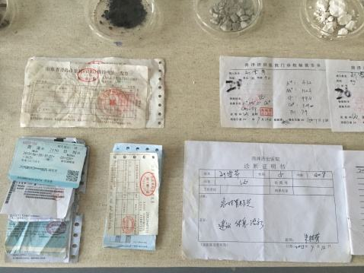
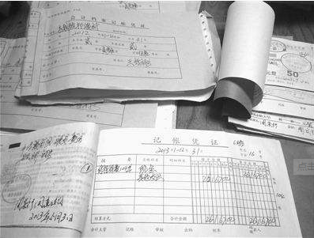
Process Identify
Reimbursement process in work
21

Slide 6
Why we want to improve this process
Slow
01
The traditional reimbursement process is very inefficient, from the application to the fight money lasts a few months is very normal.
Tedious
02
A reimbursement process generally requires multiple leadership approvals
Reimbursement process problems
Heavy
03
Leaders often need to approve large numbers of documents
Inflexible
04
Reimbursement process is often stuck in a certain part
16

Slide 7

Chapter2
How the process is managed
Zhu Yuan

Slide 8
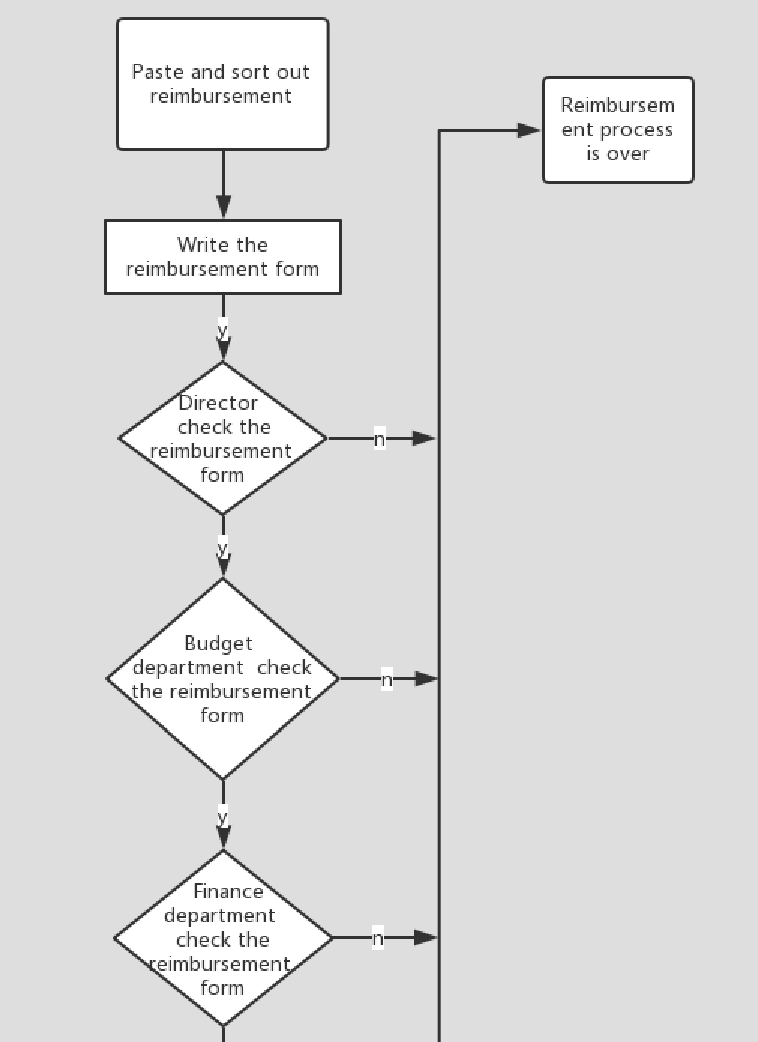
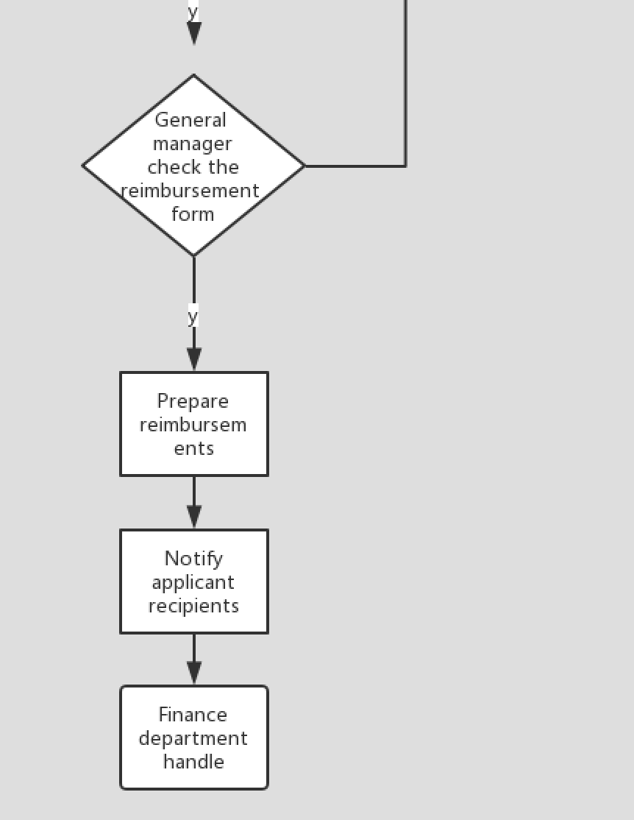
Flow diagram
27

Slide 9
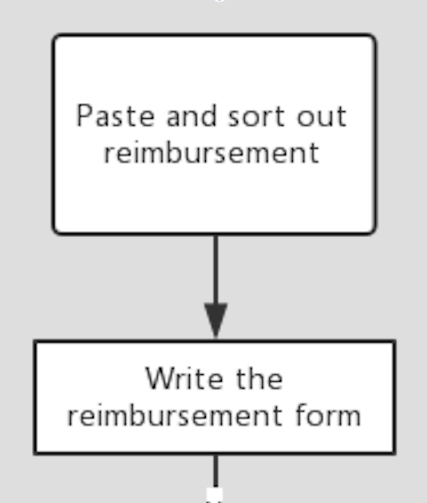
How the process is managed
Initial situation
have some reimbursement；
Action1
action1：paste and sort out reimbursement；
pre-condition1：have some reimbursement；
effect1：submit reimbursement which already pasted；
Action2
action2：write the reimbursement form；
pre-condition2：submit reimbursement which already pasted；
effect2：submit the reimbursement form；
27

Slide 10
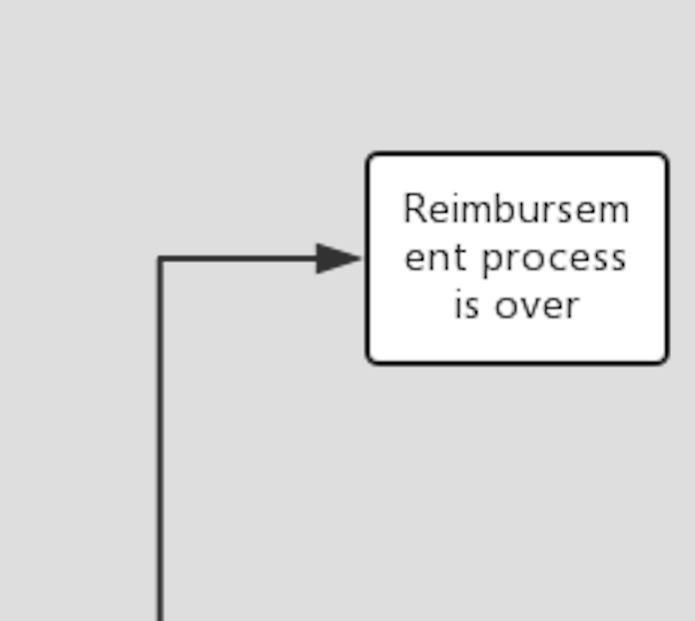
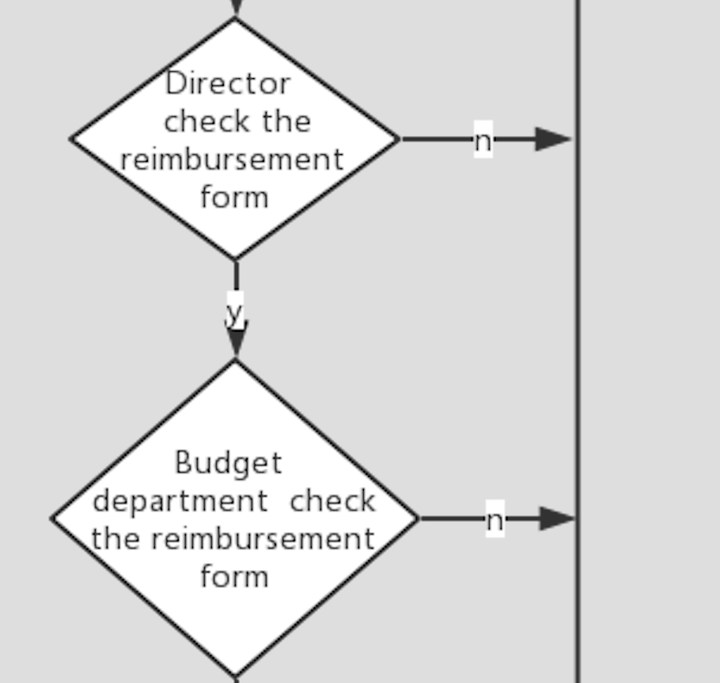
How the process is managed
Action3
action3：director check the reimbursement form；
pre-condition3：submit the reimbursement form；
effect3：
Y3：director approved；
N3：Director does pass the reimbursement form；
Action4
action4：Reimbursement failed；
pre-condition4：N3；
effect4：Reimbursement process is over；
Action5
action5：Budget department check the reimbursement from；
pre-condition4：Y3；
effert5：
Y5：Budget department approved；
N5：Budget department does pass the reimbursement form；
27

Slide 11
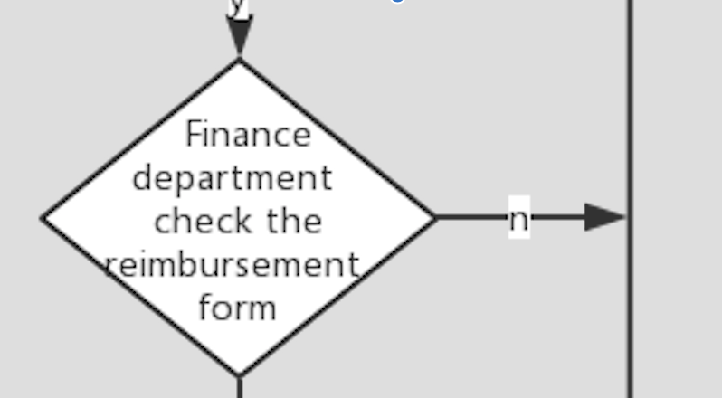
How the process is managed
Action6
action6：：Reimbursement failed；
pre-condition6：N5；
effect6：Reimbursement process is over；
Action7
action7：Finance department check the reimbursement from；
pre-condition7：Y5；
effert7：
Y7：Finance department approved；
N7:Finance department does pass the reimbursement form；
Action8
action8：Reimbursement failed；
pre-condition：N8；
effect8：Reimbursement process is over；
27

Slide 12
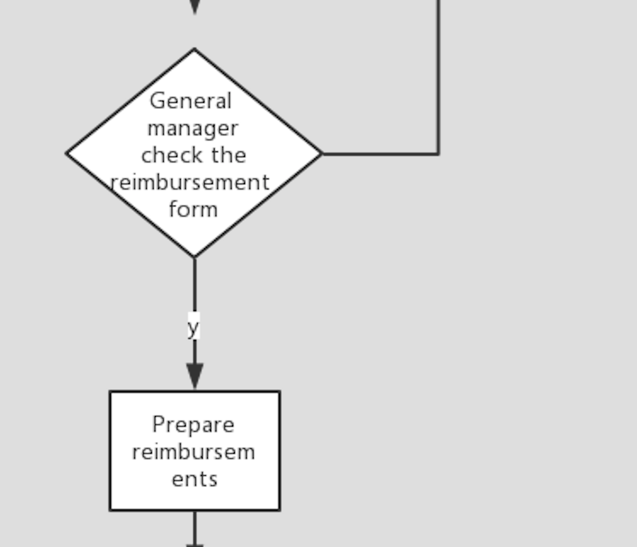
How the process is managed
Action9
action9：General manager check the reimbursement from；
pre-condition9：Y7；
effert9：
Y9：General manager approved；
N9：General manager does pass the reimbursement form；
Action10
action10：Reimbursement failed；
pre-condition10：N9；
effect10：Reimbursement process is over；
Action11
action11：Prepare reimbursements；
pre-condition11：Y9；
effert11：Reimbursements is ready；
27

Slide 13
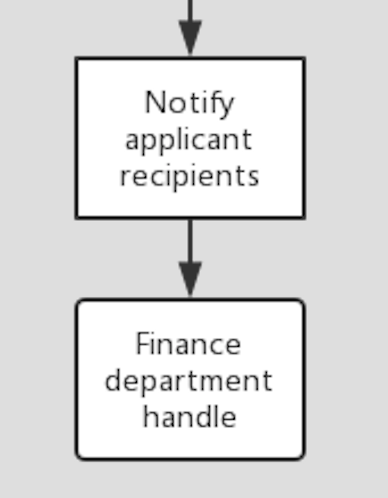
How the process is managed
Action12
action12：Notify applicant recipients；
pre-condition12：Reimbursements is ready；
effect12：Applicant's payment is completed;
Action13
action13：Finance department handle；
pre-condition13：Applicant's payment is completed；
effect13：Reimbursement process is over；
Goal
goal：Reimbursement process is over；
27

Slide 14
Chapter3
Process improvement
activities
Geng Xuebing

Slide 15
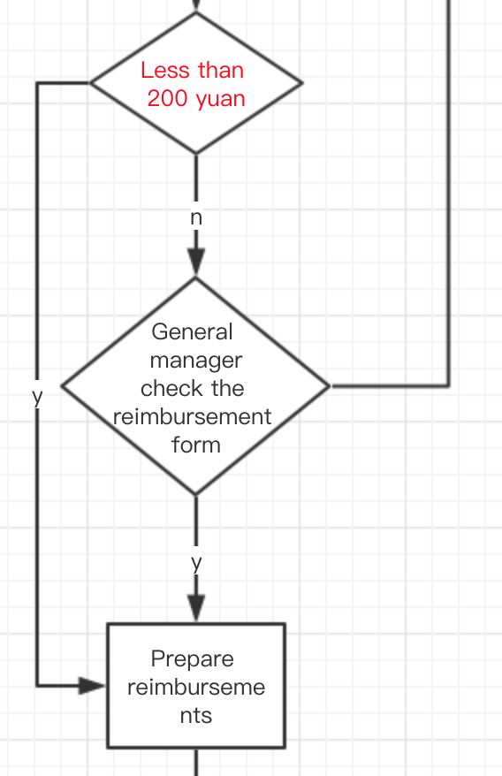
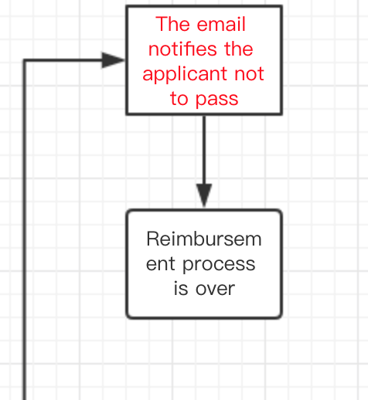
process improvement activities
Less than 200 yuan
After the check of Finance department,the reimbursements less than 200 yuan skip the general manager check process. Go straight to the next process——“Prepare reimburse
-ment”.
Email notifies
After the application failed,I added an email notifycation process.I think the applicant needs an electronic notification before the reimbursement process is over.
27

Slide 16
process improvement activities
Add an process
Action C1:less than 200 yuan
pre-condition C1：Y7；
effert C1：
YC1：The reimbursement cost is less than 200 yuan；
NC1: The reimbursement cost is more than 200 yuan；
The reason of add
This process add to relieve the pressure of the general manager. The original process is not reasonable.Because all things of reimbursement require general manager check. It will wasting the general manager's time. If the general manager has time, he can do more meaningful things to help the company grow
27

Slide 17
process improvement activities
Add an process
Action C2：The email notifies the applicant not to pass；
pre-condition C2：N3；
effect C2：The applicant knows not to pass；
Action C3：The email notifies the applicant not to pass；
pre-condition C3：N5；
effect C3：The applicant knows not to pass；
Action C4：The email notifies the applicant not to pass；
pre-condition C4：N8；
effect C4：The applicant knows not to pass；
Action C5：The email notifies the applicant not to pass；
pre-condition C5：N9；
effect C5：The applicant knows not to pass；
The reason of add
This process add to help the applicant quickly know they failed for the reimbursement apply.And it can improve the efficiency of reimbursement process.This process added is just my suggestion.
27

Slide 18
Chapter3
philosophy used to guide the process improvement
Zhu Yao

Slide 19



Subsequence of the process improvement
The “philosophy” that is used to guide the process improvement.
第三章：产品与运营
21

Slide 20
Subsequence of the process improvement
01
We need strong support from the top managements.
Only with the support of the top managements consistency can process improvement be promoted.
第二章：项目介绍
16

Slide 21
Subsequence of the process improvement
02
Carefully determine the goal of improvement
we should make the right assessment and definition of the improvement goals that can be achieved within a given time and plan.
We should choose what we can achieve and see the benefits to the organization.
第二章：项目介绍
16

Slide 22
Subsequence of the process improvement
03
Choose best practices
We should get a new model of practice activity based on the organization‘s existing software activities and process assets, referring to the advantages of other standard models.
第二章：项目介绍
16

Slide 23
Subsequence of the process improvement
04
Process improvement goals
Process improvement should be consistent with the business objectives of the organization and closely integrated with the development strategy.
第二章：项目介绍
16

Slide 24
Chapter3
Subsequence of the process improvement
Yan Congcong

Slide 25
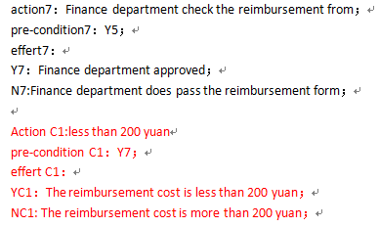




Subsequence of the process improvement
Add 1
Add 2
26

Slide 26
Subsequence of the process improvement
Streamline the reimbursement process in the right circumstances
Reduce the cycle of the employee's reimbursement
Advantage1
Strengthen the control restriction before expense reimbursemen
Advantage2
Improve and standardize the enterprise reimbursement process by sending written reports
Advantage3
Advantage4
19

Slide 27
Subsequence of the process improvement
Statistical cycle
Applicable people
Regular update
Six months from the beginning to the end
The company and the relevant subsidiaries
Keep improving according to the actual problem
22

Slide 28
PPT模板下载：www.1ppt.com/moban/ 行业PPT模板：www.1ppt.com/hangye/
节日PPT模板：www.1ppt.com/jieri/ PPT素材下载：www.1ppt.com/sucai/
PPT背景图片：www.1ppt.com/beijing/ PPT图表下载：www.1ppt.com/tubiao/
优秀PPT下载：www.1ppt.com/xiazai/ PPT教程： www.1ppt.com/powerpoint/
Word教程： www.1ppt.com/word/ Excel教程：www.1ppt.com/excel/
资料下载：www.1ppt.com/ziliao/ PPT课件下载：www.1ppt.com/kejian/
范文下载：www.1ppt.com/fanwen/ 试卷下载：www.1ppt.com/shiti/
教案下载：www.1ppt.com/jiaoan/ PPT论坛：www.1ppt.cn
Thanks~

