Slide 1
Getting there together
VR Final Project
Bauhaus-Universität Weimar
Muhammad Rizky Maulana Risman | 123437 - Pramoch Viriyathomrongul | 124244

Slide 2
What is it?
Motivated by the increasing popularity of social virtual reality systems, in which group navigation is an elementary form of interaction that is not yet supported.
The basic idea is to implement a Multi-Ray Jumping and Positioning technique in a distributed virtual environment as described by Weissker et al. with a second remote user as the passenger in the virtual environment.
Jumping can lead to involuntary changes of the group’s formation and some examples of jumping are:
Steering, a versatile option for virtual travel, introduces a sensory conflict between the visual and the vestibular systems of the user, which can easily lead to simulator sickness, but it can be mitigated by dynamic field-of-view modifications during travel
Travel by teleportation, on the other hand, reduces sensory mismatches and was shown to result in lower simulator sickness than basic steering techniques
Generally, jumping techniques consist of a method for target specification, the display of pre-travel information, a transition mode, and optional post-travel feedback
Bauhaus-Universität Weimar
Muhammad Rizky Maulana Risman | 123437 - Pramoch Viriyathomrongul | 124244
Notes:
Introduction by Rizky

Slide 3
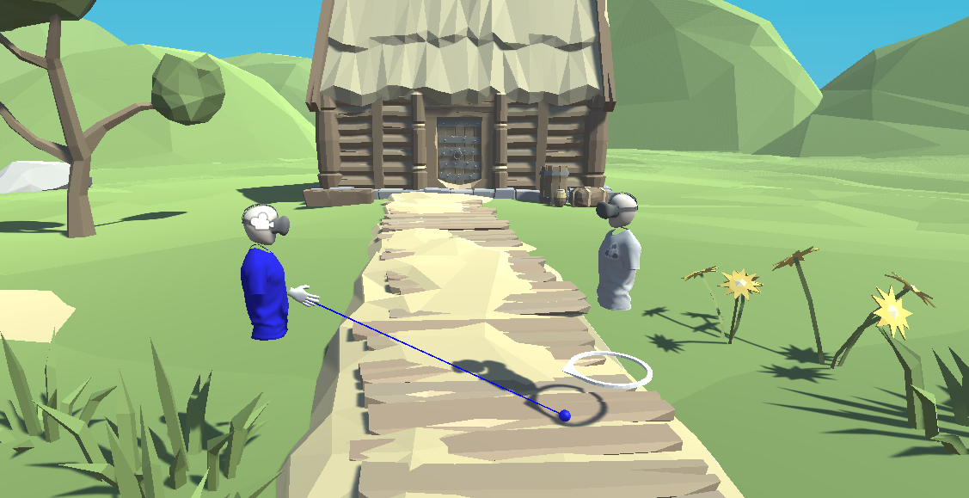
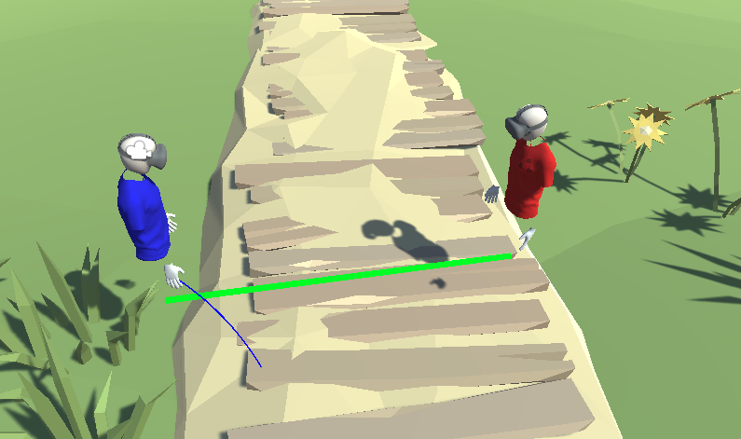
Implementation
1. Forming - We go with a singular confirmation approach which only one user can trigger group forming and that user will be nominated to be the navigator
Bauhaus-Universität Weimar
Muhammad Rizky Maulana Risman | 123437 - Pramoch Viriyathomrongul | 124244
Notes:
Pramoch

Slide 4
Implementation
2. Norming - Navigator has full power to control jumping position of both navigator and passenger, on the other hand, passenger has ability to discard jumping position that navigator selected.
Bauhaus-Universität Weimar
Muhammad Rizky Maulana Risman | 123437 - Pramoch Viriyathomrongul | 124244
Notes:
Pramoch

Slide 5
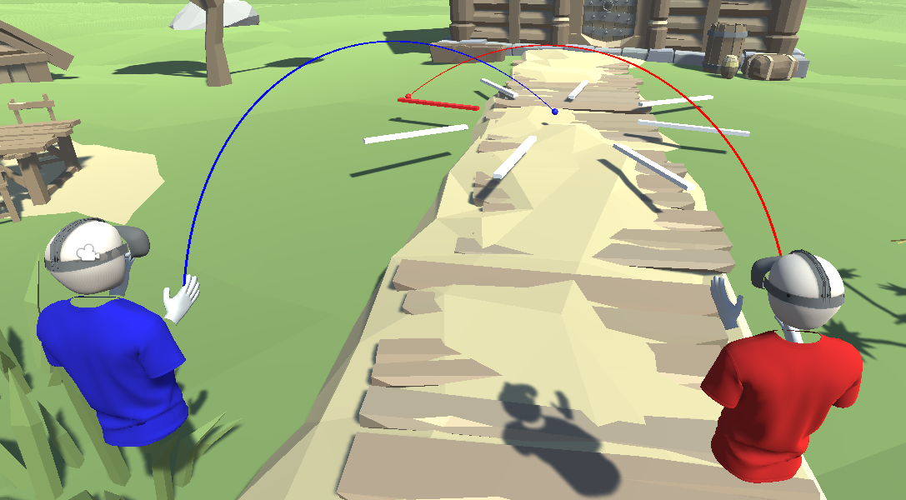
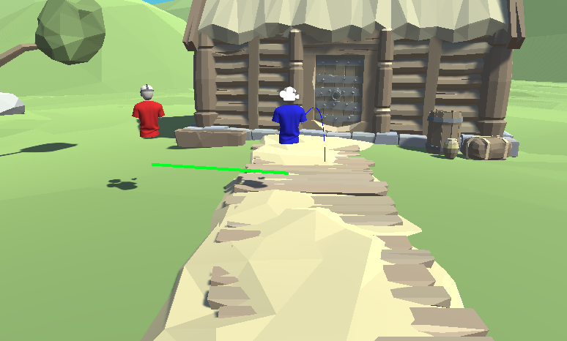
Implementation
3. Performing - First, navigator needs to select own jumping position. Then, navigator will be able to select the jumping position of the passenger which there will be circular zone indicating navigator jumping position. About the circular zone, we go with 8 directions and navigator will be able to adjust how far of passenger jumping position. Lastly, the group will teleport into the chosen position.
Bauhaus-Universität Weimar
Muhammad Rizky Maulana Risman | 123437 - Pramoch Viriyathomrongul | 124244
Notes:
Pramoch

Slide 6
Implementation
4. Adjourning - It will be the same approach as forming technique, singular confirmation from navigator.
To sum up, we mostly implement the application in such a way for expert user and novice user, like a guide and a tourist scenario.
Bauhaus-Universität Weimar
Muhammad Rizky Maulana Risman | 123437 - Pramoch Viriyathomrongul | 124244
Notes:
Pramoch

Slide 7
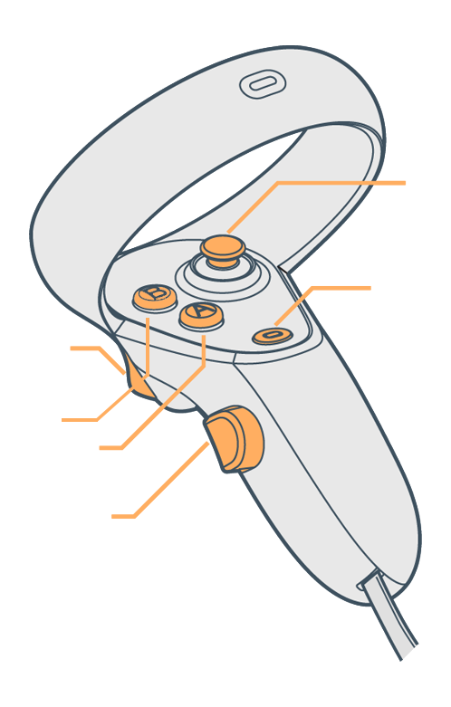
Implementation
Avatar rotation
Oculus Right Control Layout:
Oculusmenu
Individual steering navigation
Cancel group formation
Confirm teleport point
Trigger button to form group
Bauhaus-Universität Weimar
Muhammad Rizky Maulana Risman | 123437 - Pramoch Viriyathomrongul | 124244
Notes:
Pramoch

Slide 8
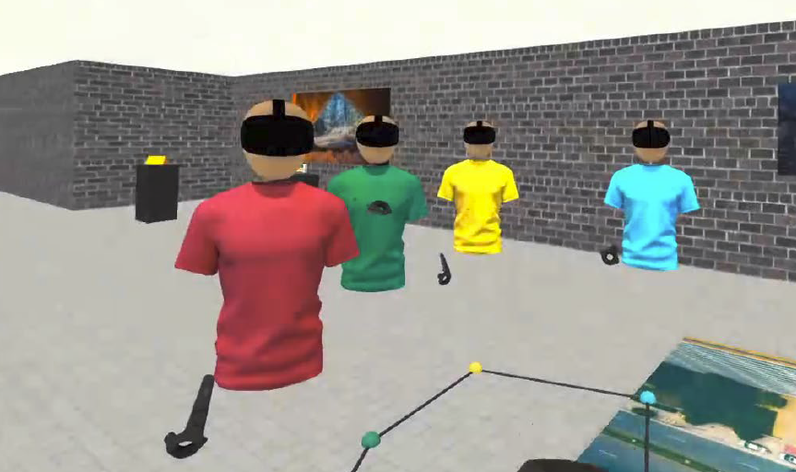
How comprehensible group jumping and positioning could be realized for more than two users?
Comprehensible techniques need to foster awareness of ongoing navigation actions and make their consequences predictable for the navigator and passengers of a group.
Passengers:
Notification mechanism to raise attention when the navigator plans a jump
Clearly visible indication of the jump’s target location for all participants
Navigator:
Awareness of current spatial configuration of users in the workspace
Clearly visible indication of the jump’s target location for all participants
More color indicators linking different users on the teleportation indicator,
however only the navigator has the control to position the passengers.
Bauhaus-Universität Weimar
Muhammad Rizky Maulana Risman | 123437 - Pramoch Viriyathomrongul | 124244
Notes:
Rizky

Slide 9
Advantages and Disadvantages of Group Jumping
Increases planning accuracy and considerably more efficient
Reduces cognitive load for navigator and passengers
Reduce motion sickness
Very helpful for novice VR users
Reduces sensory mismatches
Transitions between individual and group navigation might not be as smooth depending on the distance between the users
Certain formation adjustments may be impossible to specify
Selecting the position of passenger with the analog may be quite stressful and time consuming
Bauhaus-Universität Weimar
Muhammad Rizky Maulana Risman | 123437 - Pramoch Viriyathomrongul | 124244
Notes:
Rizky

Slide 10
Future improvement
Support 2+ users
Be able to change group jumping formation in order to suit environment layout
Be able to preview avatar at the jumping position
Make sure it will be ease execution task for navigator
Jumping in more complex environments on higher levels of spatial awareness
Bauhaus-Universität Weimar
Muhammad Rizky Maulana Risman | 123437 - Pramoch Viriyathomrongul | 124244
Notes:
Pramoch

Slide 11
Demonstration
Bauhaus-Universität Weimar
Muhammad Rizky Maulana Risman | 123437 - Pramoch Viriyathomrongul | 124244
Notes:
Pramoch

Slide 12
Thank You!
Bauhaus-Universität Weimar
Muhammad Rizky Maulana Risman | 123437 - Pramoch Viriyathomrongul | 124244
Notes:
Pramoch

