Slide 1
Investigating Personalized Argument Search
Pramoch Viriyathomrongul, 124244
Notes:
Greetings everyone once again.
Today I‘m going to give a talk about everything I have done so far in this project throughout the semester.
Without further ado, let’s get start

Slide 2
My Accomplishment
0. ARGS paper presentation / Practice task / Teammate support (presentation, practice task)
1. Argument year filter implementation (overview,, implementation code)
2. Argument feedback implementation (overview, implementation code)
3. Elasticsearch migration POC (overview)
Notes:
This is a list of my work from the beginning of the project until recently.
Every material and implementation code are linked and attached to this page, so you can look later when reviewing my presentation.
At the beginning of semester, I was assigned to read the research paper regarding building argument search engine and present to our group.
And then we were assigned to complete a practice task to get familiar with args framework.
From time to time, I also help a colleague with technical code aspects and solve some development issue.
My first real accomplishment was implementing argument year filer.
The second accomplishment was implementing user feedback logging.
And the most recent one was investigating and prove the concept of migration from Lucene to Elasticsearch.
So in this presentation, I will give a very small quick recap on feature 1 and 2, since I already present them few times throughout our previous meeting.
For the last work, I will dig deeper into my experience and explain in more detail.

Slide 3
Argument Year Filter
Notes:
So the 1st one “argument year filter”

Slide 4
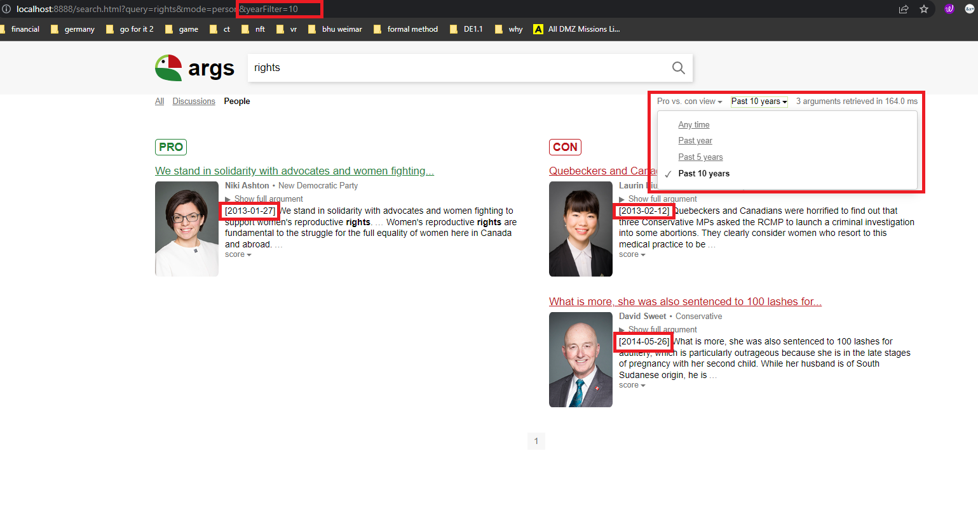
Overview
Notes:
To recap this feature, user can…

Slide 5
High-level Implementation
Added filter panel on UI
Added date text in front of each argument snippet
Added yearFilter to Args query string
Implementing argument filtering by year
Filtering process happens after Lucene retrieval process
Notes:
Because I ever talked about this feature throughout previous meeting and to make the presentation concise.
Here are the high-level implementation step that I did in this feature.
ด้นสดตามสไลด์

Slide 6
Argument Feedback
Notes:
So for my 2nd work“argument year filter”

Slide 7
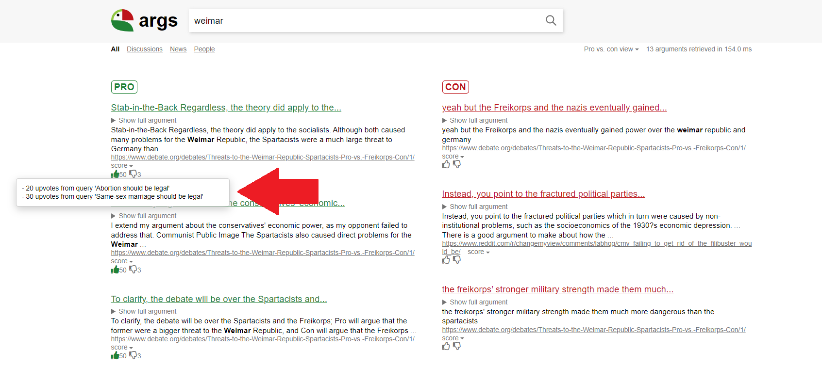
Overview
Notes:
To recap this feature, user can…
click thumbup, down
show number of feedback
along with hovering information
recognize existing feedback of each user. let say

Slide 8

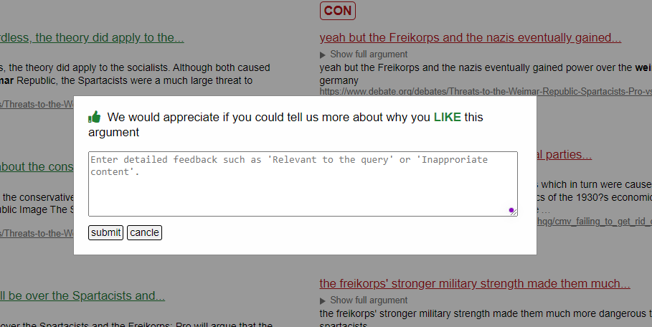
Overview
Notes:
User can add the comment after they give the feedback
by clicking this blue link and popup will open to fill out any comment regarding their feedback to argument

Slide 9
High-level Implementation
Added user feedback component on UI
Icon (this introduces addition font icon files to the project)
Number of feedback & Tooltip information
Modal box for user comment
Implementing JS for handling all kind of user interaction with new UI component
Implementing JS for collecting user feedback information
argument ID, feedback, comment, search text, search parameters, date, user IP-Address, user ID
Implementing JS for sending logs to the server-side
Added an endpoint for handling log requests on the server-side
Implementing a file log class
Added an endpoint for fetching log information on the server-side
Implementing fetching log information from file
Notes:
ย้ำอีกครั้งว่า detail และ implementation link มีแปะไว้ที่หน้าแรก
ด้นสดตามสไลด์

Slide 10
Elasticsearch Migration (POC)
Notes:
Coming to most recent work which is Elasticsearch migration

Slide 11
Approach
0. Install Elasticsearch & Kibana
1. Convert Lucene index to Elasticsearch format
2. Create Elasticsearch index & Perform indexing
3. Verify the migration
Elasticsearch: elastic.co/downloads/elasticsearch
Kibana: elastic.co/downloads/kibana
Notes:
The following are the steps I plan and execute in this investigation. (note that I do this POC on my own laptop)
As a prerequisite to this POC, I must install Elasticsearch and Kibana applications on my local machine, and set them up to communicate with each other.
The initial step is to convert documents in Lucene files to Elasticsearch index format. This step will demonstrate the compatibility of our data with new search engines.
Then, I create an elasticsearch index and insert all converted documents (in the previous step) into the elasticsearch. This step will reflect the methodology when it comes to migrating indexing process of args framework
Lastly, I have to verify the integrity after inserting all converted documents into new search engine, either by run full text queries or visualize document in Kibana. This step will reflect the methodology when it comes to migrating retrieval process of args framework
After this overview slide, I will discuss in more detai in each step how I achieved that.

Slide 12
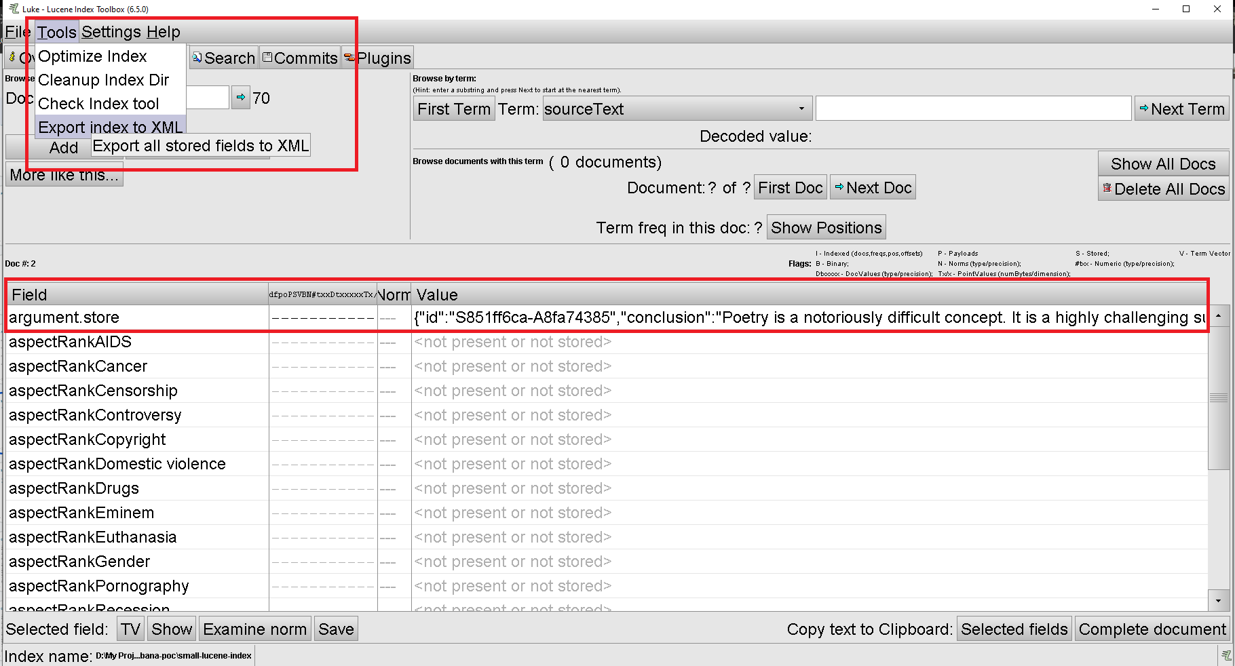
Convert Lucene index to Elasticsearch format
Write a script to retrieve documents from Lucene index files
Require Lucene API version 6.5*
(Alternative) Export documents using Luke tool
Lucene API: archive.apache.org/dist/lucene/java
Luke: github.com/DmitryKey/luke
Notes:
To convert our existing Lucene file to elasticsearch index, we must first write a script. The script needs to utilize Lucene API to read all Lucene files and extract all documents from them.
Note that since we used the old Lucene API version to create these index files, we also need to use a similar version when attempting to extract the documents.
However, since I was doing only POC work I used small index files from pactice task as an example, and I used Luke to extract all documents. (to save my time and get everything up to speed)
So basically, Luke was an open source tool used to inspect, search, and maintain Lucene indexes.
From now on, I will also attach important links at the bottom of every slide so you can refer to them later on.

Slide 13
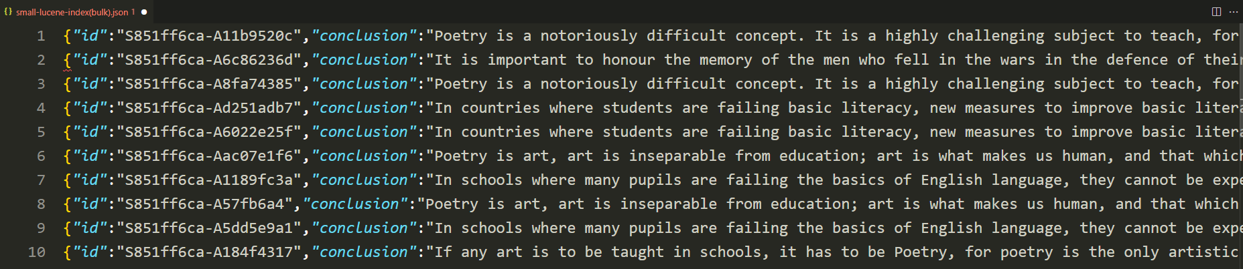
Convert Lucene index to Elasticsearch format
Mapping each document fields into JSON format
Save as JSON file
Notes:
Once we retrieve all documents from our index file, we need to convert them into JSON format which is compatible with the elasticsearch index.
Luckily, our existing index are already stored as JSON text. This means we don’t need to do any additional pre processing of the JSON document very much, like creating JSON objects and manually mapping each field value in the document to JSON object (โชว์ภาพหน้าเก่า)
Then I saved all JSON documents as one JSON file, ready for the next step.

Slide 14
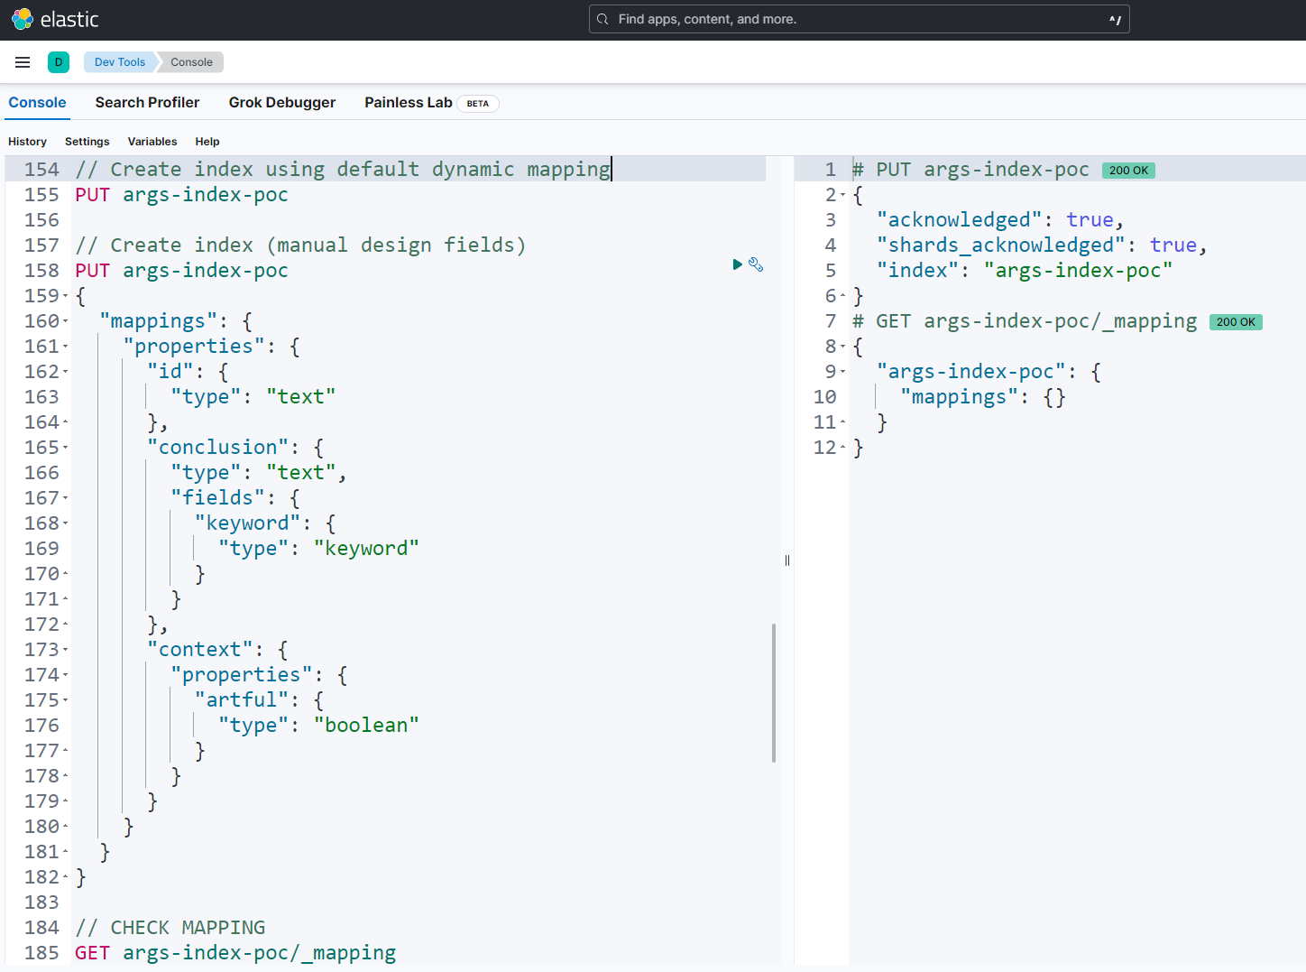
2. Create Elasticsearch index & Perform indexing
Create Elasticsearch index
Use default dynamic mapping
Notes:
The next step is to create Elasticsearch index before inserting our converted document into it.
Note that we have several ways to communicate with elasticsearch server. For example, we write code in different programming languages to connect to elasticsearch, or use curl command to do simple http requests to elasticsearch, or in this image I used console dev tool in Kibana application to write any query request to the Elasticsearch API.
Come back to create an index topic. As you can see on the left window I show 2 queries to create index, the above query is to create index without define any field name and fied type.
This is called default dynamic mapping. So whenever we insert new documents to arg-index-poc in this case, by default Elasticsearch will detect the field name and field type, then automatically create index mapping if we didn't define one. Therefore, we have the advantage of being able to add new fields in a convenient and flexible manner. However, it can impact indexing performance, especially when there are already many fields in document, or introduce mapping field conflict scenario or auto mapping field to unwanted type.
The second query illustrates the manual way to define mapping by ourselves like in this example I map ‘conclusion’ to text type and keyword type and I map ‘context’ to boolean type.
As for the POC, I'm just going with dynamic mapping since our document already contains a lot of fields, which is a lot of overhead and time-consuming to do tedious mapping work.
And on the right hand side is the response from our query. At the beginning it will show no field mapping information since we didn’t define one.

Slide 15
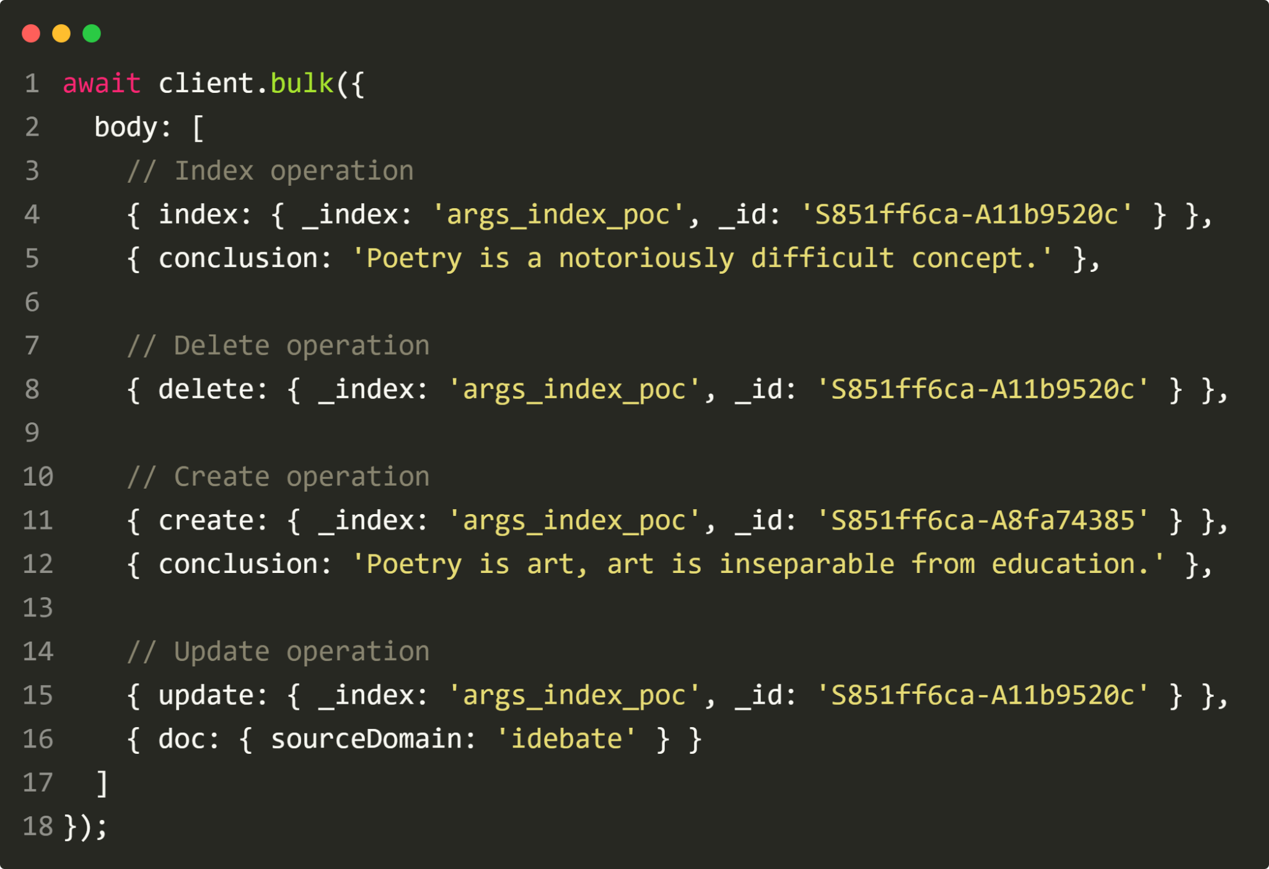
2. Create Elasticsearch index & Perform indexing
Write a script to index our document
Use Bulk API to perform multiple indexing
Elasticsearch Client: elastic.co/guide/en/elasticsearch/client/index.html
Bulk API: elastic.co/guide/en/elasticsearch/reference/current/docs-bulk.html
Notes:
Once we have index, it’s time to insert our converted documents in to Elasticsearch.
As I mention before we have several way to communicate with Elasticsearch server and one approach is to communicate via writing script.
In this screenshot, illustrate how we can index documents using Bulk API via Elasticsearch javascript library.
So what is the Bulk AP? Bulk api is the way to performs multiple CRUD operation (create, read, update, delete) in a single API call.
This reduces overhead and can greatly increase indexing speed.
BTW, Elasticsearch provide API library in form of several programming language, you can check out it on below link.

Slide 16
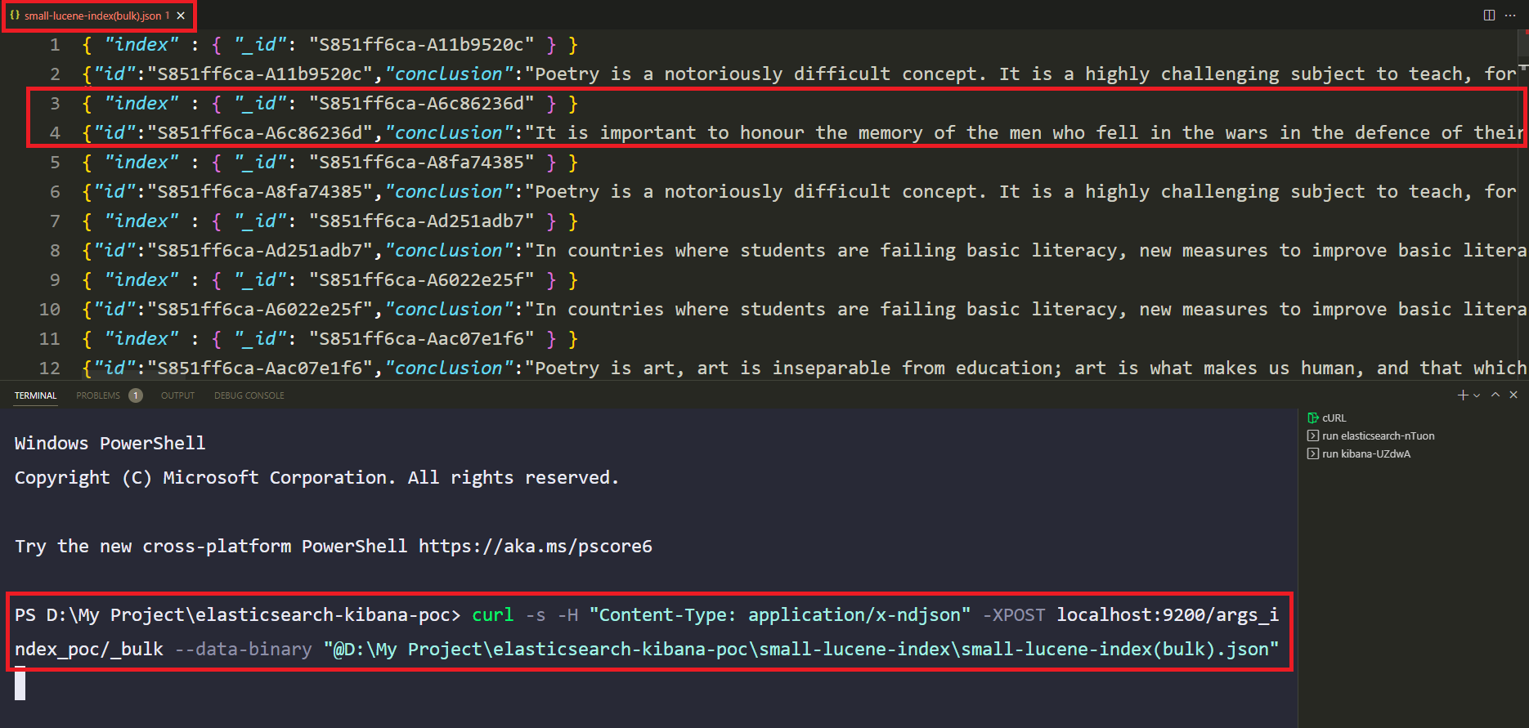
2. Create Elasticsearch index & Perform indexing
(Alternative) Submit bulk request via cURL
Notes:
But in my case, instead of writing script, I took another quick approach to index our documents.
Which is using curl command to send JSON documents to Bulk API.
As you can see on the bottom of screenshot, I write curl command to connect to Elasticsearch address, specify specific index name and attach my JSON file.
My JSON file contains our converted argument documents in the above section of screenshot.
But before we send the JSON file through Bulk API , we really need to make sure it is written in correct synopsis like in this screenshot.I put index syntax and specify id for each document.

Slide 17
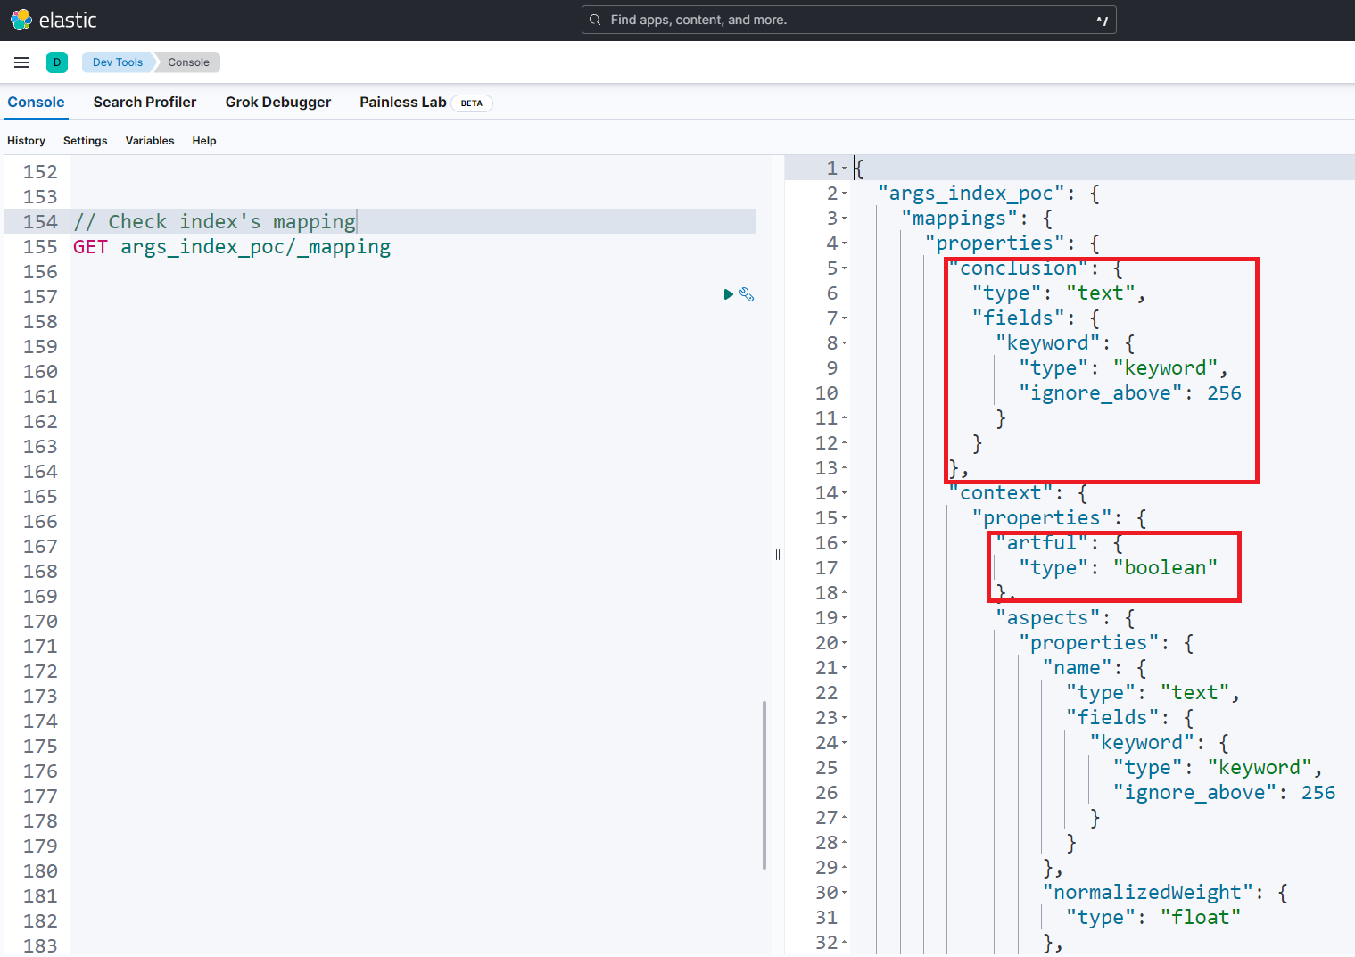
3. Verify the migration
View index’s mapping
Notes:
The last part of this POC is to verify integrity of our migration.
So first, if you remembered in one of my previous slide, when we create “args_index_poc”, we don’t have any field mapping information. (ย้อนกลับไป)
But once we insert our document through Bulk API and run the mapping query once again, we can see that Elasticsearch automatically generate mapping information as we want on the right window.

Slide 18
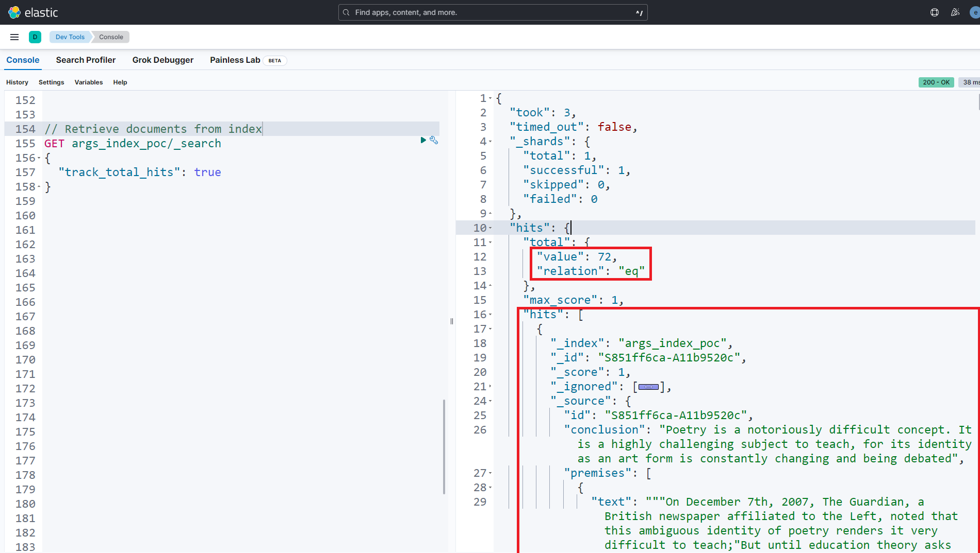
3. Verify the migration
Retrieve documents from index
Notes:
Then let’s try to retrieve documents from index.
I run simple search query on the left window and Elasticsearch return the response in the right window.
I can see exact correct number of documents inside the index.
And I can see ten sample documents that existing inside my index
That’s good sign of migration.

Slide 19
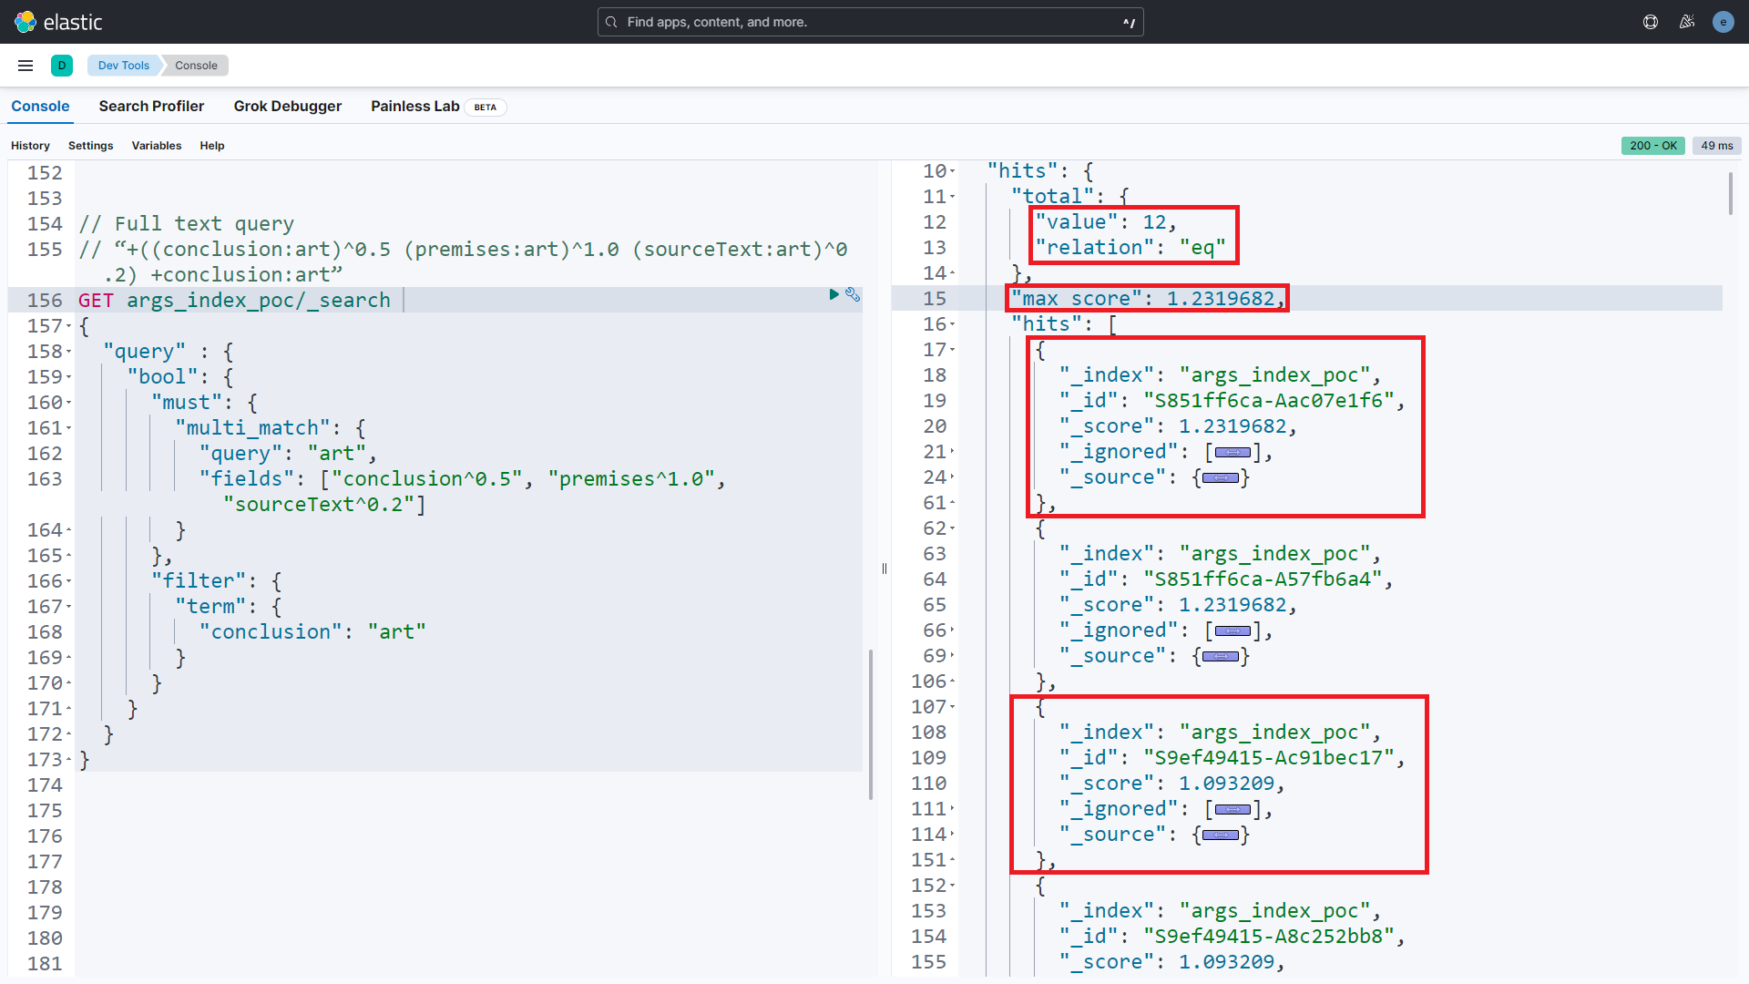
3. Verify the migration
Run combined query
When user search for “art” in Args.me website. The framework will retrieve relevant document from Lucene index, by constructing Lucene expression.
“+((conclusion:art)^0.5 (premises:art)^1.0 (sourceText:art)^0.2) +conclusion:art”
Notes:
So then I try to run a full text query by simulating the traditional behavior that usually occurs on args website.
Let say user want to search for “art” term in the searchbox of args website. What happens next is args framework creates Lucene expression that will look like this
It means
Please search for document that might contain “art” term in "conclusion" field and give weight score 0.5
Do the same for the "premise" field and give the weight 1
And "sourceText" field with weight 0.2
At the end make sure that the argument result needs to contain “art” term in the "conclusion" field.
So in this image, on the left hand side I write the same expression in the form of Elasticsearch query. Same search term, same weight score. Overall, the meanings are exactly the same.
And on the right window, I got documents results which are sort based on boost factor that I provide. (term frequency and inverse document frequency)

Slide 20
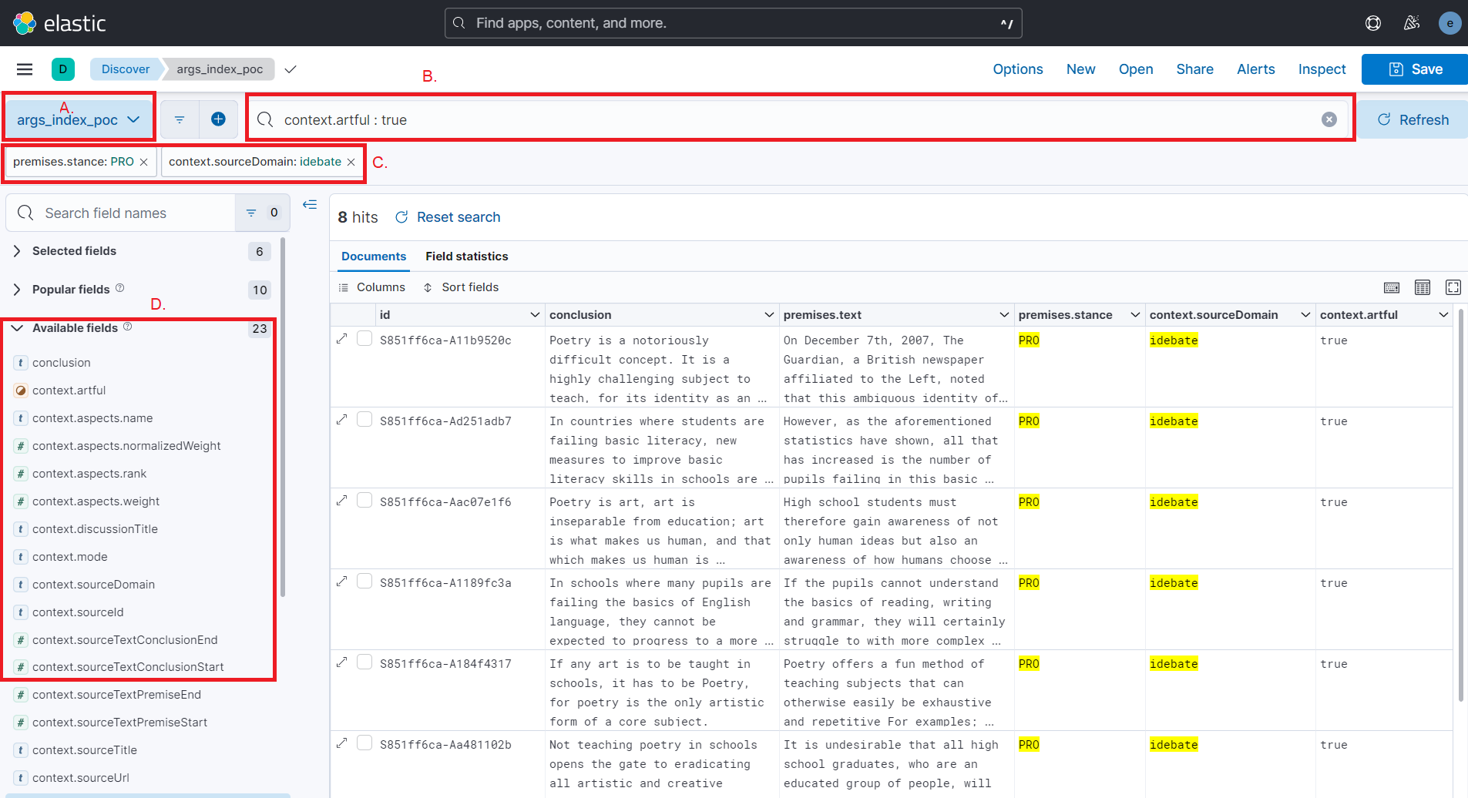
3. Verify the migration
Discover data with Kibana
Notes:
Apart from verifying migration integrity with full text search. We can take advantage of the benefits of Kibana in several ways. One of my favorite feature is Discovering.
As an example, let say I have questions about data, how many arguments contain particular "publish date" fields, and what the top most value looks like so I can design how filter option look like on args website
By using the discovering feature, we can introspect and search for particular interest in any data stream that Elasticsearch holds on to.
So in this case, I create a discovery dashboard that can look at documents inside our "args_index_poc" index that we just migrated. Actually, we can quickly go through the interface:
A. Any data stream that elasticsearch holds can be selected here.
B. Kibana query - it is a domain language query to search or filtering with particular expressions. Using this example, I try to find only documents that contain the "artful" field with a hold value set to true.
C. Even 5 years old user that doesn’t have knowledge on Elasticsearch query or Kibana query. They can simply filter the result by selecting a value from a column in the table and it will perform filtering here.
D. This panel displays all the fields or structure of our document. We can add any field to the table for easier visibility.

Slide 21
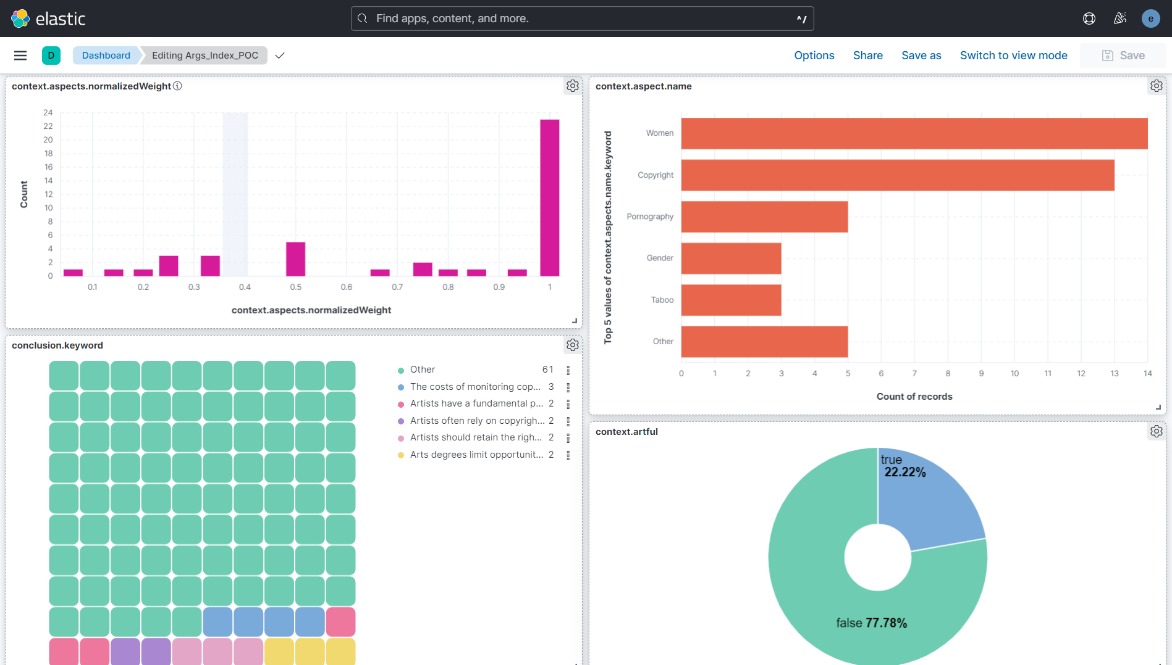
3. Verify the migration
Create visualization dashboard with Kibana
Notes:
Another favourite feature that Kibana offer is dashboard. We can create fancy dashboards to visualize our dataset, understand more about data, or observe any interesting patterns.
For example in this screenshot, I create dashboards that contain multiple panels that visualize different document fields behavior of our args index.
In the top left panel, I visualize the number of documents that have a particular "aspect weight" value.
In the top right panel, I visualize the top value of the "aspect name” field in this index.
Lower left is a heatmap according to the conclusion keyword
And lower right is the value distribution of the "context.artful" field
There are plenty of visualization graphs and endless of settings that we can play around in Kibana’s dashboard.
And this is the end of my Elasticsearch migration POC. In the next few slides, I will discuss the open questions that Johannas ask few days ago in Discord..

Slide 22
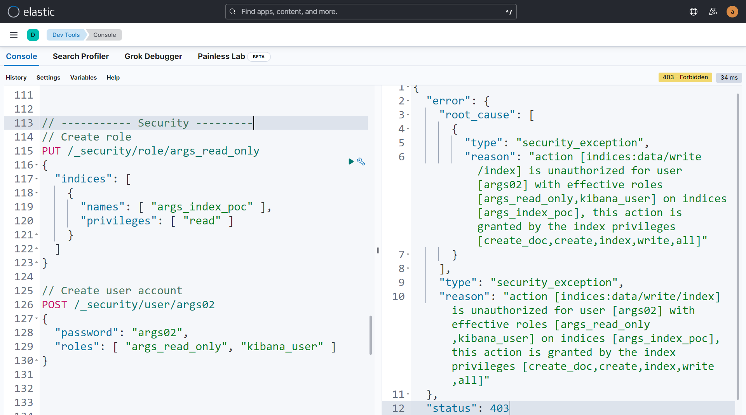
Open Questions (1)
“I would like that the query endpoint of Elasticsearch is open (read only) so that everyone can directly test own retrieval functions on the arguments.”
Setting up security: elastic.co/guide/en/elasticsearch/reference/master/field-and-document-access-control.html
Notes:
So the first question is about having open Elasticsearch endpoints that everyone can run and test their own retrieval function.
create role first
create user and assigned with predefined role
right handside is response example when this user try to perform any write operation to the Elasticsearch

Slide 23
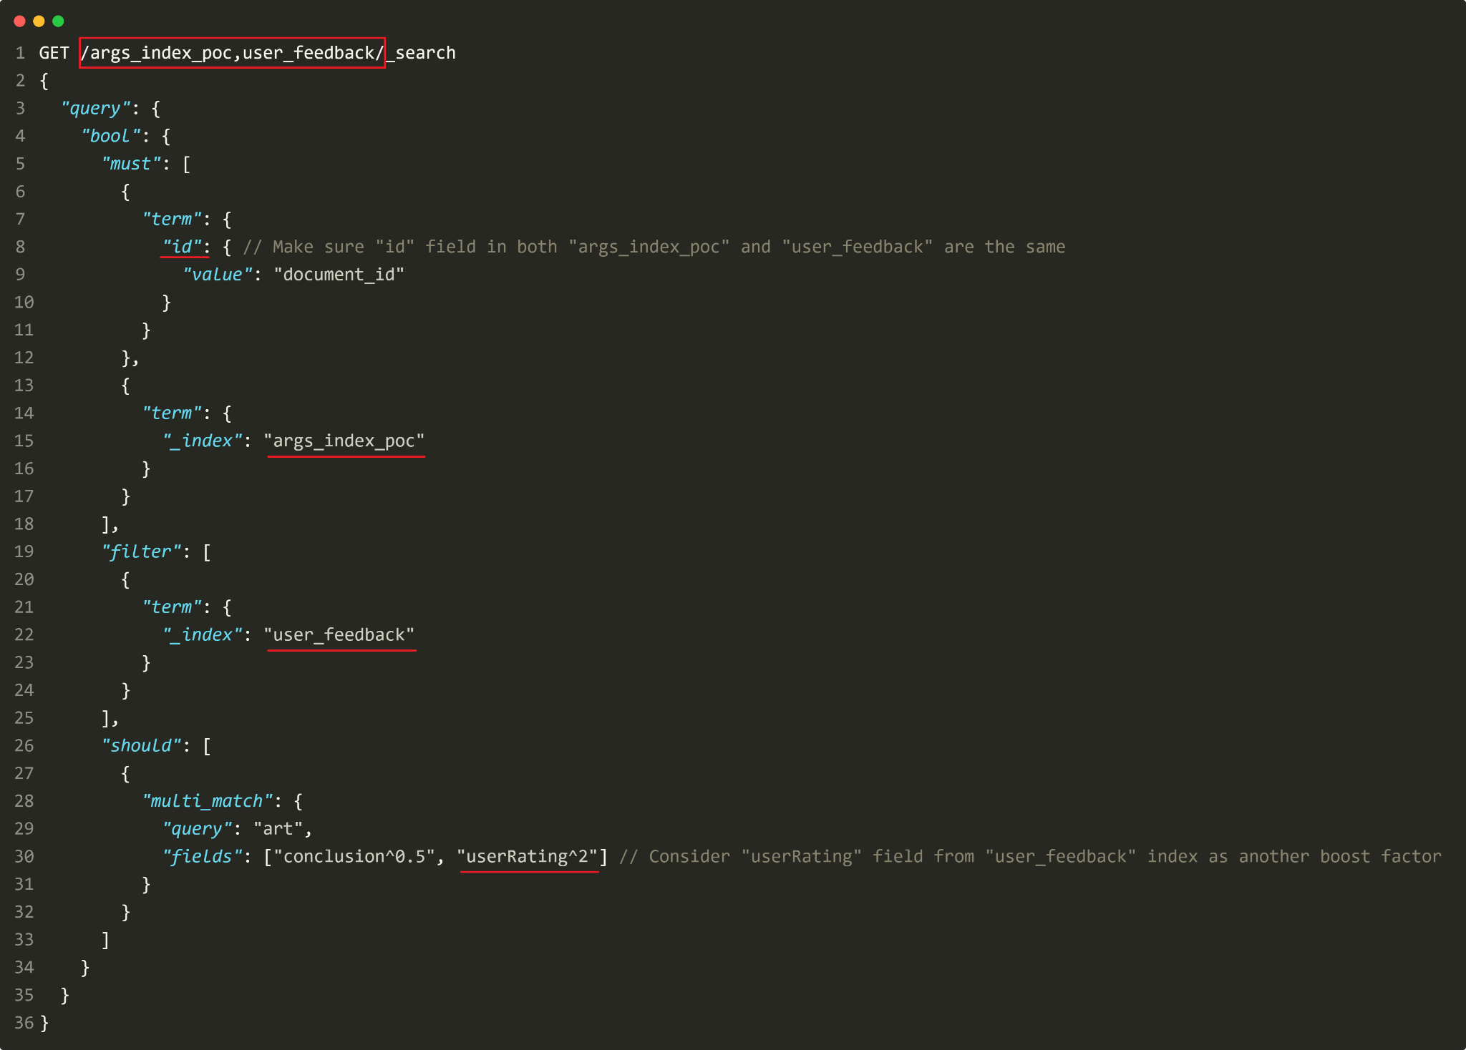
Open Questions (2)
“We have to store user ratings in a separate index to avoid leakage of personal data. How can we then consider those in argument retrieval?”
Searching multiple indices:
elastic.co/guide/en/elasticsearch/reference/current/search-multiple-indices.html
Notes:
The second question is about how to consider multiple indices in the retrieval process.
Elasticsearch allows us to query multiple indices simultaneously at the same time.
As an example, I show how to query the term "art" in our argument index based on a pre-defined weight score while also calculating the weight score based on a userRating field in user feedback index.
อธิบายตามภาพที่ highlight

Slide 24
Open Questions (3)
“How to set up Kibana? When we have the open endpoint mentioned, is that everything that Kibana needs?”
Generate an enrollment token
e.g. eyJ2ZXIiOiI4LjcuMCIsImFkciI6WyIxOTIuMTY4LjAuMzc6OTIwMCJdLCJmZ3IiOiJhYjU4
Config Kibana app to point to Elasticsearch’s address
config location: kibana/config/kibana.yml
Setup enrollment token in Kibana
user still need to authenticate with Elasticsearch via username and password
Creating enrollment token: elastic.co/guide/en/elasticsearch/reference/master/create-enrollment-token.html
Notes:
3rd question is to give more detail on how to setup Kibana.
First we need to generate an enrollment token. It is used to securely establish a trust relationship between Kibana and Elasticsearch.Normally, when we run Elasticsearch for the first time, Elasticsearch automatically generates this token for us. The token will look like this(long string). However, we can create more tokens later as we want by running curl command same as this screenshot or we can execute bat file with correct synopsis argument to obtain enrollment token. More details about generating enrollment tokens can be found in this reference link.
Next we need to configure Kibana to point to the correct Elasticsearch address. This can be done via a config file which is located as show here.
Following that, when we open Kibana in the browser for the first time, we must input the enrollment token we received from the previous step. Note that even though we have done with enrollment token setup, we still need to authenticate with username and password to use Kibana with a pre-assigned role.

Slide 25
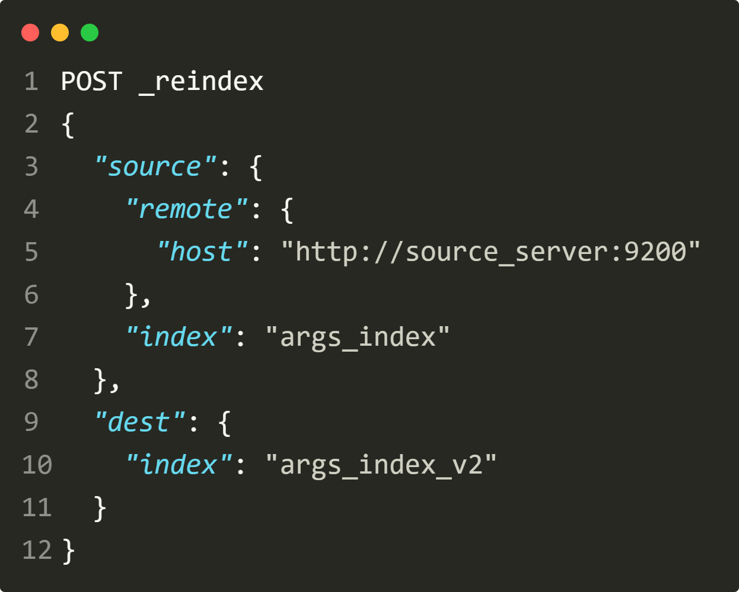
Open Questions (4)
“I am also curious to see your mapping for the data. At the moment much of the research in the Webis group deals with summarizing or phrasing arguments. And the premises in the current dataset also really need that. So I expect that we will soon have several different texts to display in the interface instead of the premise. How would you handle this?”
Elasticsearch create the default mapping by default (dynamic mapping)
Alternative Approach
Create new index with last mapping information
Add or Modify desired field
Reindex the document from original index to the one that just created
Reindex API:
elastic.co/guide/en/elasticsearch/reference/current/docs-reindex.html
Notes:
4th question is about how I setup mapping data and how to handle new fields that will be developed in the future.
บอกว่า Elastic use dynamic mapping by default if we didn’t specify mapping field information so it is already flexible and convenient to add new field.
However. I would suggest another approach and it is similar to best practice that engineer use to maintain and develop data in database.
We need to have dev server and main server.
On dev server สามารถใช้ write full ได้
อธิบายวิธีตาม slide
ability to reindex data across server (_reindex API) back and forth

Slide 26
Open Questions (5)
“ I assume that sooner or later someone wants to try out dense retrieval. It seems Elastisearch supports that. How could one model that?”
Choose a dense vector representation technique
Generate dense vectors for your documents and store them in Elasticsearch
Install a dense retrieval plugin or library
Query your index with a dense vector representation of your query
Perform nearest neighbor search using the installed plugin or library
Score your search results based on vector similarity
Dense retrieval: elastic.co/blog/improving-information-retrieval-elastic-stack-search-relevance
Dense vector: elastic.co/guide/en/elasticsearch/reference/current/dense-vector.html
Notes:
Last question is about how to model dense retrieval in Elasticsearch.
To be honest, this is another substantial topic that needs some time to research and understand. I didn’t have much time to understand how it worked and didn't have enough hands-on experience.
Consequently, I am unable to properly explain or answer question at this time. Nevertheless I try to find an overview of the best way to implement dense retreival in Elasticsearch engine. As a result, I have compiled a list of step that I have found as well as a few worthwhile articles regarding this subject.
And this is my last slide of the presentation. Thank you for your attention.
—---------------------------------------------------------------------------------------------
"Dense retrieval" refers to the use of dense vector representations of text documents to retrieve relevant results in a search query. This technique is also known as "nearest neighbor search" or "similarity search".
Traditionally, Elasticsearch uses sparse vectors to represent text documents, where each dimension represents a term in the document. When a search query is executed, Elasticsearch calculates the relevance of documents based on the presence or absence of query terms in the document.
Dense retrieval, on the other hand, uses dense vectors, where each dimension represents a continuous value that describes a feature of the document (such as the semantic meaning of the text). This allows for more nuanced similarity comparisons between documents, as well as more efficient nearest neighbor search.

Slide 27
Thank you

