Slide 1
Summer semester internship 2014
Embedded System Project

Slide 2
HiL System for teaching the basics of Digital Systems
5488049 Ms. Patboke Jitthamma (Sand)
5488054 Pramoch Viriyathomrongul (Eaew)
15 June 2014
Technical University Chemnitz

Slide 3
Background
Issues
• The faculty has to change all the old breadboards to new breadboard model(ie. Digilent Electronics Explorer board) which includes fully instruments for teaching digital system.
• Thus, the old software which operates on old breadboard, doesn’t compatible with new breadboard model.
• Although, WaveForms is a software that comes with new breadboard model, it doesn’t provide sufficiently teaching function.
Expectation
• Producing new software for EE board, inherits behavior from both old and new software.

Slide 4

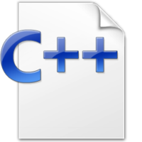
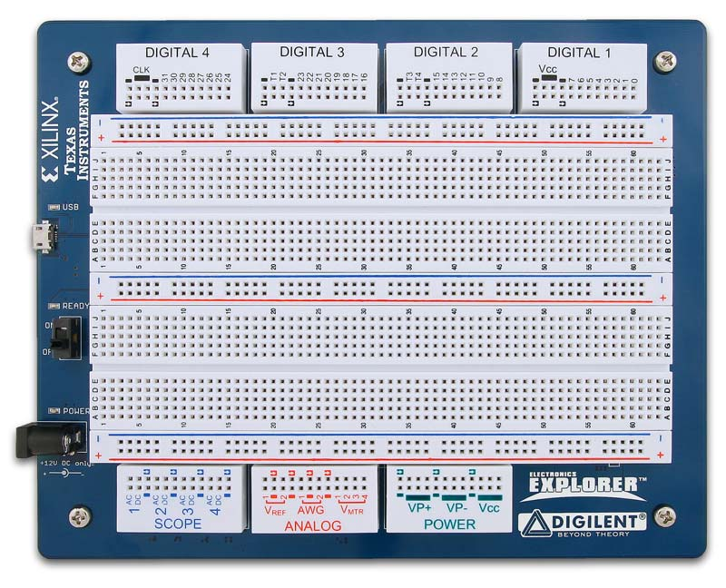
Scope
HW-access by API (Windows/Linux)
Parsing of VHDL files; Write and read of test- vectors
Waveform user interface
Technical Tool
Language -> JAVA Native Interface, C++, API
Hardware-> Electronics Explorer Board

Slide 5
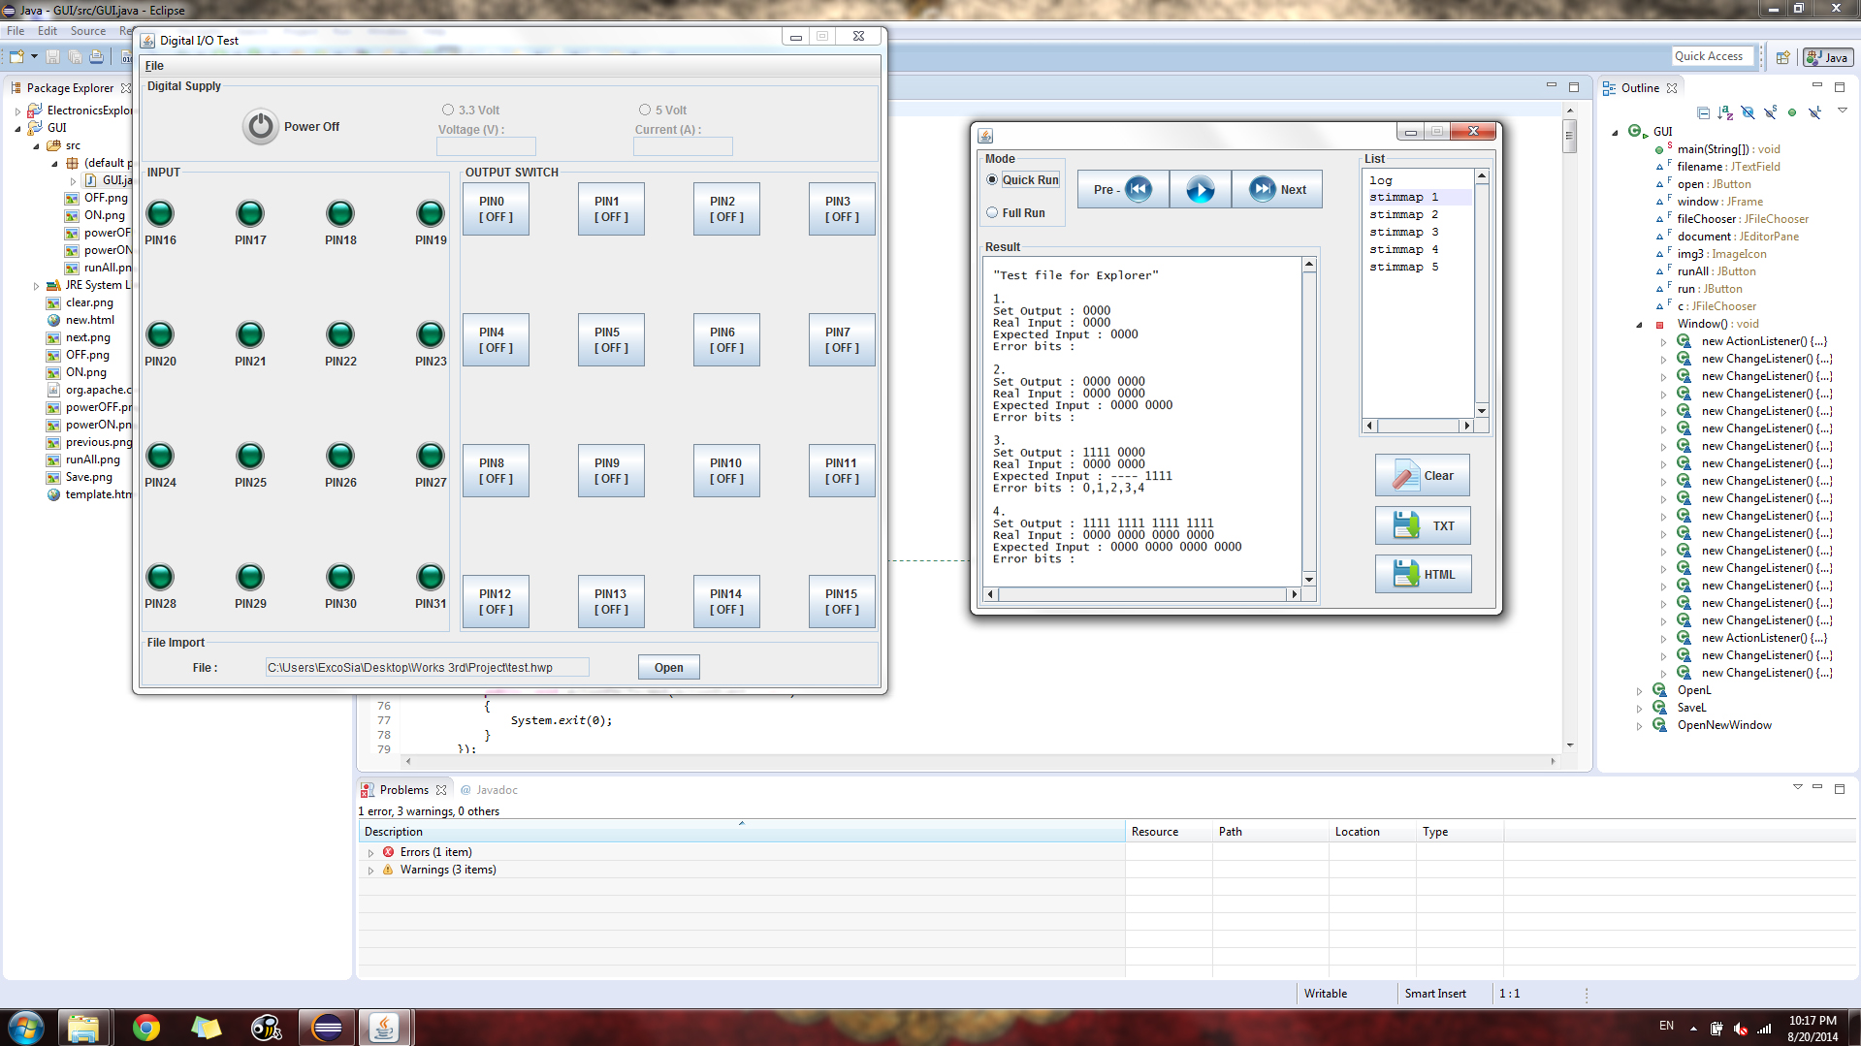
Goal
Application of Digital I/O Test

Slide 6
Features
Control and monitor the power supplies
Reading output i/o pins(PIN 16 to PIN 31)
which are displayed by LED
Enable/disable specific input i/o pins(PIN 0 to PIN 15)
by toggled buttons
Import VHDL file
Write and read of test- vectors in quick and full mode.
Export the result in .TXT or .HTML

Slide 7
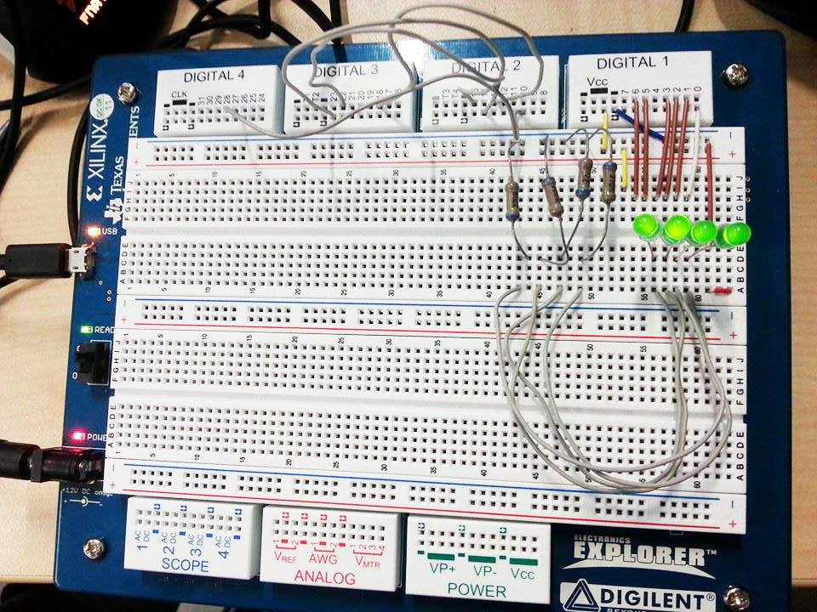
Demonstration System

Slide 8
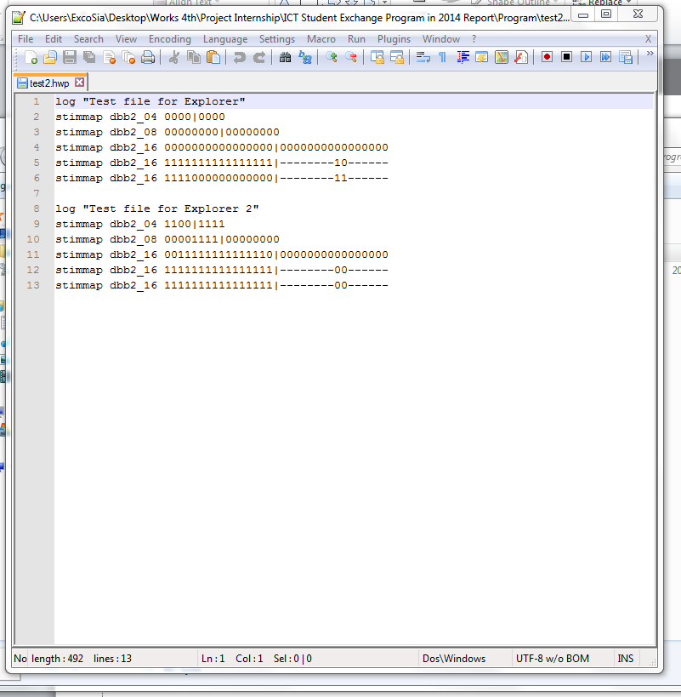
Demonstration System

Slide 9
Demonstration System

Slide 10
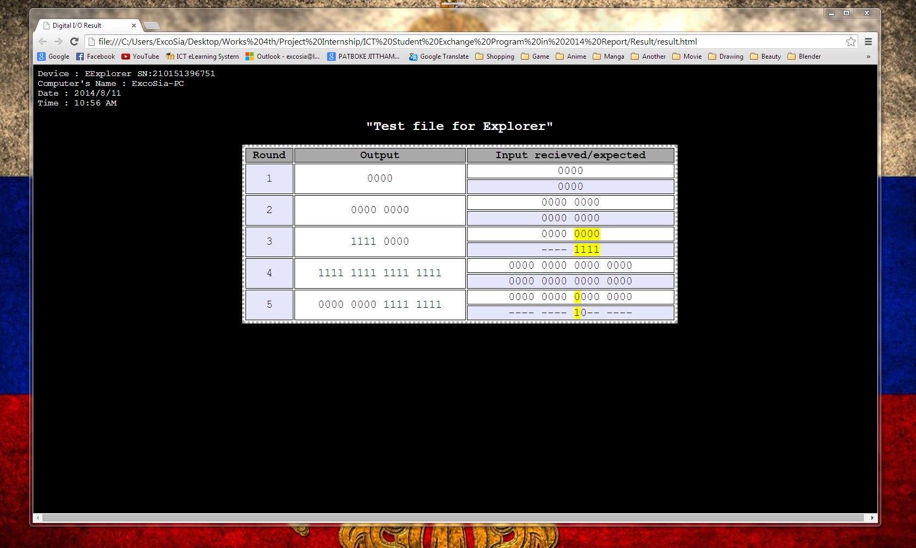
Demonstration System

Slide 11
Conclusion
Produced an application which inherited behavior from old and new software.
Import/export VHDL file and result file respectively.
Write and read test-vectors.
Control and monitor the power supplies of hardware.
Toggle and read value from i/o pins.
As this result, our software will utilizes on new breadboard and also can develop addition further features in the future.

Slide 12
Thank you for your attention

