Slide 1
Final Project
Visualization Course, SS 2022
Pramoch Viriyathomrongul, 124244
Notes:
Hello everyone, my name is …
Today I’m going to present my final project for visualization course.

Slide 2
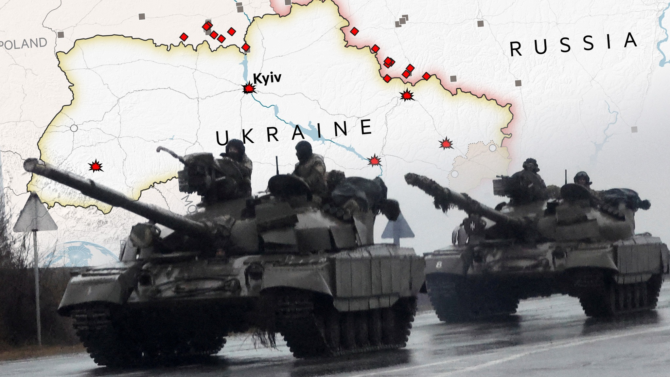
2022 Russian invasion of Ukraine
Reference image: www.ft.com
Notes:
My topic is 2022 Russian invasion of Ukraine.
I chose this topic because it is a well-known dataset tied to the current event.
In addition, I would like to visualize different questions compared to other visualization that already uses this dataset on the internet, along with implementing a bit of un-common design that I learned from the lecture.

Slide 3
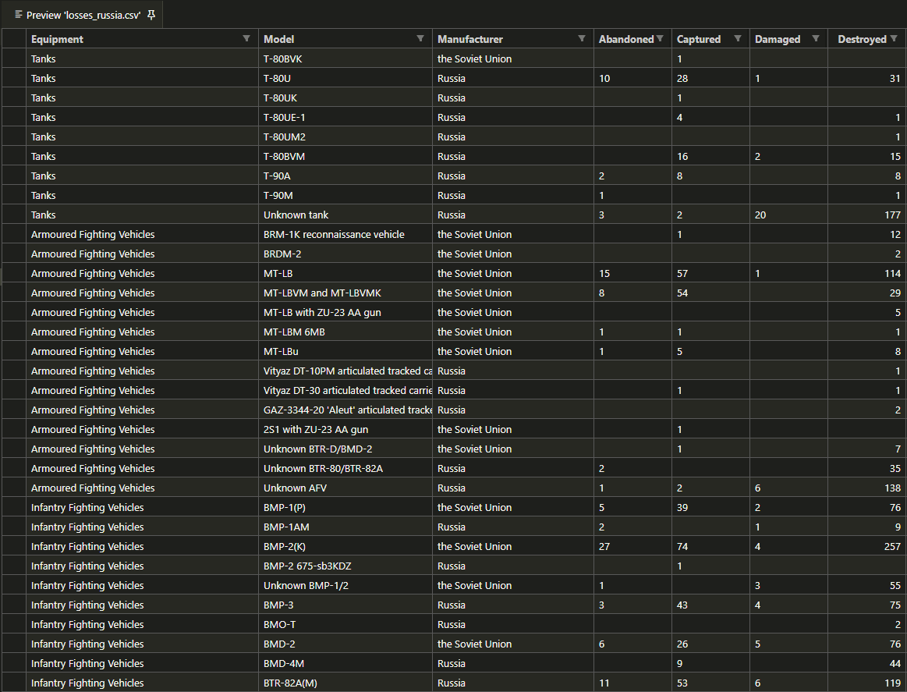
Data abstraction
2 Table data
losses_russia.csv
losses_ukraine.csv
Attribute sample
equipment: categorical
(e.g. tanks, naval ship)
model: categorical
(e.g. T-80U, BMP-3)
captured: quantitative
(e.g. 0-2,000)
destroyed: quantitative
abandoned: quantitative
Notes:
First, let’s start on my chosen dataset.
The dataset describes russian and ukrainian equipment losses during the war.
I used 2 table data files, each consisting of items and multi-attributes inside.
Some examples of attributes are:
Equipment which is categorical data and the value are equipment names like tank, naval ship, infantry fighting vehicle.
Model which is categorical data and the value are specific code names like T-80U, BMP3 which are not entirely necessary in my chart.
But the most used attributes are captured attributes, destroyed attributes, or abandoned attributes which are quantitative data and value range from 0 - 2000

Slide 4
Research question & Technique
Categorize military equipment losses between Ukraine and Russia in this war
task: discover distribution
visualization: sunburst chart
interaction: sequence navigation
Locate type of equipments that can be benefit to change in war strategy
task: compare distribution
visualization: grouped bar chart
interaction: equipment filter
Notes:
From the data, I formulate the questions that would benefit from visual analysis
(and of course, along with the advice from the TA)
My first question is, I want to categorize equipment losses between Ukraine and Russia in this war so far. So I can see the big picture of who suffers the major losses and what type of equipment has the highest or lowest losses percentage.
In this case, I have to perform discover distribution task.
So I decided to go with a sunburst chart and sequence navigation interaction.
because I think sunburst is a good use of area mark to discover distribution in visual encoding
sequence navigation help understand hierarchy relation between parent-child data
and the chart is also an uncommon design for this dataset compared to others on the internet
After I have the big picture of wars, the following interesting question would be, if one country has suffered a loss of one type of equipment, can that country find a change of equipment strategy in the data?
In this case, my task is to compare equipment loss distribution among each type.
So I implemented a grouped bar chart with equipment filter interaction.
because equipment data at the sunburst periphery are usually tiny and very difficult to distinguish
so bar chart is quite an excellent choice to compare the distribution easily
and it works well and is convenient with filter interaction

Slide 5
Result
Notes:
Without further ado, let see my implementation result.
My visualization dashboard consist of 2 chart as I stated previously
For the sunburst chart
inner radial, middle radial, outer radial
sequence navigation (hover)
answer who are most loss / what equipment category most loss/less loss / equipment name most loss/less loss
Because outer radial of sunburst are tiny to compare and hard to answer the 2nd question that we want to locate change of war strategy
So we can use bar chart with filter equipment category to answer that.
For example we can see most of equipment loss are greater from russia side. But if we are russia side we can locate and see we have advantage of naval area
and if we need to focus on ground area we can focus to choose more on infantry vehicle rather than using tank etc.
And if we are the ukraine side, of course they need to avoid naval area and, let say on the air let use helicopter or unman aerial because has quite different loss ratio compare to ukraine side
And that’s how I use this chart to answer the 2nd question.

