Slide 1

Indoor Commodity Tracking System Application Bluetooth Low Energy
Supervisor:
Mr. Nguyễn Đức Lợi
Tạ Đức Huy – SE61754 (Leader)
Mai Thế Quân – SE61192
Đoàn Văn Phát – SE61827
Team Members:

Slide 2
REPORT WEEK 2 – Software Project Management Plan
1. Problem Definition
2. Project Organization
3. Project Management Plan
4. Coding Convention

Slide 3
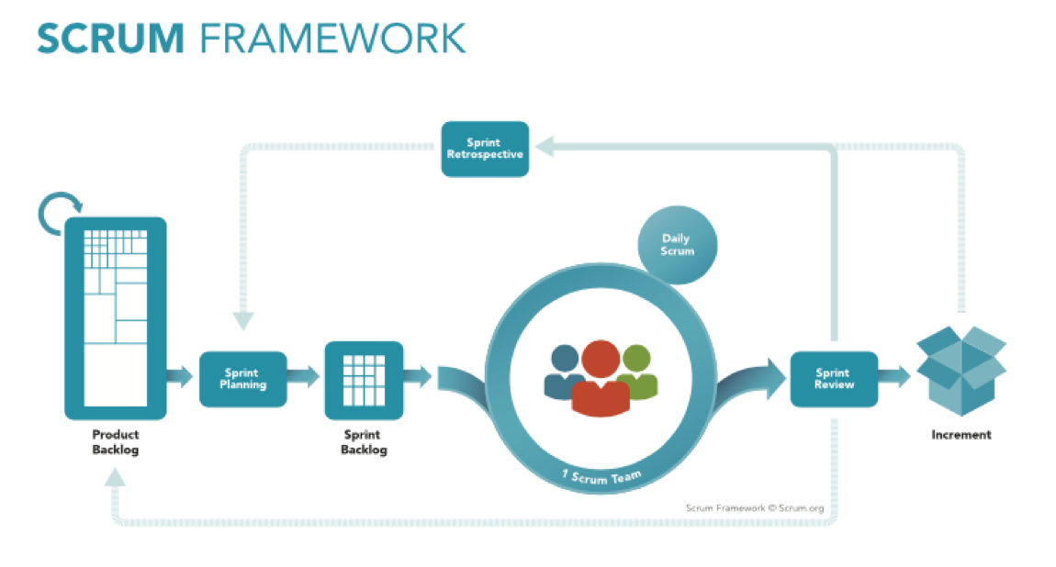
Project Organization

Slide 4
Project Organization
No | Full name | Roles | Responsibilities
1 | Nguyễn Đức Lợi | Supervisor, Project Manager | Specify user requirements and system requirements. Give advices, technical supports and solutions. Supervise the development process.
2 | Tạ Đức Huy | Team leader, developer, tester | Manage all progresses. Clarify requirements. Create development plan. Divide and assign tasks for members. Design database Coding. Testing. Prepare and verify documents.
3 | Mai Thế Quân | Team member, developer, tester | Clarify requirements. Coding. Testing. Prepare documents.
4 | Đoàn Văn Phát | Team member, developer, tester | Clarify requirements. Design GUI Coding. Testing. Prepare documents. Manage budgets.

Slide 5
Project Organization
Tools / Techniques | Name / Version
Operating system | Windows 10, Ubuntu
Frontend | JavaScript, jQuery, CSS, HTML, Bootstrap
Backend | Yii2 Framework
Embedded | C/C++, NodeJS
Modeling tool | Draw.io, Star UML
IDE | Visual Studio Code, PHP Storm
DBMS | MySQL
Source control | Github
Project management tool | Trello

Slide 6
Project Organization

