Slide 1

Indoor Commodity Tracking System Application Bluetooth Low Energy
Supervisor:
Mr. Nguyễn Đức Lợi
Tạ Đức Huy – SE61754 (Leader)
Mai Thế Quân – SE61192
Đoàn Văn Phát – SE61827
Team Members:

Slide 2
REPORT WEEK 1 – Topic Introduction
1. Project Information
2. Introduction
3. Current Situation
4. Problem Definition
5. Proposed Solution (Advantages and Disadvantages)
6. Functional Requirements
7. Role and Responsibility
8. Conclusion

Slide 3
Project Information
Project name: INDOOR COMMODITY TRACKING SYSTEM APPLICATION BLUETOOTH LOW ENERGY
Project Code: BTRACKING
Product Type: Embedded Device, Web Application, API Web Server
Start Date: 10/09/2018
End Date: 30/11/2018

Slide 4
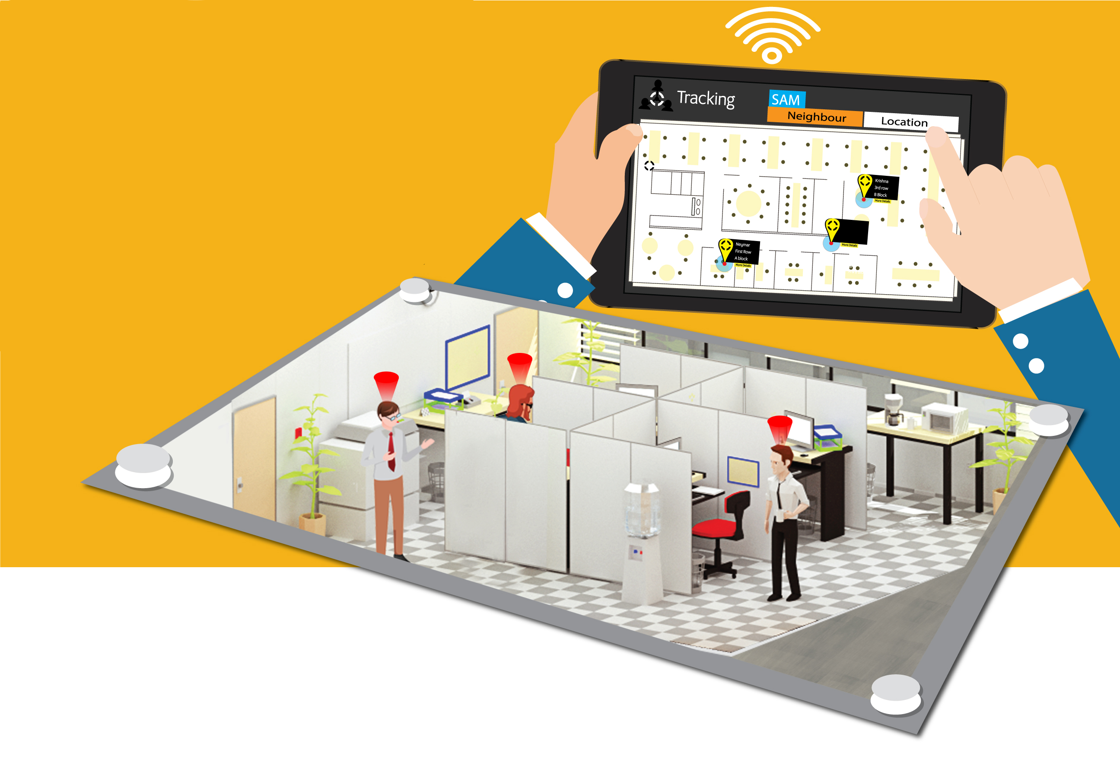
Introduction
Notes:
Indoor commodity tracking system uses Bluetooth connection to locate an object in a map. Map are generated from a structure of a house, a building or an area. Then, it displays on UI of web application. User can see their objects moving in the map. If the object moves out of the map, the system will ring the bell and announce to user.

Slide 5
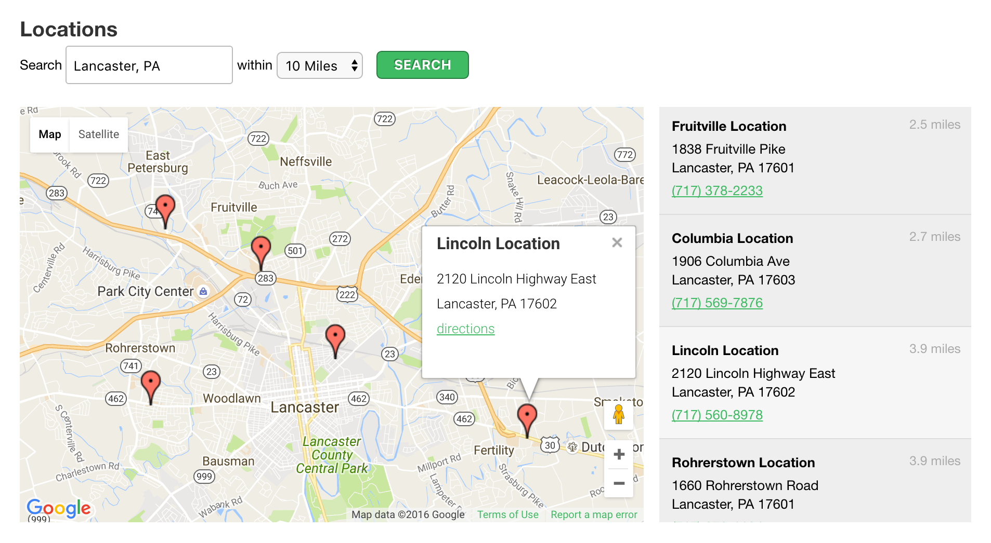
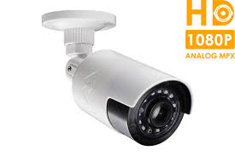
Current Situation
Notes:
Nowadays, determining the location of an object is very importance. Specifically, a camera is a device that only helps us see things in a certain range and we can’t set up the camera in the sensitive areas like the toilet. If we want a camera that can see a larger range, we must pay a lot of money. Besides, in the world have many applications used for location an object but these applications just can locate an object in Google Map by Google API, it locates an object by coordinates in a big map.

Slide 6


Problem Definition
Notes:
Advantage of existing system on the market
Big amount of users
Locate object in Google Map by Google API
Drawbacks of existing system on the market

Slide 7
Comparisons
No | Name | Cost | Kind of map | Accuracy
1 | GPS (Google API, Google Map) | ~$15 | World Map | 100-300m
2 | Btracking | ~$40 | Direct Map | 0.1-0.2m

Slide 8
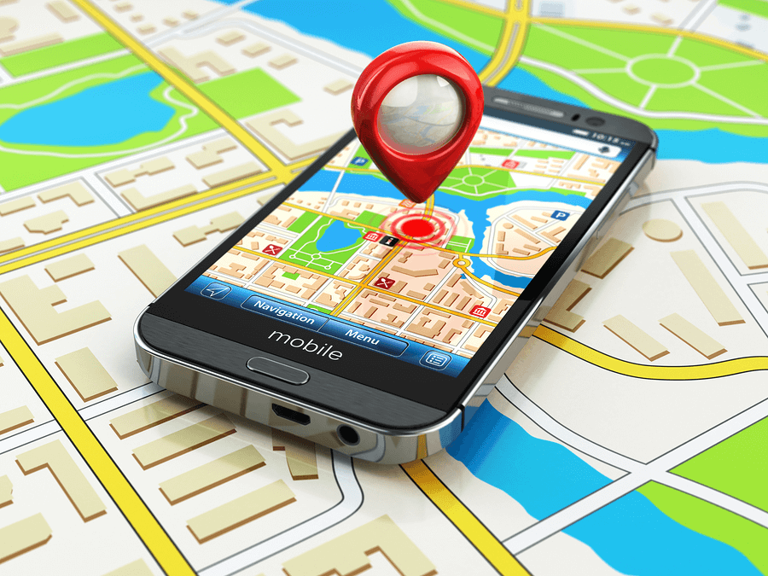
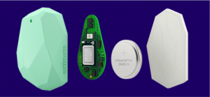
Solutions

Slide 9
Proposed Solution
Web App:
Control the object on the map.
Check the system status.
Gateway and nodes:
Gateway receive message from web application and control nodes.
Gateway receive coordinate from location block, handle it and then transmit them to web app.
Location block:
Get and send coordinate to gateway.

Slide 10
Proposed Solution
Advantages:
Low costs which allow more affordable prices.
Can control using web app.
Can see all the objects on the map.
Can be easily set up anywhere.
Higher security.
Disadvantages:
The range be limited by map.

Slide 11
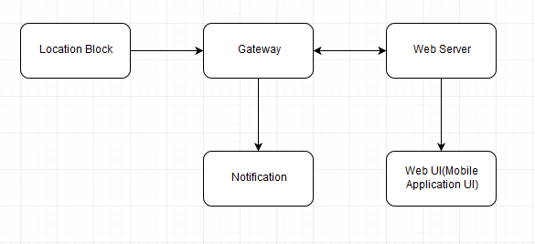
Functional Requirements

Slide 12
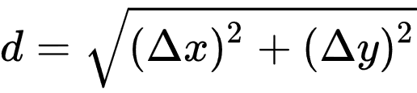
Algorithm
Distance between 2 points in Oxy
Distance from Beacon to ESP
d = A*(r/t)^B+C

Slide 13
Role and Responsibility
No | Full name | Role | Position | Contact
1 | Nguyễn Đức Lợi | Project Manager | Supervisor | loinnd@fpt.edu.vn
2 | Tạ Đức Huy | Developer | Leader | huytdse61754@fpt.edu.vn
3 | Mai Thế Quân | Developer | Member | quanmtse61192@fpt.edu.vn
4 | Đoàn Văn Phát | Developer | Member | phatdvse61827@fpt.edu.vn

Slide 14
Conclusion
Research to determine and implement the appropriate MCU for the Central Control Unit and other nodes
Design and implement integrate PCB board.
Research and implement NoSQL Database, Web Application.
C, C++ embedded into Raspberry pi 3.
Use software in design PCB, Schematic such as OrCAD, Proteus.
Communication technique: TCP, HTTP, MQTT.

