Slide 1

Indoor Commodity Tracking System Application Bluetooth Low Energy
Supervisor:
Mr. Nguyễn Đức Lợi
Tạ Đức Huy – SE61754 (Leader)
Mai Thế Quân – SE61192
Đoàn Văn Phát – SE61827
Team Members:

Slide 2
REPORT WEEK 2 – Software Project Management Plan
1. Problem Definition
2. Project Organization
3. Project Management Plan
4. Coding Convention

Slide 3
Problem Definition
Official name: Indoor Commodity Tracking System Application Bluetooth Low Energy
Abbreviation: BTRACKING

Slide 4
Problem Definition
Problem Abstract
At present, GPS positioning and tracking technology is very popular. However, its accuracy is not high, especially in the home. Nowadays the world is pushing the industrial revolution of 4.0, in which the demand for projects to monitor location in an indoor area increased. For example, monitoring and patient care at the hospital, tracking the location of objects in exhibits, etc. Therefore, location-based technology using BLE technology is becoming more common.

Slide 5
Problem Definition
Boundaries of the System
Our system provides these functions:
Determine the location of the object in the house.
Monitor the location of the object.
Set rules for objects (only located in certain areas, do not encroach on certain areas).
Group objects to manage.
Show the location history of the object.
Loudspeaker alert sound, app if any abnormal.

Slide 6
Problem Definition
Future plans
Analyze the trend of moving objects.
Tracking more information of object (heart rate monitoring, blood oxygen levels, acceleration, sudden change of position, ...).
Apply to schools for student attendance

Slide 7
Problem Definition
Hardware requirements
For passive devices:
Component | Hardware
SoC | CC2640/NRF51822
Communication | Bluetooth Low Energy
Devices | - Battery - Reset button
Power source | Sony CMOS BR2325 Battery 3.3V

Slide 8
Problem Definition
For activate devices:
Component | Hardware
Mainboard | BTracking active V1
Communication | Wifi and Bluetooth Low Energy
Devices | CP210x USB to UART Bridge Power and filtering module ESP32 Module with BLE
Power source | 5V

Slide 9
Problem Definition
For Local server:
Component | Hardware
Mainboard | Raspberry Pi 3/3+
Communication | Wifi
Power source | 5V

Slide 10
Problem Definition
For alarm device:
Component | Hardware
Mainboard | BTracking Alarm V1
Communication | Wifi
Devices | CP210x USB to UART Bridge Power and filtering module ESP32 Module with BLE Mono Speaker 5W
Power source | 5V

Slide 11
Problem Definition
Software requirements:
Software | Name / Version
Operating system | Windows 10, Ubuntu
Web programming | Yii Framework
Modeling tool | Draw.io, Star UML
IDE | Visual Studio Code, Visual Studio 2017, Php Storm
DBMS | MySQL
Source control | Github
Project management tool | Trello
Web browser | Chrome 42 or above

Slide 12
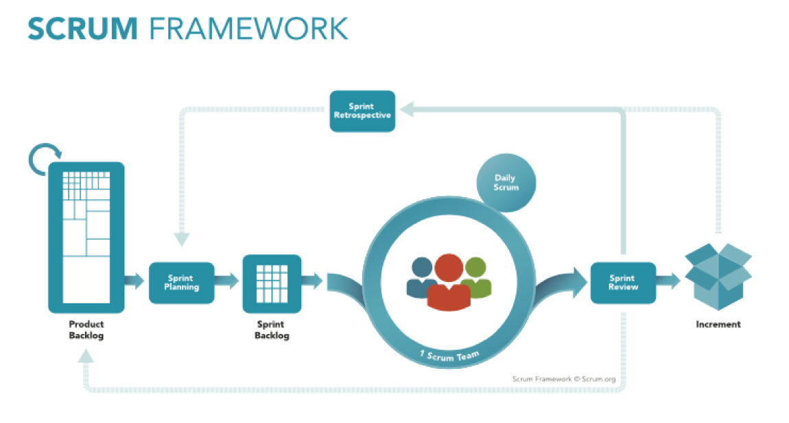
Project Organization

Slide 13
Project Organization
No | Full name | Roles | Responsibilities
1 | Nguyễn Đức Lợi | Supervisor, Project Manager | Specify user requirements and system requirements. Give advices, technical supports and solutions. Supervise the development process.
2 | Tạ Đức Huy | Team leader, developer, tester | Manage all progresses. Clarify requirements. Create development plan. Divide and assign tasks for members. Design database Coding. Testing. Prepare and verify documents.
3 | Mai Thế Quân | Team member, developer, tester | Clarify requirements. Coding. Testing. Prepare documents.
4 | Đoàn Văn Phát | Team member, developer, tester | Clarify requirements. Design GUI Coding. Testing. Prepare documents. Manage budgets.

Slide 14
Project Organization
Tools / Techniques | Name / Version
Operating system | Windows 10, Ubuntu
Frontend | JavaScript, jQuery, CSS, HTML, Bootstrap
Backend | Yii2 Framework
Embedded | C/C++, NodeJS
Modeling tool | Draw.io, Star UML
IDE | Visual Studio Code, PHP Storm
DBMS | MySQL
Source control | Github
Project management tool | Trello

Slide 15
THANK YOU FOR YOUR ATTENTION

