Slide 1
blktrace

Slide 2
安装
yum install blktrace -y
blktrace依赖debugfs，需要挂载它：
mount -t debugfs debugfs /sys/kernel/debug
blktrace包安装后有blktrace、blkparse、btt、blkiomon这4个命令
其中blktrace负责采集I/O事件数据
blkparse负责将每一个I/O事件数据解析为纯文本方便阅读
btt、blkiomon负责统计分析。

Slide 3
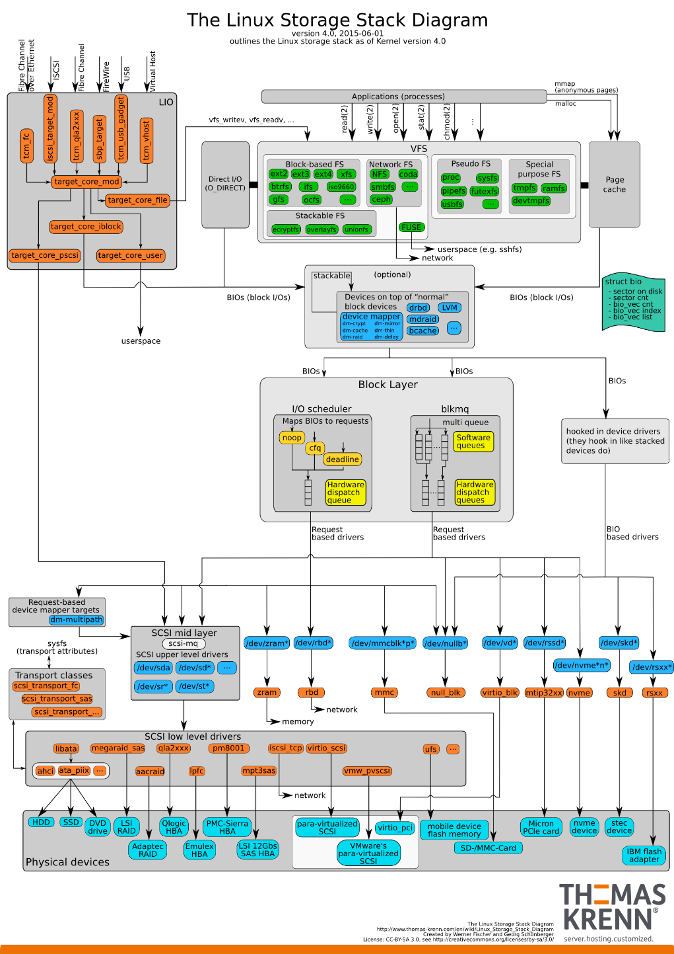
blktrace的原理
blktrace在block layer采集了每一个I/O的数据，可以用于完成一些非常深入的分析任务。service time才是衡量磁盘性能的核心指标和直接指标。iostat无法提供这个指标，但是blktrace可以。
一个I/O请求，从应用层到底层块设备，路径如下图所示：

Slide 4
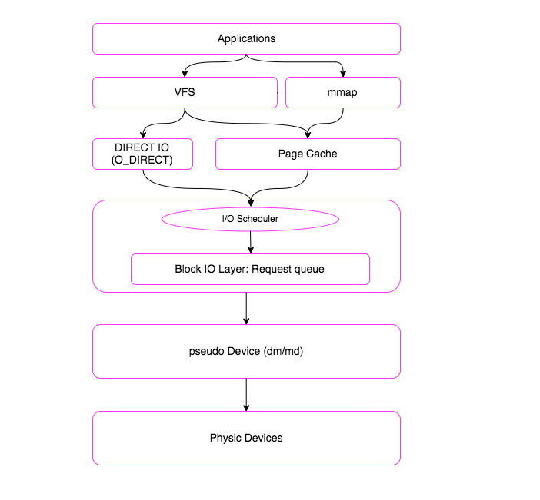
blktrace的原理
一个I/O请求进入block layer之后，可能会经历下面的过程：
Remap: 可能被DM(Device Mapper)或MD(Multiple Device, Software RAID) remap到其它设备
Split: 可能会因为I/O请求与扇区边界未对齐、或者size太大而被分拆(split)成多个物理I/O
Merge: 可能会因为与其它I/O请求的物理位置相邻而合并(merge)成一个I/O
被IO Scheduler依照调度策略发送给driver
被driver提交给硬件，经过HBA、电缆（光纤、网线等）、交换机（SAN或网络）、最后到达存储设备，设备完成IO请求之后再把结果发回。

Slide 5
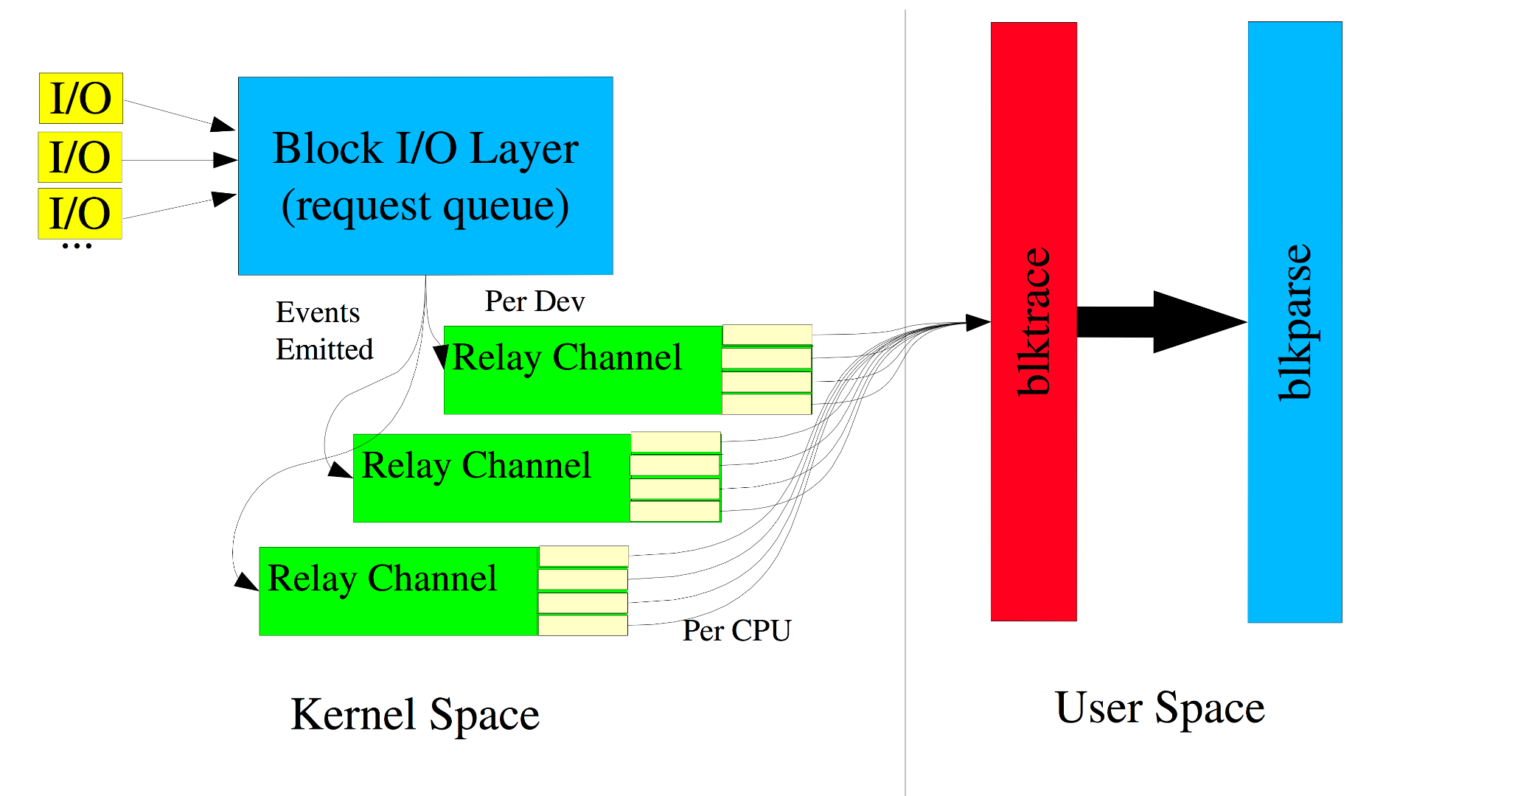
blktrace的原理
blktrace 能够记录下IO所经历的各个步骤:

Slide 6
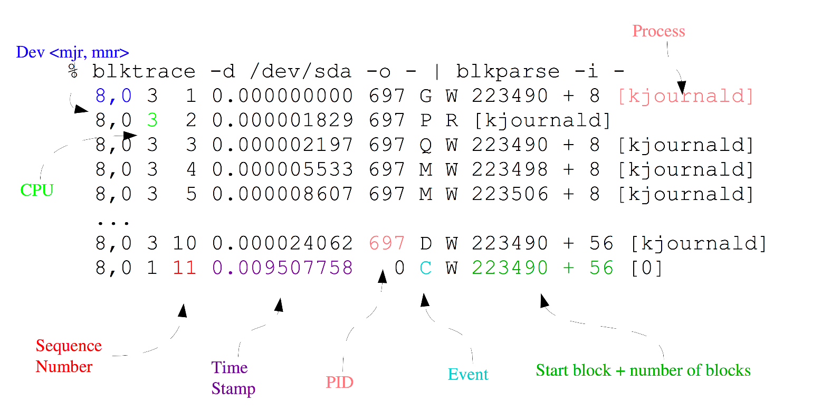
blktrace的原理
第一个字段：8,0 这个字段是设备号 major device ID和minor device ID。
第二个字段：3 表示CPU
第三个字段：11 序列号
第四个字段：0.009507758 Time Stamp是时间偏移
第五个字段：PID 本次IO对应的进程ID
第六个字段：Event，这个字段非常重要，反映了IO进行到了那一步
第七个字段：R表示 Read， W是Write，D表示block，B表示Barrier Operation
第八个字段：223490+56，表示的是起始block number 和 number of blocks，即我们常说的Offset 和 Size
第九个字段： 进程名

Slide 7
blktrace的原理
其中第六个字段非常有用：每一个字母都代表了IO请求所经历的某个阶段。Q – 即将生成IO请求,G – IO请求生成
I – IO请求进入IO Scheduler队列,D – IO请求进入driver ,C – IO请求执行完毕.
Q--------->G--------------->I--------->M------------------------->D-------------------------------------->C
|-Q time-|-Insert time-|
|----------- merge time -------------|-merge with other IO|
|----------------scheduler time time----------------------------|---driver,adapter,storagetime--|
|--------------------------------- await time in iostat output -------------------------------------------|
Q2Q — time between requests sent to the block layer
Q2G — time from a block I/O is queued to the time it gets a request allocated for it
G2I — time from a request is allocated to the time it is Inserted into the device's queue
Q2M — time from a block I/O is queued to the time it gets merged with an existing request
I2D — time from a request is inserted into the device's queue to the time it is actually issued to the device
M2D — time from a block I/O is merged with an exiting request until the request is issued to the device
D2C — service time of the request by the device
Q2C — total time spent in the block layer for a request

Slide 8
blktrace的原理
注意：整个IO路径，分成很多段，每一段开始的时候，都会有一个时间戳，根据上一段开始的时间和下一段开始的时间，就可以得到IO 路径各段花费的时间。
service time 反应块设备处理能力的指标，就是从D到C所花费的时间，简称D2C。
D2C 的 AVG 越大，代表设备越慢，延迟越高。 D2C 的 MAX 越大，代表设备的 tail latency 越高。 N 代表 btt 统计到的 D2C 的 IO 个数。
而iostat输出中的await，即整个IO从生成请求到IO请求执行完毕，即从Q到C所花费的时间，我们简称Q2C。
Q2C - D2C 就代表了内核软件栈引入的延迟
我们知道Linux 有I/O scheduler，调度器的效率如何，I2D是重要的指标。
offset，我们能拿到某一段时间里，应用程序都访问了整个块设备的那些block，从而绘制出块设备访问轨迹图。
size和Read or Write，我们可以知道IO size的分布直方图。

Slide 9
Blktrace使用
$ blktrace -d <dev> [ -r debug_path ] [ -o output ] [ -k ] [ -w time ]
[ -a action ] [ -A action mask ]
-d Use specified device. May also be given last after options.
-r Path to mounted debugfs, defaults to /sys/kernel/debug.
-o File(s) to send output to.
-D Directory to prepend to output file names.
-k Kill running trace.
-w Stop after defined time, in seconds.
-a Only trace specific actions (use more -a options to add actions).
Available actions are:
READ
WRITE
BARRIER
SYNC
QUEUE
REQUEUE
ISSUE
COMPLETE
FS
PC
-A Give the trace mask directly as a number.
-b Sub buffer size in KiB.
-n Number of sub buffers.
-l Run in network listen mode (blktrace server)
-h Run in network client mode, connecting to the given host
-p Network port to use (default 8462)
-s Disable network client use of sendfile() to transfer data
-V Print program version info.

Slide 10
Blktrace使用
blktrace -d /dev/dm-5 /dev/dm-6 -w 60
这个命令每一个CPU都会输出一个文件，-d 监控磁盘 –w 运行时长（秒）
blkparse可以将对应不同cpu的多个文件合并成一个二进制文件-d,-0合并成一个人类阅读格式：
blkparse -i dm-6 -d dm-6.blktrace.bin -o dm-6.txt
blktrace /dev/dm-6 -o - | blkparse -i -
blkparse dm-6 -a issue -o dm-6.txt
btt就可以分析这个dm-6.blktrace.bin
btt -i dm-6.blktrace.bin -o dm-6
设备延迟时间:
btt -i dm-6.blktrace.bin -l dm-6.d2c_latency
IO总的延迟时间:
btt -i dm-6.blktrace.bin -q dm-6.q2c_latency
btt -i dm-6.blktrace.bin -B dm-6.offset
其中r表示读操作的offset和size信息，w表示写操作的offset和size信息，c表示读＋写。

Slide 11
blkparse使用
$ blkparse -i <input> [ -o <output> ] [ -b rb_batch ] [ -s ] [ -t ] [ -q ]
[ -w start:stop ] [ -f output format ] [ -F format spec ]
[ -d <binary> ]
-i Input file containing trace data, or '-' for stdin.
-D Directory to prepend to input file names.
-o Output file. If not given, output is stdout.
-b stdin read batching.
-s Show per-program io statistics.
-h Hash processes by name, not pid.
-t Track individual ios. Will tell you the time a request took to
get queued, to get dispatched, and to get completed.
-q Quiet. Don't display any stats at the end of the trace.
-w Only parse data between the given time interval in seconds. If
'start' isn't given, blkparse defaults the start time to 0.
-d Dump sorted data in binary format

Slide 12
blkparse使用
-f Output format. Customize the output format. The format field
identifiers are:
%a - Action
%c - CPU ID
%C - Task command (process) name
%d - Direction (r/w)
%D - Device number
%e - Error number
%M - Major
%m - Minor
%N - Number of bytes
%n - Number of sectors
%p - PID
%P - PDU
%s - Sequence number
%S - Sector number
%t - Time (wallclock - nanoseconds)
%T - Time (wallclock - seconds)
%u - Time (processing - microseconds)
%U - Unplug depth

Slide 13
blkparse使用
-F Format specification. The individual specifiers are:
A - Remap
B - Bounce
C - Complete
D - Issue
M - Back merge
F - Front merge
G - Get request
I - Insert
P - Plug
Q - Queue
R - Requeue
S - Sleep requests
T - Unplug timer
U - Unplug IO
W - Bounce
X - Split
-v More verbose for marginal errors.
-V Print program version info.

Slide 14
btt参数说明
Usage: btt
[ -a | --seek-absolute ]
[ -A | --all-data ]
[ -B <output name> | --dump-blocknos=<output name> ]
[ -d <seconds> | --range-delta=<seconds> ]
[ -D <dev;...> | --devices=<dev;...> ]
[ -e <exe,...> | --exes=<exe,...> ]
[ -h | --help ]
[ -i <input name> | --input-file=<input name> ]
[ -I <output name> | --iostat=<output name> ]
[ -l <output name> | --d2c-latencies=<output name> ]
[ -L <freq> | --periodic-latencies=<freq> ]
[ -m <output name> | --seeks-per-second=<output name> ]
[ -M <dev map> | --dev-maps=<dev map>
[ -o <output name> | --output-file=<output name> ]
[ -p <output name> | --per-io-dump=<output name> ]
[ -P <output name> | --per-io-trees=<output name> ]
[ -q <output name> | --q2c-latencies=<output name> ]
[ -Q <output name> | --active-queue-depth=<output name> ]
[ -r | --no-remaps ]
[ -s <output name> | --seeks=<output name> ]
[ -S <interval> | --iostat-interval=<interval> ]
[ -t <sec> | --time-start=<sec> ]
[ -T <sec> | --time-end=<sec> ]
[ -u <output name> | --unplug-hist=<output name> ]
[ -V | --version ]
[ -v | --verbose ]
[ -X | --easy-parse-avgs ]
[ -z <output name> | --q2d-latencies=<output name> ]
[ -Z | --do-active

Slide 15
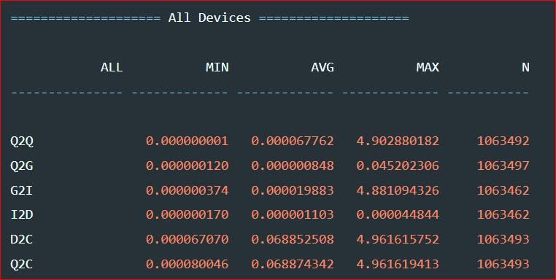
平均时间
D2C: time the I/O is “active” in the driver and on the device
Q2C: Total processing time of the I/O；客户发起请求到收到响应的时间

Slide 16
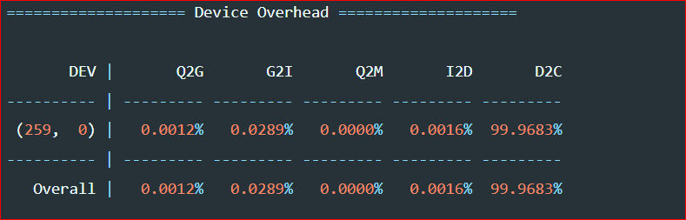
设备损耗
第二部分得到各个阶段消耗比例得到定性分析

Slide 17
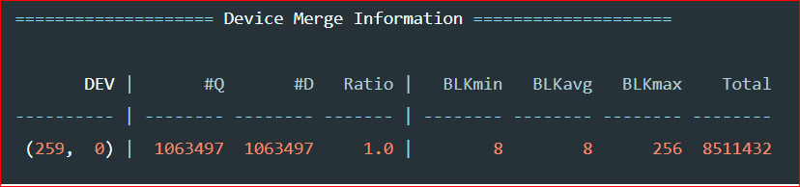
设备合并信息
A key measurement when making changes in the system (software \emph{or} hardware) is to understand the block IO layer ends up merging incoming requests into fewer, but larger, IOs to the underlying driver. In this section, we show the number of incoming requests (Q), the number of issued requests (D) and the resultant ratio. We also provide values for the minimum, average and maximum IOs generated.
IO合并请求信息，Q表示传入的IO请求，D表示合并后发出的请求，D越小证明数据包越大，合并请求比例越高(越高越好)。 ,此外还能看到平均IO块大小为8。

Slide 18
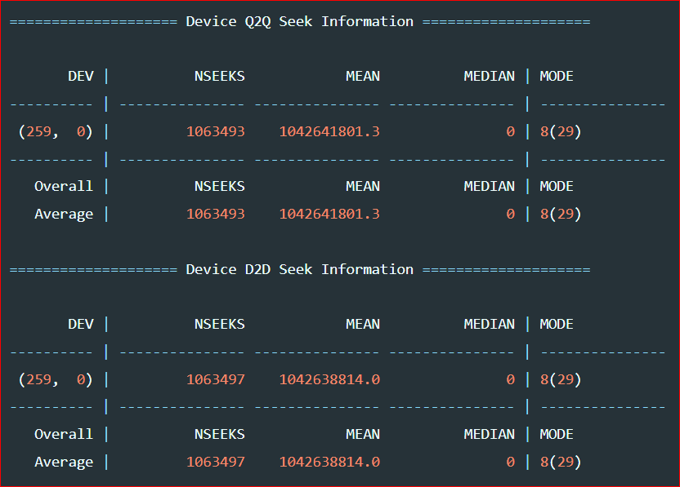
磁盘寻道讯息
用于显示连续队列和提交IO之间的扇区距离。NSEEKS表示提交到驱动的IO寻道次数， MEAS表示IO之间距离，MEDIA为０表示向前和向后寻道次数一样，MODE中数值表示块IO中连续的扇区。
Q2Q是到达的IO请求之间，D2D是驱动中处理的IO.请求

Slide 19
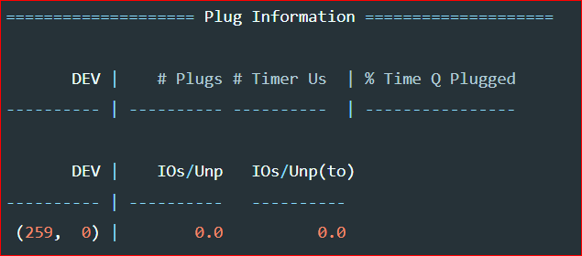
请求队列阻塞信息
这个就是现实队列阻塞，不能被驱动处理。这里的统计信息就是现实不能被处理的比例。

Slide 20
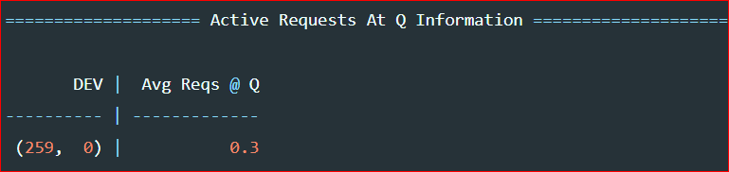
队列中IO调度
请求在IO调度上花费的时间。

Slide 21
blkiomon使用
blkiomon对设备/dev/ dm-6的io监控60秒，每2秒显示一次，如下：
blktrace -d /dev/dm-6 -a issue -a complete -w 60 -o - | blkiomon -I 2 -h -
time: Mon Oct 17 11:38:17 2022
device: 253,6
sizes read (bytes): num 5, min 32768, max 32768, sum 163840, squ 5368709120, avg 32768.0, var 0.0
sizes write (bytes): num 574, min 32768, max 32768, sum 18808832, squ 616327806976, avg 32768.0, var 0.0
d2c read (usec): num 5, min 269, max 693, sum 2292, squ 1154232, avg 458.4, var 20715.8
d2c write (usec): num 574, min 211, max 21733705, sum 136276774, squ 2370505493621902, avg 237416.0, var 4073434162752.7
throughput read (bytes/msec): num 5, min 47284, max 121814, sum 395134, squ 34409763578, avg 79026.8, var 636717597.4
throughput write (bytes/msec): num 574, min 1, max 155298, sum 45712017, squ 3931246993393, avg 79637.7, var 506705423.2
sizes histogram (bytes):
0: 0 1024: 0 2048: 0 4096: 0
8192: 0 16384: 0 32768: 579 65536: 0
131072: 0 262144: 0 524288: 0 1048576: 0
2097152: 0 4194304: 0 8388608: 0 > 8388608: 0
d2c histogram (usec):
0: 0 8: 0 16: 0 32: 0
64: 0 128: 0 256: 3 512: 486
1024: 62 2048: 9 4096: 7 8192: 4
16384: 0 32768: 0 65536: 0 131072: 0
262144: 0 524288: 0 1048576: 0 2097152: 0
4194304: 0 8388608: 0 16777216: 4 33554432: 4
>33554432: 0
bidirectional requests: 0

Slide 22
使用FIO，异地重放BIN文件
注意，有可能损坏目前盘上已有数据。
fio --name=replay --filename=/dev/dm-7 --thread --direct=1 --read_iolog=dm-5.bin
使用strace跟踪查看当时主机上IO行为：
strace -o strace.out fio --name=replay --filename=/dev/dm-7 --thread --direct=1 --read_iolog=dm-5.bin

Slide 23
监控脚本
blkmon.sh：
服务器可以在需要时候运行监控脚本获取合并后的BIN文件用于解析。
这里监控3个盘空格分隔，监控10秒，一般不要超过60秒，文件太大，解析太慢。
blktrace -d /dev/dm-4 /dev/dm-5 /dev/dm-6 -w 10
这里分别按盘分别合并成2进制文件，只需要保留bin文件用于后面解析。
blkparse -i dm-4 -d dm-4.bin > /dev/null
blkparse -i dm-5 -d dm-5.bin > /dev/null
blkparse -i dm-6 -d dm-6.bin > /dev/null
合并后，删除按CPU监控文件。
find . -name "*.blktrace.*" -exec rm -rf {} \;

Slide 24
解析脚本
blkreport.sh：
解析脚本可以运行在与监控脚本不同服务器，只需要拷贝需要解析的BIN文件放在同一目录用于解析。例如dm-4.bin
解析结果将BTT结果和一些数据作图后合并为一个解析日期的PDF文件，便于查看保存。
解析dm-4.bin:
python3 blkreport.py -d dm-4
删除解析中间文件：
find . -regex '.*\.png\|.*\.result\|.*\.md' -exec rm -rf {} \;
gen_png.sh
使用btt解析bin,并使用gnuplot生成图形，gnuplot需要安装：
yum install gnuplot -y

Slide 25
解析脚本
blkreport.py使用pandoc将文档合并成PDF，需要下载安装pandoc ：
https://github.com/jgm/pandoc/releases/download/2.19.2/pandoc-2.19.2-linux-amd64.tar.gz
tar xvzf pandoc-2.19.2-linux-amd64.tar.gz --strip-components 1 -C /usr/local/
pandoc -v
ln -s /usr/local/bin/pandoc /usr/bin/pandoc
For PDF output, you’ll need LaTeX.
yum install texlive –y
-------LaTeX Error: File `translator.sty' not found.
https://ctan.org/search?phrase=translator
unzip -d /usr/share/texlive/texmf-dist/tex/latex/ translator.zip
-----------psutil
pip install psutil
解析脚本需要python3环境，建议安装一台方便的机器集中解析，监控机器只需要安装blktrace，获取合并后的bin文件。

Slide 26
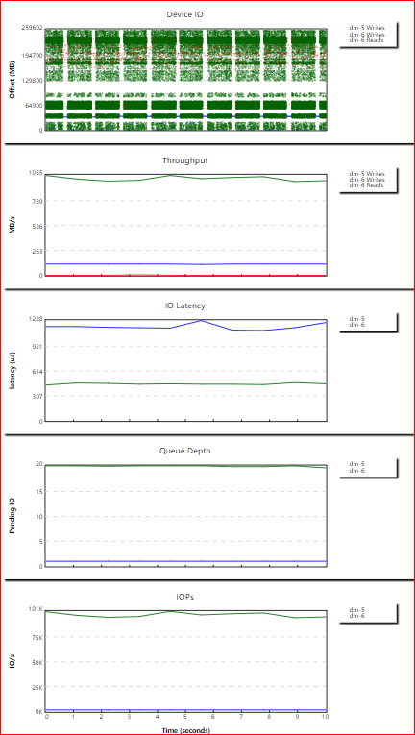
iowatcher
http://masoncoding.com/iowatcher/
iowatcher -t dm-5.bin -o dm-5.svg
iowatcher -t dm-5.bin -t dm-6.bin -l dm-5 -l dm-6 -o dm.svg
-d, --device <device>
Controls which device you are tracing. You can only trace one device at a time for now. It is sent directly to blktrace, and only needed when you are making a new trace.
-D, --blktrace-destination <destination>
Destination for blktrace.
-p, --prog <program>
Program to run while blktrace is run.
-K, --keep-movie-svgs
Keep the SVG files generated for movie mode.
-t, --trace <file|directory>
Controls the name of the blktrace file. iowatcher uses a dump from blkparse, so -t tries to guess the name of the corresponding per CPU blktrace data files if the dump file doesn't already exist. If you want more than one trace in a given graph, you can specify -t more than once. If a directory is specified, iowatcher will use the name of the directory as the base name of the dump file and all trace files found inside the directory will be processed.
-l, --label <label>
Sets a label in the graph for a trace file. The labels are added in the same order the trace files are added.
-m, --movie [spindle|rect]
Create a movie. The file format depends on the extension used in the -o filename.* option. If you specify an .ogv or .ogg extension, the result will be Ogg Theora video, if png2theora is available. If you use an .mp4 extension, the result will be an mp4 video if ffmpeg is available. You can use any other extension, but the end result will be an mp4. You can use --movie=spindle or --movie=rect, which changes the style of the IO mapping.
-T, --title <title>
Set a title to be placed at the top of the graph.
-o, --output <file>
Output filename (default: trace.svg).
-r, --rolling <seconds>
Control the duration for the rolling average. iowatcher tries to smooth out bumpy graphs by averaging the current second with seconds from the past. Larger numbers here give you flatter graphs.
-h, --height <height>
Set the height of each graph
-w, --width <width>
Set the width of each graph
-c, --columns <columns>
Numbers of columns in graph output
-x, --xzoom <min:max>
Limit processed time range to min:max
-y, --yzoom <min:max>
Limit processed sectors to min:max
-a, --io-plot-action <action>
Plot given action (one of Q,D,C) in IO graph
-P, --per-process-io
Distinguish between processes in IO graph
-O, --only-graph <graph>
Add a single graph to the output (see GRAPHS). By default all the graphs are included, but with -O you get only the graphs you ask for. -O may be used more than once.
-N, --no-graph <type>
Remove a single graph from the output (see GRAPHS). This may also be used more than once.
GRAPHS
Choices for -O and -N are:
io, tput, latency, queue_depth, iops, cpu-sys, cpu-io, cpu-irq, cpu-user, cpu-soft

Slide 27
ioprof
https://github.com/intel/ioprof
I/O Histogram - Great for determining size of hot data for SSD caching
I/O Heatmap - Useful visualization to “see” where the hot data resides
I/O Size Stats - IOPS and bandwidth stats, which is useful for mixed workloads
Top Files (opt) - Can ID top accessed files in EXT3/EXT4 filesystems
Zipf Theta - An estimate of Zipfian distribution theta
./ioprof.pl -m trace -d /dev/dm-4 -r 60
./ioprof.pl -m trace -d /dev/dm-5 -r 60
./ioprof.pl -m trace -d /dev/dm-6 -r 60
./ioprof.pl -m post -t dm-4.tar -p
./ioprof.pl -m post -t dm-5.tar -p
./ioprof.pl -m post -t dm-6.tar -p
不建议使用，仅限于参阅ioprof.py源码

Slide 28
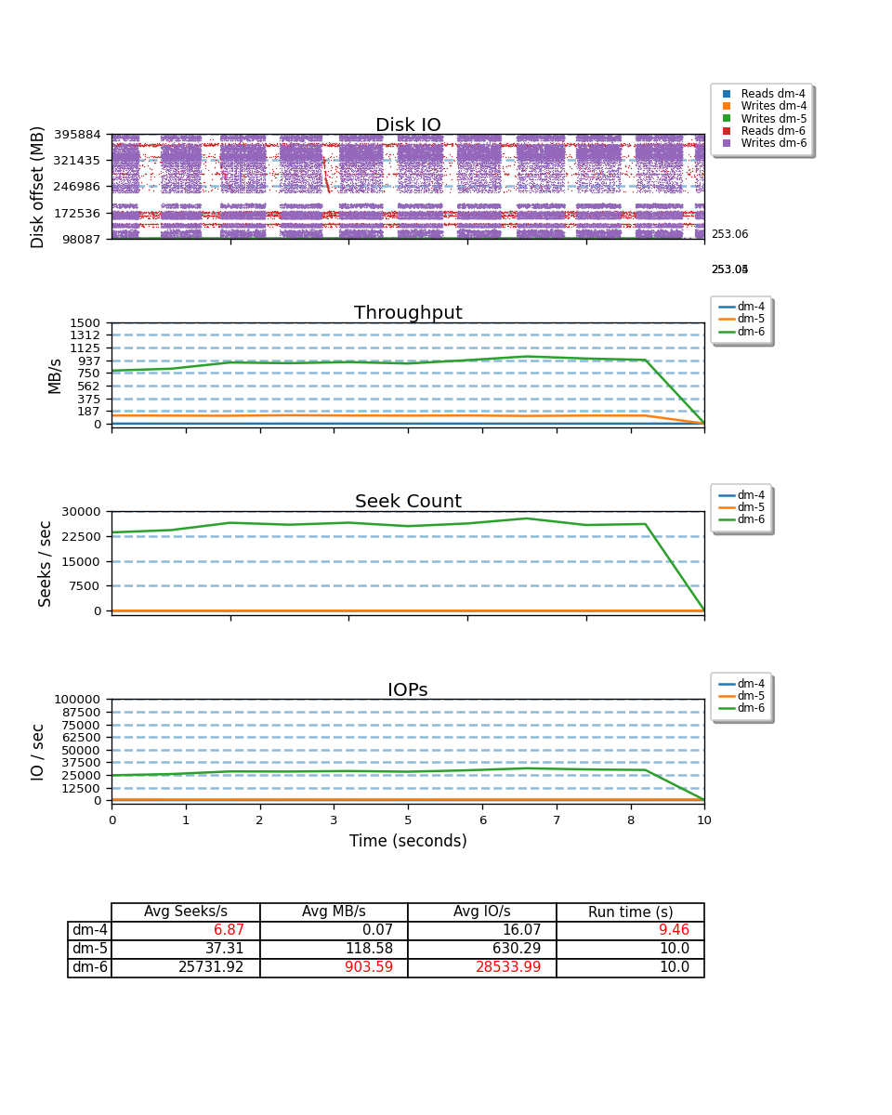
seekwatcher
https://github.com/trofi/seekwatcher
pip3 install numpy
pip3 install Cython
yum -y install libjpeg-turbo-devel
yum -y install python3-devel
pip3 install Pillow
pip3 install matplotlib
ln -s /usr/bin/python3.6 /usr/bin/python
python setup.py install
blktrace -d /dev/dm-4 /dev/dm-5 /dev/dm-6 -w 10
seekwatcher -t dm-4 -o dm-4.png
seekwatcher -t dm-5 -o dm-5.png
seekwatcher -t dm-6 -o dm-6.png
seekwatcher -t dm-4 -t dm-5 -t dm-6 -l dm-4 -l dm-5 -l dm-6 -o dm-456.png

