Slide 1
Office Timeline Template
Phase 1 Here
19 days
Jul 20 - Aug 14
Phase 2 Here
16 days
Aug 15 - Sep 7
Phase 3 Here
24 days
Aug 15 - Sep 17
Phase 4 Here
17 days
Sep 8 - Sep 30
Phase 5 Here
25 days
Oct 4 - Nov 7
Phase 6 Here
23 days
Nov 11 - Dec 11
Milestone 2
Milestone 5
Jun 7
Oct 30
Milestone 1
Milestone 3
Milestone 4
Milestone 6
May 10
Tue Aug 12
Thu Sep 25
Nov 15
2014
May
Jun
Jul
Aug
Sep
Oct
Nov
Dec
Today
Dec 18
Milestone 7

Slide 2
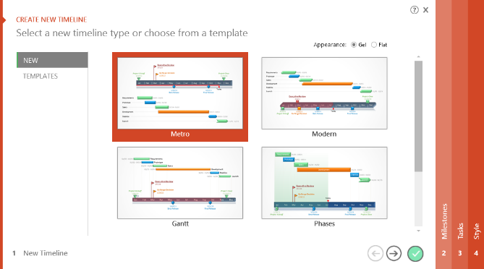

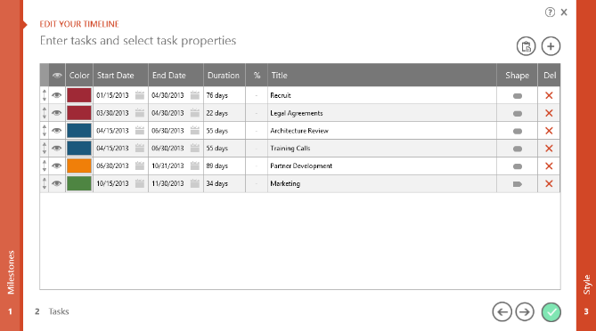
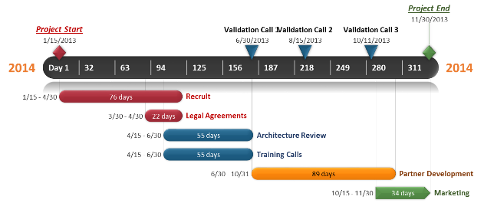
To change and update this template automatically,
download the free Office Timeline PowerPoint add-in!
Office Timeline is a free, award winning, timeline maker that's really easy to use.
Simple, easy-to-use wizards.
Professional, quick results.
Built directly into PowerPoint

