Slide 1
HOME
TASK
MANAGER

Slide 2
INTRO
A task managing application for people who share the same household. Users can records logs of chores done and when, add new chores to the list, as well as change and delete when necessary.

Slide 3
REASON
As I'm sure anyone who's ever shared a living space with any other person... ever, there are things around the house that either people forget to do, don't do, or already do but don't tell you.
Things like accidentally feeding your pets twice or forgetting who took out the trash last would be a thing of the past!

Slide 4
PROBLEMS
• Transitioning concepts into actual code ie syntax, logic flow etc
• Error handling. How do I get my thing to see the problem!
• Using correct data types for correct functions.
• No ethical issues thus far as I've written everything myself.

Slide 5
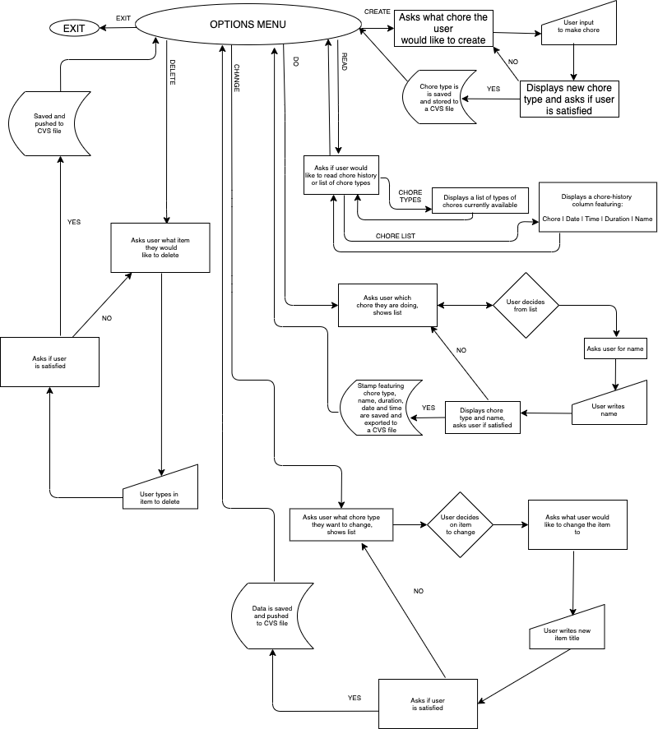
NO :'(

Slide 6
OPTION MENU
Standard options menu featuring prompts for 'doing' chores as well as (CRUD) create, read, edit, delete and exit.

Slide 7
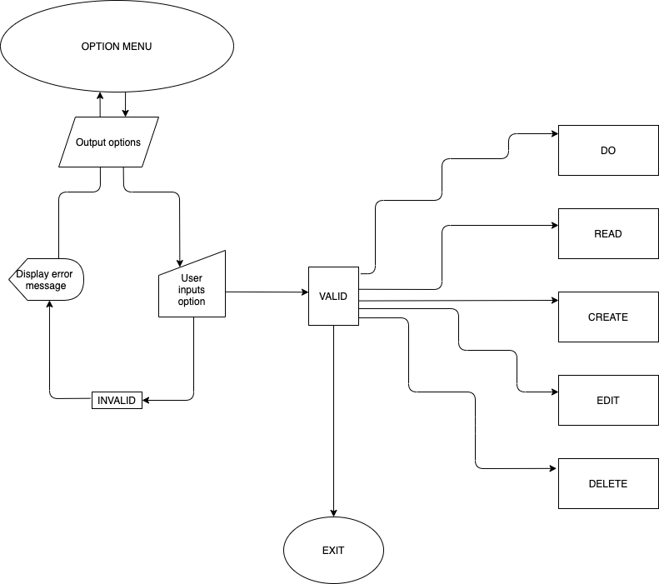

Slide 8

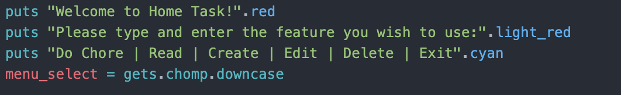

Slide 9
'DO' CHORES PROCESS
• Reads list of chores from 'chore list' CVS file
→ Shows a list of available chores to end user.
• If valid, asks for a user name
→ Stores chore, name, and timestamp to the 'chore history' CVS file.
If invalid,
→ Restart loop.

Slide 10
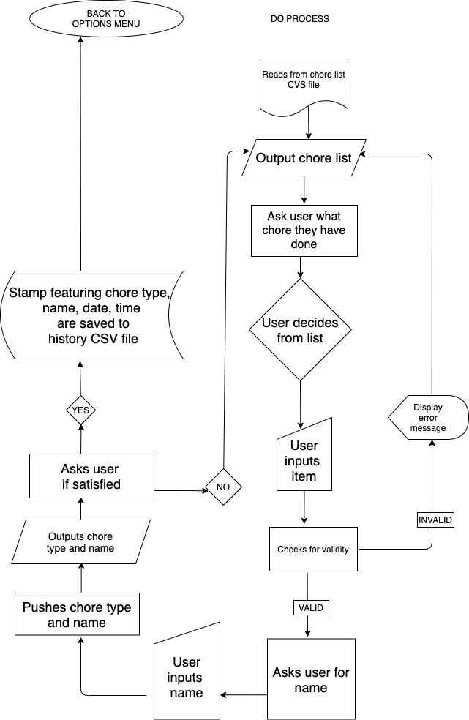

Slide 11
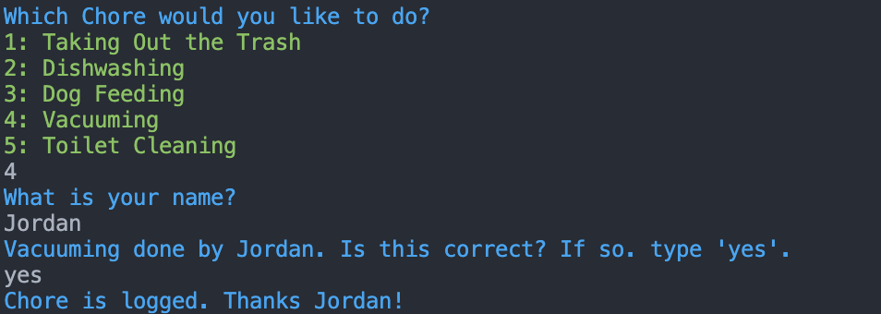
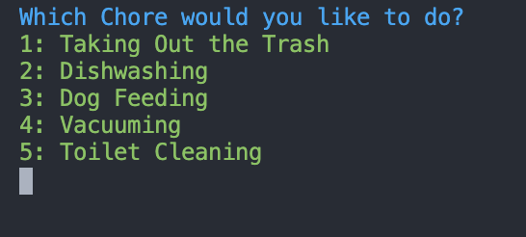
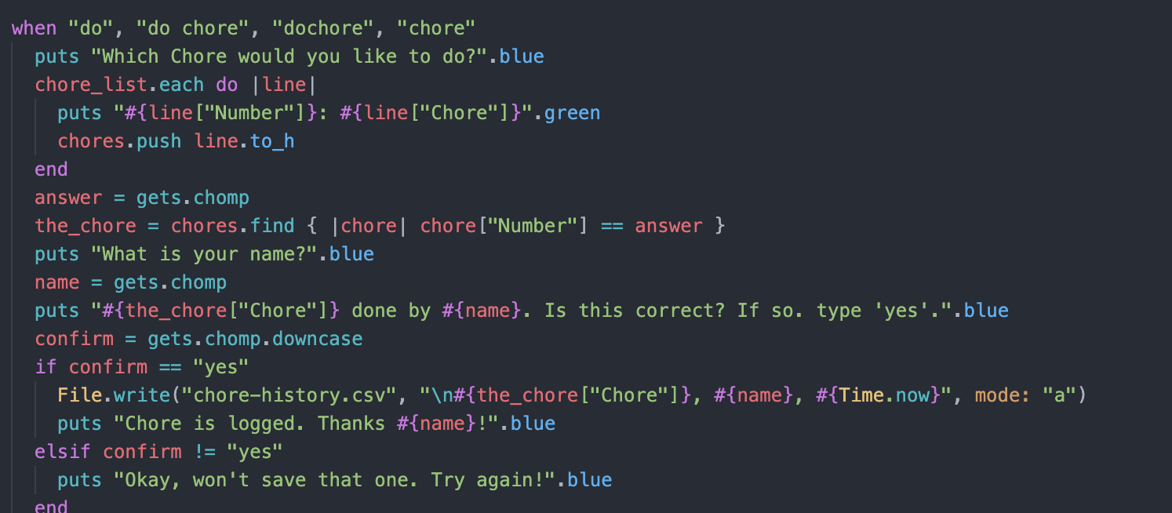

Slide 12
READ PROCESS
• First, asks user if they would prefer to read the 'chore list' CSV file, or the 'chore history' CSV file.
• If 'chore list',
→ Reads 'chore list' CSV,
→ Outputs to screen.
• If 'chore history',
→ Reads 'chore history' CSV,
→ Outputs to screen.

Slide 13
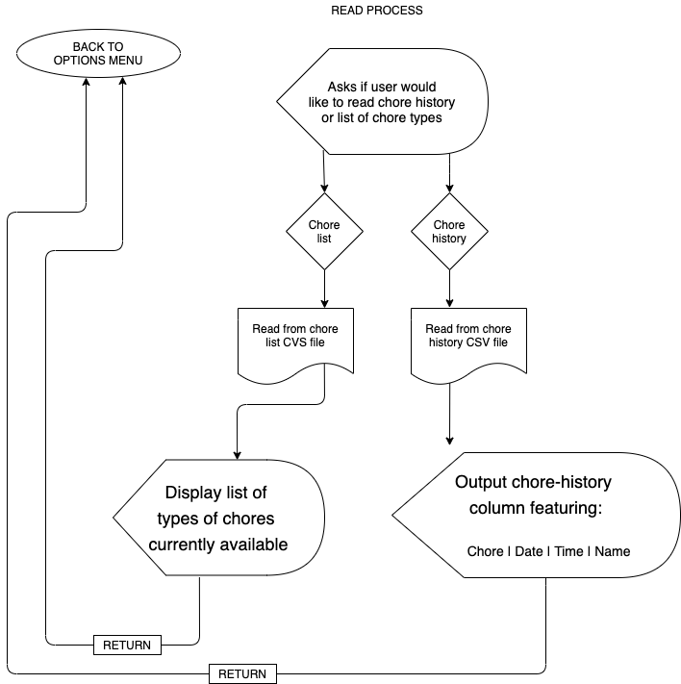

Slide 14
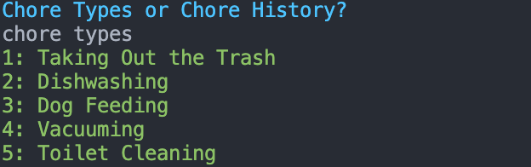
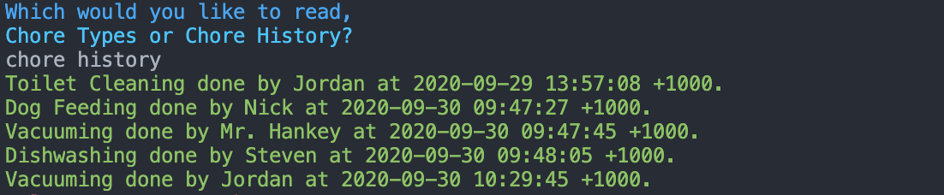
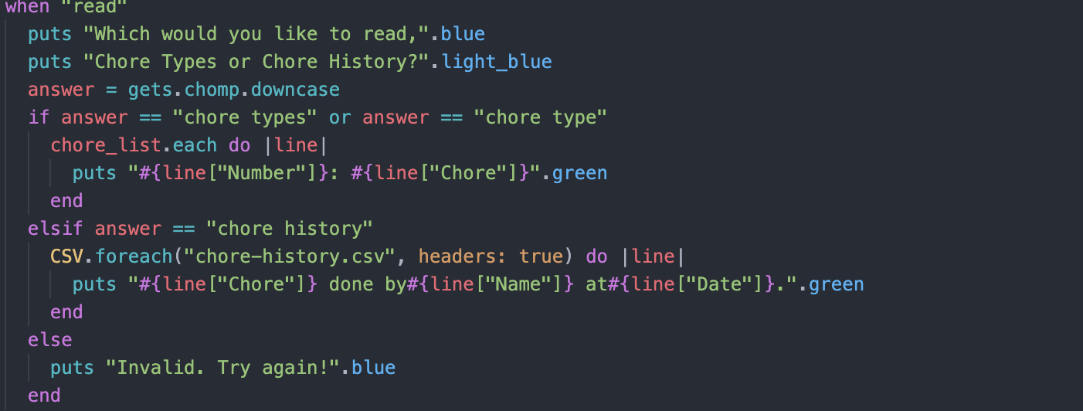

Slide 15
CREATE PROCESS
• User input to create a new chore type
• Confirms with user if new input is to be sent
• If yes,
→ write to 'chore list' CSV file.
• If no,
back to the start you go!

Slide 16
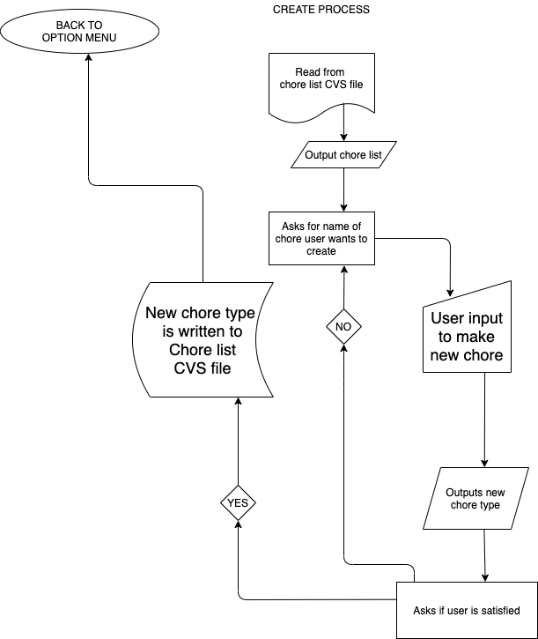

Slide 17
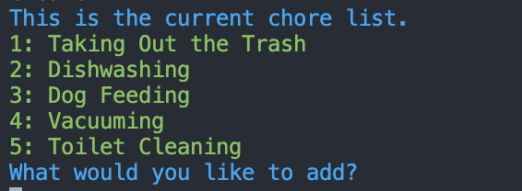
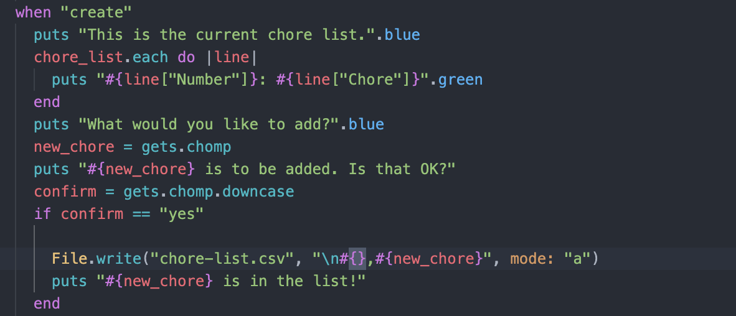

Slide 18
EDIT PROCESS
• Reads 'chore list' CSV file,
→ Outputs list to screen
• Asks user what chore they'd like to edit
• If invalid,
→ Back to the start!
• If valid,
→ Asks what they would like to change it to.
• User types in new value,
→ Program confirms if this what user wants
• If yes,
→ overwrites new value to CVS file.
• If no,
→ Back to the start!

Slide 19
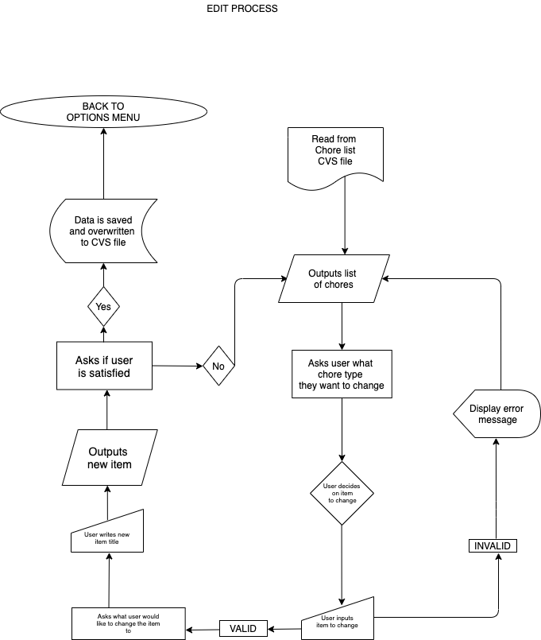

Slide 20
DELETE PROCESS
• Reads 'chore list' CVS file,
→ Outputs chores to user.
• Asks what the user would like to delete
→ User types in chore.
• If invalid,
→ Back to the start!
• If valid,
→ Output value, asks if user wants to delete.
• If yes,
→ Item is deleted.
• If no,
→ Back go the start!

Slide 21
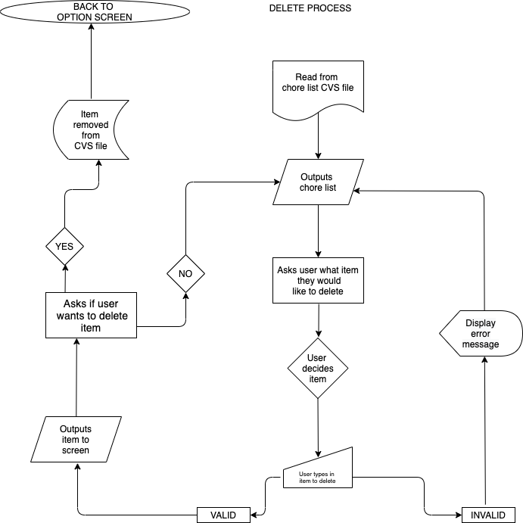

Slide 22
EXIT PROCESS
• Outputs message asking user if they want to exit application
• If yes,
→ Close application.
If no,
→ Back to option menu.

Slide 23
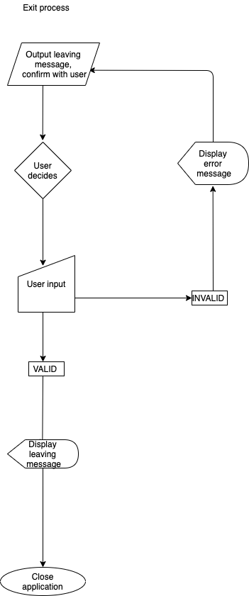

Slide 24
END
Thanks for not falling asleep!

