Slide 1
Jordan Bradley

Slide 2
Purpose
• A site about me and my skills that I can edit and update as I gain new skills.
• Future reference point for employment or collaborations.

Slide 3
Components
Page list:
Home page
Bio page
Portfolio page
Blog page
Contact page

Slide 4
Styling (Wireframes + Site)
• Minimalistic
• Functional
• Easy to navigate
• Not overwhelming

Slide 5
Shared elements;
• Black nav bar with white hover e!ect
• Similar title stylisation across 5 pages
• Cream background
• Copyright footing.

Slide 6
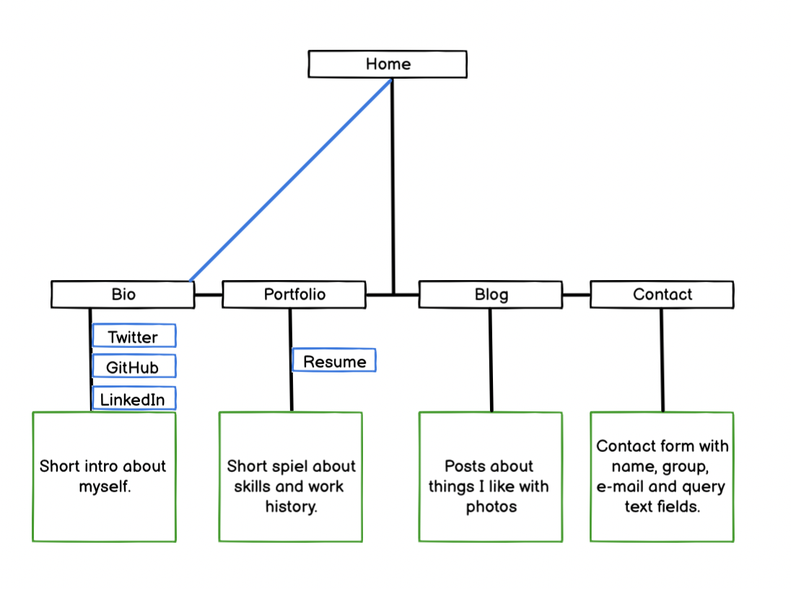

Slide 7
In my opinion, a consistent approach to aesthetic creates not only an easier browsing experience, but also an easy to remember one.

Slide 8
Difficulties
• Deciding on content
• Flex + grid
• Margins + padding
• Discarded elements

Slide 9
Title page
• Photo of myself on a black and white grayscale, hovers into colour. Features a click-thru prompt that takes user onto bio page.

Slide 10
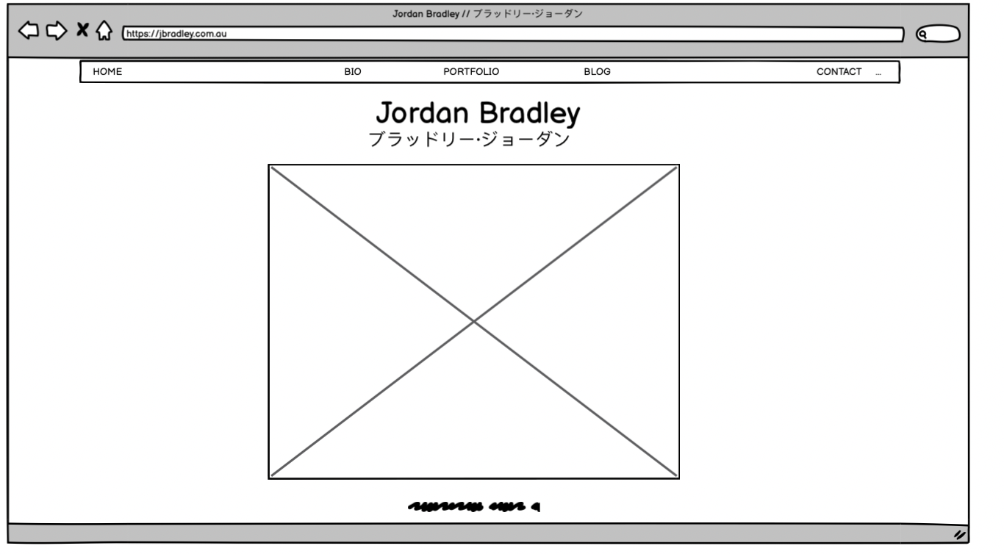

Slide 11
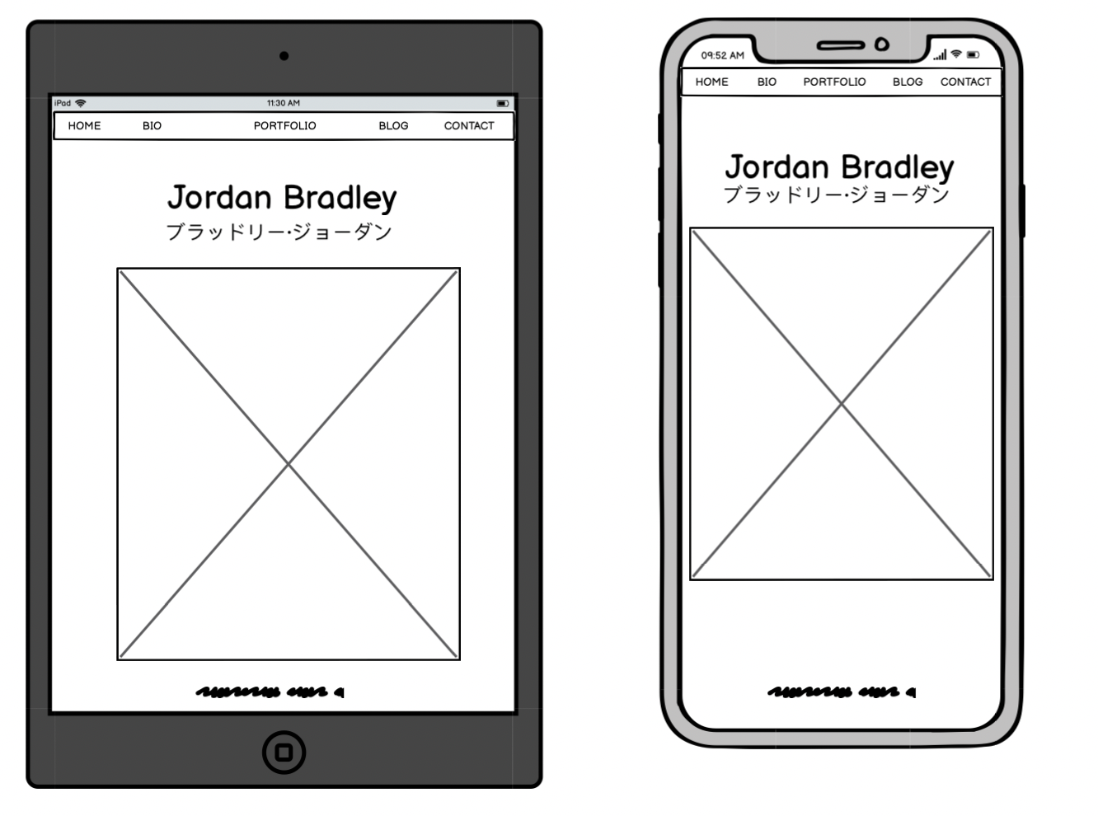

Slide 12
Bio page
• Links to social media pages represented with vectors, highlights upon hovering.
• A short bilingual about me passage factored into a scrolling element.
• A black and white photo of myself.
(In mobile and tablet versions, the photo is on top and text is on bottom. On desktop version, text is left and photo is right.)

Slide 13
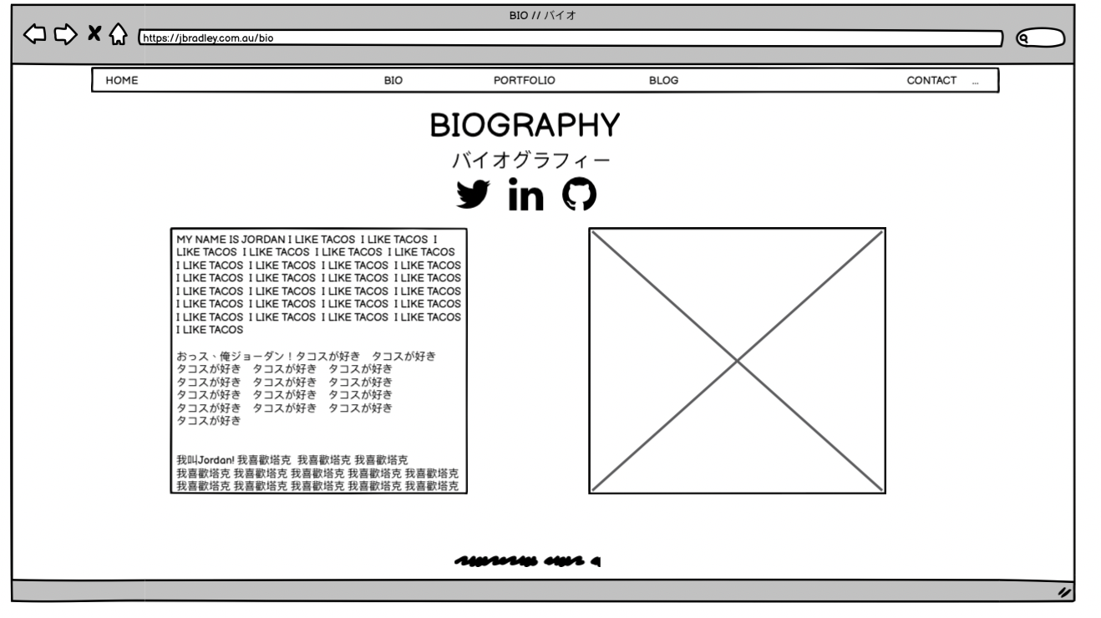

Slide 14
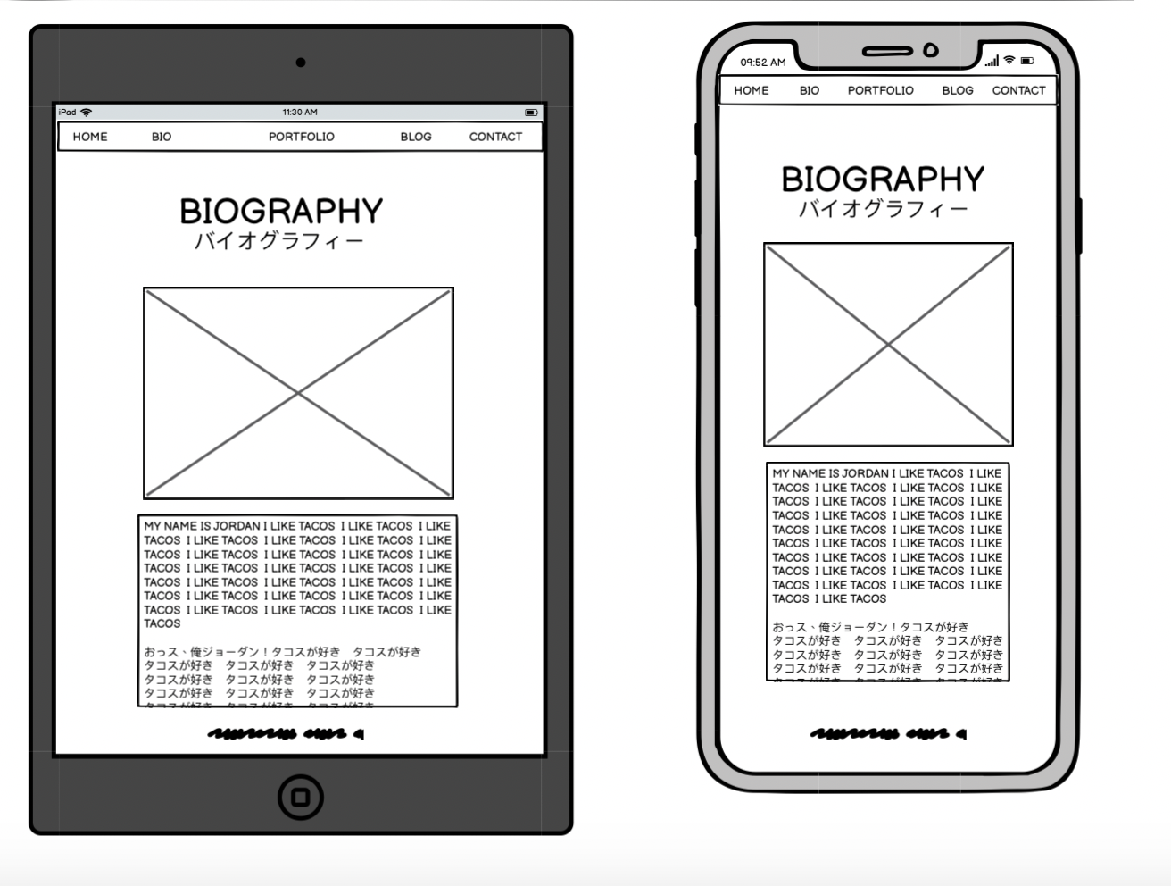

Slide 15
Portfolio page
• A scrollable element featuring bilingual text that focuses on what I’m learning and and what prior skills I have.
• Features a link to my resume in both languages.

Slide 16
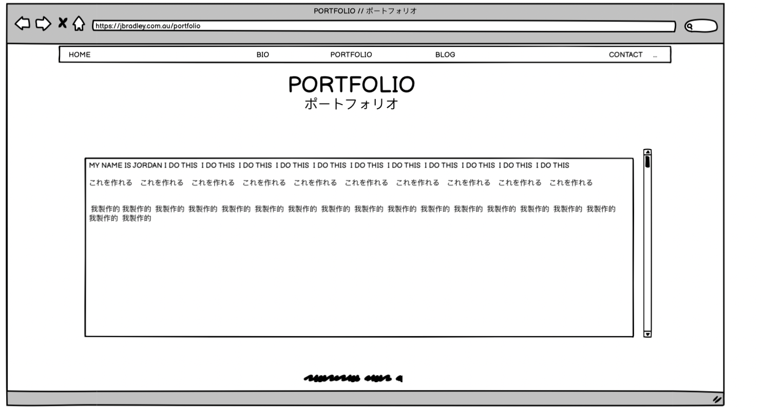

Slide 17
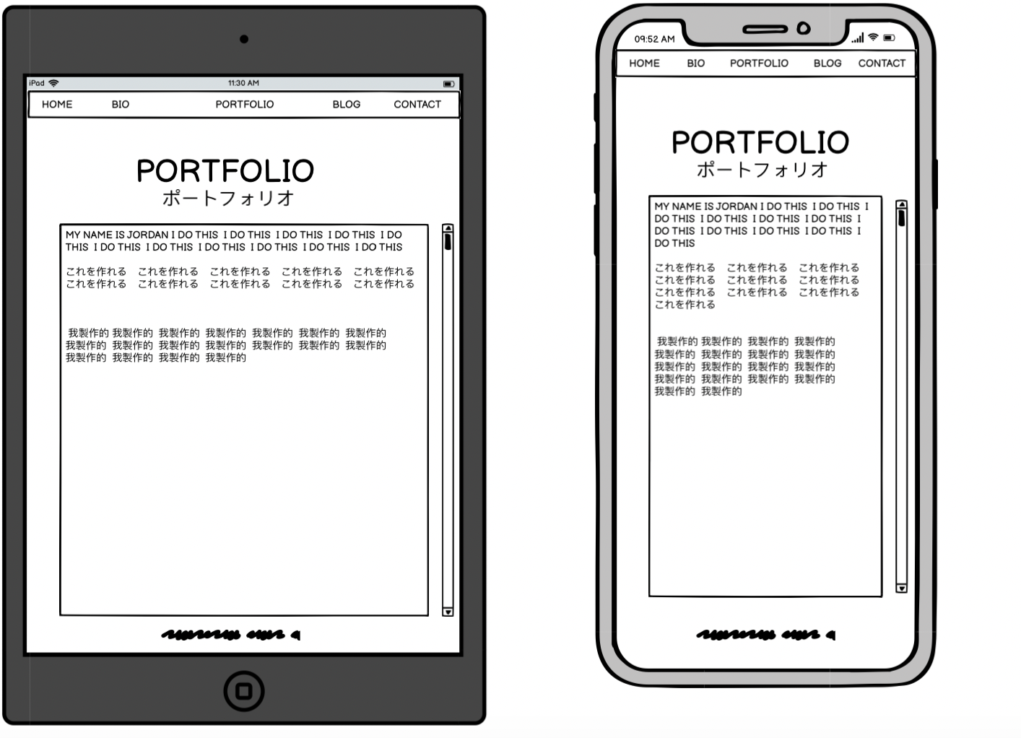

Slide 18
Blog page
• A scrollable element featuring 5 posts about past events or places I had been to. Text features both a header and paragraph element each.
• 5 accompanying photos for each text.
(In mobile and tablet versions, the photos are on top and text is on bottom. On desktop version, text is left and photos are right.)

Slide 19
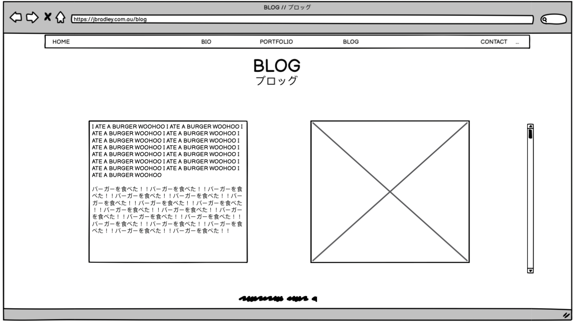

Slide 20
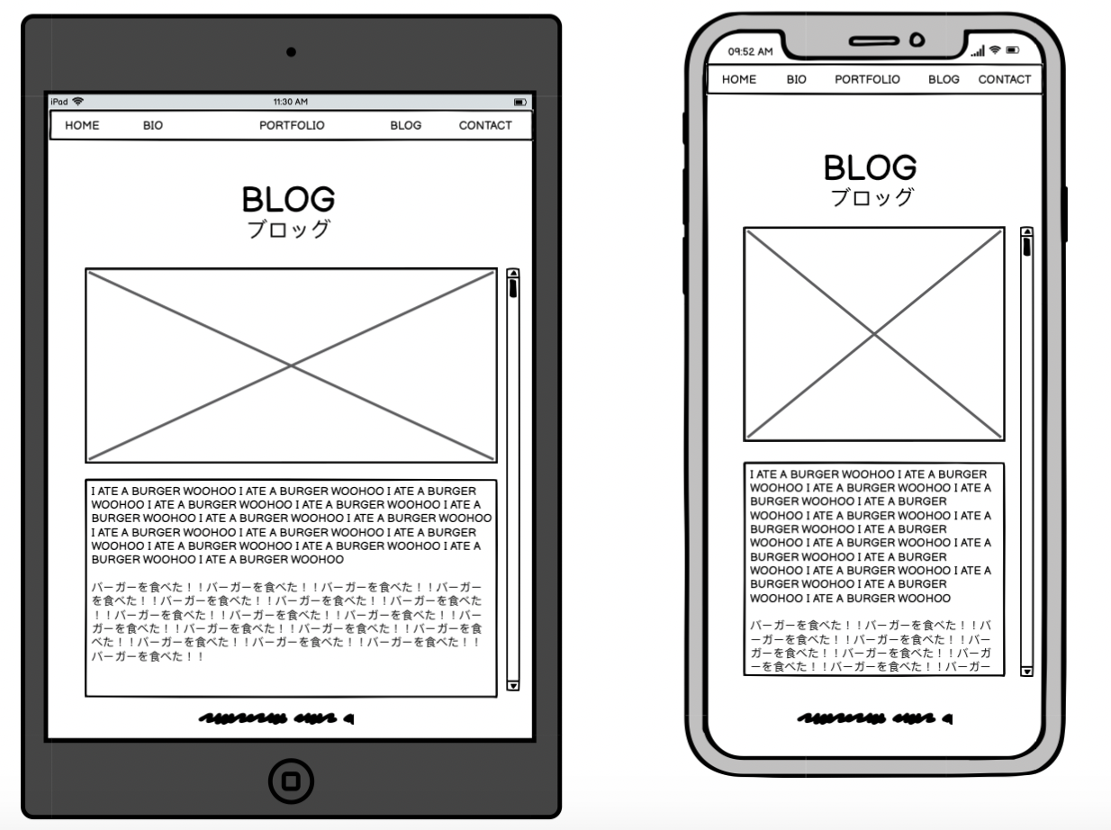

Slide 21
Contact page
Forms that can be filled out for those who wish to get in contact, specifically featuring sections for:
• Name
• Organisation
• E-mail address
• Query

Slide 22
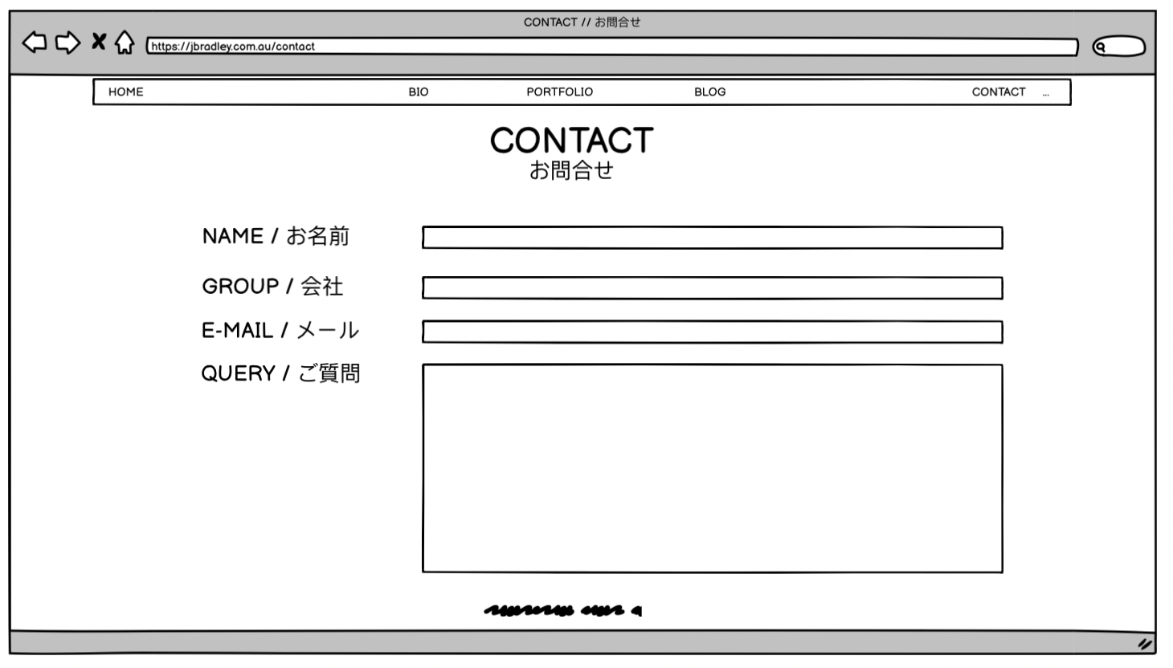

Slide 23


