Slide 1

Group 11 - Gas Leak Detection System
SARFO, Samuel Sarpong
SELORMEY, Daniel Tsatsu
SARPONG, Kwadwo Adomako Mensah
SOKPE, Leslie Dela
SOSU SENAYAH, Jeffery Edem
TAGOE, Richard Nii Amartey Kweku
TANOR, Bismark
TIAH, Christopher Hindolo
TUMAWU, Jonath

Slide 2
Table of Contents
1
Problem Statement
2
Methodology
3
Demonstration/Simulation
4
Conclusion

Slide 3

Problem Statement
Accidental gas leaks pose a significant threat to human safety and the environment. These leaks can lead to explosions, health hazards, and contribute to greenhouse gas emissions.
Solving this problem is crucial for preventing loss of life, protecting property, and mitigating environmental damage. A reliable gas leak detection system can provide early warnings, allowing for prompt intervention and minimizing potential harm.
The main goal of this project is to develop an efficient and cost-effective gas leak detection system that can accurately identify and alert users to the presence of dangerous gas levels in a timely manner.

Slide 4
Methodology
Our methodology involves a combination of sensor technology, data analysis, and wireless communication to create a comprehensive gas leak detection system. We utilize gas sensors to detect the presence of specific gases, process the sensor data using microcontrollers, and transmit alerts wirelessly to a central monitoring system. This approach allows for real-time monitoring and rapid response to gas leaks, enhancing safety and minimizing potential damage.
Components Used:
Arduino Uno: The microcontroller board that processes sensor data and controls outputs. We Chose for ease of programming, reliability, and affordability
MQ-2 Gas Sensor: Detects the presence of gases such as LPG, methane, and butane. We used the MQ-2 sensors, which are highly sensitive to gases, especially LPG and butane, and also they quickly detect gas leaks, ensuring early warning.
Breadboard: Provides a platform for wiring components without soldering.
Buzzer: Emits an alarm sound when a gas leak is detected. It provides an instant audio alert for safety and prompt immediate action
LEDs: The LED provides a visual alert when the system detects a gas leaks (e.g., green for normal, red for gas detected)
Push buttons: Used to reset or activate a function manually
Jumper wires: Connect various components and establish electrical pathways.

Slide 5

Approach Taken to Solve the Problem (Gas Leak Detection System)

Slide 6
Approach Taken to Solve the Problem (Gas Leak Detection System)
The approach taken to solve the gas leak detection problem involved several key steps. First, we identified the need for a system that could detect gases such as LPG, methane, or butane and provide real-time alerts through visual and audio indicators. The system also needed to be reliable and include a reset mechanism for user control.
To achieve this, we carefully selected components that would meet the system's requirements. The MQ-2 gas sensor was chosen for its ability to detect gas concentrations, while the Arduino Uno served as the microcontroller to process sensor data and control outputs. LEDs were used to indicate system status, with a green LED signaling safe conditions and a red LED paired with a buzzer triggering an alert when dangerous levels were detected. A push button was also included to allow manual reset or system testing.
The circuit was designed by connecting the MQ-2 sensor to the Arduino, which continuously monitored gas levels. When the sensor detected a concentration above a predefined threshold, the red LED and buzzer were activated to alert users. The system remained in alert mode until the gas concentration dropped or the reset button was pressed.
To ensure accuracy and reliability, we conducted several tests in a controlled environment, exposing the sensor to gas levels using the Wokwi software and observed its response. Adjustments were made to the threshold level to optimize performance. Wiring and programming were also verified to eliminate any errors.
Finally, the system was prepared for real-world application in homes, industrial settings, and vehicles. Future improvements could include adding wireless alerts through WiFi or SMS for remote monitoring, enhancing the system’s effectiveness in preventing gas-related hazards.

Slide 7
Summary of the Approach
Define the problem – Detect gas leaks, provide alerts.
Choose components – MQ-2, Arduino, LEDs, buzzer.
Design circuit – Connect components.
Develop code – Read sensor values, set thresholds, trigger alerts.
Test and refine – Ensure accuracy.
Implement – Deploy in various scenarios.

Slide 8

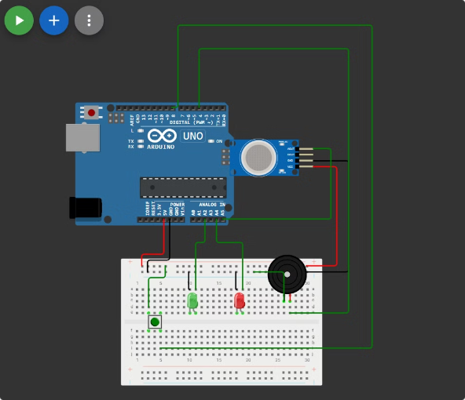
Code Overview and Schematic

Slide 9
Simulation/Demonstration

Slide 10
Conclusion
The Gas Leak Detection System successfully detects gas leaks above a defined threshold.
The system provides visual (LED) and auditory (buzzer) alerts when a leak is detected.
A manual reset button allows for alarm deactivation once the environment is safe.
The system demonstrates a practical application of sensor technology for safety and monitoring.

Slide 11
Challenges faced and Improvements

Slide 12
Thank you

