Slide 1
Automating segmentations of subcortical labels using
deep learning on Quantitative Susceptibility Mapping
Project presentation for CS512
Group 1
Rasheed Abid, A20500507, rabid@hawk.iit.edu
Khalid Saifullah, A20423546, ksaifullah@hawk.iit.edu
Department of Biomedical Engineering, Illinois Institute of Technology, Chicago, IL, USA
www.iit.edu/~mri

Slide 2
Introduction
Quantitative Susceptibility Mapping (QSM) is an advanced magnetic resonance imaging (MRI) technique that can measure magnetic susceptibility variations within tissues.
Quantitative magnetic Susceptibility Mapping (QSM):
Assesses magnetic susceptibility of tissues.
Is currently considered as a useful marker for brain iron homeostasis.
Yet, brain segmentation with QSM only has not been studied much, as manually doing it takes humongous efforts.
With very low contrast in this modality, it is very challenging to demarcate regions in the brain automatically.
PURPOSE
Implement DL models on QSM images only to automatically segment sub-cortical brain structures

Slide 3
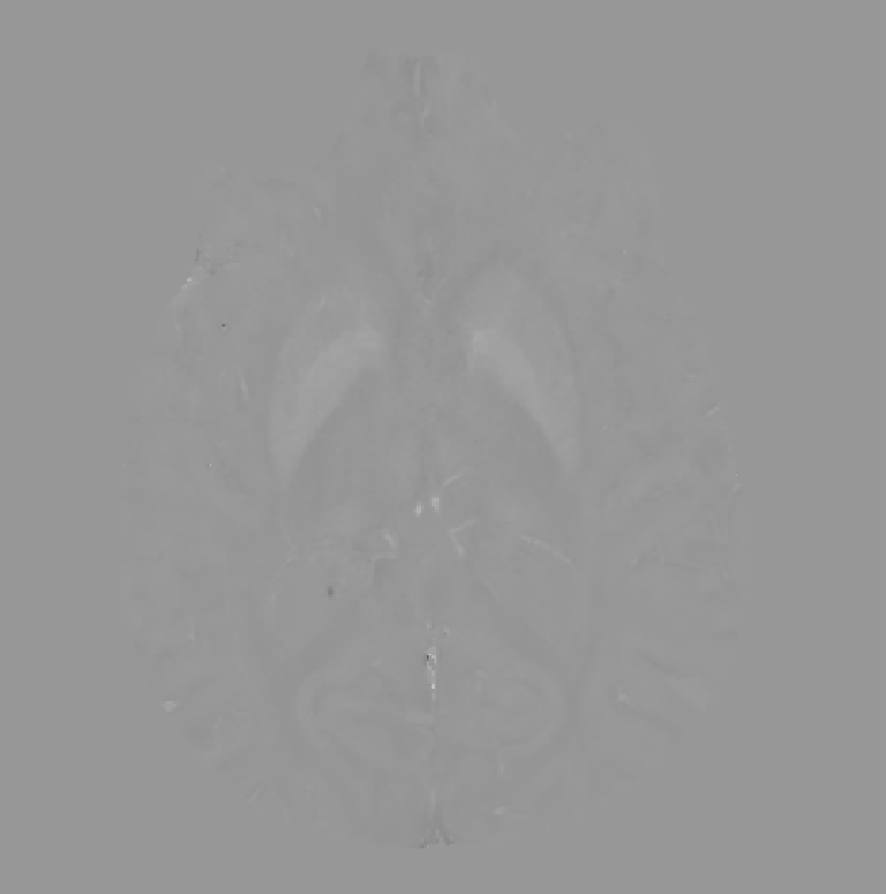
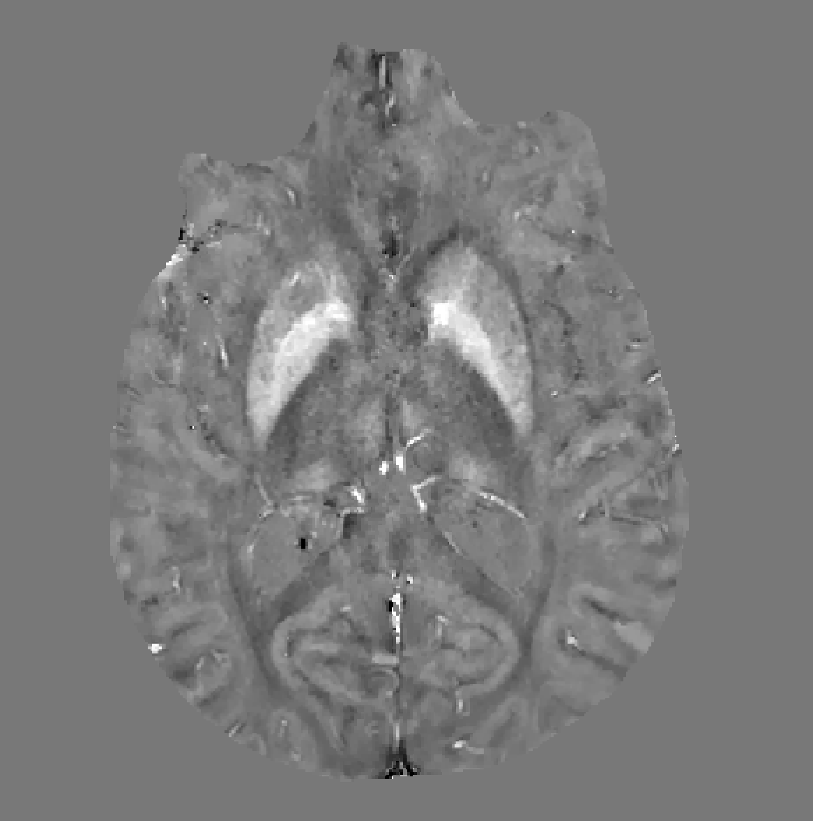
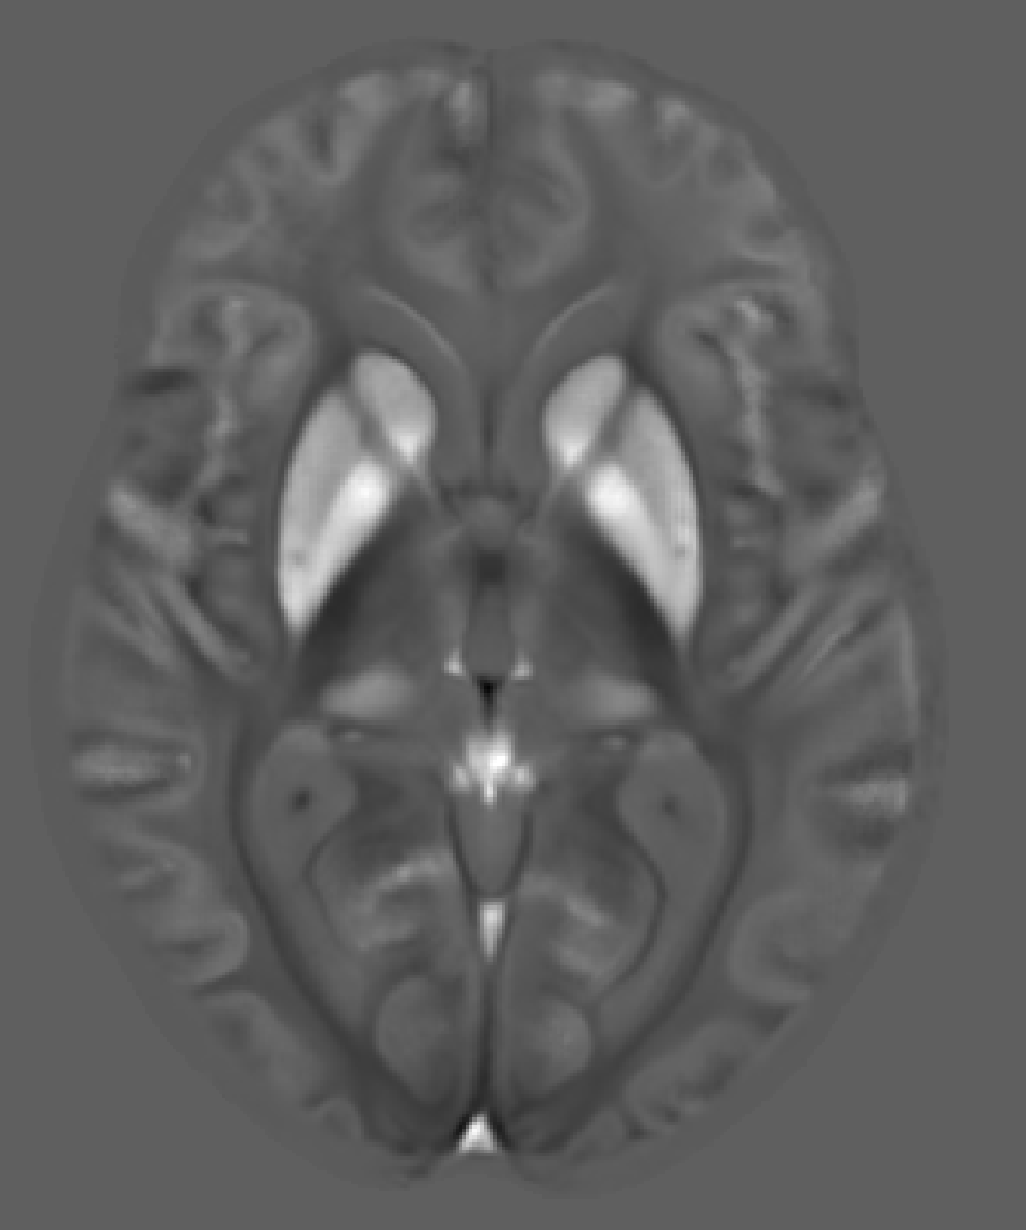
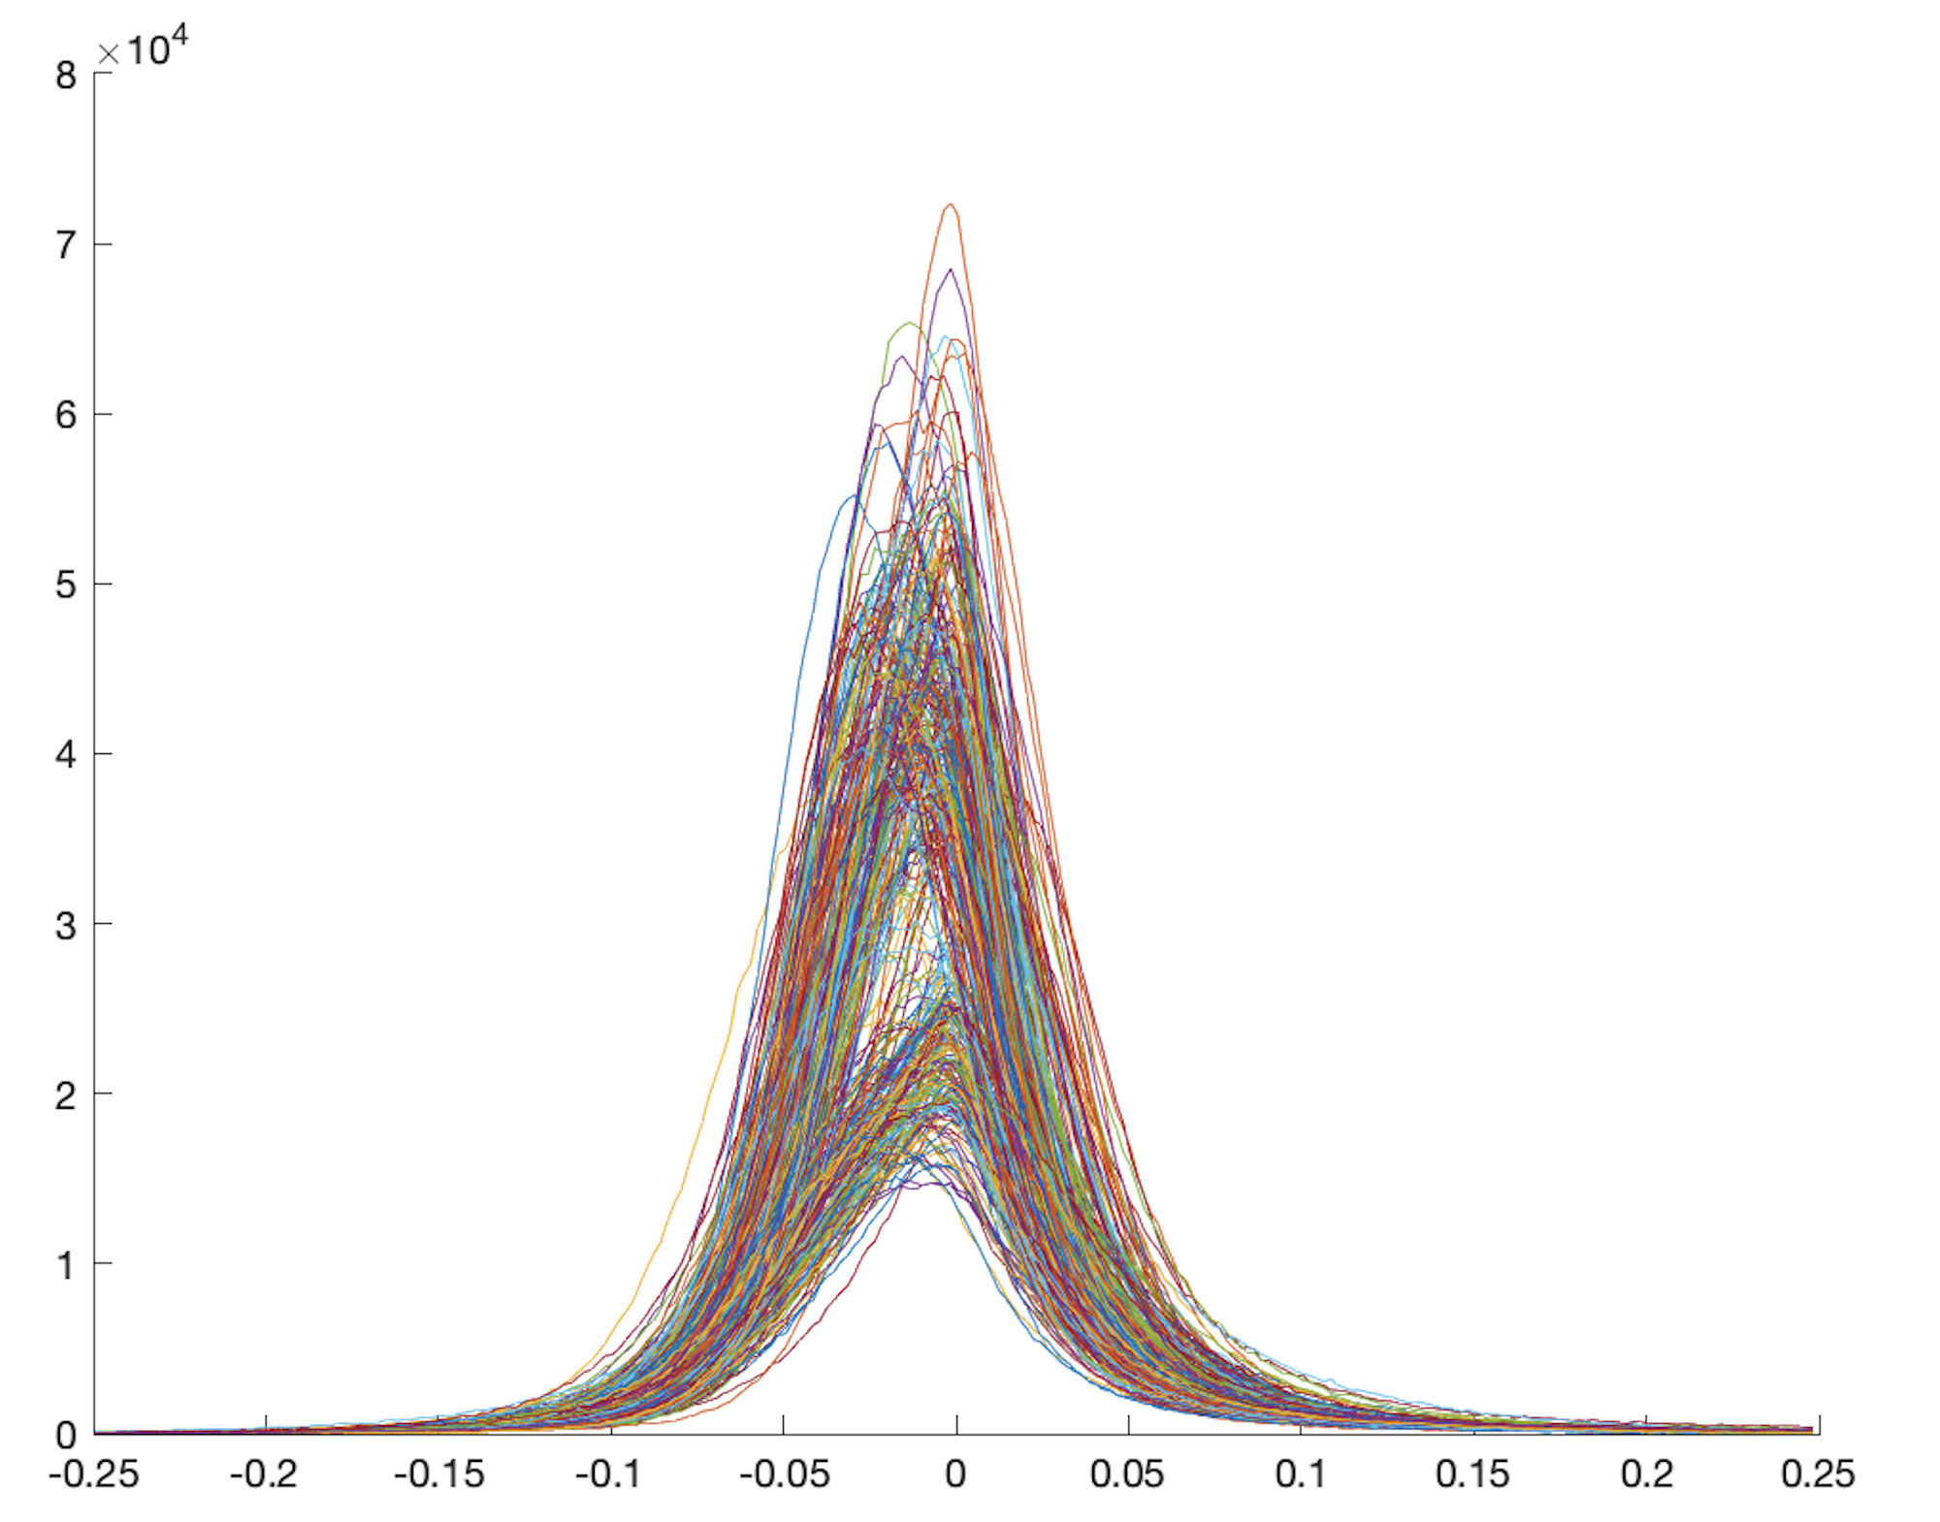
Dataset
A dataset of 109 subjects with 5 sub-cortical labels in common were collected for this project, from the study [2].
We will only present a portion of the dataset for testing and reconstruction purposes.
Contains QSM images for all the subject in their native space, with the common labels of many brain regions including the ones:
Hippocampus, amygdala, putamen, caudate, thalamus
sAlso contains their brain mask, which was extracted from other modalities of brains.
- This is a high resolution data with 0.5mm voxel
Native QSM
Native QSM in range(-0.25, 0.25)
Histogram
MIITRA Atlas

Slide 4
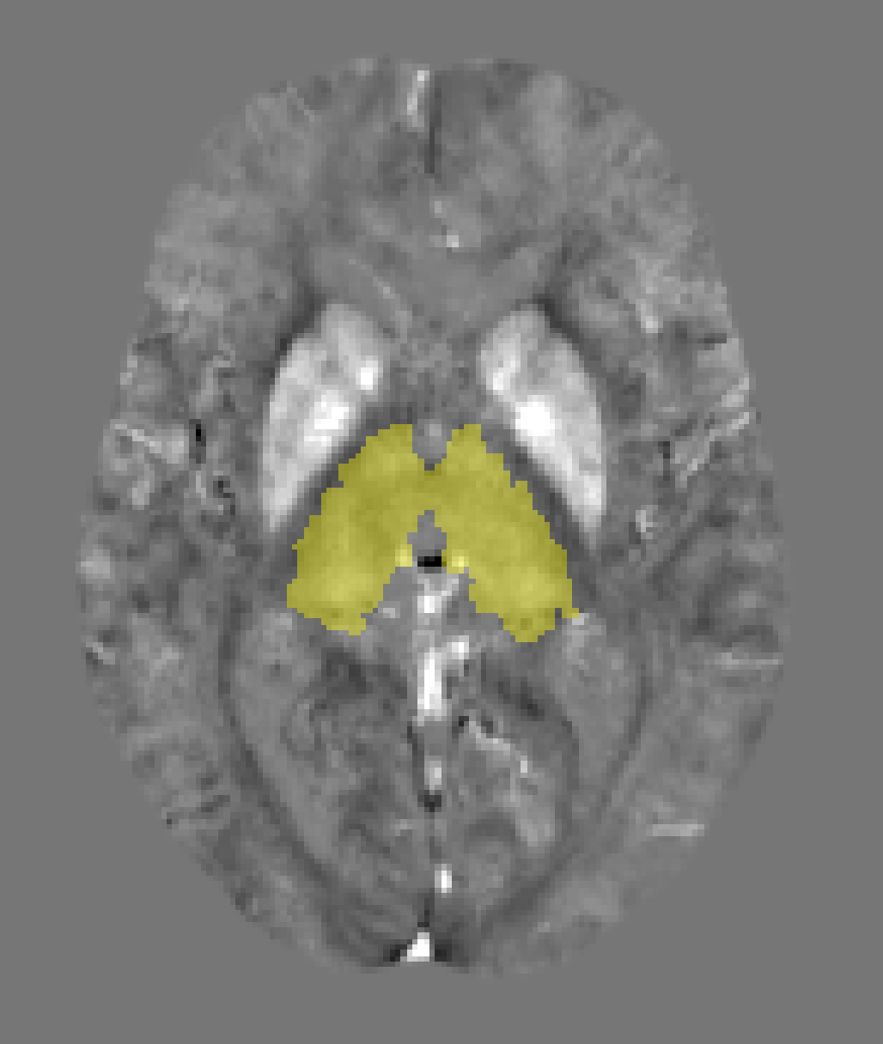
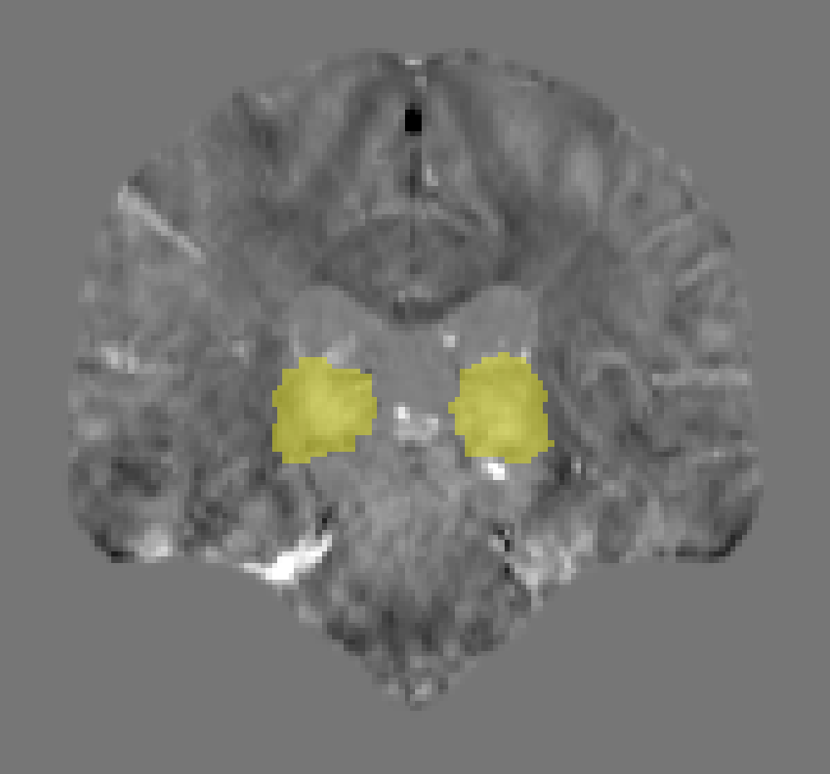

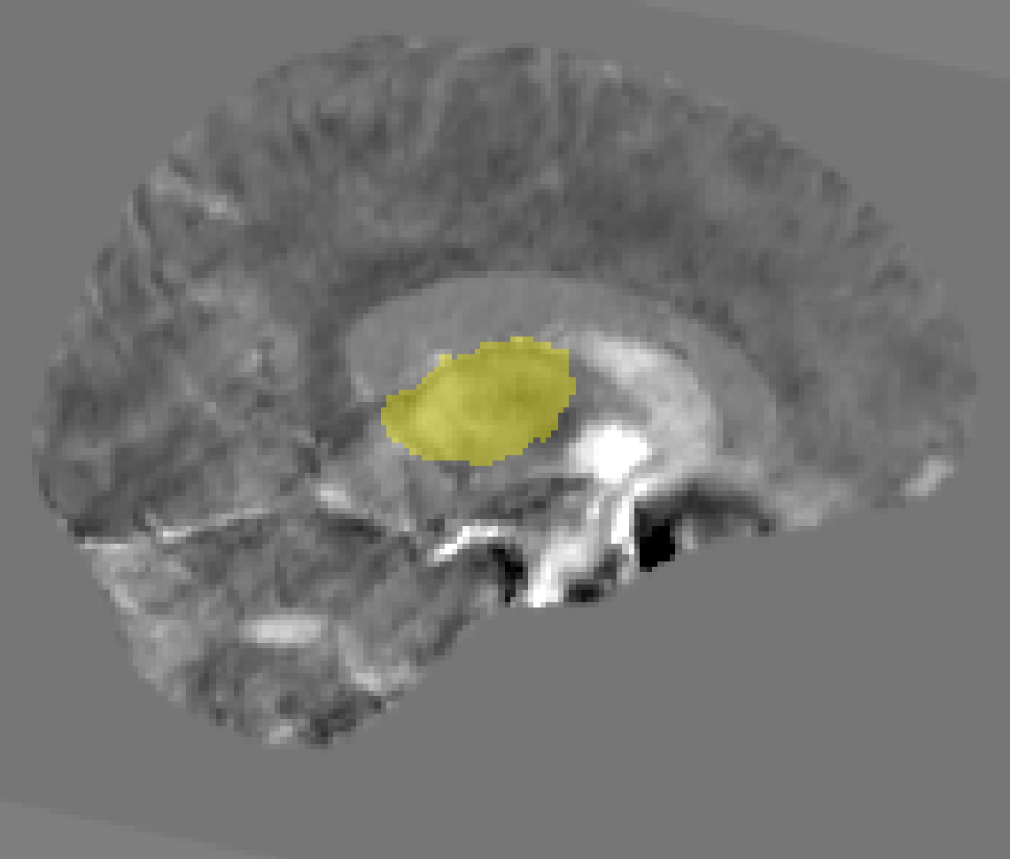
Preprocessing
Native QSM space
Atlas space
bg removal
Standardized QSM
Registration
QSM ATLAS
QSM
padding
QSM
intensity correction
ANTS
Downsample
Combined labels
Extract, split and mask labels
QSM Brain labels
Merge label hemispheres
Labels
padding
Downsample

Slide 5
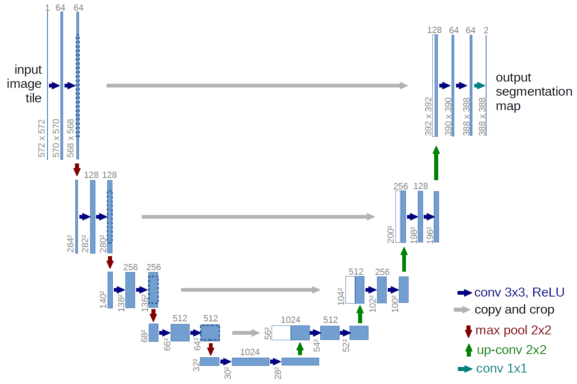
Model Architecture
Architecture of UNet

Slide 6
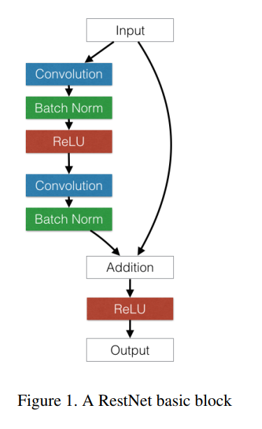
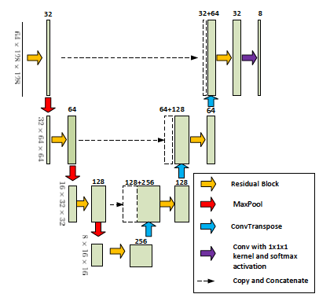
Model Architecture
Architecture of Residual block
Architecture of ResUNet

Slide 7
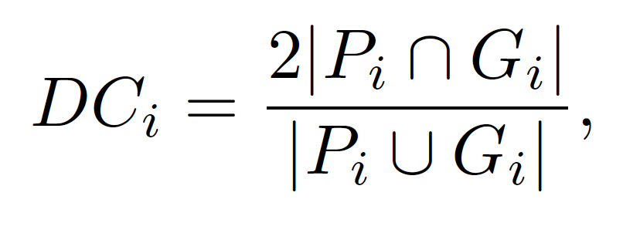

Evaluation
To follow the paper and standard matching, we used dice similarity coefficient.
Here P is the predicted label and G is the ground truth.
Additionally to the paper, we used Hausdorff distance to measure the dissimilarities among the labels. Hausdorff distance determines the maximum distance of each voxel from the nearest predicted values to ground truth.

Slide 8
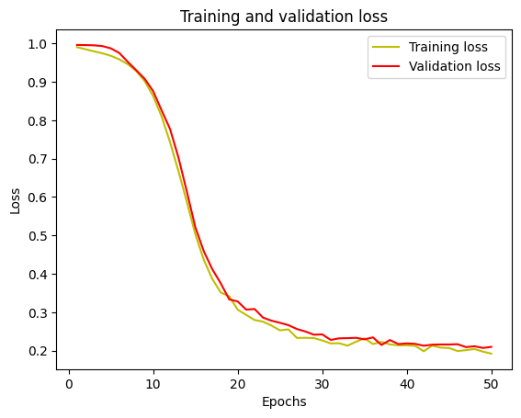
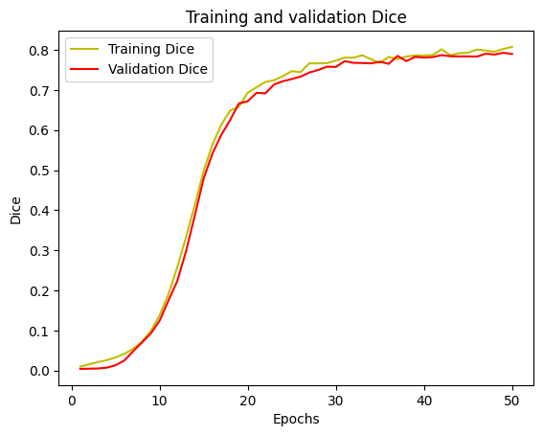
Results
A typical case for hippocampus of our loss and dice curve vs epochs.

Slide 9
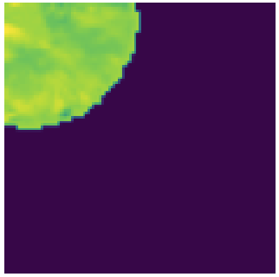
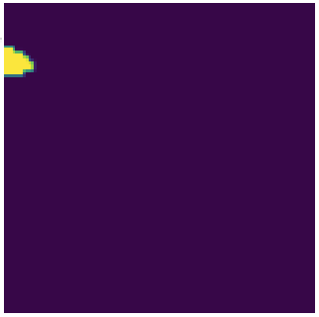

Results
Prediction in patches for putamen.
Original brain image | Predicted | Ground truth

Slide 10
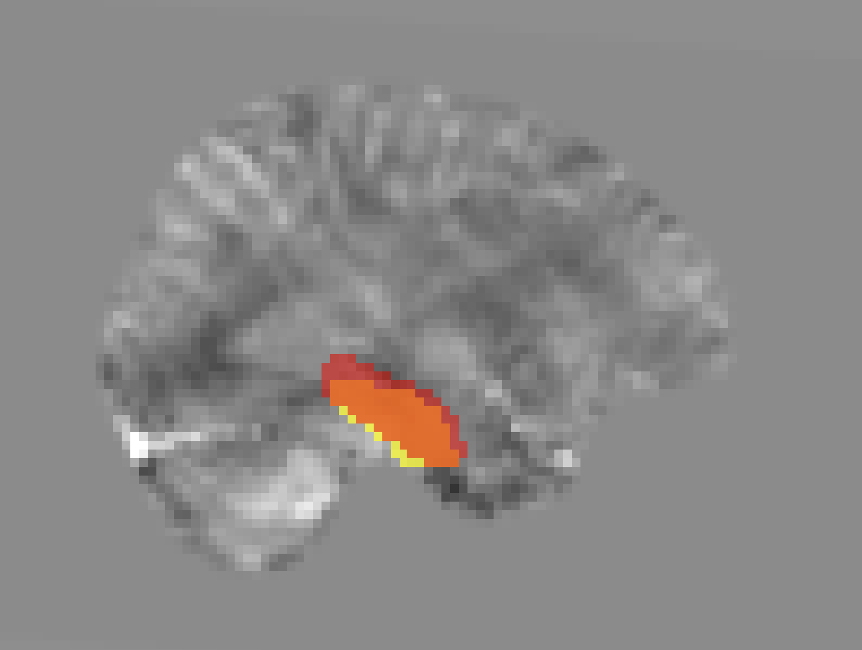
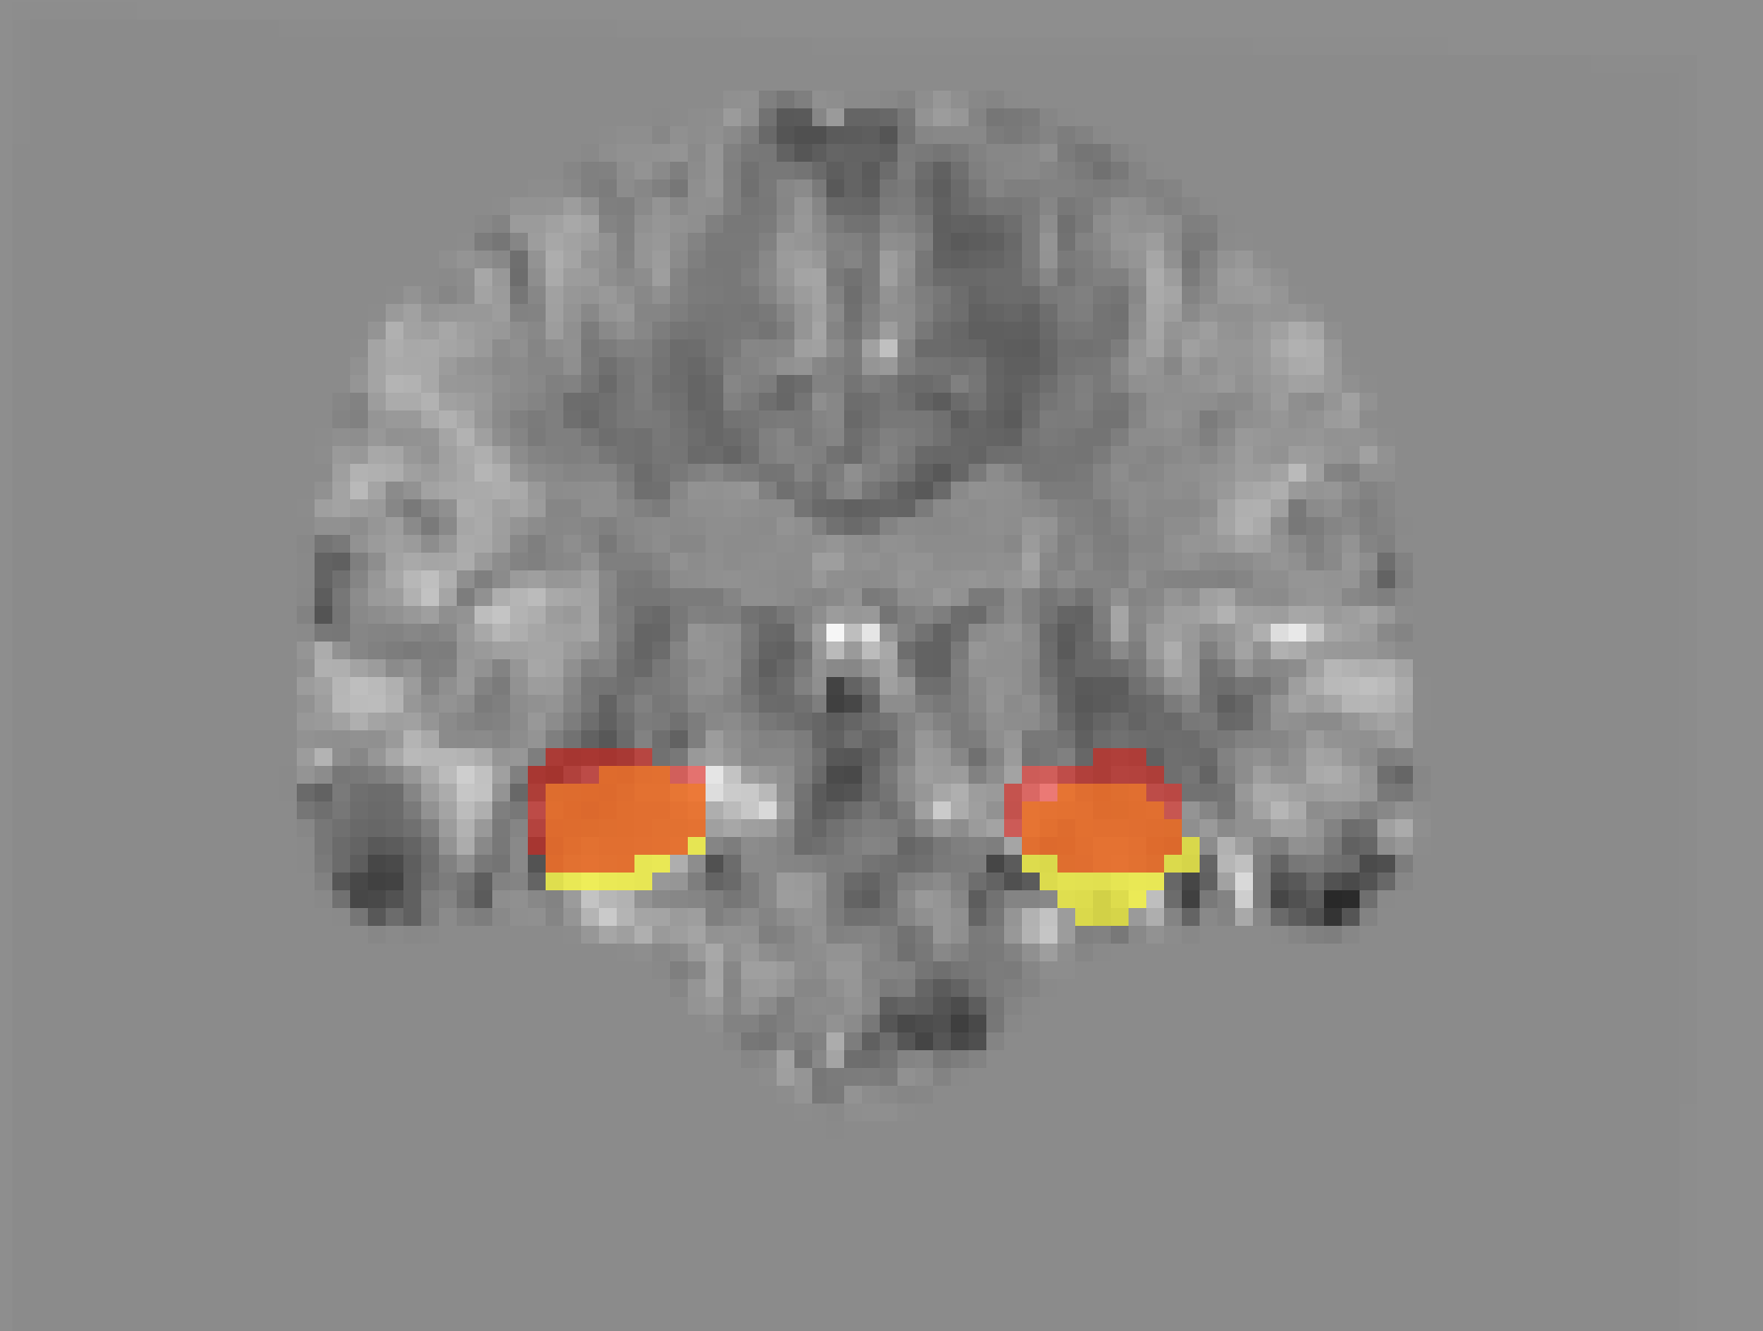
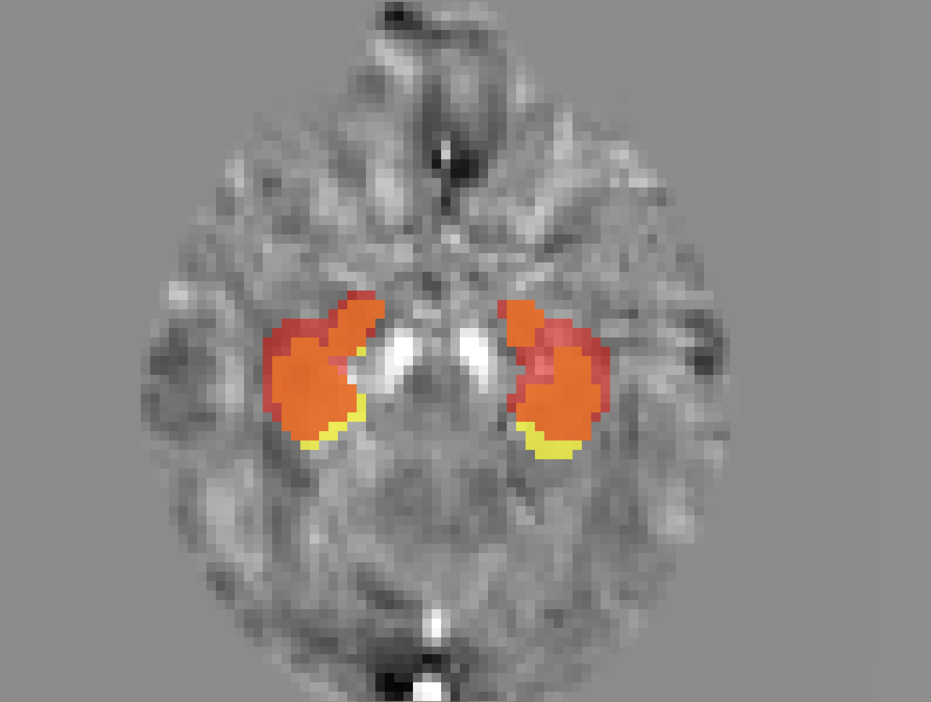
Results
Once we have the reconstruction we get the following results. Red denotes predicted, yellow indicates ground truth.

Slide 11
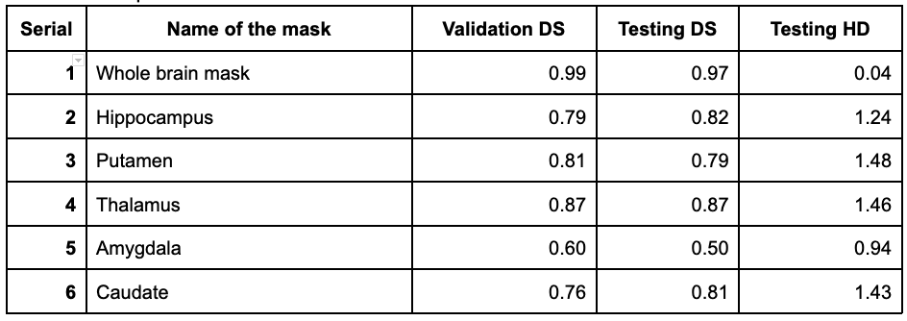
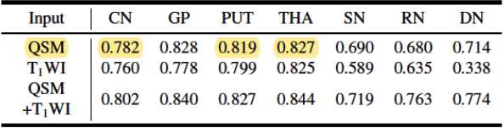
Results comparison

Slide 12
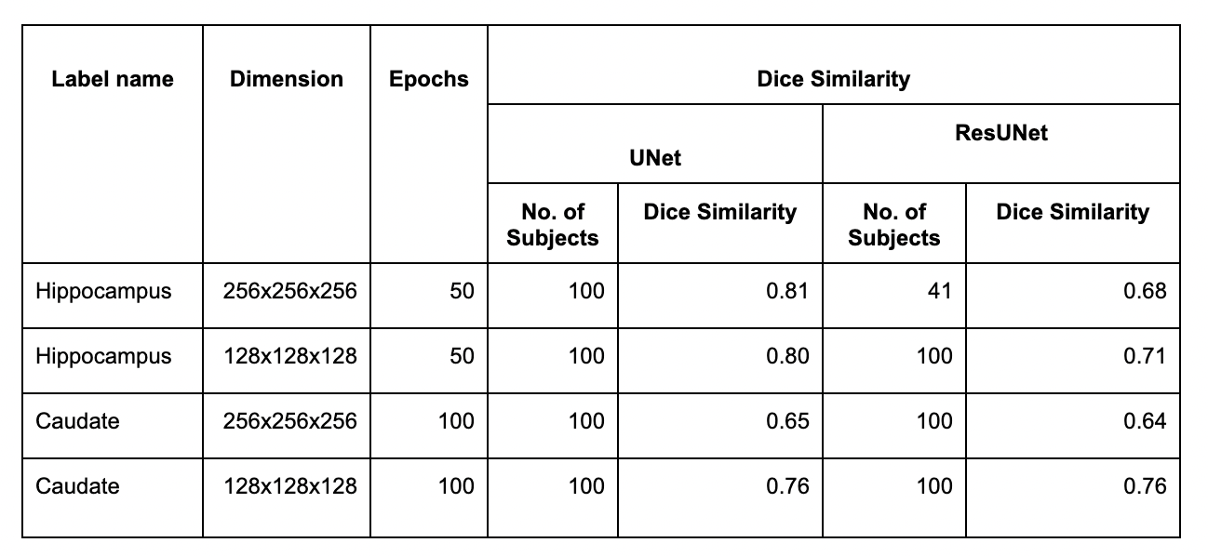
UNet VS ResUNet
UNet
Figure: Comparison of dice similarity results between Unet and ResUNet.

Slide 13
Conclusions
This project aimed to implement a 3D segmentation model on QSM data using deep learning, based on a previously published paper.
The challenges of larger and higher resolution data required careful preprocessing, neural network designing, and hyperparameter tuning to achieve higher accuracy in segmentation, for small volumetric label data.
The results of this project will have significant implications for the diagnosis of neurological disorders, if researched further.

Slide 14
References
[1] Chai, C., Qiao, P., Zhao, B., Wang, H., Liu, G., Wu, H., Haacke, E.M., Shen, W., Cao, C., Ye, X. and Liu, Z., 2020. Automated Segmentation of Brain Gray Matter Nuclei on Quantitative Susceptibility Mapping Using Deep Convolutional Neural Network. arXiv preprint arXiv:2008.00901.
[2] Niaz, M.R., Wu, Y., Ridwan, A.R., Qi, X., Bennett, D.A. and Arfanakis, K., 2021. Development and evaluation of high‐resolution gray matter labels for the MIITRA atlas. Alzheimer's & Dementia, 17, p.e052575.
[3] Yu, B., Li, L., Guan, X., Xu, X., Liu, X., Yang, Q., Wei, H., Zuo, C. and Zhang, Y., 2021. HybraPD atlas: Towards precise subcortical nuclei segmentation using multimodality medical images in patients with Parkinson disease. Human brain mapping, 42(13), pp.4399-4421.
[4] Jung, W., Bollmann, S. and Lee, J., 2022. Overview of quantitative susceptibility mapping using deep learning: Current status, challenges and opportunities. NMR in Biomedicine, 35(4), p.e4292.
[5] Avants, B.B., Tustison, N. and Song, G., 2009. Advanced normalization tools (ANTS). Insight j, 2(365), pp.1-35.
[5] Ronneberger, O., Fischer, P. and Brox, T., 2015. U-net: Convolutional networks for biomedical image segmentation. In Medical Image Computing and Computer-Assisted Intervention–MICCAI 2015: 18th International Conference, Munich, Germany, October 5-9, 2015, Proceedings, Part III 18 (pp. 234-241). Springer International Publishing.
[6] Jha, D., Smedsrud, P.H., Riegler, M.A., Johansen, D., De Lange, T., Halvorsen, P. and Johansen, H.D., 2019, December. Resunet++: An advanced architecture for medical image segmentation. In 2019 IEEE International Symposium on Multimedia (ISM) (pp. 225-2255). IEEE
[7] We took pointers and help from the scripts found here: https://github.com/bnsreenu/python_for_microscopists

