Slide 1
The Printing Press and its Effect on How We Communicate Today
By Russell Heimlich

Slide 2
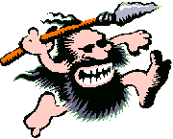
Communication
Important to the survival of mankind
Leads to technological advancements

Slide 3
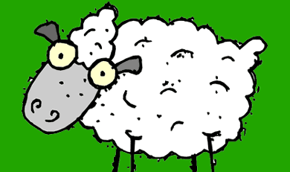
Before the Printing Press
Early Middle Ages – Scribes copied books by hand
Vellum instead of paper
Bible = 300 sheep skins

Slide 4
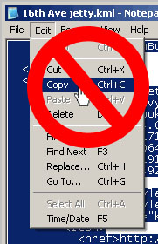
Copying text by hand was bad!
Laborious
Inefficient
Prone to errors
Scholarly research difficult
Less copies
Fragile

Slide 5
“[One] needs to recall the conditions before texts could be set to type. No manuscript, however useful as a reference guide, could be preserved for long without undergoing corruption by copyists, wear and tear, moisture, vermin, theft, or threat”
-Elizabeth Eisenstein
The Printing Revolution in Early Modern Europe

Slide 6
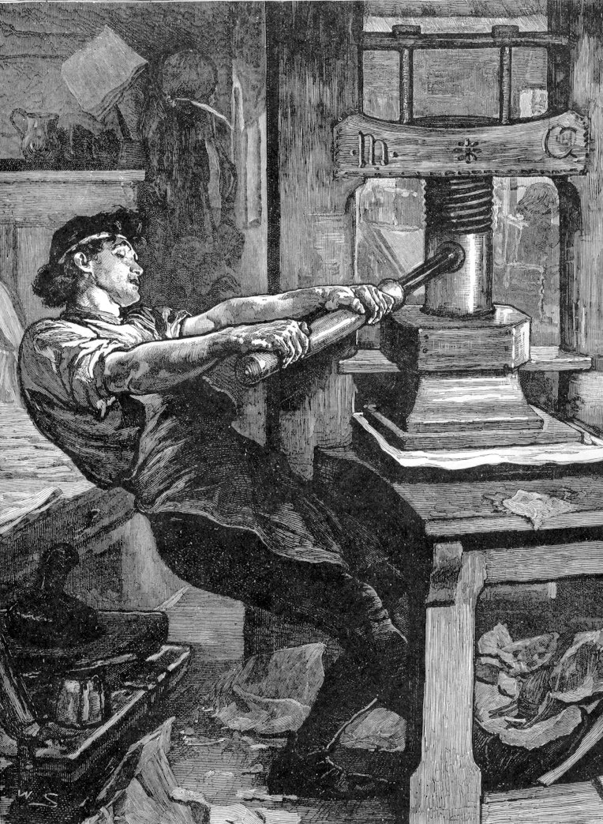
The Printing Press
Invented by Johann Gutenberg of Mainz
Along with cheap paper, made printing affordable.
More efficient
Printers operating in 200+ European cities 50 years later.

Slide 7

Printing Revolution
Increase in literacy
More informed citizens
Enhanced self esteem
New means for manipulation

Slide 8
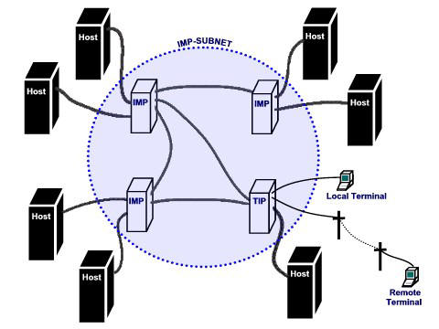
The Internet
ARPANET created in 1969
Nationwide information network
National Science Foundation took over in 1990

Slide 9
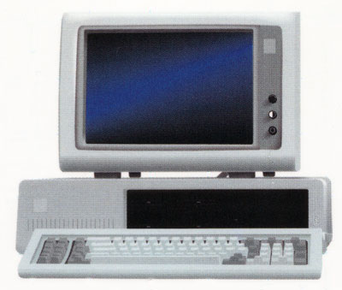
Internet growth
Public access granted in 1992
Cheap, powerful personal computers
Hyper linking

Slide 10
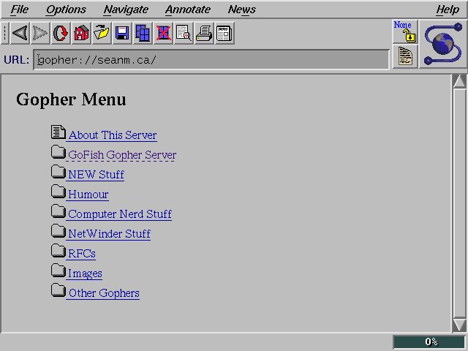
Web Browsing
Mosaic Browser
Graphics
Multimedia

Slide 11
Commonalities
New Meeting Spaces
Feedback
More Practical Research
Control of Information
Ability to Spread New Ideas

Slide 12
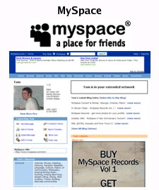
New Meeting Spaces
Print shops = scholarly gathering points
Spread of knowledge and ideas
Boosted Discussions
Internet = 24/7 global meeting place
Web sites, blogs, email, instant messaging

Slide 13
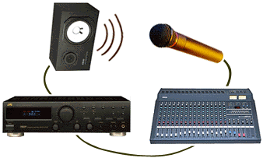
Feedback
Publishers appreciated reader input
Fix errors, comment, corrections
Subsequent editions of books
Reversed spread of erroneous information
Email, blog comments, IM
WIKIs

Slide 14
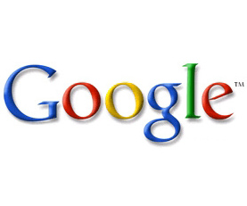
More Practical Research
“Wandering Scholars” irrelevant
Libraries
Search engines
Google
“To organize the world’s information and make it universally accessible and useful.”

Slide 15
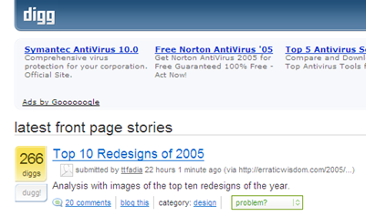
Control of Information
Previously, church ruled information
Traditional media losing control
Digg.com
Democratic media

Slide 16
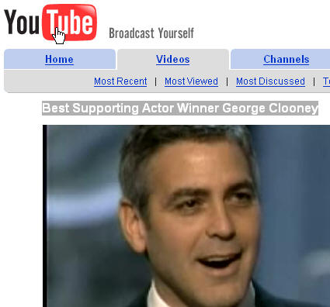

Spread New Ideas
Develop niche followings
User created content
YouTube.com
Podcasting

Slide 17

Conclusion
Broke down barriers in communication
Disseminating information easier and more efficient
Increase in knowledge.

