Slide 1
DATABASE PROJECT
E-commerce Store
Database & SQL
FRONTEND
BACKEND
A presentation of the project interface, frontend and backend, database design, ERD, and SQL operations.
DATABASE
PROJECT PRESENTATION | SQL FUNDAMENTALS

Slide 2
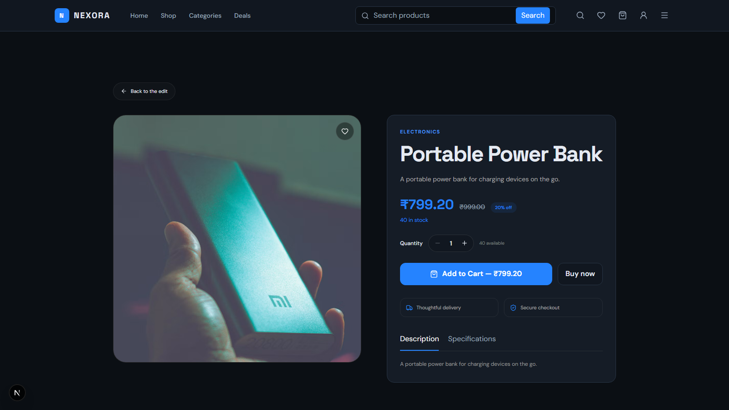
01 / PROJECT
What does the project do?
A real product-detail screen from the running NEXORA marketplace.
PROJECT INTERFACE
A marketplace page for viewing a product and placing an order.
The screenshot shows the NEXORA product-detail page, including:
? Product image and category
? Name, description, and price
? Stock and quantity controls
? Add to Cart and Buy now actions
PROJECT OVERVIEW AND LIVE INTERFACE
02

Slide 3
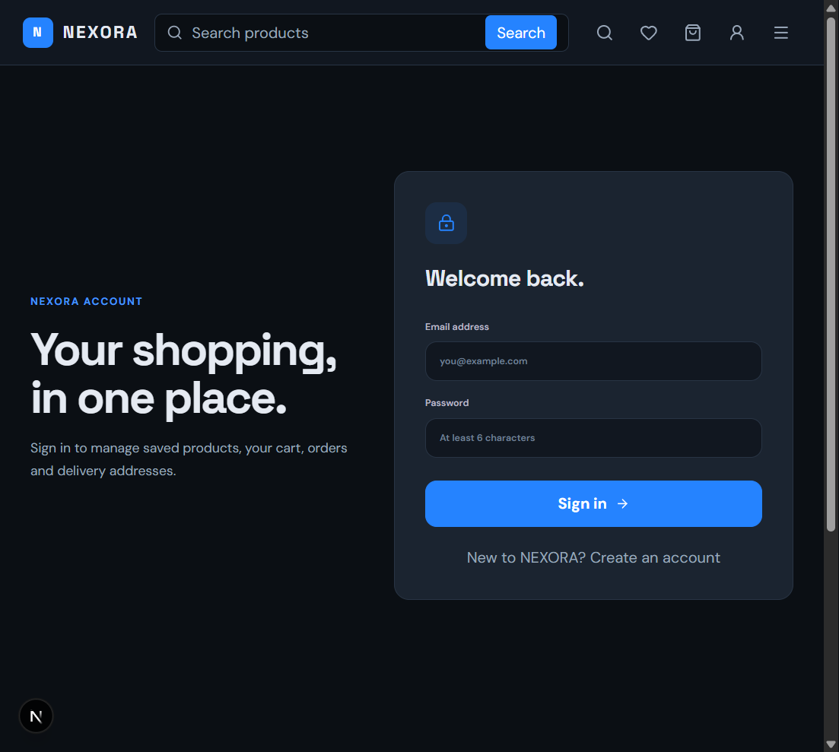
01 / PROJECT SCREENSHOTS
NEXORA sign-in page
A real screenshot of the running project login interface.
ACCOUNT INTERFACE
Sign in to access the online store account.
This screen lets a customer:
- Enter an email address and password
- Sign in to their account
- Access saved products, cart, orders, and delivery addresses
LIVE PROJECT LOGIN SCREEN
03

Slide 4
02 / HOW IT WORKS
Three layers work together
A clear separation makes the application easier to build and maintain.
01 FRONTEND
02 BACKEND
03 DATABASE
The user-facing interface
The application logic
The persistent data store
Shows products, filters, cart, and order details. Sends requests to the backend.
Receives requests, validates input, applies business rules, and runs database queries.
Stores products, categories, customers, orders, and order items in related tables.
HTML | CSS | JavaScript
API | validation | SQL
tables | keys | relations
User action -> frontend request -> backend processing -> database query -> results displayed
FRONTEND, BACKEND, AND DATABASE
04

Slide 5
03 / DATABASE DESIGN
Tables keep information organized
Primary keys identify rows; foreign keys connect related records.
CUSTOMERS
CATEGORIES
PRODUCTS
PK customer_id
PK category_id
PK product_id
name | email | phone | city
category_name
FK category_id | name | price | stock
One customer can place many orders.
One category can contain many products.
Each product belongs to a category.
ORDERS
ORDER_ITEMS
PK order_id
PK order_item_id
FK customer_id | date | total | status
FK order_id | FK product_id | quantity | price
Each order belongs to one customer.
Connects ordered products with orders.
PK = Primary Key | FK = Foreign Key
DATABASE TABLES
05

Slide 6
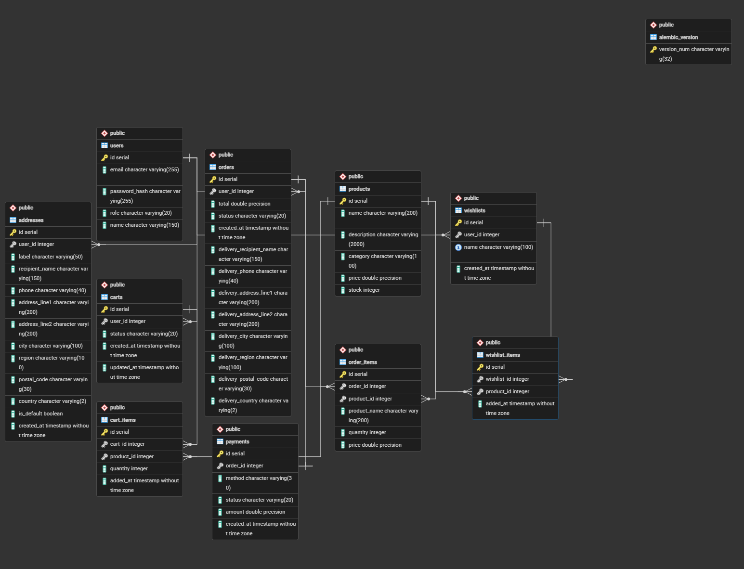

Slide 7
DATABASE DETAILS
What each database table stores
The ERD contains 10 application tables plus Alembic migration history.
Customer and admin accounts.
Named saved-product lists.
users
PK uid; name, email, password_hash, role
wishlists
PK wid; FK user_uid; name, created_at
Saved delivery destinations.
Products saved in each list.
addresses
PK address_id; FK user_uid; recipient, phone, address, city, postal code, country, is_default
wishlist_items
PK wishlist_item_id; FK wishlist_wid, product_pid; added_at
Product catalog and inventory.
Purchase and delivery record.
products
PK pid; name, description, category, price, stock
orders
PK oid; FK user_uid; total, status, created_at, delivery snapshot
Active, converted, or abandoned carts.
Purchased lines with snapshots.
carts
PK cid; FK user_uid; status, created_at, updated_at
order_items
PK order_item_id; FK order_oid, product_pid; product_name, quantity, price
Cart lines; unique product per cart.
One COD payment per order.
cart_items
PK cart_item_id; FK cart_cid, product_pid; quantity, added_at
payments
PK payment_id; unique FK order_oid; method, status, amount, created_at
DATABASE DETAILS

Slide 8
DATABASE DETAILS
Relationships and data integrity
Foreign keys connect records and prevent orphaned records.
users ? addresses
1 to many
A customer can save multiple delivery addresses.
users ? carts
1 to many
Each cart belongs to a specific user.
carts ? cart_items
1 to many
A cart contains multiple product lines.
products ? cart_items
1 to many
Products may appear in many carts.
users ? wishlists ? wishlist_items
one-to-many each
Wishlist items associate lists with saved products.
users ? orders ? order_items
one-to-many each
Orders belong to customers and contain purchased lines.
products ? order_items
1 to many
Each line points to a product with purchase-time values.
orders ? payments
1 to 0/1
Unique payment order key; method is cash on delivery.
Integrity rules include non-negative prices/stock/payment amounts, positive quantities, unique cart/wishlist product rows, and valid order statuses.
DATABASE DETAILS

Slide 9
APPLICATION FLOW
How the real NEXORA app works
Stack and data flow identified from the project README and source.
FRONTEND
BACKEND
DATABASE
Next.js ? React ? TypeScript ? Tailwind
FastAPI ? SQLAlchemy ? JWT
PostgreSQL ? Alembic
Renders storefront, login, product detail, cart, and admin pages. Calls the API and displays responses.
Validates requests and user roles; applies product, cart, checkout, and order rules. ORM sends queries.
Persists users, products, carts, addresses, orders, order lines, and payments. Alembic versions schema changes.
Browser :3000
REST API :8000
NEXORA_db
Browser action ? REST API ? validation / business rules ? SQLAlchemy query ? PostgreSQL ? response updates the UI
APPLICATION FLOW

Slide 10
SQL EXAMPLE
Product search, filtering, and pagination
The API supports text, category, min/max price, sorting, and page parameters.
REQUEST TO PRODUCT API
EQUIVALENT POSTGRESQL QUERY
GET /products?q=phone
SELECT pid, name, category, price, stock
&category=electronics
FROM products
&min_price=500&max_price=1500
WHERE (name ILIKE '%phone%' OR description ILIKE '%phone%')
&sort=price_desc&page=1&size=10
AND category = 'electronics'
AND price BETWEEN 500 AND 1500
ORDER BY price DESC
LIMIT 10 OFFSET 0;
What each filter does
? q searches name or description
? category matches one category
? min_price / max_price bound price
ILIKE is PostgreSQL case-insensitive matching. OFFSET = (page - 1) ? size, so page 2 at size 10 starts at offset 10. API responses include a computed 20% festival price; it is not a stored products column.
? sort supports name / price_asc / price_desc
? page + size select a result window
SQL EXAMPLE

Slide 11
SQL EXAMPLE
CRUD using the real products table
Product POST, GET, PUT, and DELETE routes are implemented; write access requires admin permission.
CREATE
POST /products
READ
GET /products/16
INSERT INTO products (name, description, category, price, stock)
SELECT pid, name, price, stock
VALUES ('USB-C Charger', 'Fast charger', 'electronics', 24.99, 35)
FROM products
RETURNING pid;
WHERE pid = 16;
UPDATE
PUT /products/16
DELETE
DELETE /products/16
UPDATE products
DELETE FROM products
SET price = 19.99, stock = 40
WHERE pid = 16;
WHERE pid = 16;
Use WHERE for targeted updates/deletes. The backend also validates values, stock, and role permissions.
SQL EXAMPLE

Slide 12
BUSINESS RULES
Checkout and order lifecycle
The backend validates stock and records linked order data for accurate history.
1
2
3
4
5
Choose items
Validate
Calculate
Create records
Fulfil
Unique product IDs + positive quantities
Product exists; stock is enough
20% discount; $7.95 shipping if subtotal < 100
Order + line snapshots + pending COD payment
placed ? packed ? shipped ? delivered
PURCHASE-TIME SNAPSHOTS
CANCELLATION AND PAYMENT
order_items saves product_name and price at purchase time. orders also copies delivery details so profile edits do not rewrite past order records.
Cancellation restores inventory. When an order is delivered, its cash-on-delivery payment changes from pending to paid. Invalid status transitions are rejected.
BUSINESS RULES

Slide 13
SQL EXAMPLE
Aggregate functions and admin reporting
Admin statistics include paid revenue, orders, customer count, products, low stock, and top sellers.
TOP 5 PRODUCTS BY UNITS SOLD
AGGREGATES AND MEANING
SELECT product_name, SUM(quantity) AS units_sold
COUNT(*)
rows / orders / customers
FROM order_items
GROUP BY product_name
ORDER BY units_sold DESC
SUM(quantity)
units sold
LIMIT 5;
SUM(amount)
paid revenue
AVG(price)
average price
CATEGORY SUMMARY WITH HAVING
MIN / MAX
price range
SELECT category, COUNT(*) AS products, AVG(price) AS avg_price
FROM products GROUP BY category
GROUP BY
one result per group
HAVING COUNT(*) >= 2;
HAVING
filter aggregate groups
SQL EXAMPLE

Slide 14
SQL EXAMPLE
Joining customers, orders, products, and payments
Join conditions below use the project?s actual foreign-key columns.
CUSTOMER ? ORDER ? ORDER LINE
JOIN TYPES
SELECT u.name, o.oid, o.status,
INNER
only matching rows
oi.product_name, oi.quantity, oi.price
FROM users u
INNER JOIN orders o ON o.user_uid = u.uid
LEFT
keep all left rows
INNER JOIN order_items oi ON oi.order_oid = o.oid
ORDER BY o.created_at DESC;
RIGHT
keep all right rows
FULL OUTER
keep rows from both
To include optional payment data: LEFT JOIN payments p ON p.order_oid = o.oid. This keeps an order in results even if its payment record is absent.
SELF
one table joined to itself
No table currently references itself, so SELF JOIN is a general SQL concept?not a current project relationship.
SQL EXAMPLE

Slide 15
05 / SQL IN ACTION
Find and manage product data
CRUD means Create, Read, Update, and Delete.
CRUD OPERATIONS
FILTER + SORT EXAMPLE
CREATE / INSERT
Add a product row
SELECT product_name, price
FROM Products
READ / SELECT
View and search products
WHERE price BETWEEN 500 AND 1500
AND product_name LIKE '%Laptop%'
ORDER BY price DESC
LIMIT 5 OFFSET 0;
UPDATE
Change price or stock
DELETE
Remove a selected row
WHERE | AND | OR | NOT | IN | BETWEEN | LIKE
ORDER BY | LIMIT | OFFSET - find, sort, and page through results.
Use WHERE with UPDATE and DELETE so only the intended row is changed.
CRUD, FILTERING, AND SORTING
15

Slide 16
06 / SUMMARIZE AND CONNECT
SQL answers bigger questions
Aggregates summarize rows; joins combine related information from tables.
AGGREGATE FUNCTIONS
JOINS
Use these to calculate summaries from many rows.
INNER JOIN
only matching rows
SELECT category_id,
LEFT JOIN
all left rows + matches
COUNT(*) AS products,
AVG(price) AS avg_price
FROM Products
RIGHT JOIN
all right rows + matches
GROUP BY category_id
HAVING AVG(price) > 500;
FULL OUTER JOIN
all rows from either side
SELF JOIN
a table joined to itself
COUNT | SUM | AVG | MIN | MAX
SELECT c.name, o.order_id
GROUP BY groups; HAVING filters those groups.
FROM Customers c JOIN Orders o ON c.customer_id = o.customer_id;
AGGREGATES AND JOINS
16

Slide 17
END OF PRESENTATION
Thank you!
Questions?
PROJECT
3-TIER FLOW
ERD
SQL
Project interface | Frontend | Backend | Database | Tables | SQL operations
E-COMMERCE STORE DATABASE PROJECT

