Slide 1
DATABASE PROJECT
E-commerce Store
Database & SQL
FRONTEND
BACKEND
A presentation of the project interface, frontend and backend, database design, ERD, and SQL operations.
DATABASE
PROJECT PRESENTATION | SQL FUNDAMENTALS

Slide 2
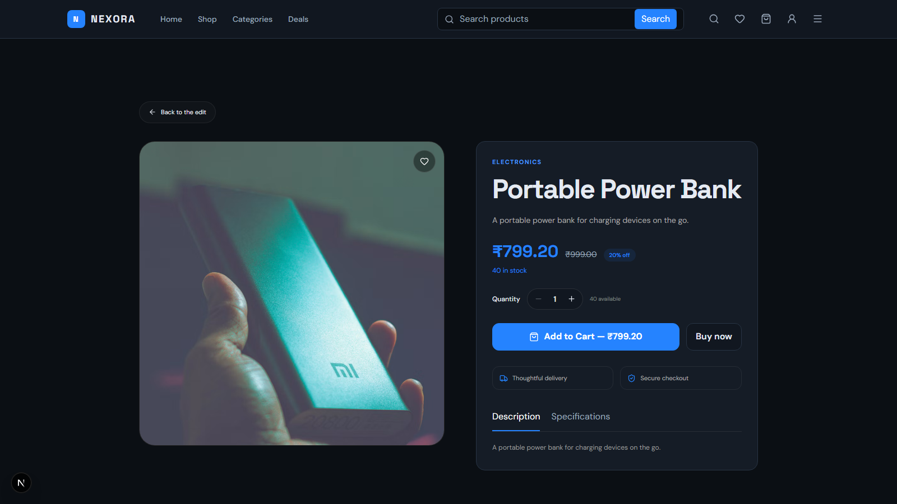
01 / PROJECT
What does the project do?
A real product-detail screen from the running NEXORA marketplace.
PROJECT INTERFACE
A marketplace page for viewing a product and placing an order.
The screenshot shows the NEXORA product-detail page, including:
? Product image and category
? Name, description, and price
? Stock and quantity controls
? Add to Cart and Buy now actions
PROJECT OVERVIEW AND LIVE INTERFACE
02

Slide 3
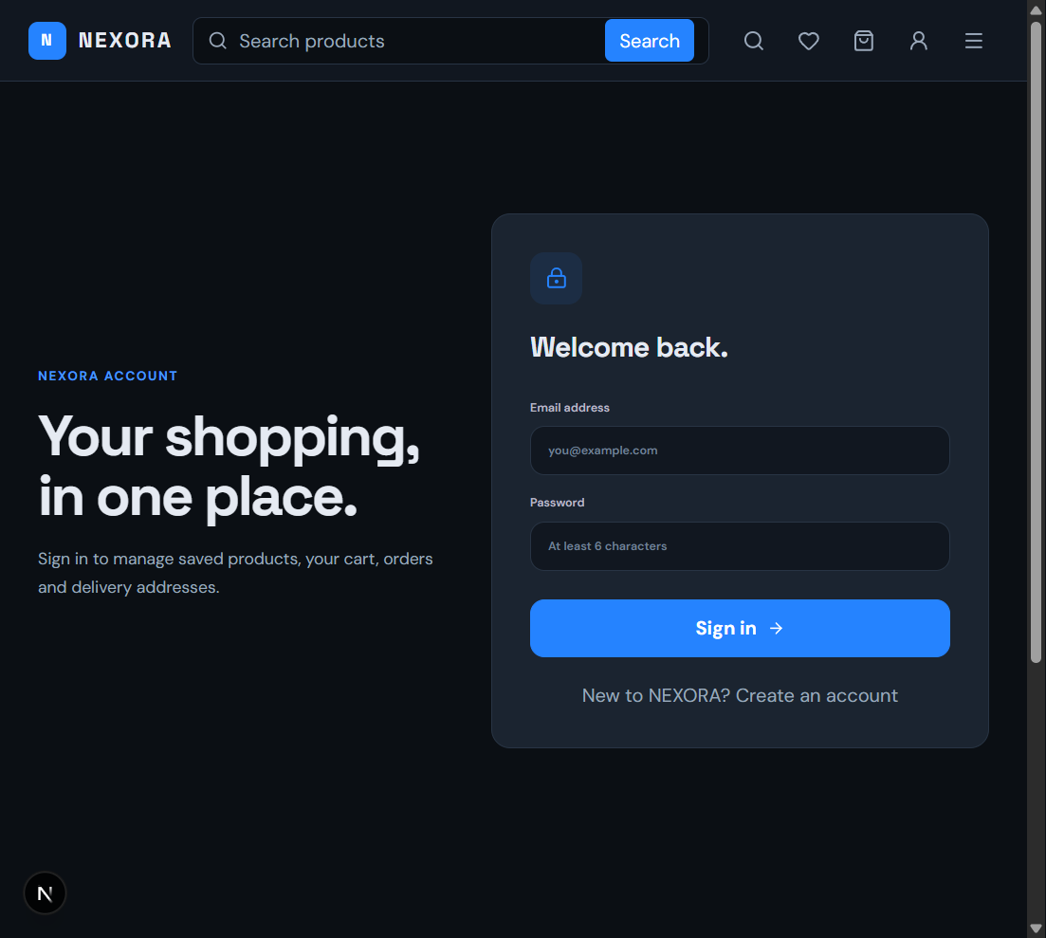
01 / PROJECT SCREENSHOTS
NEXORA sign-in page
A real screenshot of the running project login interface.
ACCOUNT INTERFACE
Sign in to access the online store account.
This screen lets a customer:
- Enter an email address and password
- Sign in to their account
- Access saved products, cart, orders, and delivery addresses
LIVE PROJECT LOGIN SCREEN
03

Slide 4
02 / HOW IT WORKS
Three layers work together
A clear separation makes the application easier to build and maintain.
01 FRONTEND
02 BACKEND
03 DATABASE
The user-facing interface
The application logic
The persistent data store
Shows products, filters, cart, and order details. Sends requests to the backend.
Receives requests, validates input, applies business rules, and runs database queries.
Stores products, categories, customers, orders, and order items in related tables.
HTML | CSS | JavaScript
API | validation | SQL
tables | keys | relations
User action -> frontend request -> backend processing -> database query -> results displayed
FRONTEND, BACKEND, AND DATABASE
04

Slide 5
03 / DATABASE DESIGN
Tables keep information organized
Primary keys identify rows; foreign keys connect related records.
CUSTOMERS
CATEGORIES
PRODUCTS
PK customer_id
PK category_id
PK product_id
name | email | phone | city
category_name
FK category_id | name | price | stock
One customer can place many orders.
One category can contain many products.
Each product belongs to a category.
ORDERS
ORDER_ITEMS
PK order_id
PK order_item_id
FK customer_id | date | total | status
FK order_id | FK product_id | quantity | price
Each order belongs to one customer.
Connects ordered products with orders.
PK = Primary Key | FK = Foreign Key
DATABASE TABLES
05

Slide 6
04 / ERD
How the tables relate
OrderItems resolves the many-to-many relationship between orders and products.
Customers
Orders
OrderItems
1 : MANY
1 : MANY
PK customer_id
PK order_id
PK order_item_id
name | email | city
FK customer_id | date
FK order_id | FK product_id
MANY : 1
Products
Categories
PK product_id
PK category_id
FK category_id | price | stock
category_name
MANY : 1
Customers -> Orders -> OrderItems <- Products <- Categories
ENTITY RELATIONSHIP DIAGRAM
06

Slide 7
05 / SQL IN ACTION
Find and manage product data
CRUD means Create, Read, Update, and Delete.
CRUD OPERATIONS
FILTER + SORT EXAMPLE
CREATE / INSERT
Add a product row
SELECT product_name, price
FROM Products
READ / SELECT
View and search products
WHERE price BETWEEN 500 AND 1500
AND product_name LIKE '%Laptop%'
ORDER BY price DESC
LIMIT 5 OFFSET 0;
UPDATE
Change price or stock
DELETE
Remove a selected row
WHERE | AND | OR | NOT | IN | BETWEEN | LIKE
ORDER BY | LIMIT | OFFSET - find, sort, and page through results.
Use WHERE with UPDATE and DELETE so only the intended row is changed.
CRUD, FILTERING, AND SORTING
07

Slide 8
06 / SUMMARIZE AND CONNECT
SQL answers bigger questions
Aggregates summarize rows; joins combine related information from tables.
AGGREGATE FUNCTIONS
JOINS
Use these to calculate summaries from many rows.
INNER JOIN
only matching rows
SELECT category_id,
LEFT JOIN
all left rows + matches
COUNT(*) AS products,
AVG(price) AS avg_price
FROM Products
RIGHT JOIN
all right rows + matches
GROUP BY category_id
HAVING AVG(price) > 500;
FULL OUTER JOIN
all rows from either side
SELF JOIN
a table joined to itself
COUNT | SUM | AVG | MIN | MAX
SELECT c.name, o.order_id
GROUP BY groups; HAVING filters those groups.
FROM Customers c JOIN Orders o ON c.customer_id = o.customer_id;
AGGREGATES AND JOINS
08

Slide 9
END OF PRESENTATION
Thank you!
Questions?
PROJECT
3-TIER FLOW
ERD
SQL
Project interface | Frontend | Backend | Database | Tables | SQL operations
E-COMMERCE STORE DATABASE PROJECT

