Slide 1
C++ memory model
How to avoid the biggest frustrations
(Dieter Kybelksties)

Slide 2
Genesis of C++
In the beginning man created assembler and in the image of bits and bytes created he him.
Digital computers since Babbage have the concept of memory consisting of bits and bytes.
Bit 1 bit of binary information
Byte n bits of binary information, recently n was set fixed to 8 bits
Modern computer hardware access terabytes of (mass-)storage, Gigabytes of main memory, Megabytes of cache, and kilobytes of onboard/prom storage
Decreasing memory-size here comes with increased speed

Slide 3
Early computers / Assembler
One fundamental thing about any digital computer is, that programs are stored on the same memory, in the same manner as the data they manipulate. In fact viruses use exactly that property to do their evil work.
Early programmers would use assembly language to create programs

Slide 4
Example Assembler
fib:
movl %edi, %eax ; put the argument into %eax
testl %edi, %edi ; is it zero?
je .return_from_fib ; yes - return 0, which is already in %eax
cmpl $2, %edi ; is 2 greater than or equal to it?
jbe .return_1_from_fib ; yes (i.e., it's 1 or 2) - return 1
movl %edi, %ecx ; no - put it in %ecx, for use as a counter
movl $1, %edx ; the previous number in the sequence, which starts out as 1
movl $1, %esi ; the number before that, which also starts out as 1
.fib_loop:
leal (%rsi,%rdx), %eax ; put the sum of the previous two numbers into %eax
cmpl $2, %ecx ; is the counter 2?
je .return_from_fib ; yes - %eax contains the result
movl %edx, %esi ; make the previous number the number before the previous one
decl %ecx ; decrement the counter
movl %eax, %edx ; make the current number the previous number
jmp .fib_loop ; keep going
.return_1_from_fib:
movl $1, %eax ; set the return value to 1
.return_from_fib:
ret ; return

Slide 5
Tedious and error prone
Writing programs like this was very uncomfortable
It took very long
Hard to understand what a program does
Difficult to debug
Instructions are 1-word numbers
“variables” are 1 word registers
“pointers” a 1 word registers, …
Similar operations repeated very often

Slide 6
Solution “C”
As a solution to this, C was invented
C abstracts in the way that
  variables have names
  Chunks of repeated instructions are given names (functions)
  Data access/referencing/dereferencing in a syntactically more obvious fashion
BUT:
C is not directly executable
C - code is compiled into assembler (so after compilation you can go an edit the program in assembly language)

Slide 7
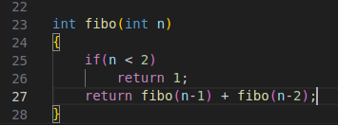
C – a “macro” language for assembler

Slide 8
Problems with C
As the acceptance of C grew and power of computers allowed for larger and more complex programs, so grew the problems
  Memory allocation/deallocation
  Naming and parameter-lists long and cluttered
  Syntactical problems leading to unreadable code
  …
Solution(?) ==> C++

Slide 9
Heap and stack
Logically we actually have 4 types of memory:
Text (program memory): here all the functions and classes are defined that make up the program. Allocated on the stack
Data: initialized/unitialized global data
Stack: here local variables, parameters and function call pointers are stored
Heap: here dynamically allocated objects are stored

Slide 10
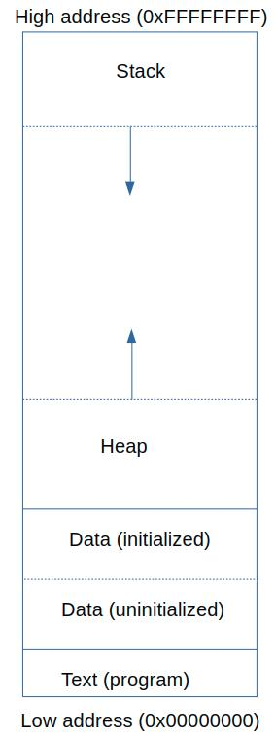
C++ memory layout

Slide 11
What happens when I call a C/C++ function?
Say the following function is called:
int add(int a, int b)
{
return a + b;
}
int main() {
add(660, 6);
…
}
1: the assembly instructions for function add are located in the program store #add1
2: when we call add in the main function a function pointer to #addr1
3: Then a copy of value 660 is put on the stack #addr2
4: then a copy of value 6 is put on the stack #add3
5: then in the program store the #addr2 and #addr3 are referenced
6: the calculation is performed and the result is put in the address n the program space #addr4
7: the stack is unwound up to and including the function pointer in step 1

Slide 12
What happens when I call a C/C++ function?
Say the following function is called:
int add(int a, int b)
{
return a + b;
}
int main() {
  add(660, 6);
  …
}
1: the assembly instructions for function add are located in the program store #add1
2: when we call add in the main function a function pointer to #addr1
3: Then a copy of value 660 is put on the stack #addr2
4: then a copy of value 6 is put on the stack #add3
5: then in the program store the #addr2 and #addr3 are referenced
6: the calculation is performed and the result is put in the address n the program space #addr4
7: the stack is unwound up to and including the function pointer in step 1

