Slide 1
CMake
Build system for modern C++
(Dieter Kybelksties)

Slide 2
Background
C++ is a compiled language as opposed to interpreted language (like Python, bash)
A C++ compiler translates a C++-text into native binary (assembly)
3 phases
  Pre-compile
  Compile
  Link

Slide 3

C++ code as compact as possible
Additional information is needed to compile from C++-text to binary
Additional information can be complex, and there can be a lot of it
For example command-line to compile 1 file into an object file:

Slide 4
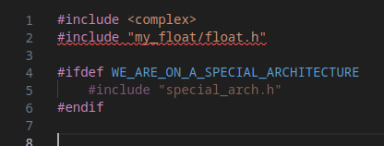
When does the pre-compiler need parameters?
The pre-compiler recursively replaces #include instructions with contents of files.
The #include instructions are usually only filenames, sometimes with relative paths. So where do we find these files?
Variable definitions/references in code

Slide 5
When does the compiler need parameters?
Which C++ standard to use (compile against)
Compile for performance or debug
Whether to compile for different architecture (cross-compile)
Whether to treat warnings as errors
Output location for compiled (object) files
…
Command parameters need to be added for every single file that is compiled

Slide 6
When does the linker need parameters?
The input for the linker are the object files created by the compiler, plus (static or dynamic) libraries, so we need locations for all the files
Symbolic or static linkage
Location of linker to use
...

Slide 7
In summary need to instruct our compiler:
Where to find files/headers/libraries – this can be lots of different folders
Attributes we want our executable to have
  Create debuggable binary?
  High-performant?
  Create for a different hardware (cross-compile)?
  Dynamic/static?
  ...
Use external tools or pre-compilers (eg. lex/yacc)?
This information is usually given as parameters to the comile command
  -I : include path
  -D: variable definition
  -o: output-filename
  -L: library directory
  -Wall: Turn on all warnings
  ...

Slide 8
Traditionally we used Makefiles
On Posix systems the standard: Makefiles – normally one for each folder .
In the makefiles we declared targets and a recipe for how to build each target.
To make this process a bit more general we could define
  variables (much like shell-variables)
  Dependencies
  General recipes
This was very cumbersome end error prone.

Slide 9
Next iteration: autotools
Microsoft (in VisualStudio) used visual tools to define XML documents to simplify the creation of Makefiles.
Unix/Linux used autotools (automake,...). Autotools would search standard directories to find:
“Known” directories, and whether and where specific libraries and tools are installed
whether and where specific headers are installed
Check capabilities of compiler and linker, like C++-standard etc.
Autotools worked and made things easier, but remained a dark art for many

Slide 10
CMake
For a few years now cmake has been the weapon of choice to define and configure builds of C++ projects.
Similar in approach to the way autotools works
Generates Makefiles or Ninja files
Text-based
Descriptive
Well-documented
Powerful
Well maintained and community supported

Slide 11
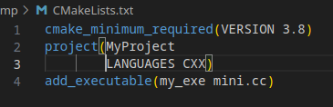
Minimal example
File CMakeLists.txt:
If the C++ file mini.cc exists and is a valid C++-program source, this would be sufficient to build a simple executable with cmake
The executable would be called my_exe.

Slide 12
Exercises
Create a folder and unzip CMakeExercises.tar.gz into this folder (tar -xvf CmakeExercises.tar.gz)
Each of the folders Step01 - Step07 contains a file __INSTRUCTIONS__.md – a markdown text-file – that tells you what to do.

Slide 13
Do excercises
>>>

Slide 14

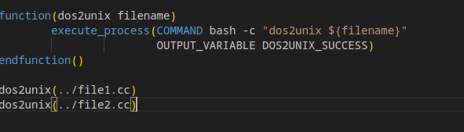
Variables, functions
set(<variable-name> <variable-value>)
function(<function-name> [parameter] [...])

Slide 15
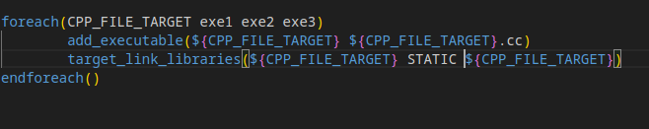
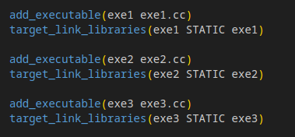
Flow-control
foreach(…) for example create similar targets:
Is equivalent to:

Slide 16
Cmake help pages
String operations: https://cmake.org/cmake/help/latest/command/string.html
If-then-else: https://cmake.org/cmake/help/latest/command/if.html
Find libraries: https://cmake.org/cmake/help/latest/command/find_library.html
Find a program: https://cmake.org/cmake/help/latest/command/find_program.html
Run bash commands: https://cmake.org/cmake/help/v3.0/command/execute_process.html
and more

