Slide 1
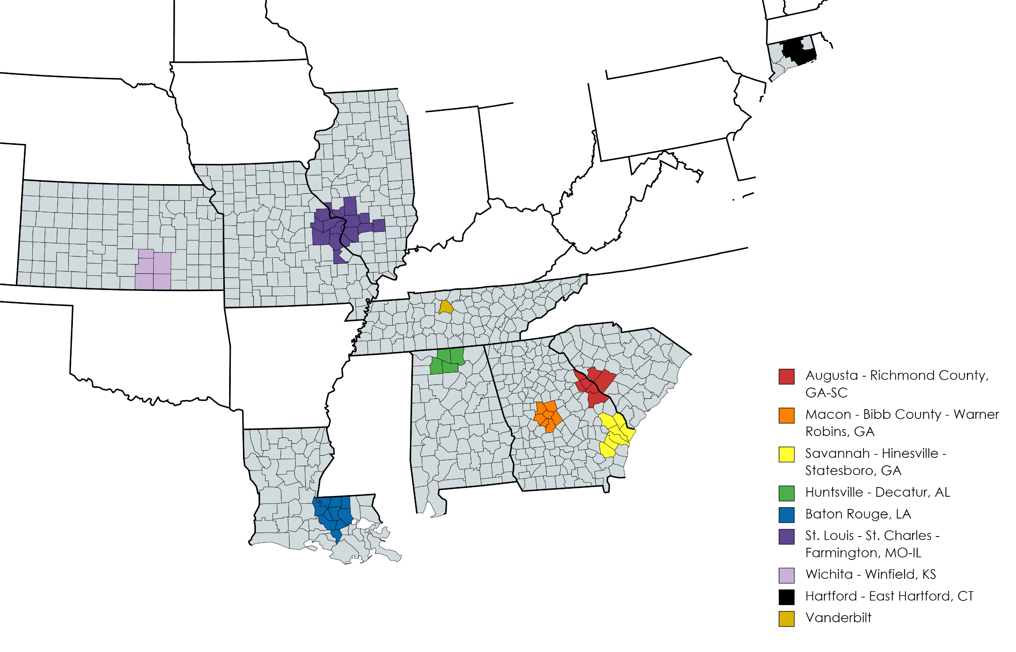

Potential High-Value Metro Areas
The following have been identified as high-value metro areas in terms of producing NFL talent
After identifying metro areas which have a high NFL to high school recruit ratio, these metro areas were identified as potential high-value locations for Vanderbilt
The selection criteria for these areas include:
Proportion of NFL talent attending G5 schools
Proportion of NFL talent attending out-of-state schools
Proximity to Vanderbilt
Historical recruiting performance for Vanderbilt
Coaching staff ties to area

