Slide 1
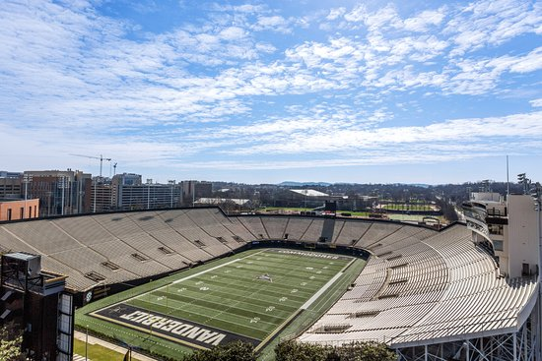
Vanderbilt Recruiting Study
Logan King – Graduate Recruiting Assistant

Slide 2

Outline
National Recruiting Analysis
Overall Counts
Ratings
Distance
Cluster Analysis
Vanderbilt Recruiting Analysis
Overall Counts
Rankings & Ratings
Distance
Successes & Failures
Cluster Analysis
Recommendations
Future Research

Slide 3
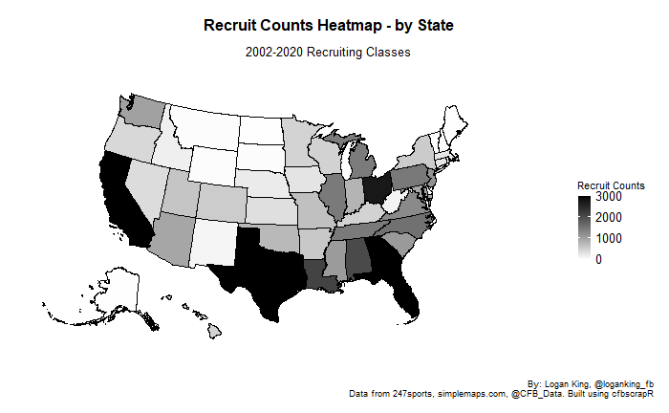
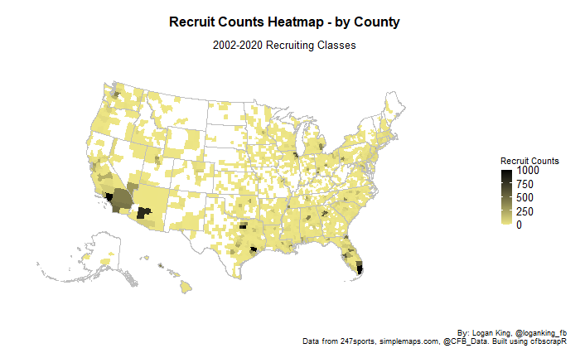
National Recruiting – Overall Counts
56,442 high school recruits ranked by 247 from 2002-2020
Top states in terms of producing recruits: Texas, Florida, California, Georgia, Ohio
Top cities in terms of producing recruits: Los Angeles, Dallas, Miami, Houston, Phoenix
Recruit counts have been increasing over observed period
No significant difference in recruit count growth by state year-to-year

Slide 4
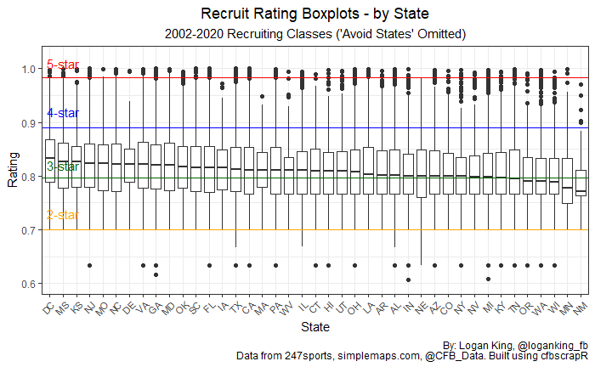
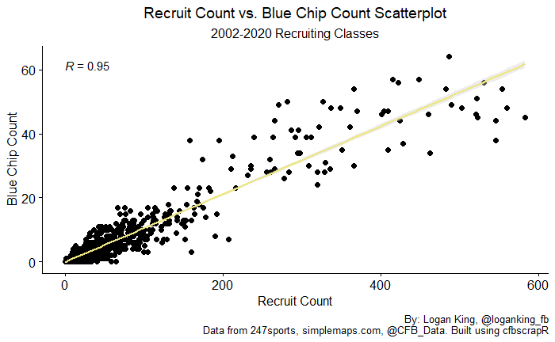
National Recruiting - Ratings
Recruit rating does not vary significantly across states
Recruit rating by position does not vary significantly across states
Blue chip production highly correlated to overall counts
No state inherently better at producing higher percentage of blue chips, some are noticeably worse
Avoid AK, ID, ME, MT, ND, NH, RI, SD, VT, WY

Slide 5
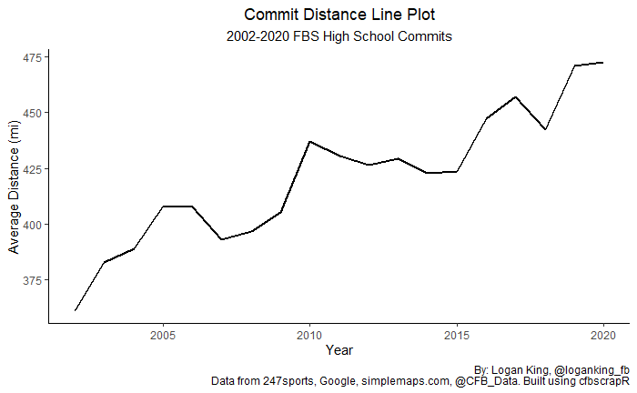
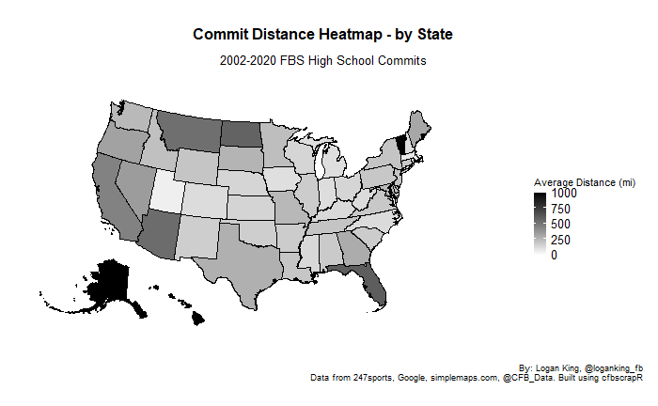
National Recruiting - Distance
Distance that recruits travel has been increasing over time
No correlation between recruit rating and distance
No correlation between state recruit density and distance
No position group is more likely to travel a greater distance

Slide 6
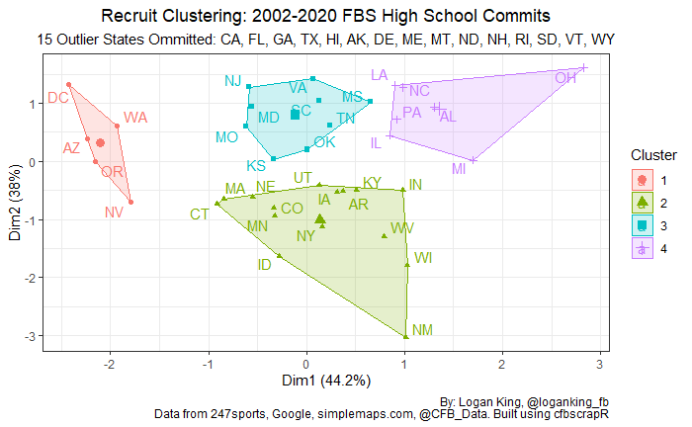
National Recruiting – Cluster Analysis
By clustering the FBS HS commit classes, we can see groups of similar states
Clusters are determined by commit count, average commit rating, and average commit distance traveled
States which are considered outliers were omitted
Group characteristics
1: Significantly high distance traveled
2: Negative coefficients for all
3: Highest rating among clusters
4: Significantly high commit counts
Group | Commit Count | Avg Rating | Avg Distance
1 | -0.6 | 0.8 | 2.0
2 | -0.7 | -0.7 | -0.3
3 | 0.2 | 0.9 | -0.2
4 | 1.6 | -0.1 | -0.6

Slide 7
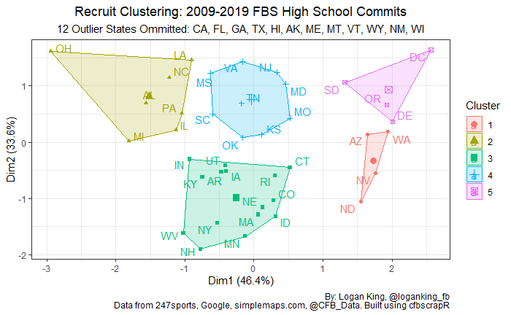
National Recruiting – Cluster Analysis Comparison
When subsetting from 2009-2019, DE, ND, NH, RI, SD, are no longer outliers. NM and WI are now classified as outliers and are removed.
The groups remain similar
Group characteristics
1: Significantly high distance traveled
2: Significantly high commit count
3: Lowest average rating among clusters
4: Middle of the road, high average rating
5: Significantly high average rating, high average distance and low commit count
Group | Commit Count | Avg Rating | Avg Distance
1 | -0.6 | 0.8 | 2.0
2 | -0.7 | -0.7 | -0.3
3 | 0.2 | 0.9 | -0.2
4 | 1.6 | -0.1 | -0.6
Group | Commit Count | Avg Rating | Avg Distance
1 | -0.5 | -0.1 | 2.1
2 | 1.7 | -0.3 | -0.6
3 | -0.6 | -0.8 | -0.3
4 | 0.3 | 0.7 | -0.3
5 | -0.9 | 1.9 | 0.9

Slide 8
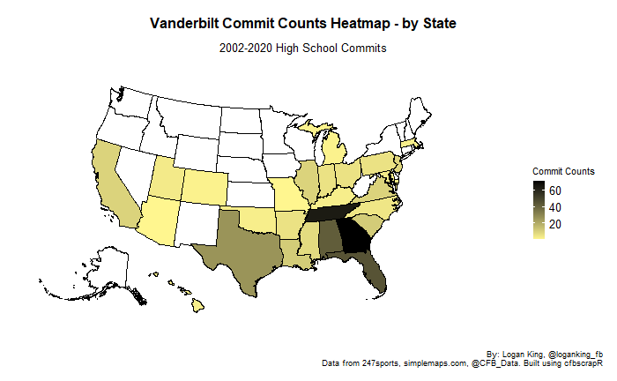
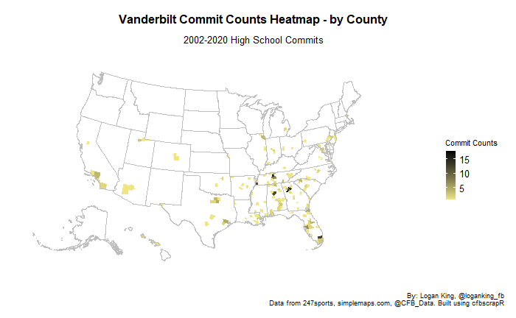
Vanderbilt Recruiting – Overall Counts
381 commits ranked by 247 from 2002-2020
Top states for Vanderbilt commits: Georgia, Tennessee, Florida, Alabama, Texas
Top cities for Vanderbilt commits: Atlanta, Nashville, Miami, Birmingham, Memphis
Of non-pipelines, Virginia, Illinois, Louisiana, North Carolina have been most recently productive

Slide 9
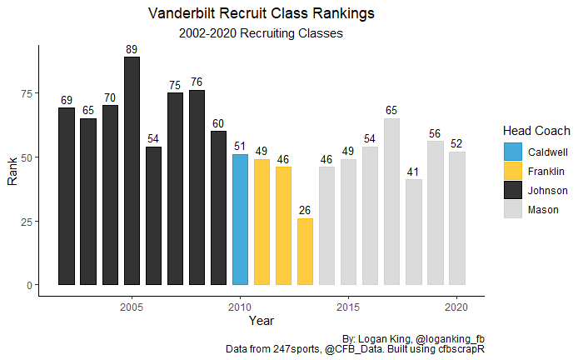
Vanderbilt Recruiting – Rankings & Ratings
Vanderbilt’s average recruiting class ranking is 58 for 2002-2020 (48 since SEC realignment in 2012)
In terms of commit ratings, Arkansas is the only state significantly lower than most others
Vanderbilt has had 18 blue-chip commits from 2002-2020, none have been 5-stars
State | Blue Chip Count
TN | 7
GA | 3
CA | 2
AL, FL, KY, MS, PA, TX | 1
Position | Blue Chip Count
DB | 4
DL, LB, WR | 3
RB, TE | 2
QB | 1

Slide 10
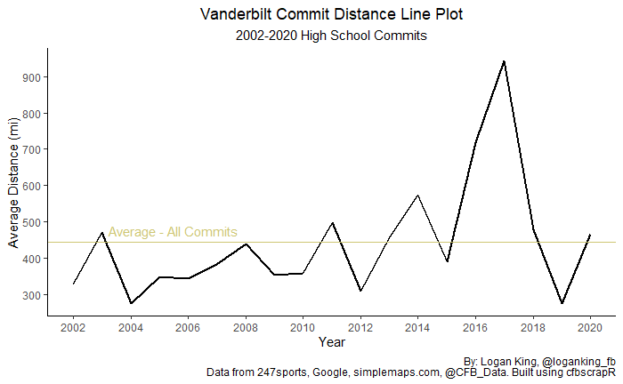
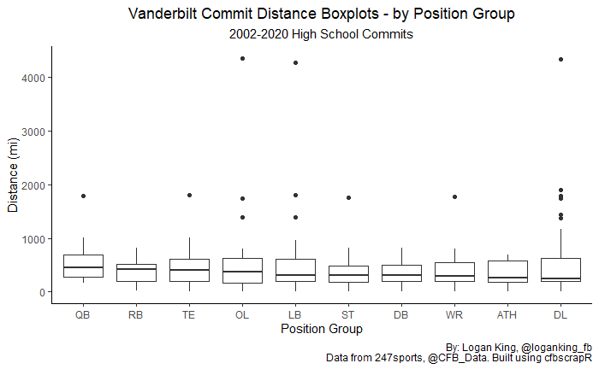
Vanderbilt Recruiting – Distance
Distance shows no clear growth/decline over time, average of about 443 miles
Rating and positional findings from national recruiting distance analysis also hold true for Vanderbilt

Slide 11
Vanderbilt Recruiting – Successes & Failures
Methodology
Success – meets one or more of three conditions (available for all years 2002-2020)
Drafted to the NFL
Appearing in an NFL game
Selected to the All-SEC team
Failure – meets one or more of two conditions:
Roster Failure: defined as having been on Vanderbilt's roster for less than three years
Snaps Failure: defined as not having achieved 50% (10% for fullbacks) of snaps on given position’s side of the ball in a single season over the course of a player's career
Recruiting classes starting from 2018 onwards are not subject to the Snaps Failure condition, as their careers have not been completed
Due to a lack of data availability, specialists (K, P, LS) are not subject to the snaps failure condition)

Slide 12
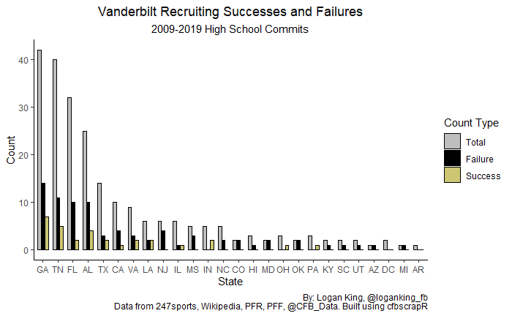
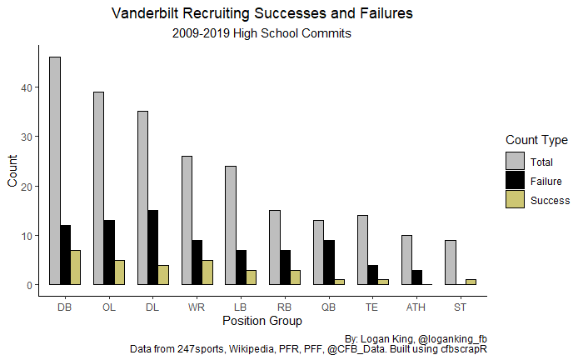
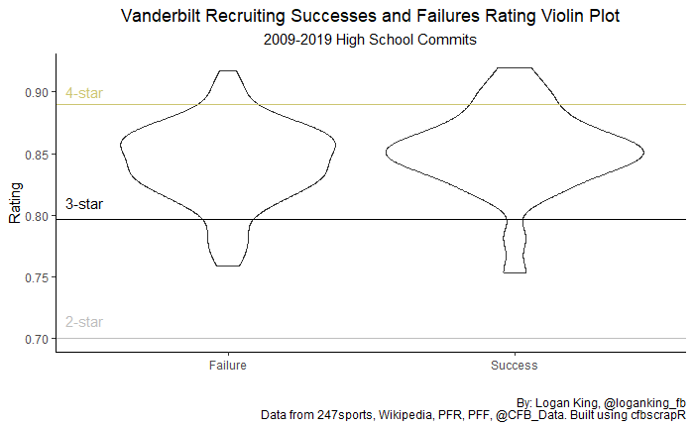
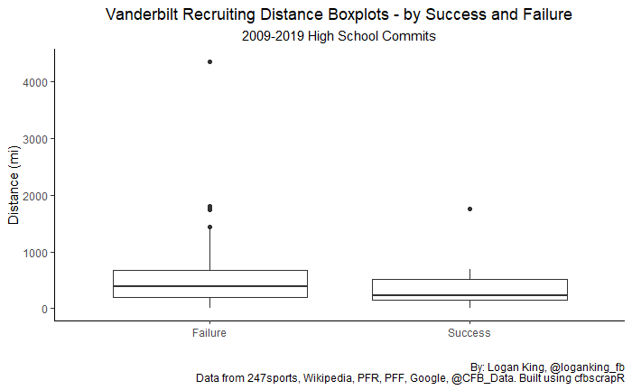
Vanderbilt Recruiting – Successes & Failures
45 successes since 2002 recruiting class
From 2009 - 2019:
231 Total Recruits
30 Successes (13%)
79 Failures (34%)
Recruit rating, distance, and Predicted GPA do not appear to be indicators of success or failure
Measurables appear to matter for ATH, TE, DL
No reliable indicator of statistical significance due to limited samples

Slide 13
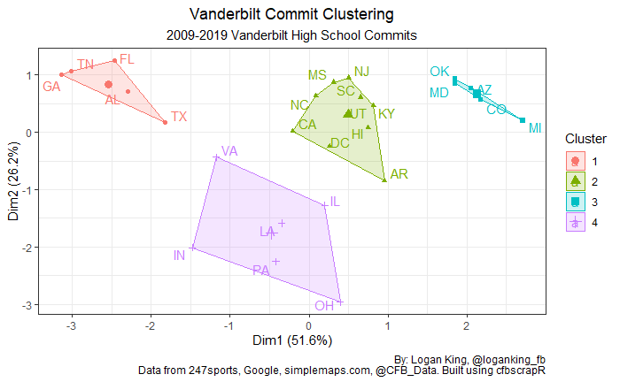
Vanderbilt Recruiting – Cluster Analysis
Like before, by clustering the Vanderbilt HS commit classes we can see groups of similar states
Clusters are determined by commit count, success percent, failure percent, most recent year, and number of distinct years
Group characteristics
1: Significantly high commit count and distinct years
2: Middle of the road numbers, towards lower end of commit count, success, and distinct years, comparatively
3: Significantly high failure rate and significantly low most recent year
4: Significantly high success percent
Group | Commit Count | Success % | Failure % | Most Recent Year | Distinct Years
1 | 1.8 | 0.3 | -0.4 | 0.9 | 1.8
2 | -0.4 | -0.7 | -0.1 | 0.4 | -0.5
3 | -0.6 | -0.8 | 1.7 | -1.1 | -0.9
4 | -0.3 | 1.5 | -0.9 | -0.5 | 0.0

Slide 14
Recommendations
Individual metrics did not produce any findings regarding success or failure in recruiting, however a combination of metrics paints a better picture as to where these outcomes may be more or less likely to occur
States to target
Continue to maintain focus on GA, TN, FL, AL, TX
Increase focus on OH, LA, PA, IL, VA
May be worth pursuing CA, NC, MS, NJ, SC, DC, IN
Each comes with caveats to be aware of
Avoid OK, AZ, MD, CO, MI, UT, KY, HI, AR
Recommendations may be altered with future research into metro areas

Slide 15
Future Areas of Research
Metro area analysis
Analysis of all NFL talent
Offer analysis
Commitment predictor
Addition of metrics such as speed, athleticism rating, etc.

