Slide 1
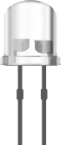
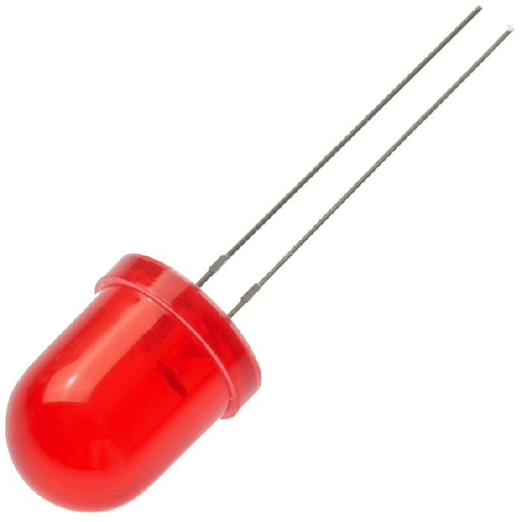
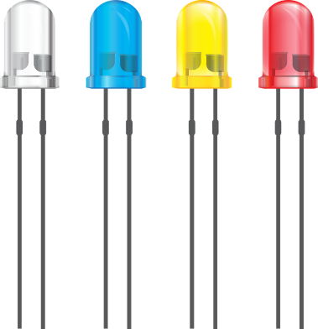
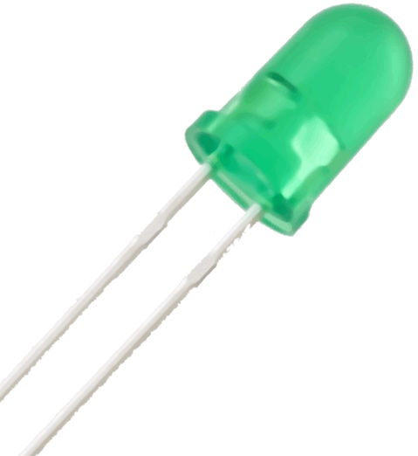
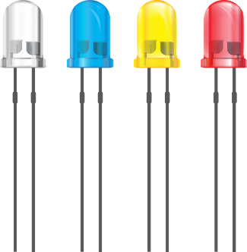
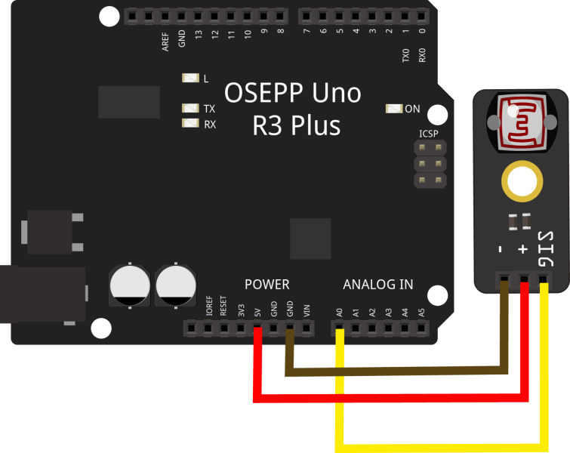
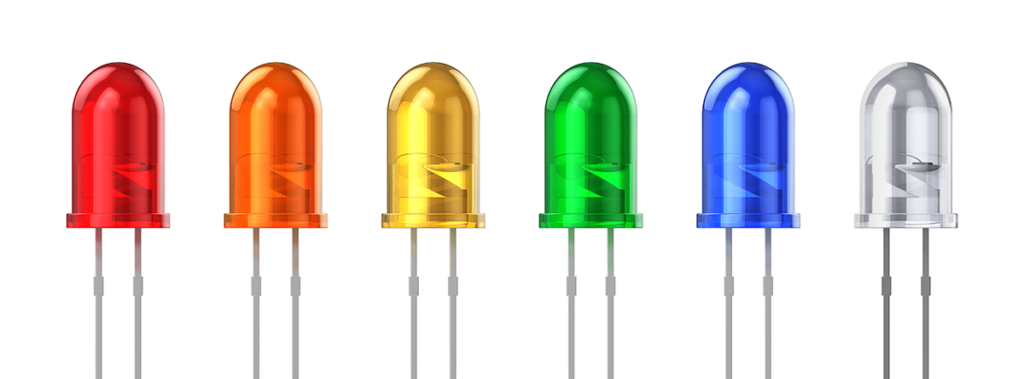
White Led is connected to pin 13 which controls the window locks
Red Led is connected to pin 12 which controls front door lock
Green Led is connected to pin 7 which controls the side door lock
Blue Led is connected to pin 1 which controls back door lock
Yellow LED is connected to pin 2 which controls garage door(s) lock.
Orange LED connected to pin 3 which controls car door locks

