Slide 1
An Analysis of the effects of housing characteristics on residential density
Daniel Hartig

Slide 2
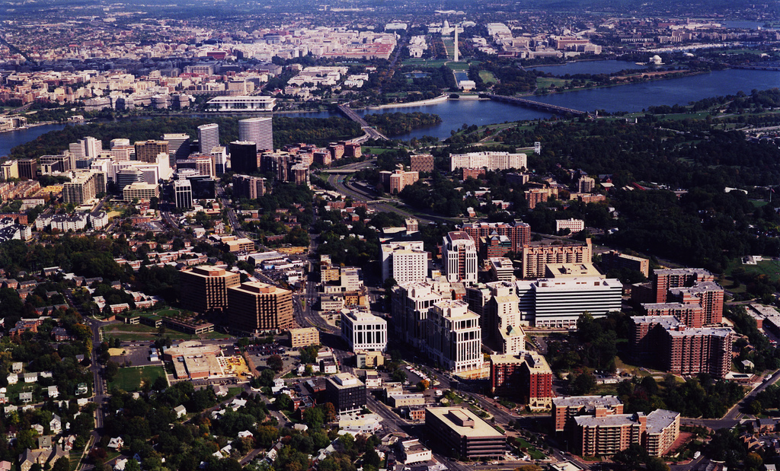
Arlington, Virginia

Slide 3

Cambridge, Massachusetts

Slide 4
Housing characteristics
 | Arlington | Cambridge
Area (km²) | 63 | 52
Population | 223446 | 261760
Pop Density | 3553 | 5068
Housing Units | 109647 | 114074
 | Arlington | Cambridge
2000-2009 | 17044 | 7678
1990-1999 | 10335 | 3751
1980-1989 | 12071 | 7478
1970-1979 | 11861 | 7909
1960-1969 | 12339 | 6989
1950-1959 | 16698 | 6928
1940-1949 | 16145 | 6681
1939 or earlier | 10227 | 65678
 | Arlington | Cambridge
Single Family, Detached | 29115 | 16087
Single Family, Attached | 10489 | 8601
Duplex | 1044 | 23516
Triplex/Four-plex | 4138 | 22338
5-9 Apartment | 6231 | 10192
10-19 Apartment | 8816 | 6062
20+ Apartment | 49528 | 27116

Slide 5
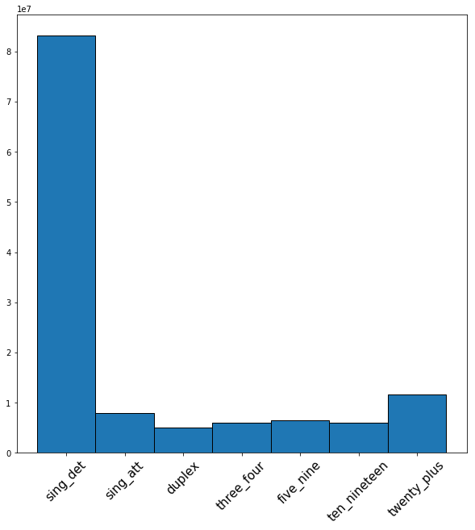
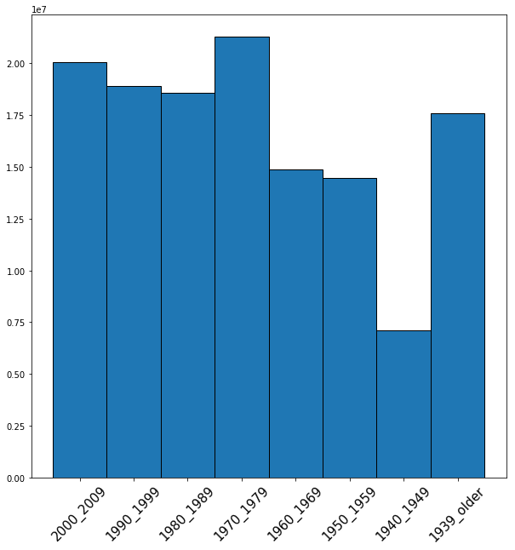
Distribution of characteristics
Type of Housing
Type of Housing
Age of Housing

Slide 6
Two way contingency table
 | 2000_2009 | 1990_1999 | 1980_1989 | 1970_1979 | 1960_1969 | 1950_1959 | 1940_1949 | 1939_older
sing_det | 13231648 | 12383720 | 11622307 | 13186186 | 8981531 | 8881509 | 4171739 | 9434389
sing_att | 1080944 | 1057279 | 1117296 | 1219262 | 876154 | 868056 | 460750 | 1147528
duplex | 481991 | 451096 | 493335 | 639427 | 569156 | 650298 | 396436 | 1294500
three_four | 672204 | 6457310 | 725539 | 887440 | 686525 | 689152 | 380892 | 1204765
five_nine | 825655 | 819087 | 911708 | 1061701 | 763556 | 704955 | 345267 | 9250555
ten_nineteen | 829216 | 805582 | 907553 | 102648 | 719441 | 644608 | 296961 | 730331
twenty_plus | 1456613 | 1206455 | 1436357 | 1784572 | 1436910 | 1335572 | 694701 | 2119241
Chi-square score of 2146451, with p-value = 0.0
Fractional difference from expected count
 | 2000_2009 | 1990_1999 | 1980_1989 | 1970_1979 | 1960_1969 | 1950_1959 | 1940_1949 | 1939_older
sing_det | 0.082 | 0.082 | 0.025 | 0.011 | -0.028 | -0.021 | -0.061 | -0.150
sing_att | -0.075 | -0.033 | 0.031 | -0.022 | -0.008 | 0.001 | 0.085 | 0.082
duplex | -0.352 | -0.351 | -0.284 | -0.193 | 0.013 | 0.180 | 0.469 | 0.920
three_four | -0.236 | -0.215 | -0.110 | -0.054 | 0.033 | 0.056 | 0.197 | 0.508
five_nine | -0.131 | -0.077 | 0.036 | 0.049 | 0.065 | 0.001 | 0.001 | 0.074
ten_nineteen | -0.069 | -0.032 | 0.100 | 0.082 | 0.070 | -0.023 | -0.081 | -0.096
twenty_plus | -0.150 | -0.247 | -0.096 | -0.023 | 0.110 | 0.051 | 0.117 | 0.363

Slide 7
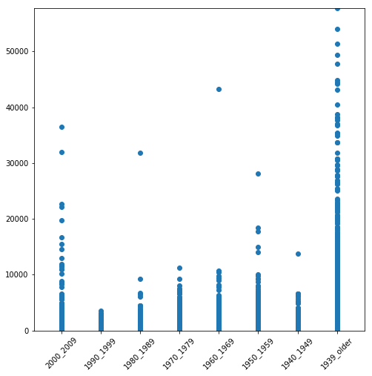
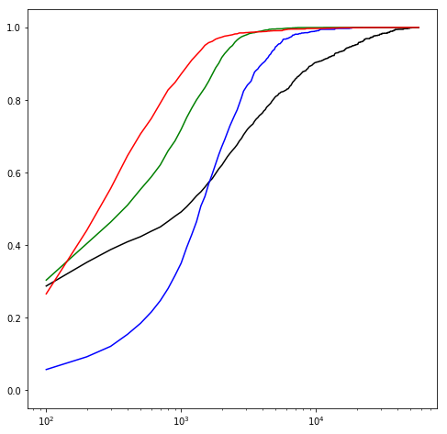
Analysis of age distribution
Cumulative population proportion
Residential Density
Residential density
Modal Age
Black – 1939 or before
Blue – 1940-1969
Green – 1970-1999
Red – 2000 or later

Slide 8
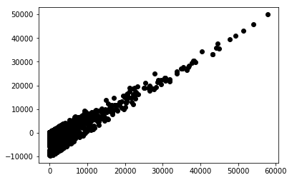
Housing type versus density regression
Using a flag for at least 20% of housing in a type category as feature
OLS Regression Results
==============================================================================
Dep. Variable: density R-squared: 0.244
Model: OLS Adj. R-squared: 0.244
Method: Least Squares F-statistic: 1757.
Date: Sun, 03 Dec 2017 Prob (F-statistic): 0.00
Time: 13:33:57 Log-Likelihood: -2.8745e+05
No. Observations: 32633 AIC: 5.749e+05
Df Residuals: 32626 BIC: 5.750e+05
Df Model: 6
Covariance Type: nonrobust
========================================================================================
coef std err t P>|t| [0.025 0.975]
----------------------------------------------------------------------------------------
Intercept 252.1625 9.315 27.069 0.000 233.904 270.421
sing_att[T.True] 743.6597 57.598 12.911 0.000 630.765 856.555
duplex[T.True] 2172.6819 83.310 26.080 0.000 2009.392 2335.972
three_four[T.True] 2378.1527 101.683 23.388 0.000 2178.851 2577.455
five_nine[T.True] 858.0827 122.476 7.006 0.000 618.026 1098.139
ten_nineteen[T.True] 384.4179 122.999 3.125 0.002 143.336 625.500
twenty_plus[T.True] 4336.1339 48.463 89.473 0.000 4241.145 4431.123
==============================================================================
Omnibus: 58417.086 Durbin-Watson: 0.758
Prob(Omnibus): 0.000 Jarque-Bera (JB): 105123996.503
Skew: 12.922 Prob(JB): 0.00
Kurtosis: 279.850 Cond. No. 14.5
==============================================================================
- Lowest condition number, but R² is almost garbage
- Problems: estimate of 100 % large apartments is
lower than estimate of 50/50 large and
small apartments
- Look at that residual plot!
- At least the coefficients all have a real meaning
- Look a the groupings of coefficients

Slide 9
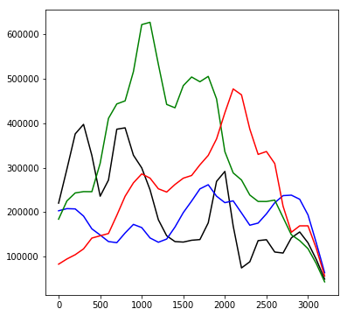
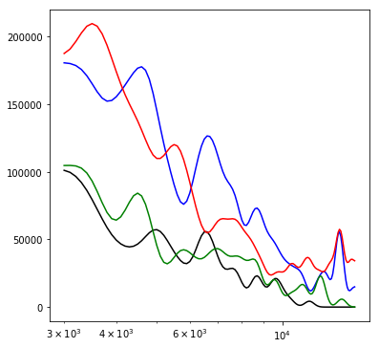
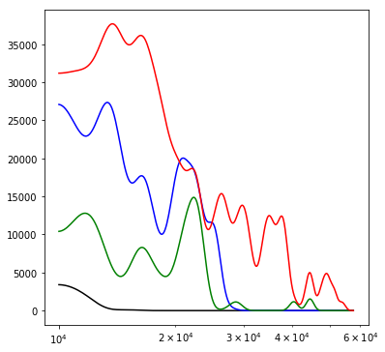
Distributions of dominant housing types by density
0 – 3333 per km²
- A zip code is counted in a
type category if at least 20%
of the housing units in that
zip code are in that type
category.
- Rowhouses: Black
- Duplex to Fourplex: Blue
- Smaller Apts: Green
- Large Apts: Red
Population in density bin
3333 – 15000 per km²
10000 – 60000 per km²
Residential Density

Slide 10
Conclusions
Any Questions?
- Zip codes built up before 1940 are the densest
- Densities above suburban (~3,000 people per km^2; like Old Town Alexandria) are dominated by either 2-4 unit housing or large apartments
- Densities in the range of big cities (~10,000 people per km^2 and higher; like Dupont Circle) are dominated by large apartments
- These two types of housing are heavily overrepresented in zip codes built up before 1940
- We haven’t sufficiently disentagled whether it is the housing age or housing type that is responsible for higher density.

