Slide 1
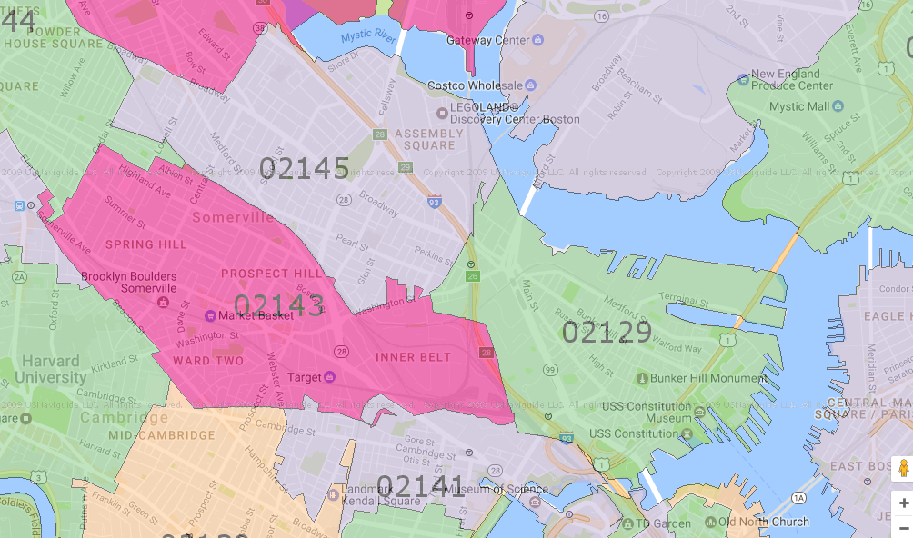
Closer to Wellington
Good
In the Water
Closer to Community College
Closer to Lechmere

