Slide 1
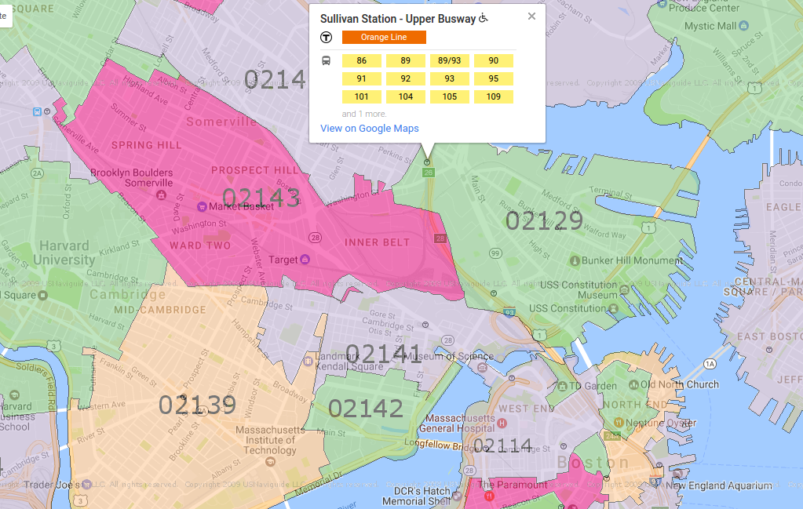
Projection too long!
02108
Projection too long!
Too far away!

