Slide 1
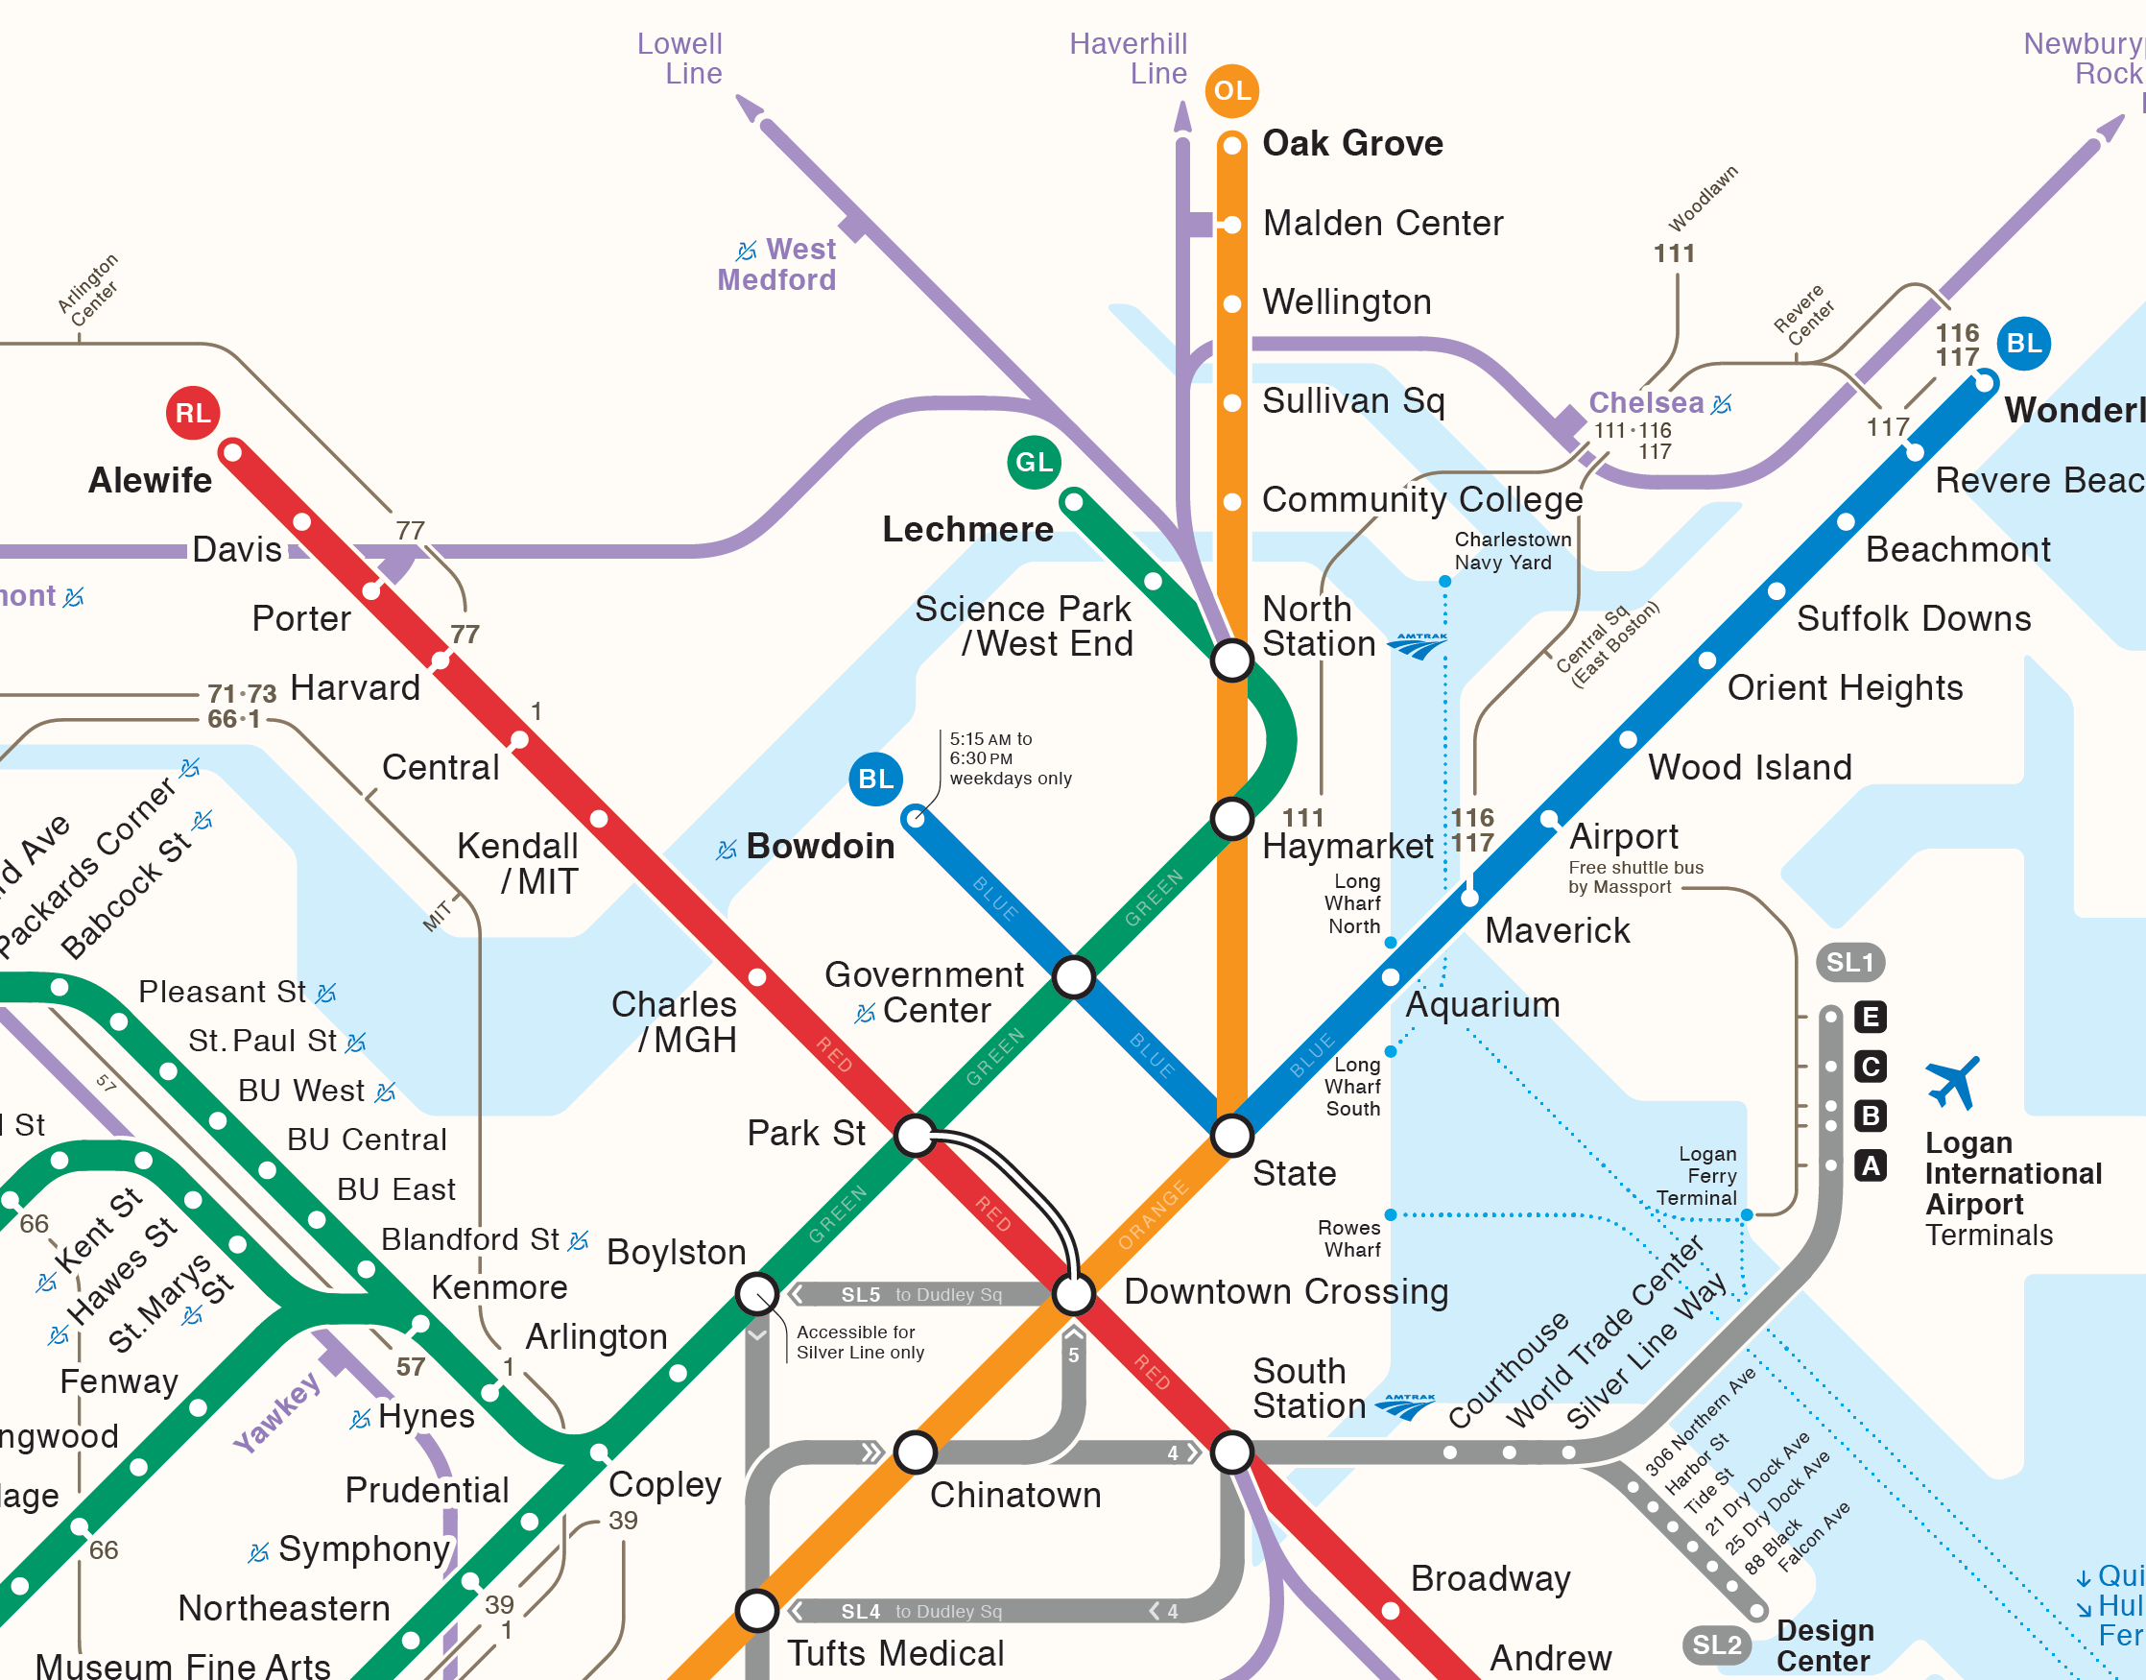
2
2
1
Transfer
2
2.5
2.5

