Slide 1
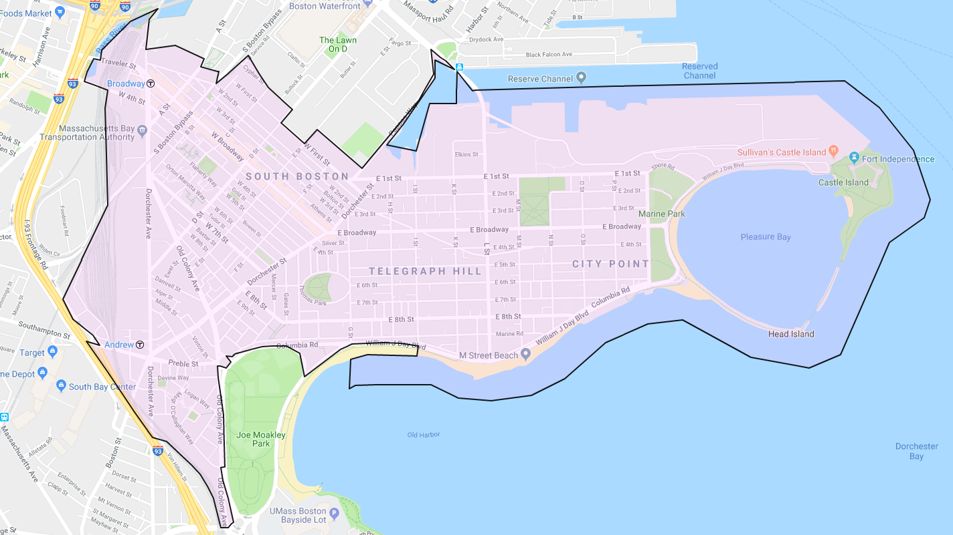
19: within 1 km of Andrew
6: within 1 km of both Andrew and Broadway
13: within 1 km of Broadway
44: greater than 1 km from any station
21: In excluded areas

