Slide 1
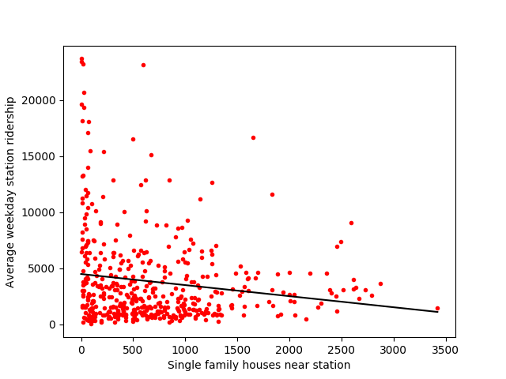
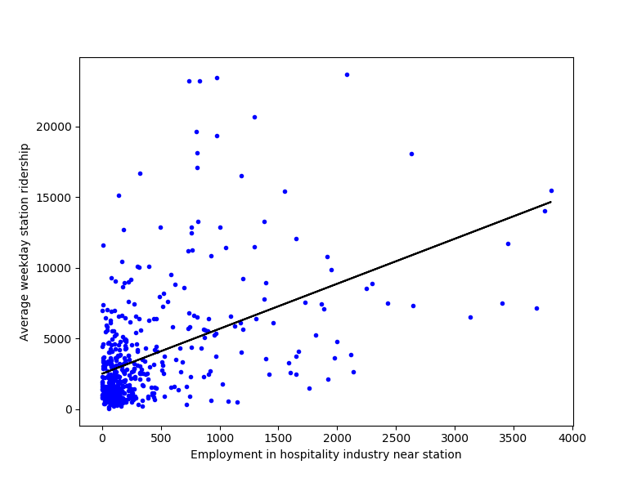
Single response variables against ridership

Slide 2
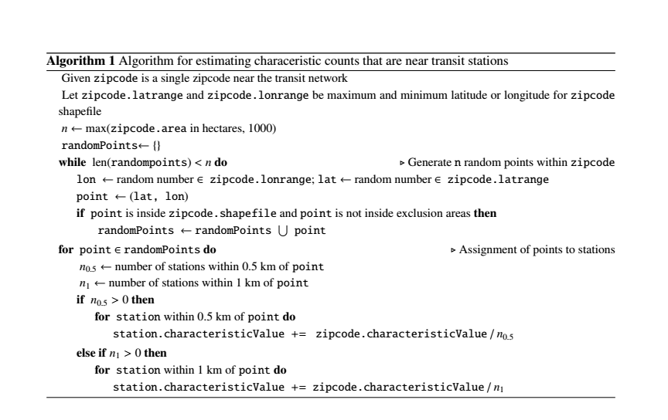
Algorithm for estimating characteristic counts

Slide 3
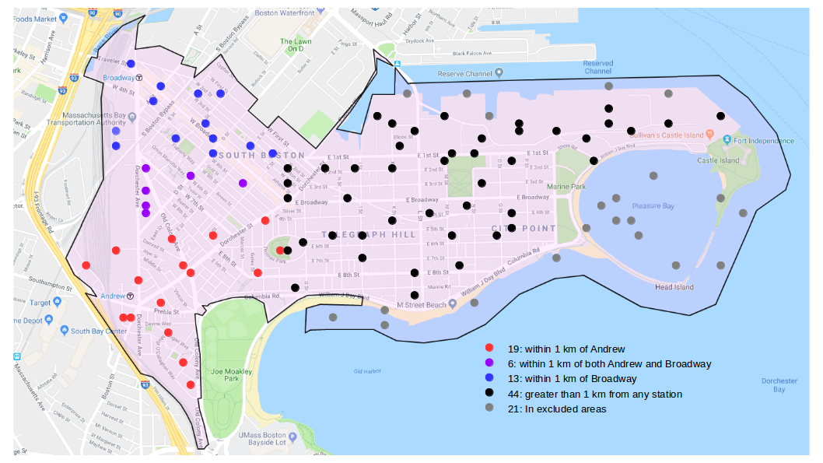
Zip code-level nearest station estimation

Slide 4
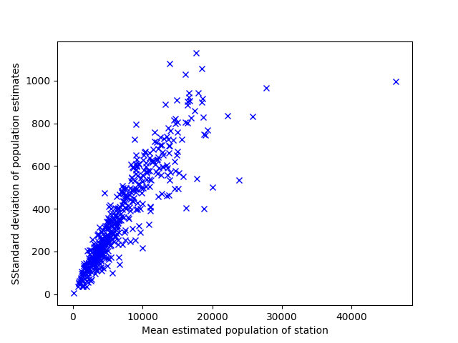
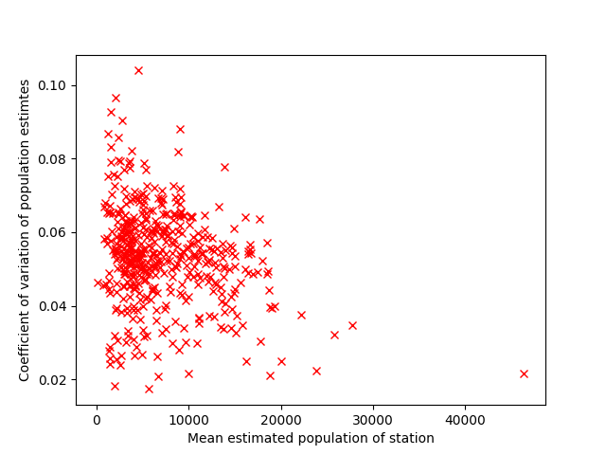
Variability of characteristic estimates by station

Slide 5
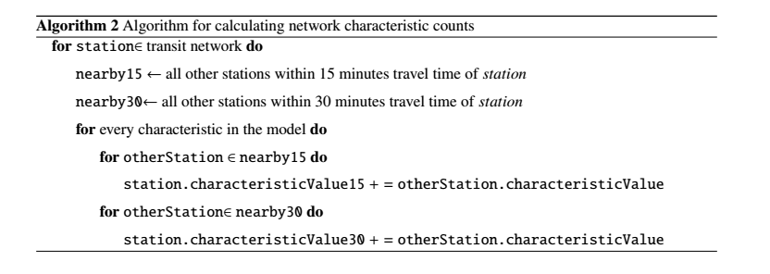
Algorithm for calculating network characteristics

Slide 6
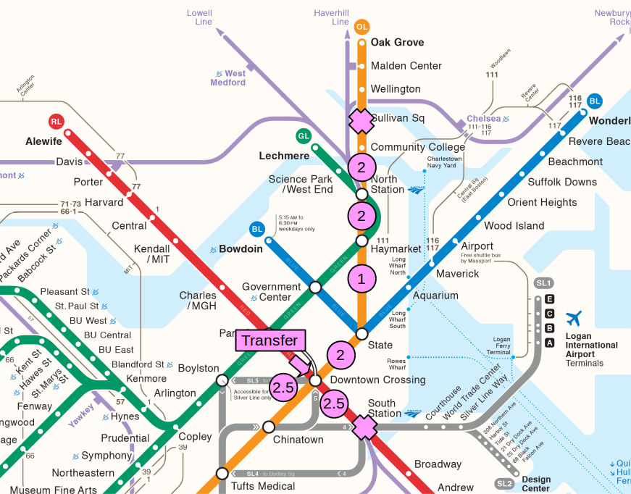
Illustration of travel time calculation

Slide 7
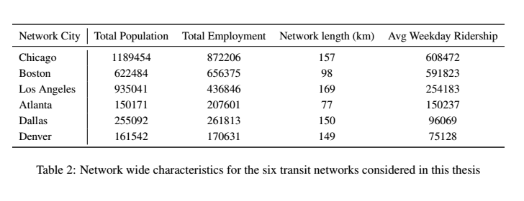
Characteristics of the cities in this thesis

Slide 8
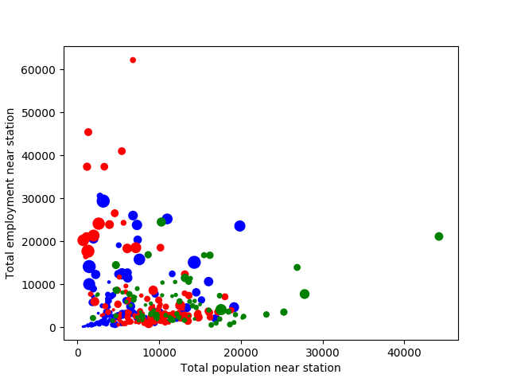
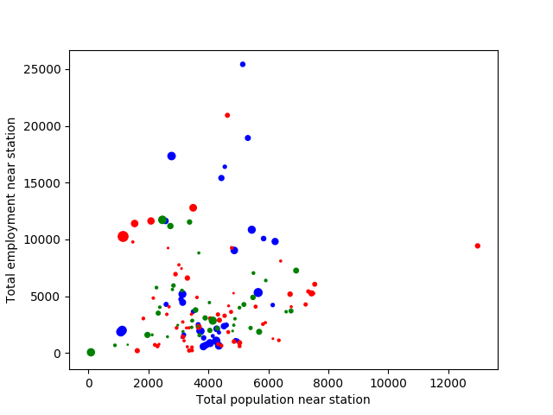
Relationship between population and employment
Within walking distance of each station
Blue – Atlanta
Red – Dallas
Green – Denver
Blue – Boston
Red – Chicago
Green – Los Angeles

Slide 9
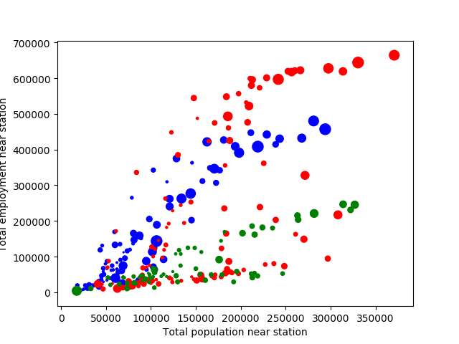
Relationship between population and employment
Within walking distance of each station
Blue – Atlanta
Red – Dallas
Green – Denver
Blue – Boston
Red – Chicago
Green – Los Angeles

Slide 10
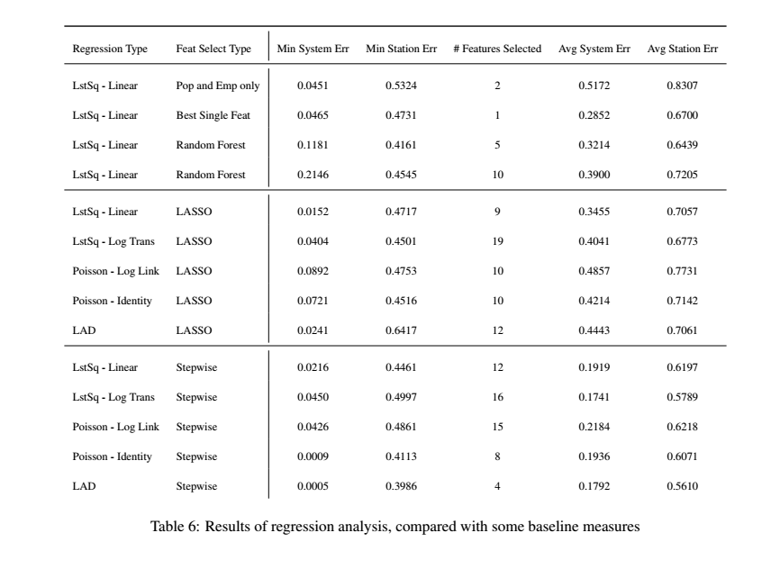
Regression results

