Slide 1
WILLM: A System for Academic Writing Improvement based on Large Language Models Bachelor Thesis Final Presentation
Ben Thillen
Study Program: Bachelor Computer Science Matr.-Nr.: 409574
Chair of Computer Science 5 Information Systems & Databases
Supervisors:
Advisors:
Prof. Dr. Stefan Decker
Prof. Dr. Bernhard Rumpe
Yongli Mou
Fatemeh Fathi
November 12, 2024

Slide 2




Introduction
Motivation
Unclear feedback: “Improve coherence”, “Bad organization”
Grammarly, Quillbot
Grammar
Paraphrasing
Deeper, complex issues
Improve coherence

Slide 3
Introduction
Thesis Goals
Research Questions:
Does continuous written feedback on grammar, vocabulary, organization, coherence, and writing style along with automated scoring from Large Language Models (LLM) improve academic writing over time?
How effective are active recall quizzes from LLMs in improving writing skills over long-term?
How effective are personalized reviews from LLMs in improving writing skills over long-term?
Concrete Requirements:
Immediate Feedback: Continuous, automated feedback on grammar, vocabulary, organization, coherence, and writing style.
Long-Term Enhancement: Active recall quizzes combined with spaced repetition and personalized reviews.

Slide 4



Related Work
Writing Assessment
Table 1: Writing assessment with AI tools
Authors | Methodology | AI Tools Used | Findings
[Tran et al., 2023] | Assessment with TOEFL iBT¹, pre- and post-test design |  | AI Tools are beneficial
[Song et al., 2023] | Assessment with IELTS², pre- and post-test design |  | AI-assisted instruction improved writing skills
[Mizumoto et al., 2023] | Essay scoring |  | Promising, with additional feedback
[Mansour et al., 2024] | Essay scoring |  | Average performance, with additional feedback
1https://www.ets.org/toefl/test-takers/ibt/about.html
2https://ielts.org/organisations/ielts-for-organisations/understanding-ielts-scoring

Slide 5

Related Work
Writing Improvement Tools
Table 2: Writing Improvement Tools
Tool | Functionalities
 | Grammar and Spell Checking, Paraphrasing, Tone Adjustments, Assessment, …
 | Grammar and Spell Checking, Paraphrasing, Tone Adjustments, Summarizing, Translation, …
 | Grammar and Spell Checking, Paraphrasing, Summarizing, AI Text Generation, …
Only Immediate Feedback
https://www.grammarly.com/ https://quillbot.com/ https://www.wordtune.com/

Slide 6
Related Work
Long-Term Enhancement Techniques
Table 3: Long-term memory enhancement techniques
Authors | Technique | Findings
[Ruan et al., 2019] | Active Recall, Spaced Repetition | Better memory recall performance in quizzes
[Dunlosky et al., 2013] | Active Recall, Spaced Repetition | Reinforces learning in quizzes
[Chang, 2019] | Reflective Learning | Identifies knowledge gaps and supports deep learning
[Song et al., 2023] | Reflective Learning | Reflective learning encouraged by ChatGPT

Slide 7



Conceptualization
Use Cases
Correction
Immediate Writing Improvement
Checks grammar, vocabulary, organization, coherence and writing style
Explanations with language selection
AI Evaluation
Scoring
Writing evaluation against academic standards
Rubric based on IELTS⁶, TOEFL iBT⁷, PTE Academic⁸
Correction
Scoring
6https://ielts.org/organisations/ielts-for-organisations/understanding-ielts-scoring
7https://www.ets.org/toefl/test-takers/ibt/about.html
8https://www.pearsonpte.com/pte-academic/scoring

Slide 8

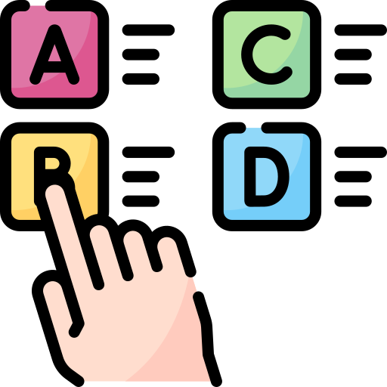


Conceptualization
Use Cases
Quiz
Long-Term Writing Improvement
Learning progress enhancement
Review
Review
Reflection on past work through tips and recent improvements
Quiz
Tips
Improvements

Slide 9





Conceptualization
Use Cases
Gamification
Aim: Capture user engagement
XP
Levels
Badges
Achievements

Slide 10
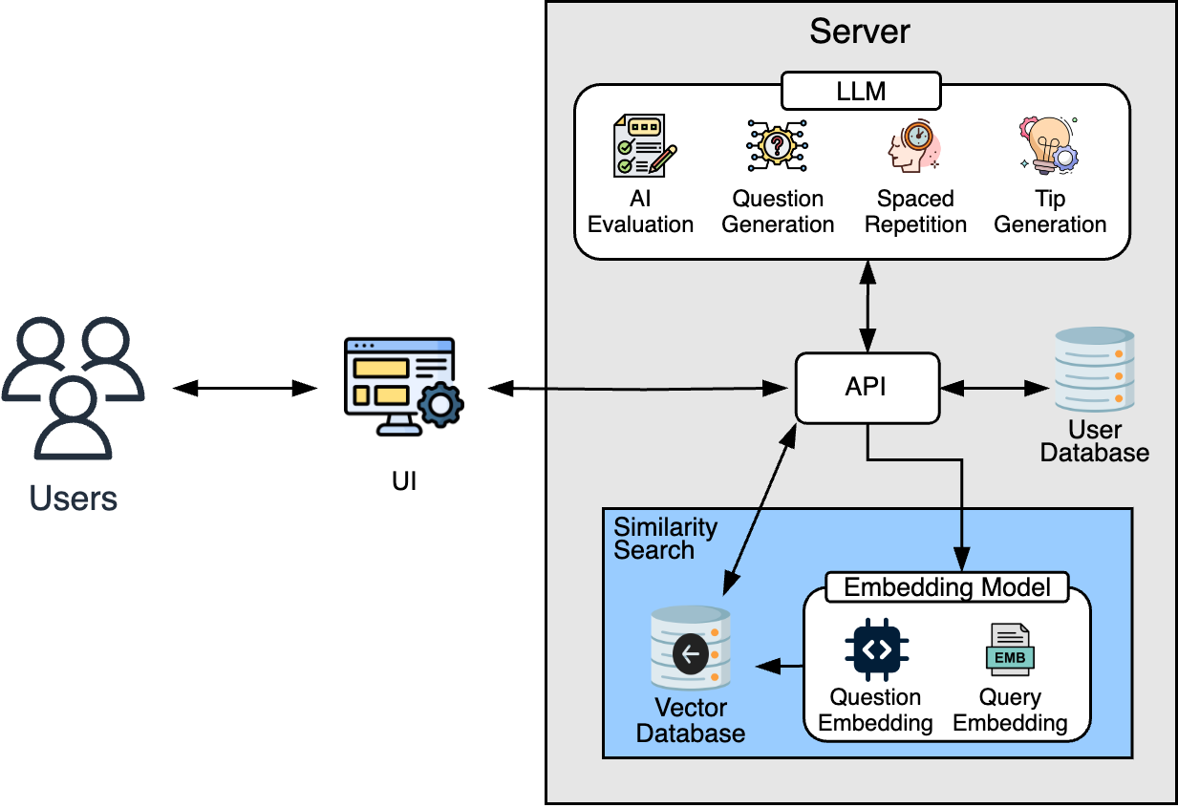
Conceptualization
System Design
Figure 2: System overview of WILLM.

Slide 11
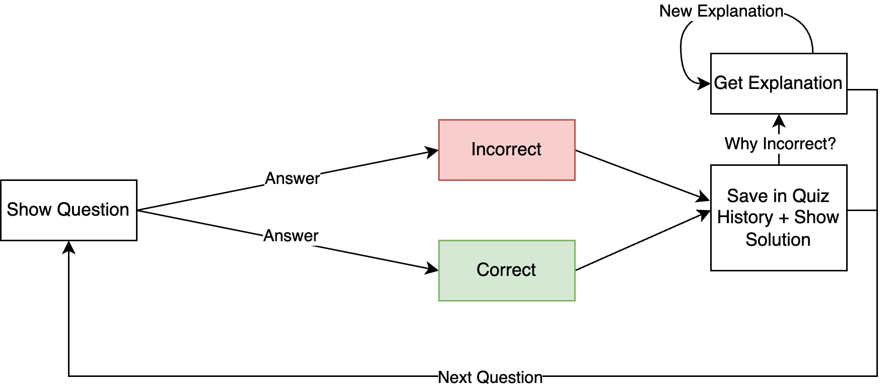
Conceptualization
Quiz Design
Five questions per quiz
Figure 3: Quiz design of WILLM.

Slide 12
Conceptualization
Quiz Schedule [Karpicke et al., 2011, Cepeda et al., 2008]
Testing intervals: 20-25% of study period
Progressive increase: Up to 5 days
Table 4: Quiz schedule
Quiz Number | Intervals
n = 1 | Presented within 24 hours of the first login.
n = 2 | Presented two days after the first quiz
n = 3 | Presented four days after the second quiz.
n = n + 1 | Presented five days after the previous quiz.

Slide 13
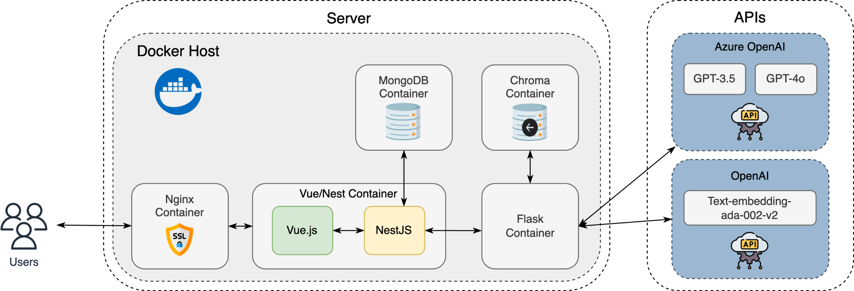
Realization
Architectural Overview
Figure 4: Architecture of WILLM.

Slide 14
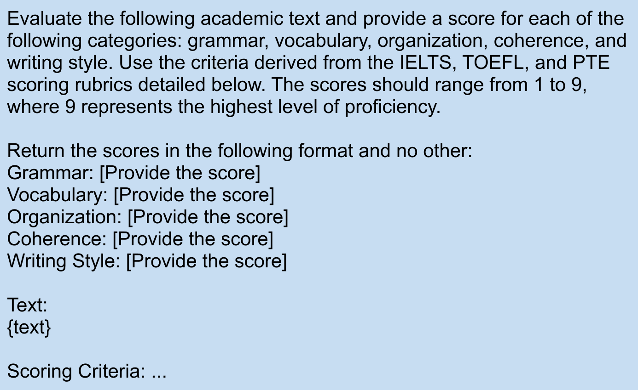
Realization
Prompt Design
Figure 5: Scoring prompt

Slide 15
Realization
Writing Rubric
Table 5: Scoring criteria for grammar
Table 6: Scoring criteria for vocabulary
Score | Description
9 | Uses a wide range of structures with full flexibility and accuracy; rare minor errors occur only as ‘slips’.
8 | Uses a wide range of structures accurately; occasional errors do not impede communication.
7 | Uses a variety of complex structures; produces frequent error-free sentences; occasional inappropriacies or errors.
6 | Uses a mix of simple and complex sentence forms; some errors in grammar and punctuation, but rarely impede meaning.
5 | Uses only a limited range of structures; attempts complex sentences but these tend to be less accurate than simple sentences.
4 | Produces frequent errors in grammar and punctuation; rarely uses subordinate clauses.
3 | Frequent grammatical errors and incorrect word forms obscure meaning.
2 | Continuous errors show lack of control of sentence structure.
1 | Little or no evidence of sentence forms.
Table 7: Scoring criteria for organization
Score | Description
9 | Uses a wide range of vocabulary with very natural and sophisticated control; rare minor errors occur only as ‘slips’.
8 | Uses a wide range of vocabulary fluently and flexibly to convey precise meanings.
7 | Sufficient range of vocabulary to allow some flexibility and precision; uses less common lexical items with some awareness of style and collocation.
6 | Adequate range of vocabulary for the task; attempts to use less common vocabulary but with some inaccuracy.
5 | Limited range of vocabulary; may demonstrate frequent errors in word choice, spelling, and/or word formation.
4 | Basic vocabulary is used repetitively; noticeable errors in word choice and formation.
3 | Limited control of vocabulary and frequent errors obscure meaning.
2 | Very limited range of words and expressions.
1 | No control over word choice and frequent errors impede understanding.
Score | Description
9 | Information and ideas are logically sequenced and fully developed; clear progression throughout.
8 | Logically organizes information and ideas; there is clear progression throughout.
7 | Logically organizes information and ideas with clear progression; uses a range of cohesive devices appropriately.
6 | Arranges information and ideas coherently with some progression; cohesive devices may be mechanical.
5 | Presents information with some organization but there may be a lack of overall progression.
4 | Limited organization; may not logically sequence ideas.
3 | Ideas are not arranged coherently; limited use of cohesive devices.
2 | Very little control of organizational features; ideas are not logically arranged.
1 | Fails to communicate any organized ideas.

Slide 16
Realization
Writing Rubric
Table 9: Scoring criteria for writing style
Table 8: Scoring criteria for coherence
Score | Description
9 | Engages the reader with an original and compelling style; tone and register are entirely appropriate for academic writing.
8 | Writing is engaging and the tone is appropriate for academic writing; minor errors in style do not detract from the overall impact.
7 | Demonstrates some complexity and flexibility in style; tone and register are appropriate for academic writing.
6 | Shows some variety in style and an attempt to engage the reader; tone may be uneven but generally appropriate for academic writing.
5 | Writing is somewhat engaging; tone and register may be inconsistent but some attempt at academic style is evident.
4 | Limited engagement with the reader; writing style may be flat and uninteresting.
3 | Writing style is simplistic and fails to engage the reader; tone is often inappropriate for academic writing.
2 | Very limited writing style; fails to engage the reader.
1 | No attempt to engage the reader; writing style is inappropriate for academic writing.
Score | Description
9 | Cohesive devices are used in such a way that it attracts no attention; ideas are fully developed and well-supported.
8 | Cohesive devices used effectively; ideas are well-developed and supported.
7 | Uses cohesive devices effectively; presents clear progression of ideas.
6 | Uses cohesive devices, though cohesion within and/or between sentences may be faulty or mechanical.
5 | Uses some cohesive devices but these may be inaccurate or repetitive.
4 | Relationships between ideas are unclear; limited use of cohesive devices.
3 | Lack of coherence; ideas are difficult to follow.
2 | Minimal use of cohesive devices; ideas are not logically connected.
1 | No coherent ideas are presented.

Slide 17
Evaluation
Study Design and Submission/Gamification Data
Table 10: Summary of submissions.
Period | Mean | Median | Min. | Max. | Std.
Weekly | 14.69 | 15.75 | 3.50 | 39.12 | 7.89
Overall | 23.32 | 16.0 | 7.0 | 95.0 | 20.26
19 participants
5 undergraduates, 9 Bachelor’s degree and 5 Master’s degree students
Duration: 3 weeks
Pre- and post-tests
Text of 300 words ± 10% and same topic
System usability scale
Table 11: Summary of gamification data.
Gamification Metric | Mean | Median | Min. | Max. | Std.
XP | 458.42 | 360.00 | 0 | 2450 | 556.59
Level | 1.84 | 2.00 | 0 | 6 | 1.35
Daily Streaks | 3.37 | 2.00 | 1 | 15 | 3.50
Weekly Streaks | 0.16 | 0.00 | 0 | 2 | 0.49
Badges Count | 0.58 | 1.00 | 0 | 2 | 0.59
High engagement variability

Slide 18
Evaluation
Study Design and Submission/Gamification Data
Table 10: Summary of submissions.
Period | Mean | Median | Min. | Max. | Std.
Weekly | 14.69 | 15.75 | 3.50 | 39.12 | 7.89
Overall | 23.32 | 16.0 | 7.0 | 95.0 | 20.26
19 participants
5 undergraduates, 9 Bachelor’s degree and 5 Master’s degree students
Duration: 3 weeks
Pre- and post-tests
Text of 300 words ± 10% and same topic
System usability scale
Table 11: Summary of gamification data.
Gamification Metric | Mean | Median | Min. | Max. | Std.
XP | 458.42 | 360.00 | 0 | 2450 | 556.59
Level | 1.84 | 2.00 | 0 | 6 | 1.35
Daily Streaks | 3.37 | 2.00 | 1 | 15 | 3.50
Weekly Streaks | 0.16 | 0.00 | 0 | 2 | 0.49
Badges Count | 0.58 | 1.00 | 0 | 2 | 0.59
High engagement variability

Slide 19
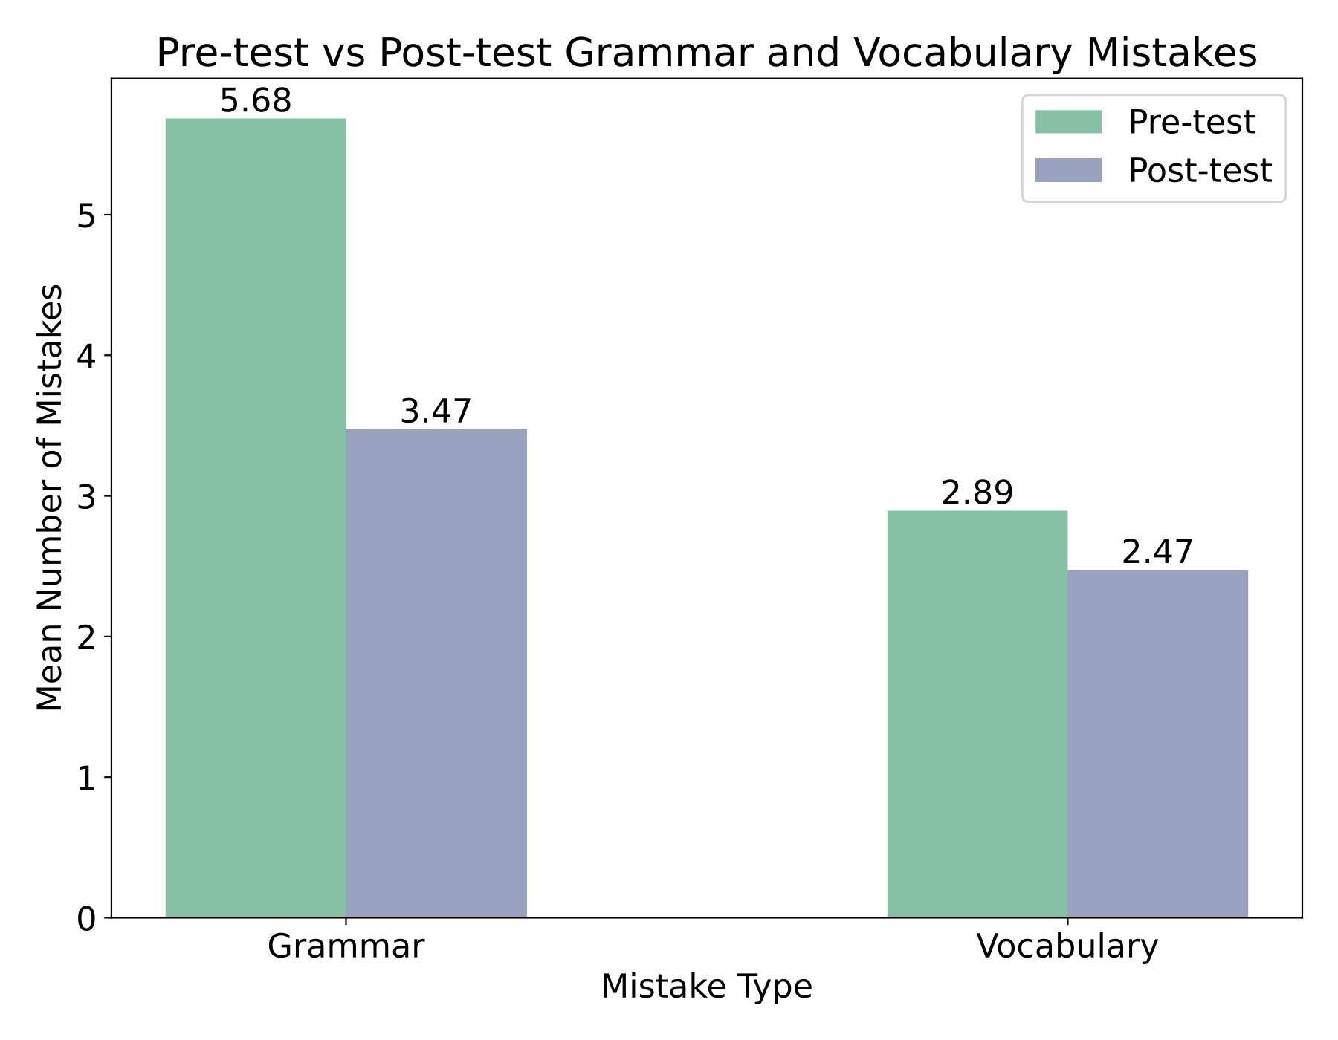
Evaluation
Results RQ1
Table 12: Descriptive statistics for pre- and post-test scores. Writing rubric score range: 1-9.
Writing Element | Test | Mean | Median | Std.
Grammar | Pre-Test | 6.22 | 6.40 | 0.94
 | Post-Test | 6.76 | 6.90 | 0.65
Vocabulary | Pre-Test | 6.35 | 6.40 | 0.71
 | Post-Test | 6.72 | 6.60 | 0.70
Organization | Pre-Test | 7.11 | 7.20 | 0.73
 | Post-Test | 7.47 | 7.60 | 0.66
Coherence | Pre-Test | 6.68 | 6.80 | 0.84
 | Post-Test | 7.10 | 7.20 | 0.70
Writing Style | Pre-Test | 6.07 | 6.13 | 0.76
 | Post-Test | 6.45 | 6.50 | 0.60
Figure 6: Pre-test vs post-test grammar and vocabulary mistakes.

Slide 20
Evaluation
Results RQ1
Paired T-Test: Tests for significant mean differences (p < 0.05)
No significant differences
Cohen’s d: Measures effect size
Medium effects [Brydges, 2019]
Table 13: Paired t-test results and Cohens’d.
Writing Element | t-value | p-value | d
Grammar | -1.98 | 0.063 | 0.454
Vocabulary | -1.66 | 0.115 | 0.380
Organization | -1.57 | 0.133 | 0.361
Coherence | -1.74 | 0.100 | 0.398
Writing Style | -1.93 | 0.069 | 0.443

Slide 21
Evaluation
Quiz Data
Table 14: Summary of quiz data.
Global Statistics | Values
Quizzes Generated | 47
Quizzes Completed | 20
Questions Attempted | 56
Questions Correct | 35
Completion Rate | 42.55%
Accuracy Rate | 62.50%
Low quiz feature engagement
Possible reason: UI

Slide 22
Evaluation
Results RQ2
Relationship between the quiz completion rates and changes in test scores
Groups by quiz completion rate
Low (<25th percentile), Medium (25th-75th), High (>75th) [Wellington et al., 2015]
One-way ANOVA
No significant differences (Sig. > 0.05)
Possible reason: Low engagement
Table 15: ANOVA results based on quiz completion rate.
Writing Element | F | Sig.
Grammar | 0.699 | 0.520
Vocabulary | 0.683 | 0.527
Organization | 0.144 | 0.868
Coherence | 0.010 | 0.990
Writing Style | 0.414 | 0.672

Slide 23
Evaluation - Review Summary
Review Data
Table 16: Summary of review data.
Global Review Data | Values
Total Reviews Generated Across All Users | 78
Average Reviews Generated per User | 4.88
Average Reviews Generated per Session | 1.77
Moderate review feature engagement
Possible reason: UI

Slide 24
Evaluation
Results RQ3
Relationship between the review generation count and changes in test scores
Groups by review generation count
Low (<25th percentile), Medium (25th-75th), High (>75th) [Wellington et al., 2015]
Kruskal-Wallis Test
No significant differences (Sig. > 0.05)
Table 17: ANOVA/Kruskal-Wallis results based on review generation count.
Writing Element | Test Type | F/H | Sig.
Grammar | ANOVA | F = 1.392 | 0.283
Vocabulary | ANOVA | F = 2.489 | 0.122
Organization | Kruskal-Wallis | H = 0.992 | 0.609
Coherence | ANOVA | F = 0.303 | 0.744
Writing Style | ANOVA | F = 0.971 | 0.405

Slide 25
Evaluation
System Usability Scale [Sauro et al., 2016, Lewis, 2018]
Table 18: The questions from the SUS questionnaire
Question Nr. | Question
1 | I think that I would like to use this system frequently.
2 | I found the system unnecessarily complex.
3 | I thought the system was easy to use.
4 | I think that I would need the support of a technical person to be able to use this system.
5 | I found the various functions in this system were well integrated.
6 | I thought there was too much inconsistency in this system.
7 | I would imagine that most people would learn to use this system very quickly.
8 | I found the system very cumbersome to use.
9 | I felt very confident using the system.
10 | I needed to learn a lot of things before I could get going with this system.
Usability Score > 68: Above average
WILLM’s Average Score: 84.21 (Grade: A+)
High usability

Slide 26
Conclusion
WILLM uses immediate feedback features in combination with LLMs for academic writing improvement.
We introduced an approach with active recall quizzes based on spaced repetition principles and an approach for generating reviews based on reflection for long-term academic writing improvement using LLMs.

Slide 27
Improvements and Future Work
Increase participant sample size.
Refine UI to make features like quizzes and reviews more accessible.
Further personalize user experience by adjusting the quiz difficulty based on user performance
Integrate a chatbot which enables users to ask specific questions

Slide 28

Demo
Mastering writing present a significant challenge for learners, despite occasional oversight regarding the critical role of writing proficiency for students. In particular, achiving proficiency in academic writing, which is one of the most important genres of writing, proves difficult for many due to it's complexity and the necessity for engaging in both critical thinking and high-quality writing techniques.

Slide 29
Icons designed by creators from Flaticon.com.

Slide 30
References
Brydges C. R. (2019)
Effect size guidelines, sample size calculations, and statistical power in gerontology. Innovation in aging, 3(4):igz036
Cepeda, N. J., Vul, E., Rohrer, D., Wixted, J. T., Pashler, H. (2008)
Spacing effects in learning: A temporal ridgeline of optimal retention.
Psychological science, 19(11):1095–1102
Chang, B. (2019)
Reflection in learning.
Online learning, 23(1):95–110
Dunlosky, J., Rawson, K. A., Marsh, E. J., Nathan, M. J., Willingham, D. T. (2013)
Improving students’ learning with effective learning techniques: Promising directions from cognitive and educational psychology.
Psychological Science in the Public interest, 14(1):4–58
Karpicke, J. D., Bauernschmidt, A. (2011)
Spaced retrieval: absolute spacing enhances learning regardless of relative spacing.
Journal of Experimental Psychology: Learning, Memory, and Cognition, 37(5):1250

Slide 31
References
Lewis, J. R. (2018)
The system usability scale: past, present, and future.
International Journal of Human–Computer Interaction, 34(7):577–590
Mansour, W., Albatarni, S., Eltanbouly, S., Elsayed, T. (2024)
Can large language models automatically score proficiency of written essays?
arXiv preprint arXiv:2403.06149
Mizumoto, A., Eguchi, M. (2023)
Exploring the potential of using an ai language model for automated essay scoring.
Research Methods in Applied Linguistics, 2(2):100050
Ruan, S., Jiang, L., Xu, J., Tham, B. J.-K., Qiu, Z., Zhu, Y., Murnane, E. L., Brunskill, E., Landay, J. A. (2019)
Quizbot: A dialogue-based adaptive learning system for factual knowledge.
In Proceedings of the 2019 CHI conference on human factors in computing systems, pages 1–13
Sauro, J., Lewis, J. R. (2016)
Quantifying the user experience: Practical statistics for user research.
Morgan Kaufmann

Slide 32
References
Song, C., Song, Y. (2023)
Enhancing academic writing skills and motivation: assessing the efficacy of chatgpt in ai-assisted language learning for efl students.
Frontiers in Psychology, 14:1260843
Tran, T. T. H. (2023)
Ai tools in teaching and learning english academic writing skills.
In Proceedings of the AsiaCALL International Conference, volume 4, pages 170–187
Wellington, W., Hutchinson, D., Faria, A. J. (2015)
The effectiveness of online quizzing as a repetitive learning tool in a marketing class: A field study of the testing effect.
In Developments in business simulation and experiential learning: Proceedings of the annual ABSEL conference, volume 42

Slide 33
Appendix

Slide 34
Conceptualization
Non-Functional Requirements
Table A.1: Non-functional requirements
Requirement | What?
Response time | Optimize all system components, especially the LLM.
Response quality | Responses (feedback) should be accurate and relevant.
Cost efficiency | Implementation should not require large financial resources.
Model selection | Models must be chosen to achieve fast response times, high output quality, and low financial resources.
Design | Should be simple and intuitive, especially for new users.

Slide 35
Conceptualization
Question Design
Table A.2: Question design
Question Type | Textual-Input or Multiple Choice? | Explanation
Revision | Textual-input | Revise and correct grammatical errors in a sentence.
Synonyms | Multiple choice | Select a more academic synonym for a highlighted word.
Organization | Multiple choice | Complete a sentence ensuring logical progression between excerpts.
Coherence | Multiple choice | Select the best continuation to maintain paragraph coherence.
Academic sentence | Textual-input | Paraphrase a sentence to make it more formal.
Argument strengthening | Multiple choice | Choose the best option to strengthen a weak argument.

Slide 36
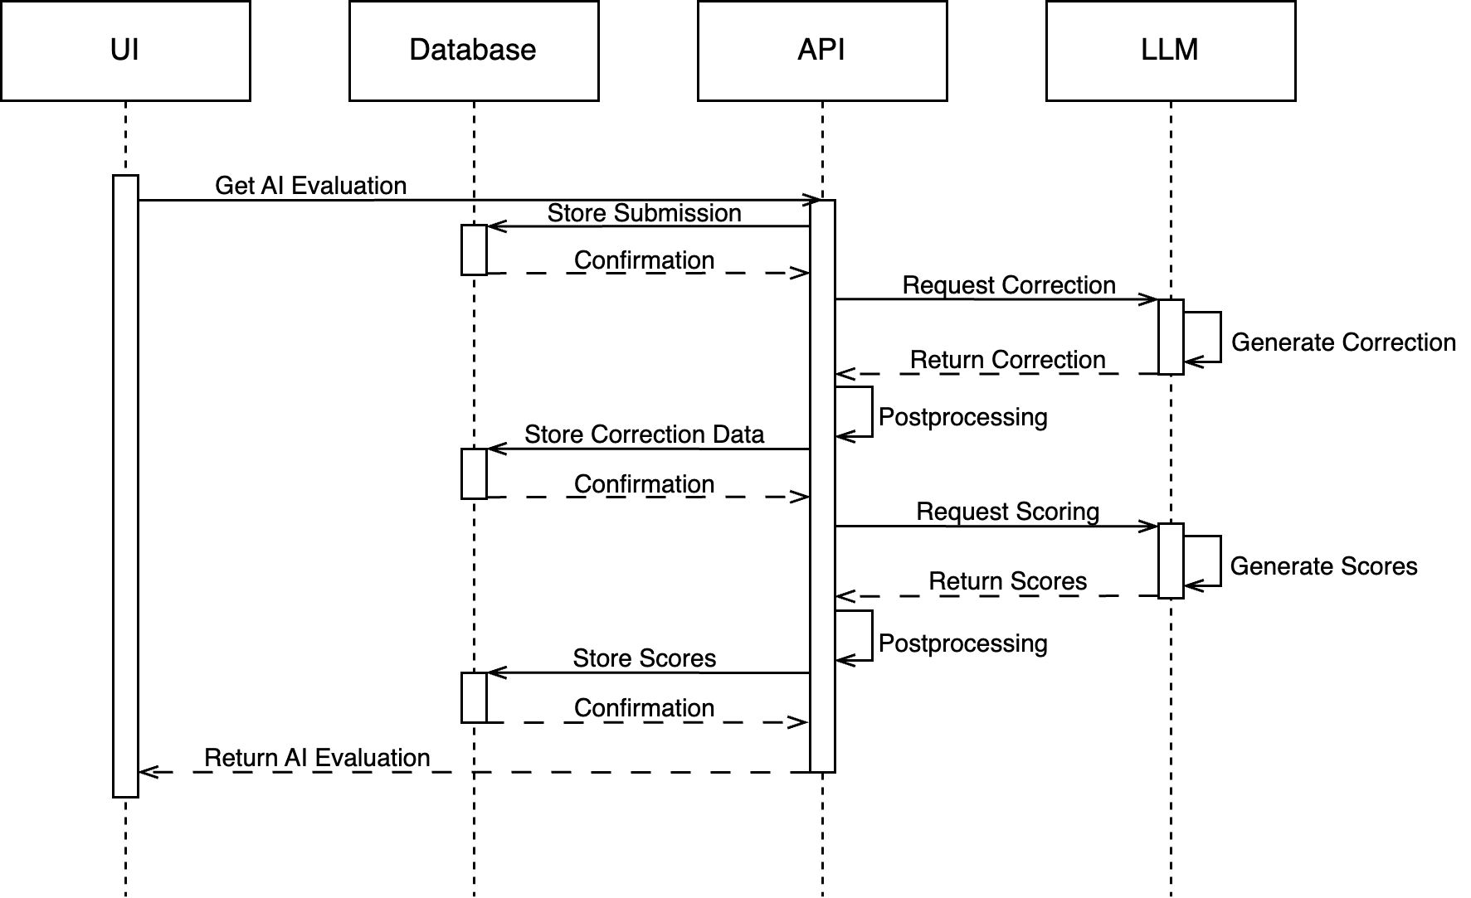
Conceptualization
AI Evaluation
Figure A.1: Sequence diagram depicting the generation of the AI Evaluation

Slide 37
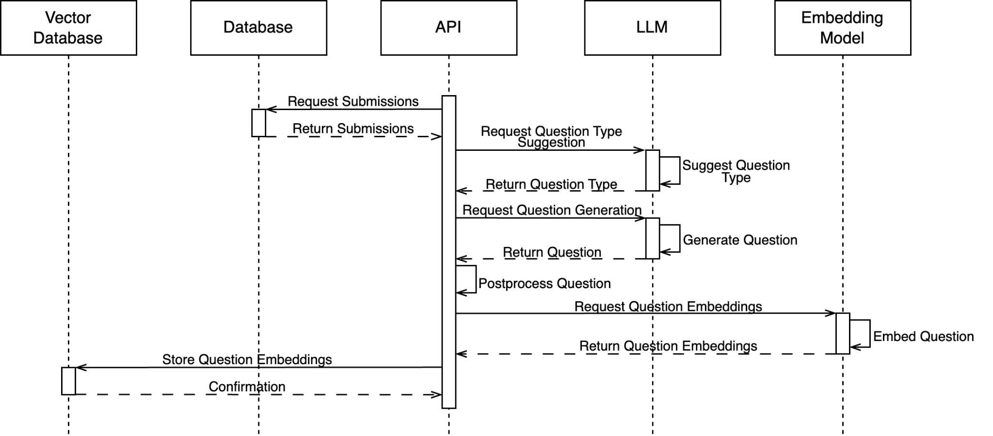
Conceptualization
Question Generation
Figure A.2: Sequence diagram depicting the question generation

Slide 38
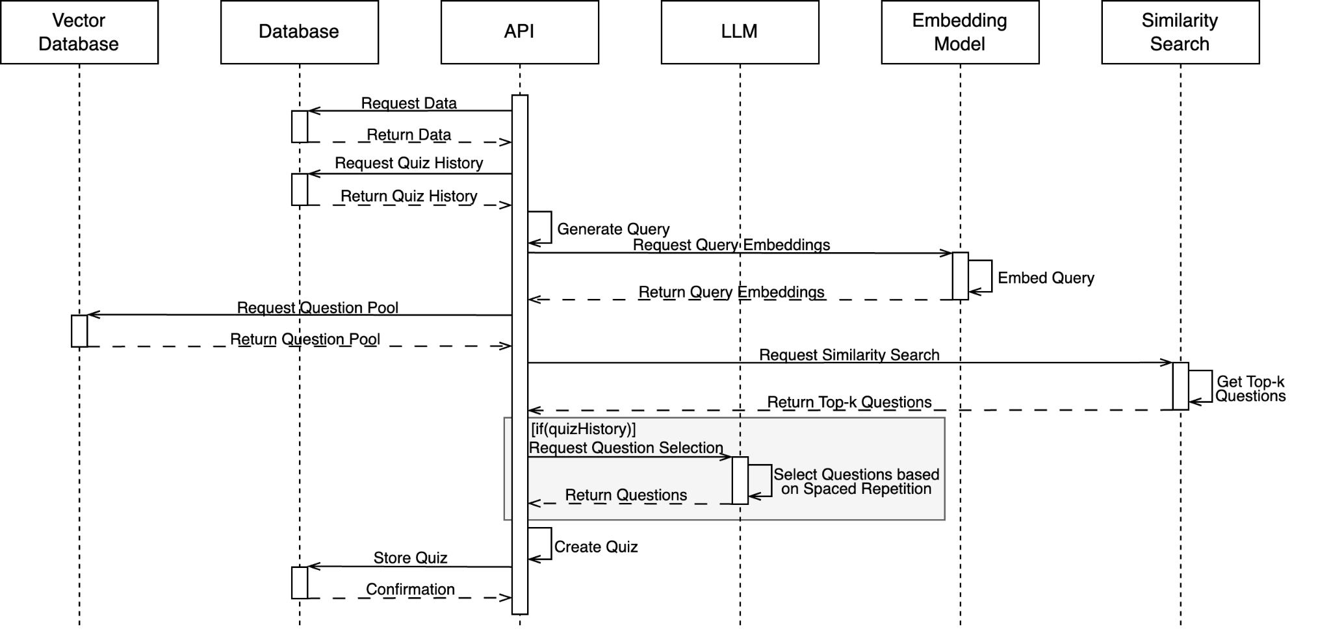
Conceptualization
Quiz Generation
Figure A.3: Sequence diagram depicting the quiz generation

Slide 39
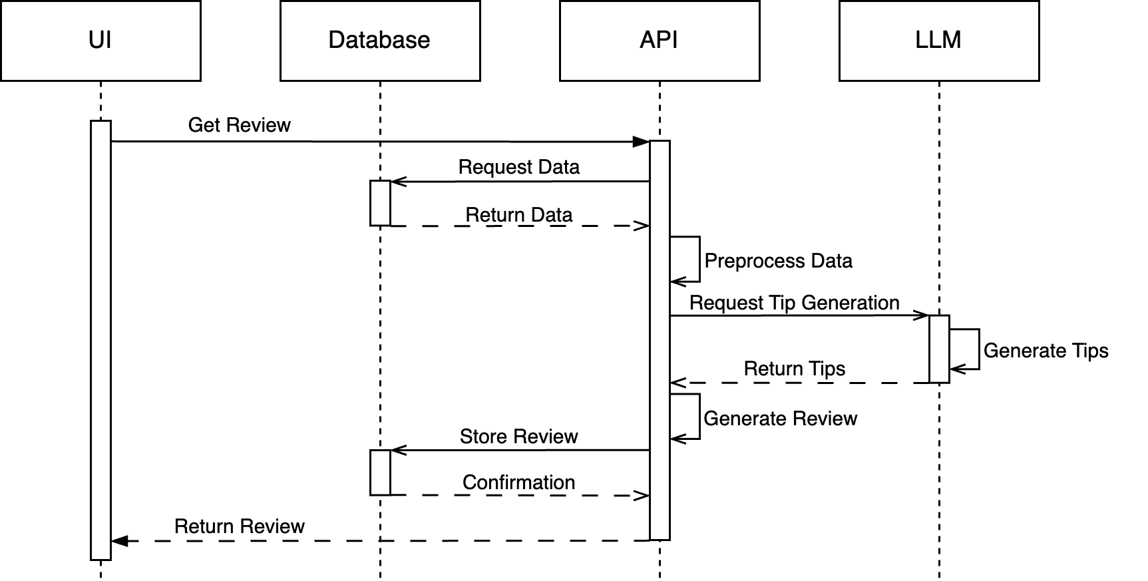
Conceptualization
Tip Generation
Figure A.4: Sequence diagram depicting the tip generation

Slide 40
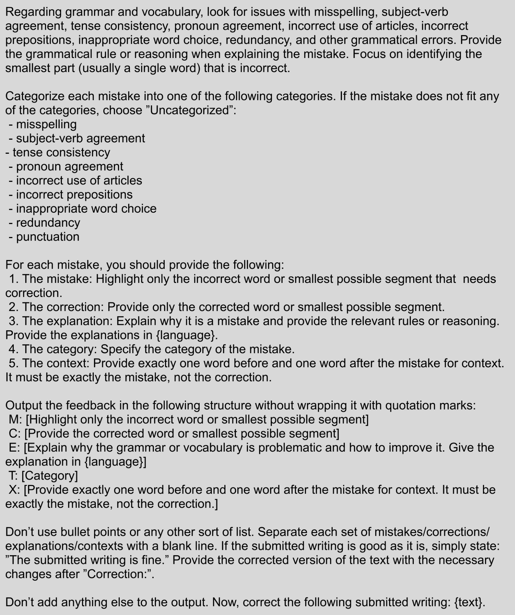
Realization
Figure A.5: Correction prompt for grammar and vocabulary.

Slide 41
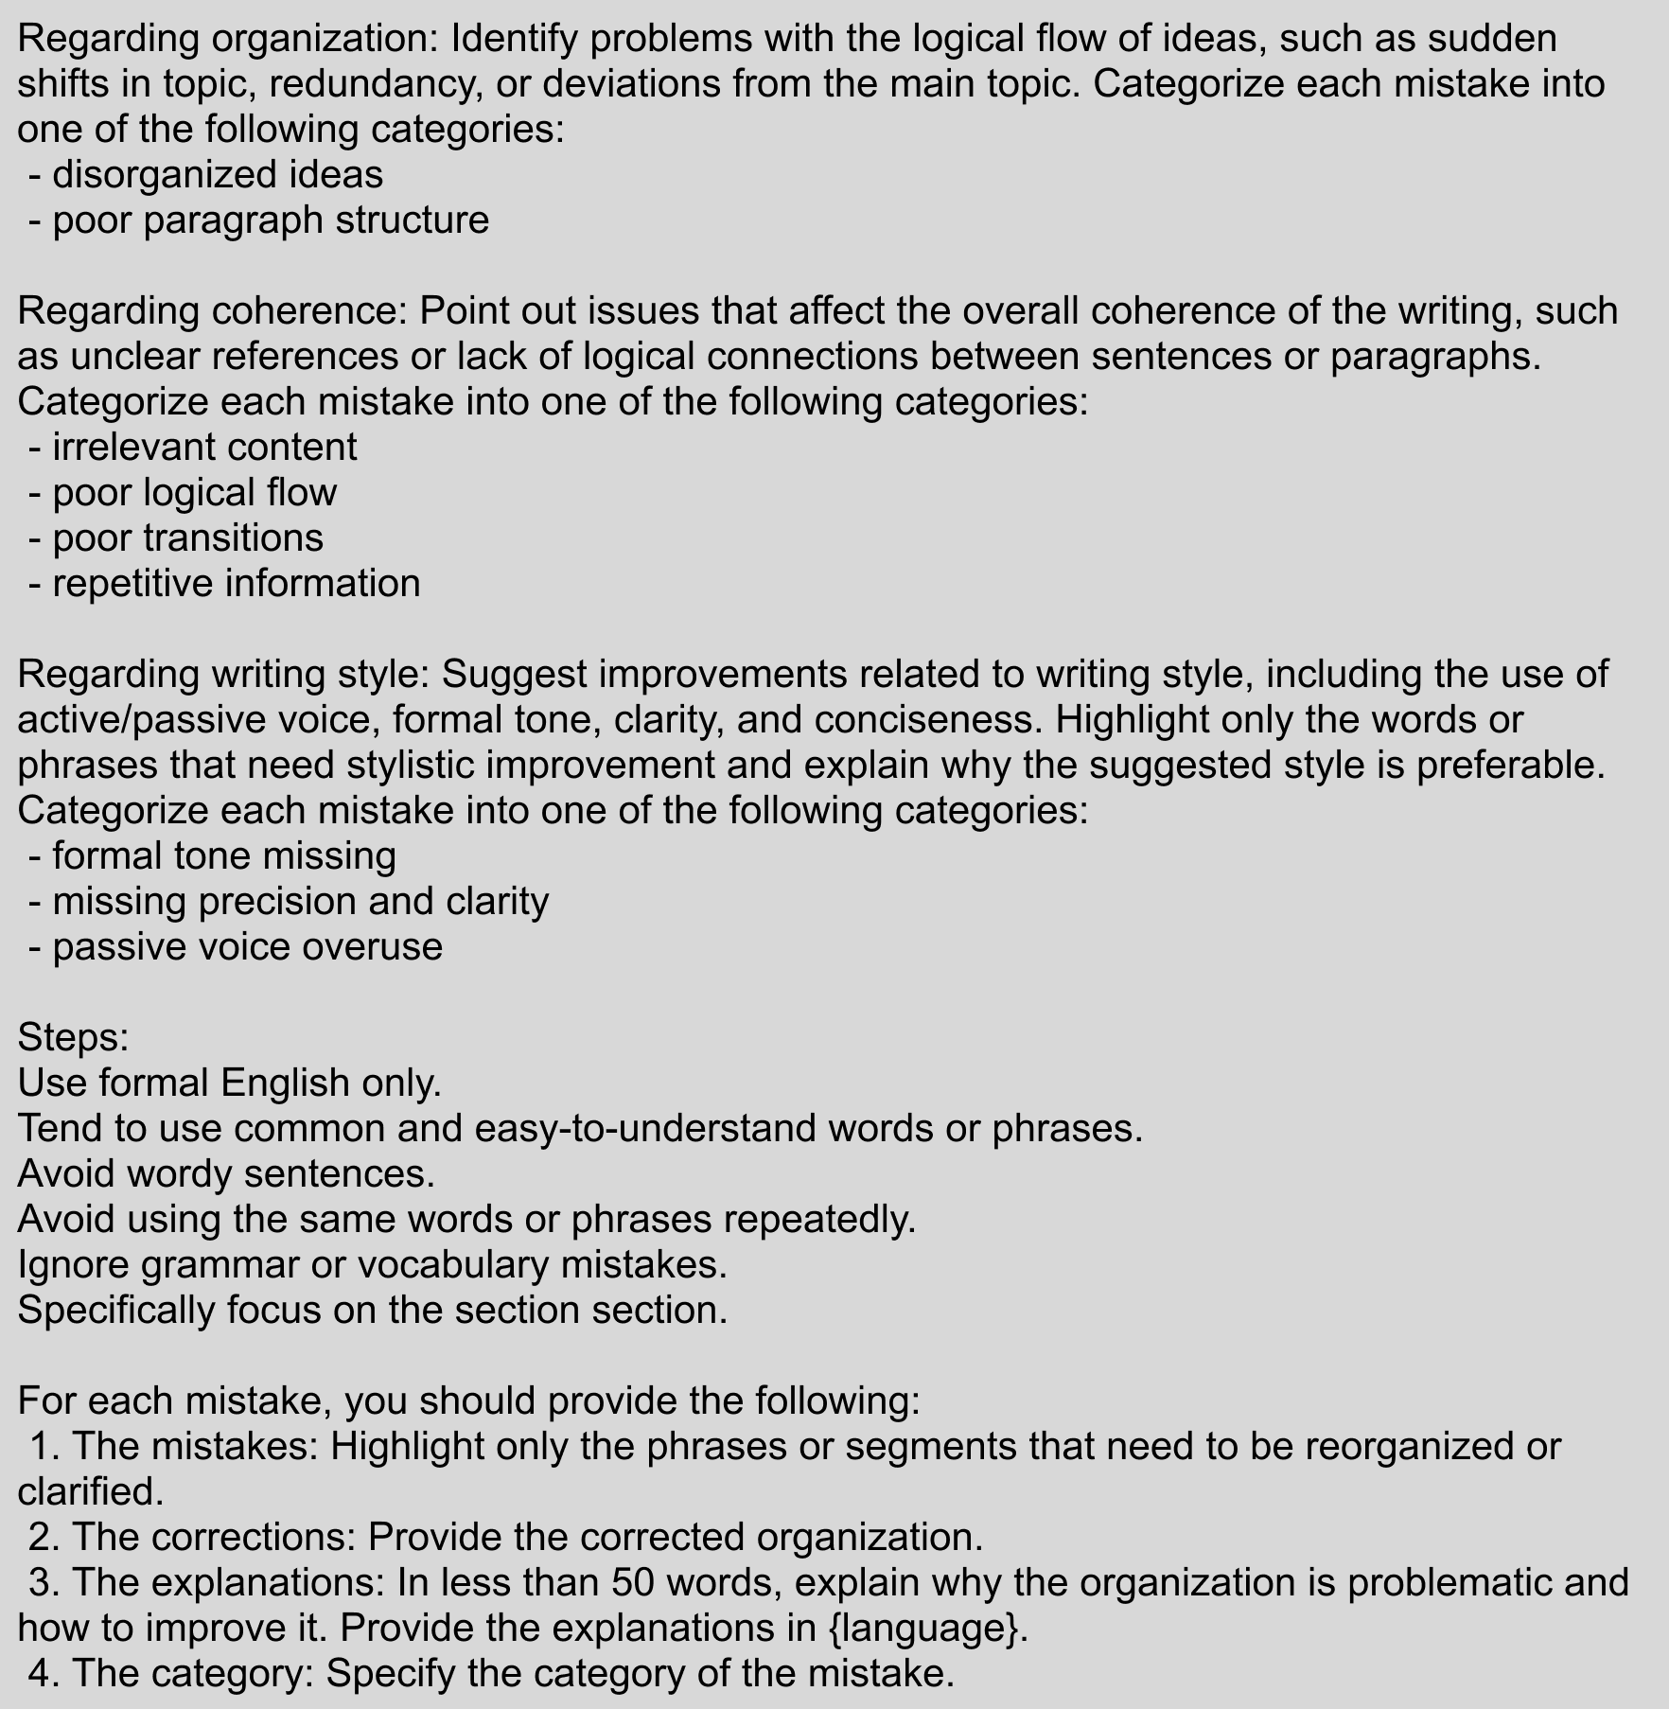
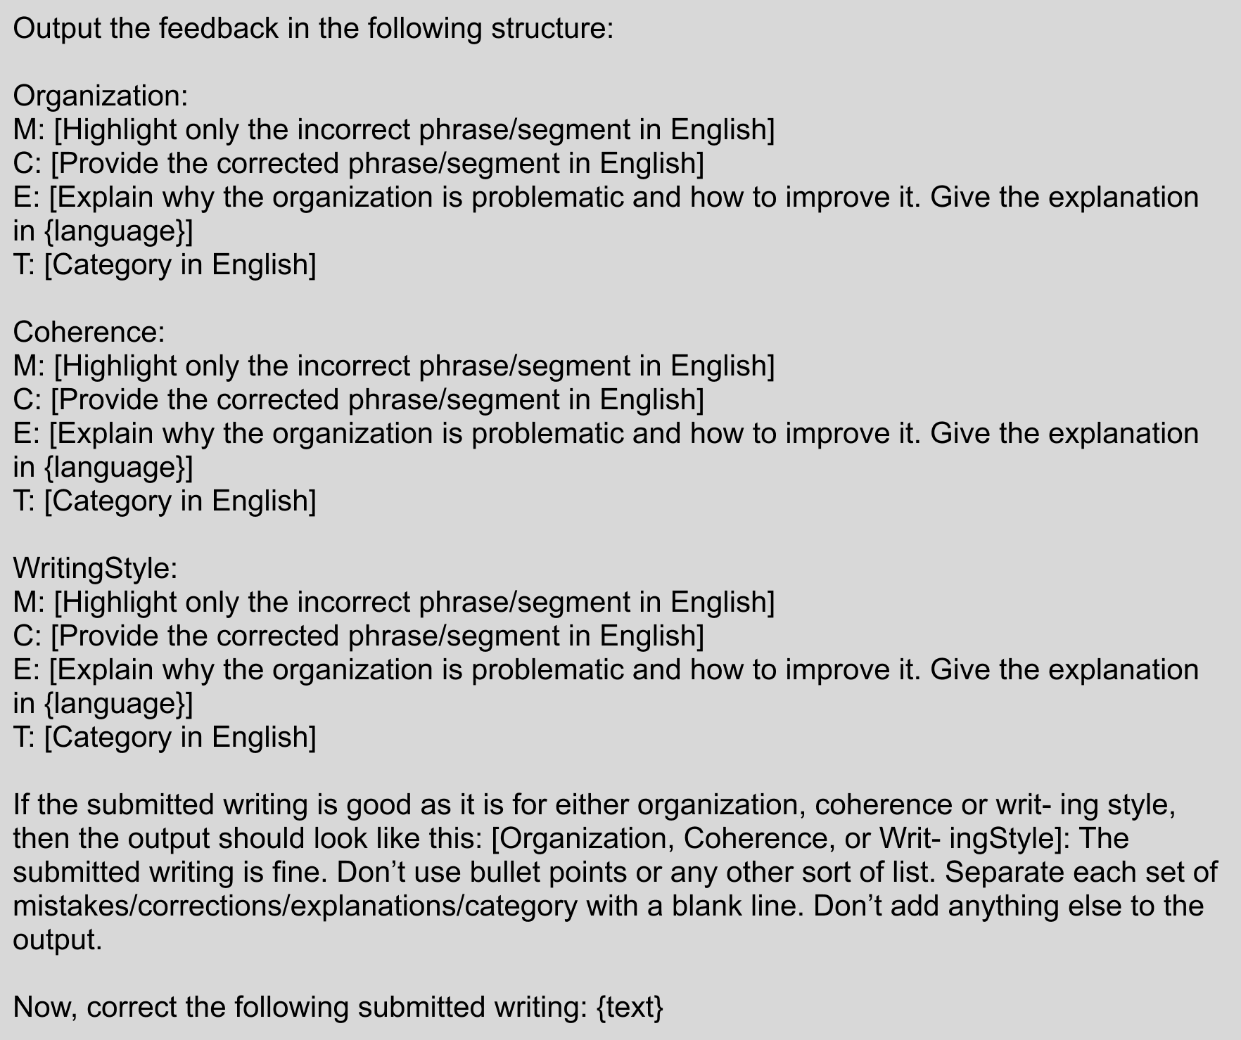
Realization
Figure A.6: Part 1 of the correction prompt for organization, coherence and writing style.
Figure A.7: Part 2 of the correction prompt for organization, coherence and writing style.

Slide 42
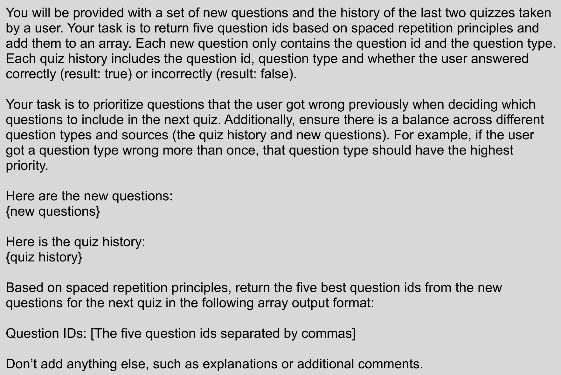
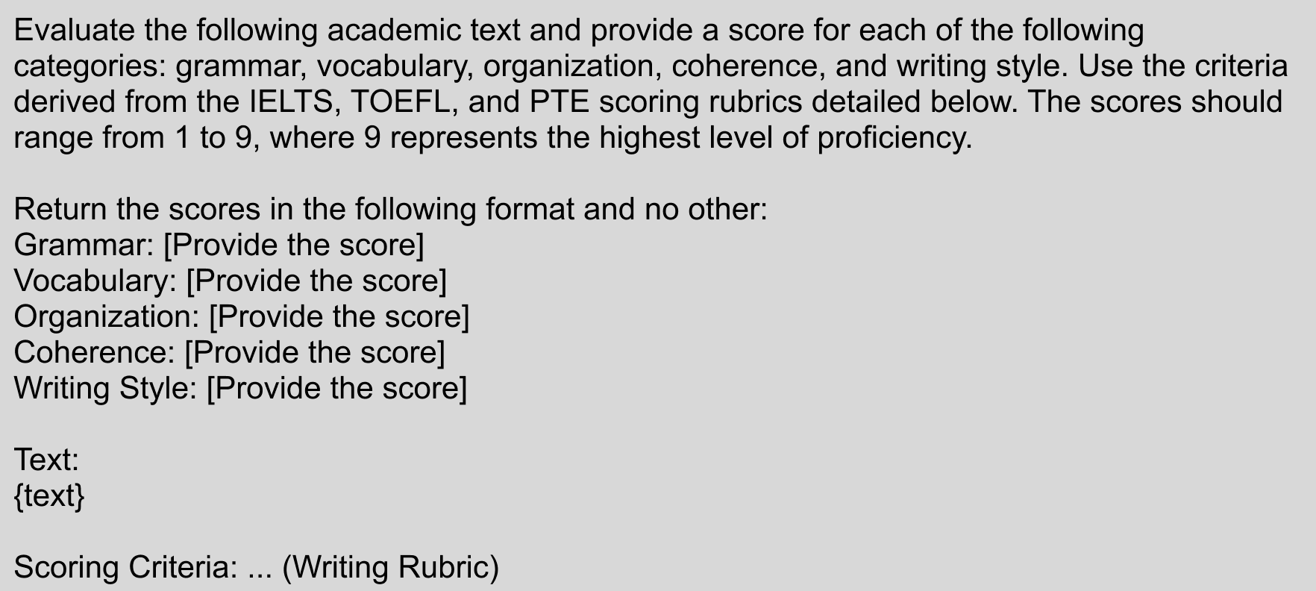
Realization
Figure A.8: Scoring prompt.
Figure A.9: Question selection prompt.

Slide 43
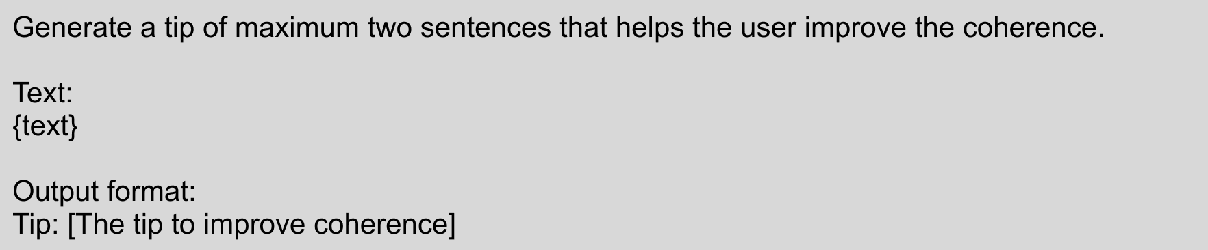
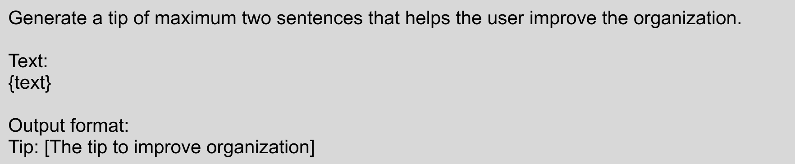
Realization
Figure A.10: Prompt for the generation of organization tips
Figure A.11: Prompt for the generation of coherence tips

Slide 44
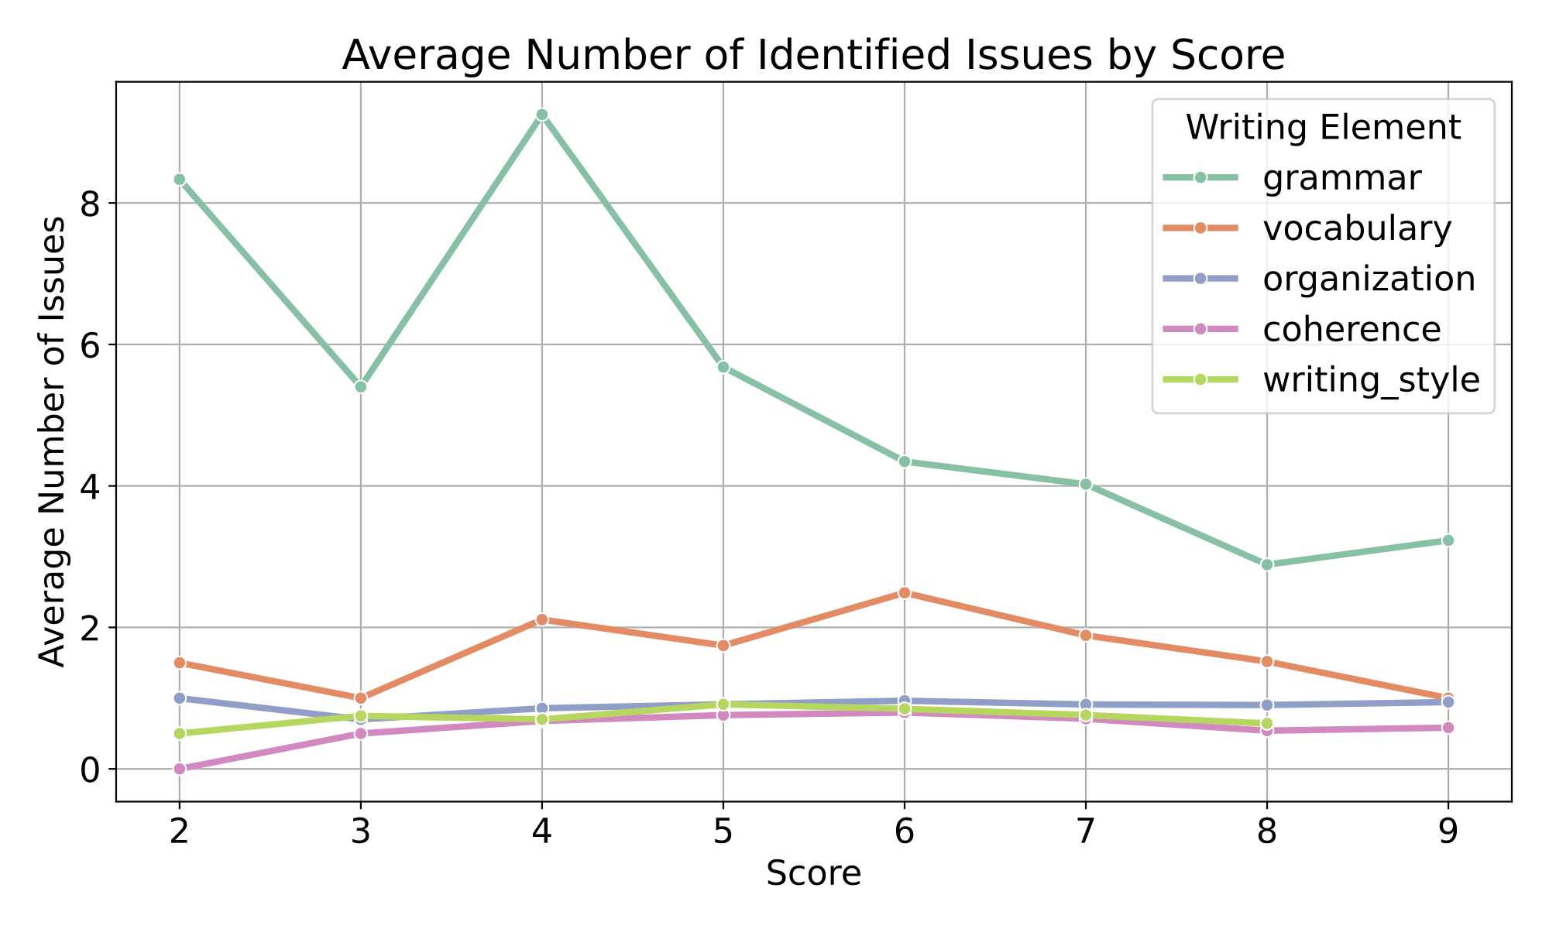
Evaluation
Average Number of Identified Issues by Score
Figure A.13: Average number of identified issues per writing element by score

Slide 45
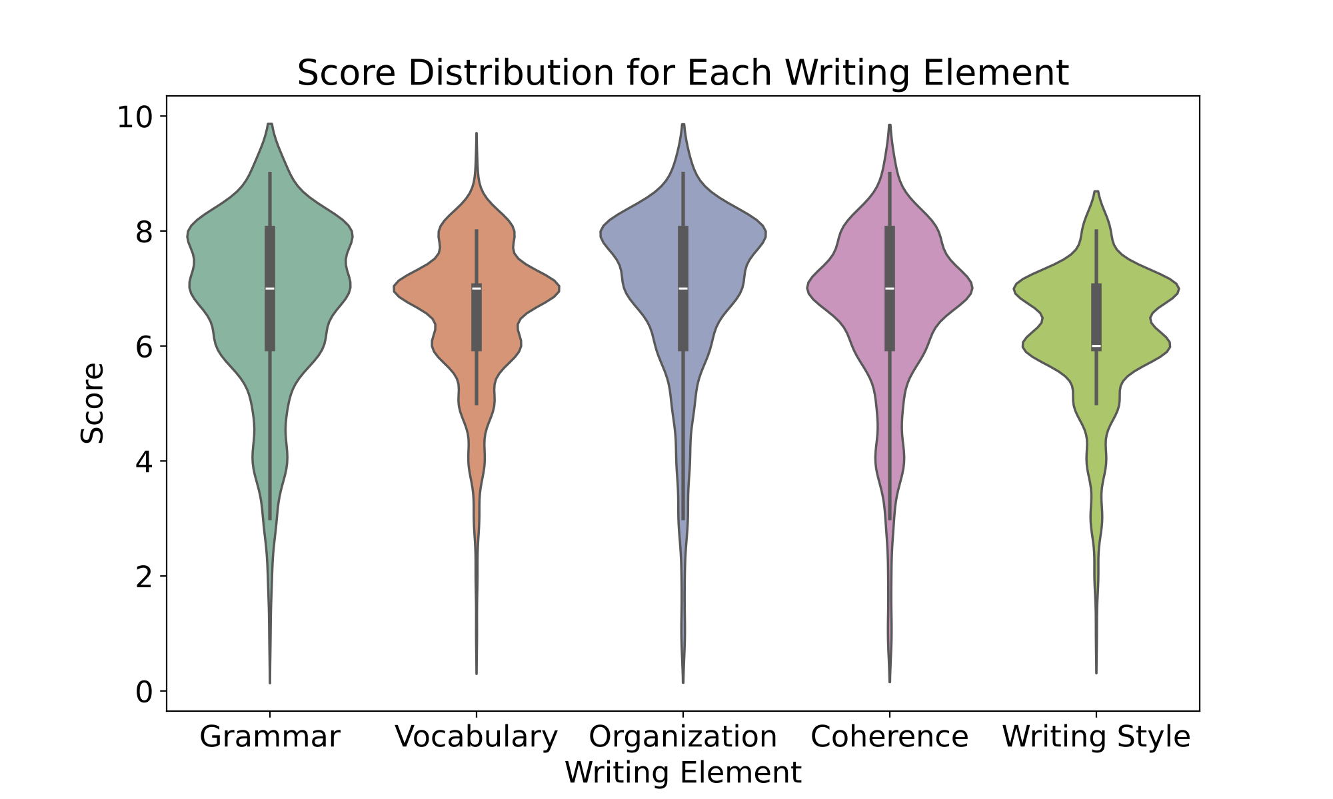
Evaluation
Score Distribution
Performance clustered around higher scores
Lower quartiles suggesting that even weakest users were not necessarily scoring low
might be attributed to the participants stronger academic backgrounds and English proficiency, reducing the room for significant improvement
Figure A.12: Score distribution for each writing element across all submissions.

Slide 46
Evaluation
Table A.3: ANOVA/Kruskal-Wallis results based on submission count.
Writing Element | Test Type | F/H | Sig.
Grammar | ANOVA | F = 1.000 | 0.391
Vocabulary | ANOVA | F = 1.087 | 0.361
Organization | Kruskal-Wallis | H = 3.383 | 0.184
Coherence | ANOVA | F = 2.264 | 0.136
Writing Style | ANOVA | F = 0.907 | 0.424

Slide 47
Evaluation
Quiz Data
Question Type | Total Questions | Correct Answers | Accuracy Rate
Academic sentence | 11 | 9 | 81.82%
Revision | 10 | 2 | 20.00%
Coherence | 19 | 14 | 73.68%
Synonyms | 5 | 4 | 80.00%
Organization | 11 | 6 | 54.55%
Table A.4: Quiz data across question types

Slide 48
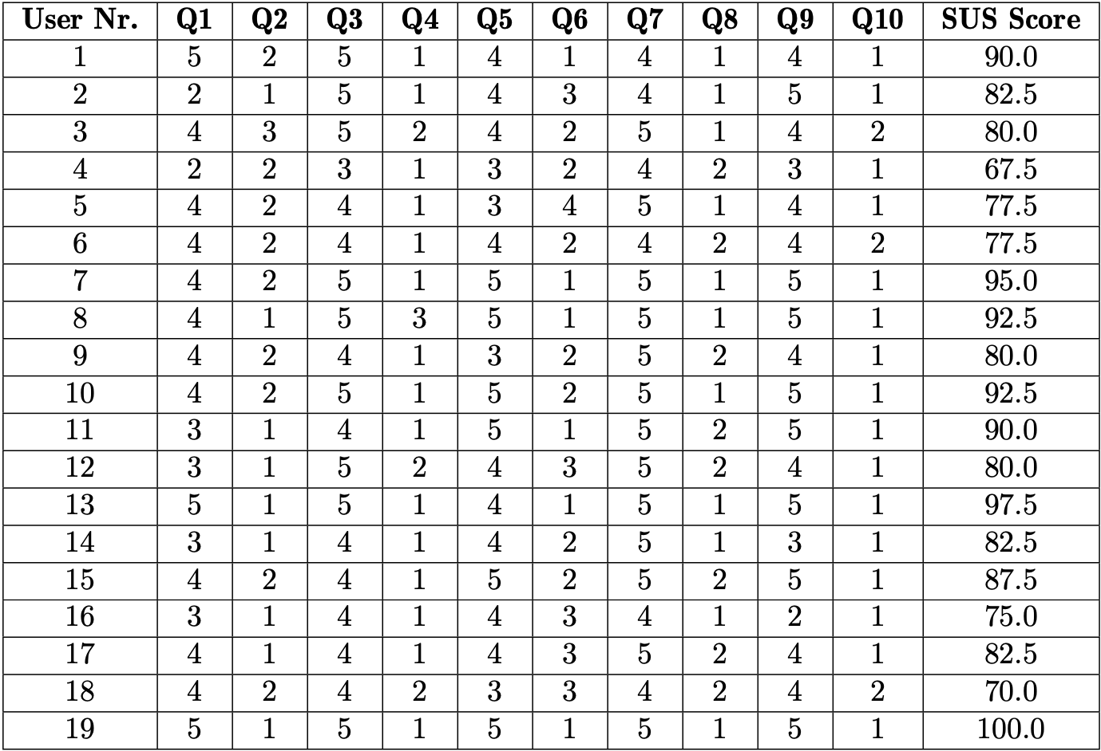
Evaluation
System Usability Scale
Figure A.13: Detailed SUS scores for each user

