Slide 1
SQL Server Query Plan—Join

Slide 2
概要
三种Physical Join方式的计算方式及特点
三种Physical Join方式对比
在默认的事务隔离级别下不同Join可能现象

Slide 3
Introduce Join
Logical Join
  Query中使用的Join关键字
Physical Join
  执行计划中使用的操作符

Slide 4
Logical Join
Inner join
Outer join
  Left Join, Right Join, Full Outer Join
Cross join
Cross apply
  Join with TVF
Semi-join
Anti-semi-join
Notes:
TVF Example：
create function dbo.fn_Sales(@Cust_Id int)
returns @Sales table (Item varchar(10))
as
begin
insert @Sales select Item from Sales where Cust_Id = @Cust_Id
return
end

Slide 5
Physical Join
Nested Loops Join
Merge Join
Hash Join

Slide 6
Hash Join
The basic algorithm:
for each row R1 in the build table
begin
calculate hash value on R1 join key(s)
insert R1 into the appropriate hash bucket
end
for each row R2 in the probe table
begin
calculate hash value on R2 join key(s)
for each row R1 in the corresponding hash bucket
if R1 joins with R2
return (R1, R2)
end

Slide 7
Hash Join
特性：
不像Nested Loop Join和Merge Join立即输出结果，Hash Join会在Build Input阶段完成之前block，到Probe阶段才开始输出结果
在Build阶段需要额外内存容纳Hash表
内存不足时使用tempdb
不要求输入table有序，输出结果也不保证有序
适用于大数量级的Join
  示例

Slide 8
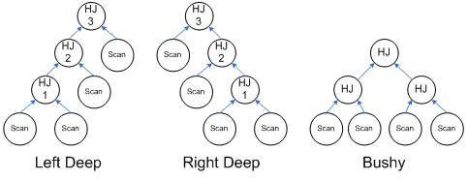
Multi-Level Hash Join Type

Slide 9
Memory Consumption
内存消耗数量级：
Left Deep：
max(HJ1 + HJ2, HJ2 + HJ3)
Right Deep:
HJ1 + HJ2 + HJ3

Slide 10
Nested Loops Join
The basic algorithm:
for each row R1 in the outer table
for each row R2 in the inner table
if R1 joins with R2
return (R1, R2)

Slide 11
Cost of Nested Loops Join
消耗：
双重循环，消耗等于外表大小乘以内表大小
  如果内表数据量级较大,循环次数会增长很快
可以使用index提高内表的检索性能
特性：
适用于数量级较小的表连接且内表有Index的场合
输出结果集的顺序由外表的顺序决定【思考】

Slide 12
Supported Logical Join
直接支持的Logical Join:
Inner join
Left outer join
Cross join
Cross apply and outer apply
Left semi-join and left anti-semi-join
不直接支持的Logical Join :
Right and full outer join
Right semi-join and right anti-semi-join

Slide 13
How To Support Left Join
支持Left Join的算法:
for each row R1 in the outer table
begin
for each row R2 in the inner table
if R1 joins with R2
return (R1, R2)
if R1 did not join
return (R1, NULL)
end
【思考】：Nested Loops Join如何支持Full Outer Join ，做一个Full Outer Join的Query并查看其计划来验证自己的想法

Slide 14
Merge Join
The basic algorithm:
get first row R1 from input 1
get first row R2 from input 2
while not at the end of either input
begin
if R1 joins with R2
begin
return (R1, R2)
get next row R2 from input 2
end
else if R1 < R2
get next row R1 from input 1
else
get next row R2 from input 2
end

Slide 15
Merge Join Type
One-To-Many Merge Join:
  R1和R2Join成功后，抛弃R2的记录并将R2的指针向下移动，这是假设R1没有重复记录的前提，如果R1有重复记录，则该记录无法和R2连接，所以只有当编译器确定R1没有重复记录时才使用这种Join（通过Unique Index或者Distinct，Group By等操作符）
Many-To-Many Merge Join
  R1和R2Join成功后，保存一份R2的拷贝，如果发现R1有重复记录，则将拷贝的记录和R1做Join
  示例

Slide 16
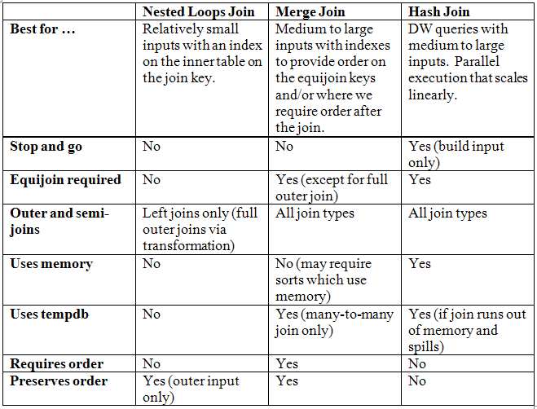
Compare

