Slide 1
Learning Graph Neural Networks with DGL
Hands-on Part
(10:30 a.m. – 17:00 p.m.)

Slide 2
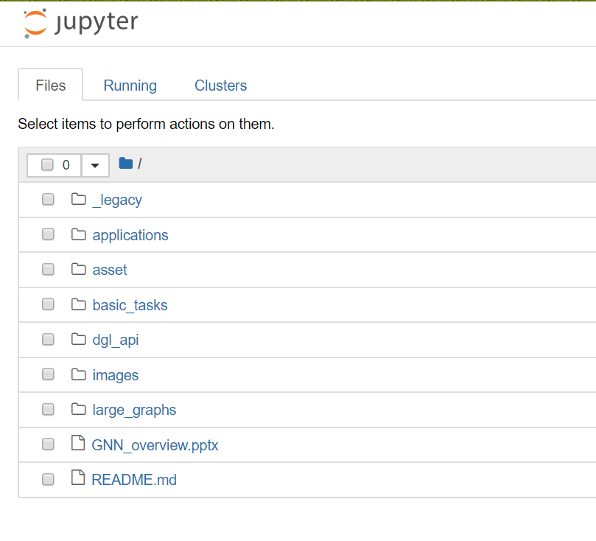
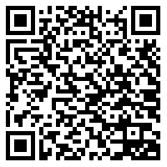
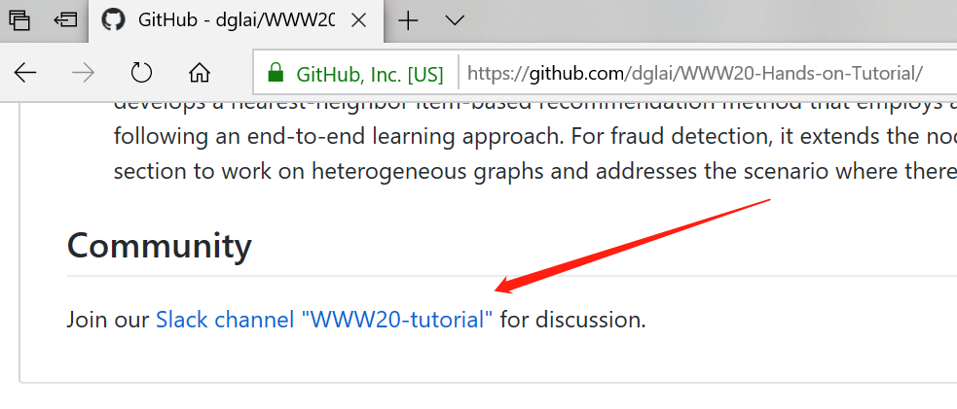
SageMaker Setup Instructions
The hands-on sessions will start at 11:00 a.m.
Send an email to dgl-www@request-nb.mxnet.io
You will receive two emails. Click the notebook link in the second one.
Need help?
Join our slack channel

Slide 3
Hands-on Sessions
GNNs for basic graph tasks by Minjie Wang (11:00 – 12:30)
GNN training on large graphs by Da Zheng (14:00-15:30)
GNN models for real-world applications by Quan Gan (16:00 – 17:30)

Slide 4
GNNs for Basic Graph Tasks
Minjie Wang

Slide 5
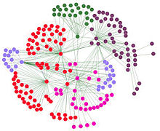
A typical workflow
Node classification
2_gnn.ipynb
1_load_data.ipynb
Pre-process and prepare training and testing sets
Build and train GNN models
Link Prediction
3_link_predict.ipynb
Graph Classification
Zachery’s Karate Club Network

Slide 6

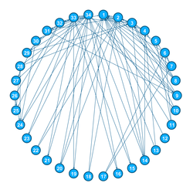
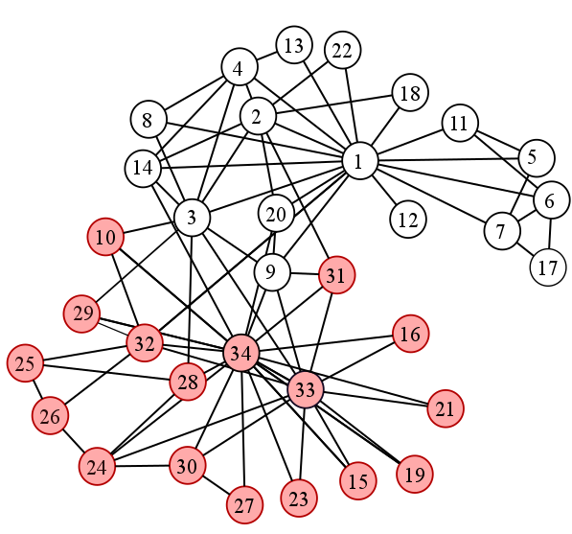
Zachery’s (Infamous) Karate Club

Slide 7
Session#1: GNNs for basic graph tasks
1_load_data.ipynb
About how to load graph data to DGL.
2_gnn.ipynb
About how to build a GNN model for community detection.
3_link_predict.ipynb
About how to build a GNN model for link prediction.
4_message_passing.ipynb
(Advanced) About how to customize a GNN module by message passing APIs.

