Slide 1

Sentiment Analysis
on Movie Reviews
By: Mahmoud Boghdady Mahmoud

Slide 2



Positive or negative movie review?
unbelievably disappointing
Full of zany characters and richly applied satire, and some great plot twists
this is the greatest screwball comedy ever filmed
It was pathetic. The worst part about it was the boxing scenes.

Slide 3
Approaches
Natural language Processing
Machine Learning
Notes:
NLP
use of semantics to understand the language
uses lexicons, dictionaries, ontologies
Ex: I am Sick. (To understand that the user is not feeling good)
Machine Learning
Don't have to understand the meaning.
Uses classifiers such as naive Bayes.
Ex: I am sick. (Doesn't have to understand what the user feels,
Just it use words (sick) to check it is related to positive or neagtive sets and is it enough to classify the sentence as positive or negative)

Slide 4

The Problem
Is this review positive or negative? (Classification).
Can we recommend this movie or not ?
Movies’ review can help to predict new movies reviews which has high impact on its success.
Increasing the attitude (target) increases the complexity.
With huge data it’s not applicable to assign a human to classify the reviews.

Slide 5
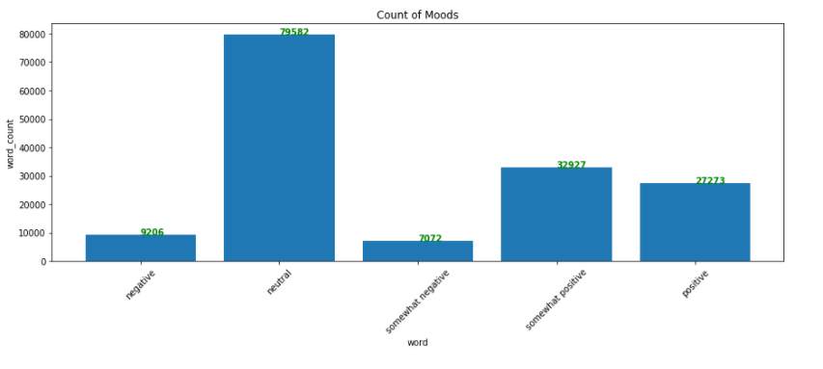
Target labels

Slide 6
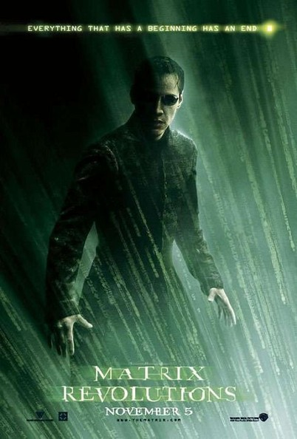
Example
The matrix is a great movie. It’s better than any other movie I have seen.
Great (positive)
Better (positive)
2 positive
0 negative
We conclude that the review is positive.

Slide 7
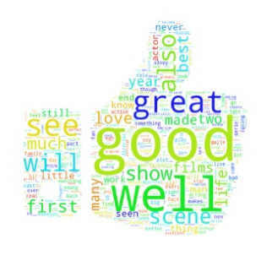
Positive words
Words that keep repeating per positive reviews.

Slide 8
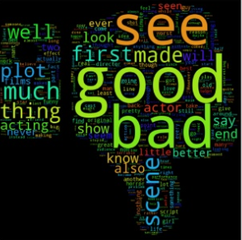
Negative words
Words that keep repeating per negative reviews.

Slide 9

Datasets
The dataset is comprised of tab-separated files with phrases from the Rotten Tomatoes dataset.
156060 of available reviews, 80 -20 % split has been used for the train/test.
The sentiment labels are:
0 – negative
1 - somewhat negative
2 – neutral
3 - somewhat positive
4 - positive

Slide 10

Preprocessing
Tokenization
Case Conversion
Stop words
Stemming

Slide 11
Multinomial Naïve Bayes
For sentiment (and probably for other text classification domains).
Word occurrence may matter more than word frequency.
The occurrence of the word fantastic tells us a lot
The fact that it occurs 5 times may not tell us much more.
Boolean Multinomial Naïve Bayes
Clips all the word counts in each document at 1

Slide 12
Evaluation
Confusion Matrix
K Fold Cross Validation

Slide 13

Confusion Matrix
Total number of correct matches vs total number of correct miss-matches.
A table that reports the number of false positives, false negatives, true positives, and true negatives.
Accuracy ≈ 64 %

Slide 14
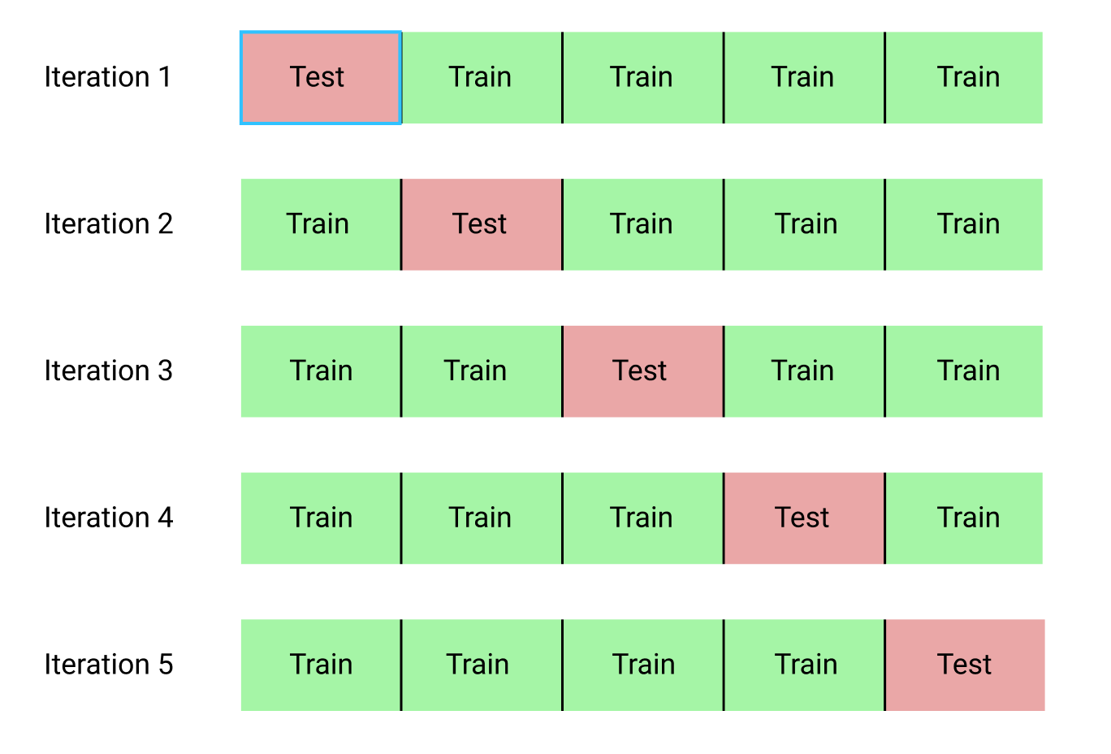
k-Fold Cross-Validation
Break up data into 10 folds
(Equal positive and negative inside each fold?)
For each fold
Choose the fold as a temporary test set
Train on 9 folds, compute performance on the test fold
Report average performance of the 10 runs
Accuracy ≈ 60 %

Slide 15
Sentiment Analysis
Questions

