Slide 1
apartment price prediction model
Data Science Model
By: Mahmoud Boghdady Mahmoud

Slide 2


Are you going to sell your apartment and you want to know what it the right price for it?
Ask an Expert
Machine Learning

Slide 3

The Problem
What factors determine the overall price for an apartment?
Can location affect the price ?
Sold apartments can help to predict new apartments’ prices.
With huge data it’s not applicable to assign a human to predict all prices.
Human can easily make mistakes.

Slide 4
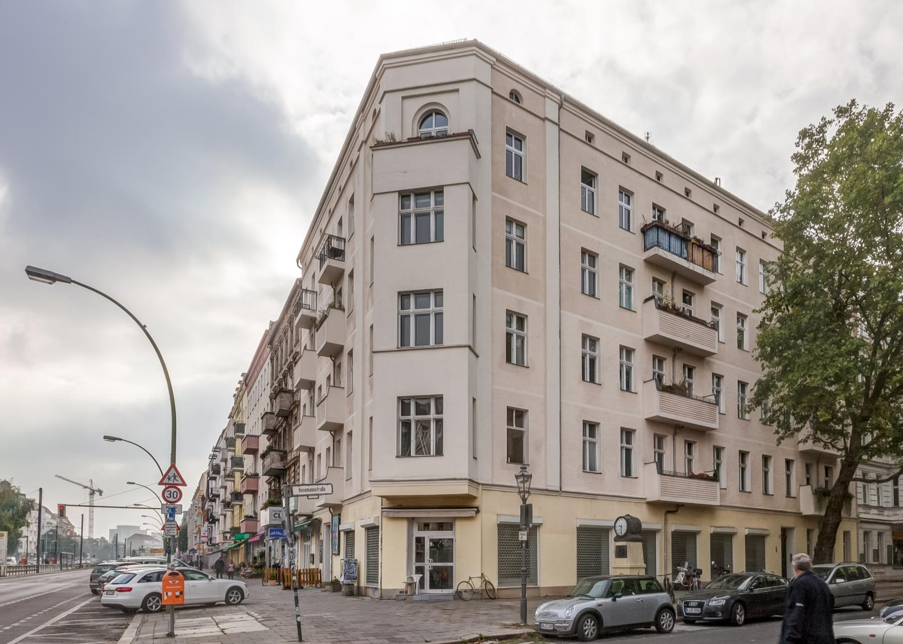
Example
Apartments with higher size are expected to have higher prices.
Some neighbourhood might have impact on the price of the apartment
Number of bedrooms and bathrooms per apartment affects the price of the apartment.

Slide 5

Datasets
The dataset is comprised of comma-separated files with apartments’ prices dataset as a label.
67108 of available reviews, 80 -20 % split has been used for the train/test.
The features are:
0 – neighbourhood
1 - price
2 – size
3 – bedrooms
4 – bathrooms
5 - building

Slide 6
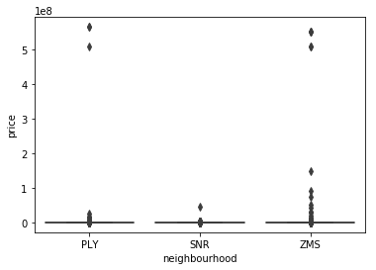
Datasets
Neighbourhood
Categorical
PLY
SNR
ZMS

Slide 7
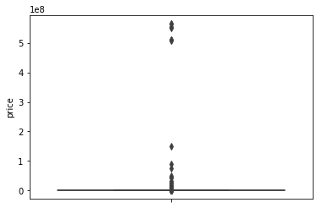
Datasets
price
Label
Actual price of the apartment
Outliers and missing values to be handled

Slide 8
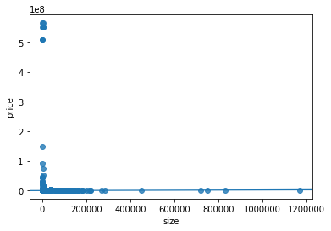
Datasets
size
continues
size of the apartment
Outliers and missing values to be handled
Minus and zero values to be removed

Slide 9
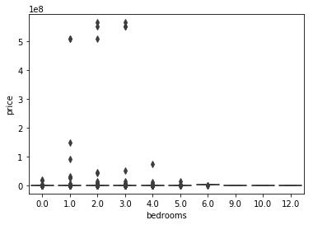
Datasets
bedrooms
0:12
Number of bedrooms per apartment
Outliers and missing values to be handled
Can hold zero values for studio apartments

Slide 10
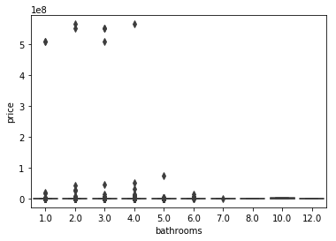
Datasets
bathrooms
1:12
Number of bathrooms per apartment
Outliers and missing values to be handled

Slide 11
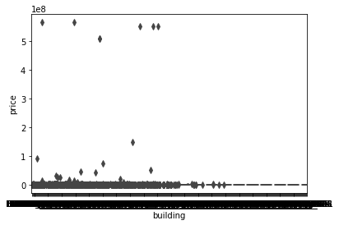
Datasets
building
Identifier
Apartment number

Slide 12

Preprocessing
Removing flag column 'building'
Taking care of missing data (mean)
Removing outliers
Removing illogical values
price <= 0 and size <=0
bedrooms can = 0 (based on business)
Ex, Studios apartments

Slide 13
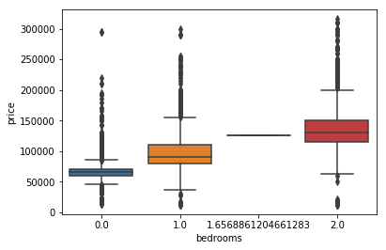
Processed Datasets
bedrooms
0:2
Bedrooms number seems to affect the prices

Slide 14
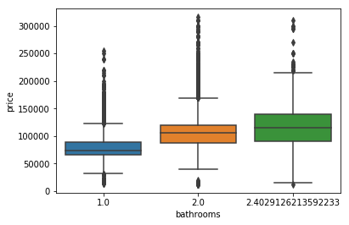
Processed Datasets
bathrooms
0:2
Bathrooms number seems to affect the prices

Slide 15
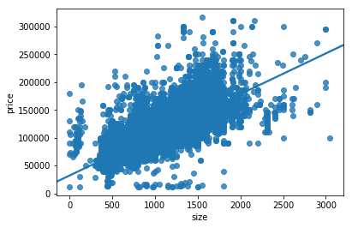
Processed Datasets
size
continues
size has a high correlation with prices

Slide 16
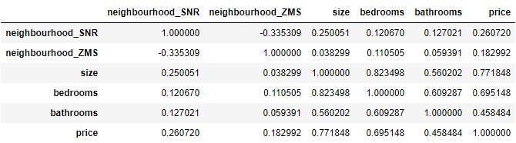
Correlation

Slide 17
Correlation
High correlation
Good correlation
Low Correlation
bedrooms
bathrooms
neighbourhood
size

Slide 18


Model
Stepwise regression model
Add one feature at each step and check accuracy
Size
0.5913712934917748
size + bedrooms
0.5950221582560616
size + bedrooms+ bathrooms
0.61527116426152
neighbourhood_SNR + neighbourhood_ZMS + size + bedrooms + bathroom
0.6423294105551967

Slide 19
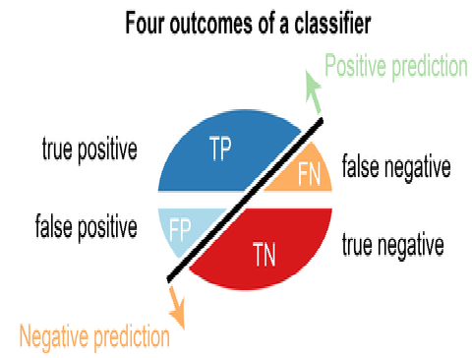
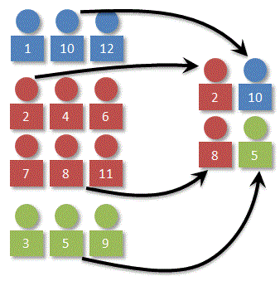
Evaluation
K Fold Cross Validation
One validation

Slide 20
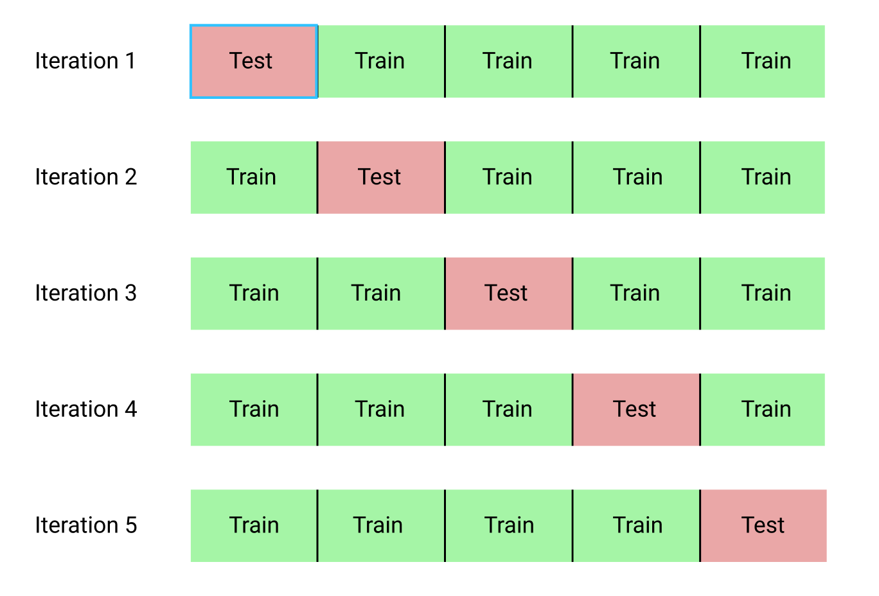
k-Fold Cross-Validation
Break up data into 10 folds
(Equal positive and negative inside each fold?)
For each fold
Choose the fold as a temporary test set
Train on 9 folds, compute performance on the test fold
Report average performance of the 10 runs
Accuracy = 0.6475216325839637

Slide 21
apartment price prediction model
Questions

