Slide 1
May 2018
Introducing
Amazon Athena
Péter Molnár
ML ProServe

Slide 2
Amazon Athena is an interactive query service that makes it easy to analyze data directly on Amazon S3 using Standard SQL
Notes:
What is Athena

Slide 3












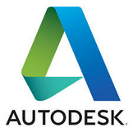














Notes:
Lots of great customers, and many more not shown here

Slide 4
What is AWS Glue Data Catalog?
Unified metadata repository across relational databases, Amazon RDS, Amazon Redshift, and Amazon S3…with support for more coming!
Get a single view into your data, no matter where it is stored
Automatically classify your data in one central list that is searchable
Track data evolution using schema versioning
Query your data using Amazon Athena or Amazon Redshift Spectrum
Hive metastore compatible; can be used as an external Hive Metastore for applications running on Amazon EMR

Slide 5
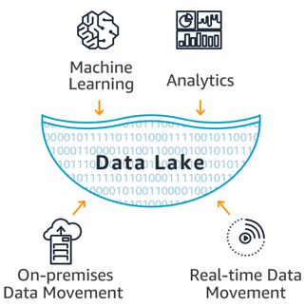
What is a Data Lake
Architectural pattern enabling:
Ubiquitous storage at any scale
Consolidated data processing
Collaborate and analyze data in different ways leading to better, faster decision making
Notes:
Athena, Glue and S3 make data lakes on AWS a reality

Slide 6








Data Lake on AWS
Your data
AWS GLUE ETL
Web app data
Amazon
SageMaker
Amazon RDS
Other databases
Amazon
QuickSight
On premises data
Streaming data
Notes:
High level reference architecture of a data lake on AWS

Slide 7



Log Aggregation
Lambda
Update table partition
Glue
Data Catalog
New File
Trigger
Create partition
on S3
AWS Service Logs
Web Application Logs
Server Logs
S3
S3
Query data
Copy to new
partition
Athena
Notes:
Simple log aggregation and processing via lambda function

Slide 8

Log Aggregation with ETL
Glue ETL
Update table partition
Glue
Data Catalog
Create partition
on S3
Glue
Crawler
AWS Service Logs
Web Application Logs
Server Logs
S3
S3
Query data
Athena
Notes:
Same simple log aggregation but this time introducing Glue as a more complex ETL engine

Slide 9


Real-Time Data Collection
Glue ETL
Update table partition
Glue
Data Catalog
Trigger Job
S3
Real-time events
Store partitioned in S3
Query data
Athena
Kinesis
Notes:
Streaming data collection using Firehose directly to S3. Firehose can store write to S3 in Parquet/ORC which makes it queryable right away. ETL is then used for compaction and other transformations

Slide 10


Data Export
Glue ETL
Update table partition
Glue
Data Catalog
Trigger Job
S3
Database Migration
Exported tables in S3
Query data
Database Migration
Service
Athena
Notes:
Offloading databases using DMS to S3 reduces DB costs and increase accessibility of the data to the broader organization

Slide 11

SaaS Model
Glue
Data Catalog
Hot data
S3
Application request
Warn & cold data
Query data
Athena
Notes:
Serving data to applications via Athena. When super low latency is not a constraint Athena could be a great low cost tool to serve customer data

Slide 12


Data Science
Glue
Data Catalog
Athena
Athena
S3
Glue ETL
S3
EMR
Application Data
SageMaker
Enrichment
Feature Store
Notes:
An ML pipeline where Athena could provide visibility at different stages of the pipeline

Slide 13


Data Enrichment – Amazon Comprehend
Glue Data Catalog
Glue Crawler
4
QuickSight
Comprehend
5
S3
2
S3
1
3
AWS Glue
ETL
Athena
Amazon
Reviews Dataset
Notes:
Utilizing Glue ETL to automate data enrichment using ML services such as Comprehend for sentiment analysis

Slide 14


Data Ingest in Parquet Format
2
3
Kinesis Data
Streams
Kinesis Data
Firehose
Parquet
Redshift
Spectrum
4
Agent
Events
Firehouse
Output Schema
5
1
Amazon Connect
AWS Glue
Data Catalog
S3
Athena
Notes:
Since Firehose supports writing data to S3 in Parquet/ORC it can eliminate the ETL stage reducing cost and time to delivery insight

Slide 15


Analytics Reporting
EMR
QuickSight
Glue
Data Catalog
Redshift
Spectrum
API
Athena
Notes:
Because of data catalog, more tools are able to locate and access data in the data lake

Slide 16
Why Amazon Athena ?
Decouple storage from compute
Serverless – No infrastructure or resources to manage
Pay only for data scanned
Schema on read – Same data, many views
Secure – IAM for authentication; Encryption at rest & in transit
Standard compliant and open storage file formats
Built on powerful community supported OSS solutions
Notes:
Decouple storage from compute: allows customers to scale and manage storage and compute needs independently. The same data may have different compute needs such as EMR, Athena or Redshift
Serverless: Athena is fully managed, serverless service. No need to understand scaling or compute optimization
Pay only for data scanned: Customers are charged only by how much data was scanned by the query. There are several levers, compression, file formats, partitioning, to enable customer to reduce cost
Schema on read: customers can create different tables and run different queries representing many independent views of the data all while the underlying data remains unchanged
Secure: IAM for authN and authZ. query encrypted S3 buckets, write output to an encrypted S3 bucket. Critical for sensitive workloads
No proprietary file formats. Fully standard and open source file formats give customers freedom to use their data where/how they see fit – ties well with decoupled storage/compute
Hive/Presto are open source software products backed by large and active communities giving it stability, maturity and quick pace of innovation

Slide 17


Familiar Technologies Under the Covers
Used for DDL functionality
Complex data types
Multitude of formats
Supports data partitioning
(Eg. CREATE TABLE, ALTER TABLE,
MSCK REPAIR)
Used for SQL Queries
In-memory distributed query engine
ANSI-SQL compatible with extensions
(Eg. SELECT * FROM tableName)

Slide 18
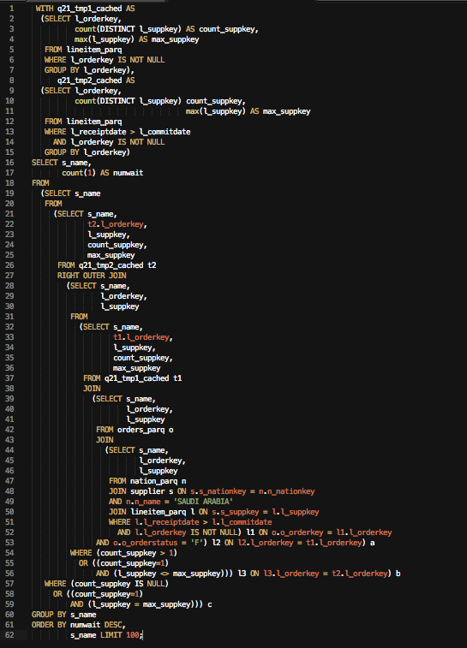
Presto SQL
ANSI SQL compliant
Complex joins, nested queries & window functions
Complex data types (arrays, structs, maps)
Presto built-in functions
File Formats: CSV, JSON, RegEx, Parquet, Avro, ORC, CloudTrail
Compression: GZIP, Zlib, LZO, Snappy
Integrated with AWS Glue Data Catalog
Notes:
You can partition your data in S3 to reduce the amount of data that Athena is scanning, therefor improving your performance and cost

Slide 19
A Better Model
Old Methodology
Analyst asks for a report
Developer writes code
Code executes on shared cluster for several hours
Analyst reviews report
Analyst asks for more…
With Amazon Athena
Analyst creates table
Analyst iterates
Generate final report
Simple, Quick and No Infrastructure or Developer to Manage

Slide 20
Simple Pricing
DDL operations – FREE
SQL operations – FREE
Query concurrency – FREE
Data scanned - $5 / TB
Standard S3 rates for storage, requests, and data transfer apply
Notes:
DDL – Hive Data Definition Language: create/update/delete table definitions -- Data definition language
SQL – Structured Query Language: language to query the data
Query concurrency – how many queries execute at the same time: We have a soft limit of 5 today, but we can increase it as needed
Data scanned – how much data did Athena need to read and process in order to answer the query.
S3 – s3 storage and usage is billed independently of and in addition to Athena

Slide 21
Security and Access Control
Encryption – SSE, SSE-KMS, CSE-KMS
Auto detect source bucket KMS key
Destination bucket may use separate key
Access Control
IAM
S3 ACL
S3 bucket policies
Coming… Athorization with Glue Data Catalog
Database level
Table level

Slide 22
Cost Monitoring
Billing console provides spend per account
Athena APIs are logged in CloudTrail
Combine CloudTrail and Athena API for per IAM user cost
More cost controls to come…

Slide 23

Movable Ink provides real-time personalization of marketing emails based on a wide range of user, device, and contextual data
Movable Ink has been collecting data on user actions since 2011, and this database grows by 75 to 100GB per day. To reduce time-to-insight, optimize costs, and increase flexibility for its analytics, the company recently adopted the serverless Amazon Athena query service.
Since the company began using Amazon Athena, it has realized both cost savings and improved performance for analytics related to user actions.
“Using Amazon Athena, we’re able to query seven years’ worth of data—adding up to hundreds of terabytes—get results at least 50 percent faster, and save nearly $15,000 per month, all without keeping a cluster running.”
Matt Chesler, director of DevOps at Movable Ink

Slide 24
Getting Started
Amazon Athena Getting Started Cookbook
Amazon Athena Getting Started with CloudTrail Video
Amazon Athena Hands-On Workshop

