Slide 1
Scenario
Library Rentals – this library contains many different items such as books, audio CDs, DVDs, vinyl records, video tapes, cassettes, magazines, and academic papers. Ensure your database stores different information on each of these types.

Slide 2
User Stories
As a Librarian I want to query if any rentals are overdue so I can chase this up
As a Customer I want to query by a particular author or artist in order to find items by someone I like
As a Social Media Consultant I want to know which items get rented out the most so I can create effective campaigns for them
As a customer, I want to know when the item was last rented to get a gauge of its popularity.
As a customer, I want to find out a films rating to see if it will be worth watching.

Slide 3
Media Collection
ID
Title
Author
Rentals
Rentals Collection
ID
Date
Reviews Collection
ID
Score
Date

Slide 4
Media Collection
ID:Int(3)
Title:String(30)
Author: String(30)
Rentals: Collection
Reviews: Collection
Note: Data types and field sizes are for illustration, expected values.
Mongo doesn’t enforce these, any data could be used.
Rentals Collection
ID: Int(3)
Date: Date
Due Date: Date
Returned : Boolean
Reviews Collection
ID: Int(3)
Score:int(3)
Date:date

Slide 5
In the database, each media item will have a media collection which holds its info.
When an item is rented, a document is created in the rentals collection that holds the rental date, due date, and a boolean ‘Returned’ set to false. –When returned the returned boolean is set as true.
Customers can optionally submit reviews about a media item. The date and score of the review are stored in a reviews collection.
Media Collection
ID:Int(3)
Title:String(30)
Author: String(30)
Rentals: Collection
Reviews: Collection
Rentals Collection
ID: Int(3)
Date: Date
Due Date: Date
Returned : Boolean
Reviews Collection
ID: Int(3)
Score:int(3)
Date:date

Slide 6
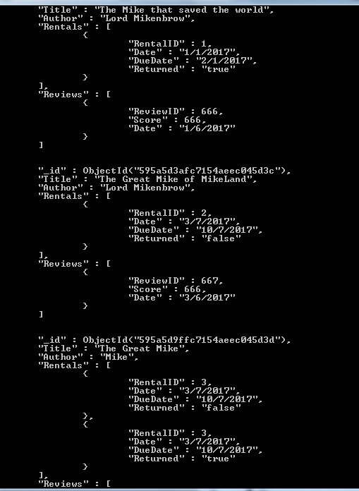
View of Data
Example data from my database.

Slide 7
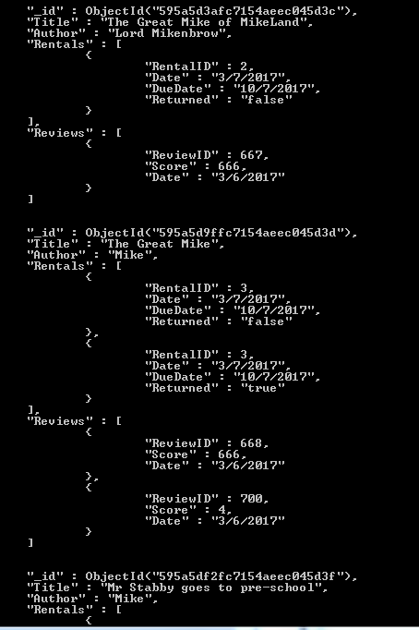
As a Librarian I want to query if any rentals are overdue so I can chase this up
Db.library.find({“Rentals.Returned”:”false”}).pretty()
Returns any record that has Returned:false for one of its rentals.

Slide 8
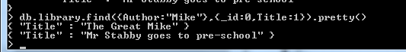
As a Customer I want to query by a particular author or artist in order to find items by someone I like
Db.library.find({Author:”Mike”},{_id:0,Title:1}).pretty()
Returns a list of the titles by the author.
(Mike in this case)

Slide 9
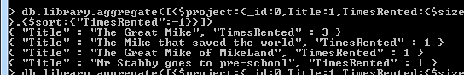
As a Social Media Consultant I want to know which items get rented out the most so I can create effective campaigns for them
Db.library.aggregate(
[{
$project:{_id:0,Title:1,TimesRented:{$size:”$Rentals”}
}
},{
$sort:{“TimesRented”:-1}
}])
Returns a list of media items, sorted by the amount of times they have been rented.

Slide 10
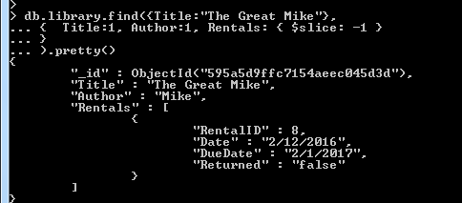
As a customer, I want to know if an item is in stock before heading to the store
db.library.find({Title:"The Great Mike"},
{ Title:1, Author:1, Rentals: { $slice: -1 }
}
).pretty()
Given the Title of a media item, this returns Title,Author and the most recent rental.

Slide 11
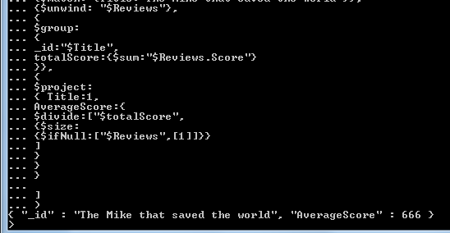
As a customer, I want to find out a films rating to see if it will be worth watching.
db.library.aggregate(
[
{$match: {Title:"The Mike that saved the world"}},
{$unwind: "$Reviews"},
{
$group:
{
_id:"$Title",
totalScore:{$sum:"$Reviews.Score"}
}},
{
$project:
{ Title:1,
AverageScore:{
$divide:["$totalScore",
{$size:
{$ifNull:["$Reviews",[1]]}}
]
}
}
}
]
)
Given a Title, this returns the Averagescore by summing all review scores and then dividing by the amount of reviews.

Slide 12
Scenario Two
Emergency Services Logs – this should be documentation on calls made to the emergency services line. This should include information on what a customer is calling about, who handled the call, the type of resolution, and any additional comments at a minimum.

Slide 13
As a Managing Director I want to query what the peak times for particular service requests are so I can appropriately assign staff
As a Calls Manager I want to query which members of staff have taken the most calls so I know who is performing well
As an Managing Director I want to query what the maximum call duration has been the past month so I can track statistics on this
As a MD, I want to know who comments most on calls to know who has too much spare time.
As a calls manager I want to see a list of unresolved calls so I can escalate them.

Slide 14
Call Collection
Call ID
Customer_Name
Customer_Postcode
Call_handler_id
Resolution Type
Subject
Date/time
Call Duration
Design of Collection
Date/time and Call duration could have been replaced with start and end time/date of a call. This way however seems easier to query.
Comments Collection
CommentID
Name
Date
Comment

Slide 15
Note: Data types and field sizes are for illustration, expected values.
Mongo doesn’t enforce these, any data could be used.
Call Collection
Call ID:int(3)
Customer_Name:String(30)
Customer_Postcode:String(15)
Call_handler_id:int(3)
Resolution Type:String(15)
Subject:String(30)
Date/time:Date
Call Duration:int(3)
Comments Collection
CommentID:int(3)
Name:String(30)
Date:date
Comment:String(500)

Slide 16
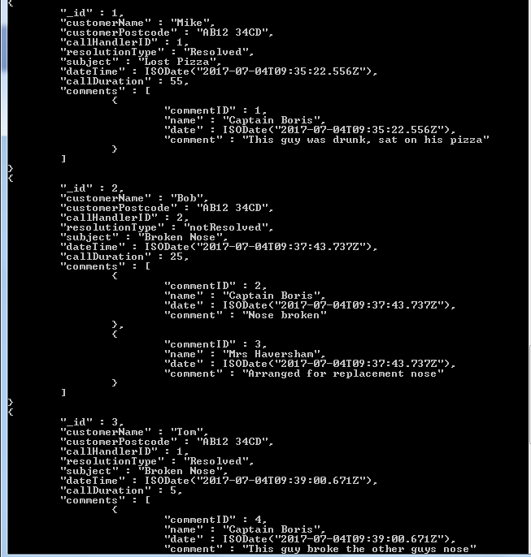
Inserting Data
5 records, with a varying amount of comments.

Slide 17
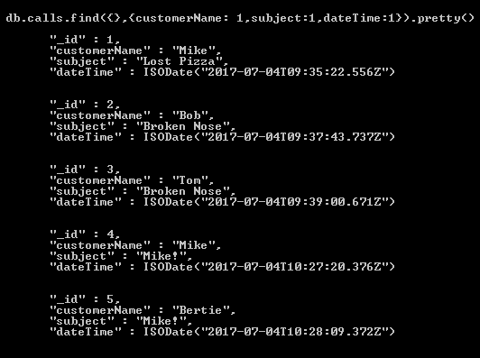
As a Managing Director I want to query what the peak times for particular service requests are so I can appropriately assign staff
Db.calls.find({},{customerName:1,subject:1,dateTime:1}).pretty()
The call will return the customerName,subject and datetime for each record.
Call times for particular requests can be checked here.

Slide 18
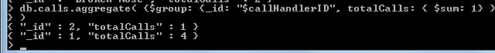
As a Calls Manager I want to query which members of staff have taken the most calls so I know who is performing well
Db.calls.aggregate({$group:{_id:”$callHandlerID”, totalCalls: {$sum:1}}})
The call will list each call handler id, and a count of the calls they have handled.

Slide 19
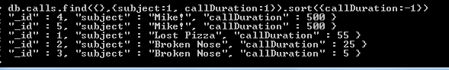
As an Managing Director I want to query what the maximum call duration has been the past month so I can track statistics on this
Db.calls.find({},{subject:1,callDuration:1}).sort({callDuration:-1})
This will list subjects and durations for all calls. Sorted so that the longest duration is at the top of the list.

Slide 20
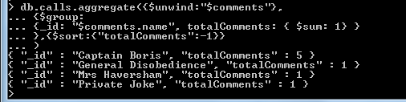
As a MD, I want to know who comments most on calls to know who has too much spare time.
db.calls.aggregate({$unwind:"$comments"},
{$group:
{_id: "$comments.name", totalComments: { $sum: 1} }
},{$sort:{"totalComments":-1}}
)
Command will return a list of all commenters and their total comments, ordered so that highest is at the top.

Slide 21
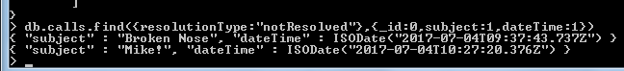
As a calls manager I want to see a list of unresolved calls so I can escalate them.
Db.calls.find({resolutionType:”notResolved”},{_id:0,subject:1,dateTime:1})
Function returns a list of the subject and date of call for unresolved calls.

